Slide 1
Biomedical importance of magnesium
م.د. زهراء محمد علي

Slide 2
Body content
A normal adult (22–26 g)
99% stored within IC compartments
60% in bones
20% in muscles
20% in other tissues.

Slide 3
Intracellular content
1%
60% is in a free/ionized form
10% is ligated, forming complexes to different salts (citrate, phosphates, oxalate, and other anions)
30% is bound to proteins

Slide 4
function
cofactor 600 enzymatic reactions
energy production
DNA synthesis
protein synthesis
for maintaining normal muscle and nerve function
regulating blood glucose levels

Slide 5
function
inflammation, response to cancer
infectious diseases
supporting a healthy immune system
contributes to the structural development of bones
required for the synthesis of the antioxidant glutathione

Slide 6
deficiency
muscle cramps,
fatigue
cardiac arrhythmias
biochemical abnormalities of hypokalemia& hypocalcemia
hypertension
atherosclerotic vascular disease
altered glucose homeostasis
metabolic bone disease

Slide 7
dietary Mg
24–76% is mainly absorbed in the ileum and colon
the rest is eliminated in the feces

Slide 8
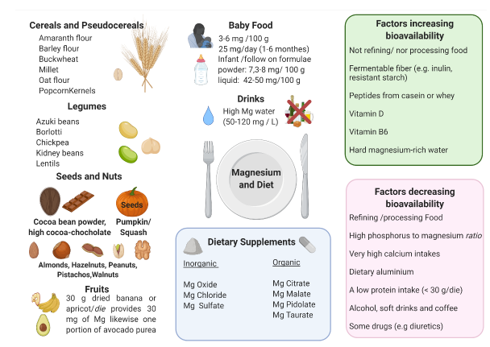
Food content

Slide 9
Food sources
widely distributed in foods
the amount contained in food is influenced by
1.the soil
2.water used to irrigate
3.fertilizers, conservation refining, processing
4. cooking methods.

Slide 10
Food sources
seeds, legumes,
nuts (almonds, cashews, Brazil nuts, peanuts),
whole grain breads, and cereals (brown rice, millet),
some fruits
cocoa

Slide 11
Food sources
acidic, light, and sandy soil is deficient in magnesium content.
agricultural techniques, such the use of potassium and ammonium at high concentration in fertilizers lead to magnesium depletion in food
Green leafy vegetables are rich in magnesium
chlorophyll-bound magnesium represent important nutritional sources of magnesium.

Slide 12
Food sources
In leafy green vegetables, such as lettuce and spinach, chlorophyll-bound magnesium represents 2.5% to 10.5% of total magnesium,
other common green vegetables, pulses, and fruits contain <1% chlorophyll-bound magnesium

Slide 13
food processing
lower magnesium content if
boiling vegetables
refining grains with the removal of germ and bran

Slide 14
loss of magnesium during food refining
white flour (−82%),
polished rice (−83%),
starch (−97%)
white sugar (−99%)

Slide 15
Food processing
Unrefined sea salt rich in magnesium
refined salt present in food and added for cooking either at industrial or domestic levels, lacks Mg
the Western diet ( easy-to-cook meals and fast food such as refined and processed food, junk food, and the near absence of legumes and seeds) predisposes apparently healthy people to magnesium deficiency

Slide 16
Daily requirement
If the intake slightly exceeds the daily requirement
1.absorption of magnesium from the gut is reduced
2.active renal secretion in the urine can exceed 100% of the filtered load
an excess of magnesium from food does not represent a health risk in healthy individuals because the kidneys eliminate excess amounts in the urine

Slide 17
High doses
high doses of magnesium from dietary supplements, drugs, or other sources can cause
diarrhea accompanied by nausea and abdominal cramping
the onset of diseases
Toxic hypermagnesemia is only observed at oral magnesium doses higher than 2500 mg, i.e., doses exceeding more than 10 times the UL.

Slide 18
diarrhea
magnesium formulations most commonly associated with diarrhea, include
magnesium carbonate
chloride
gluconate
oxide

Slide 19
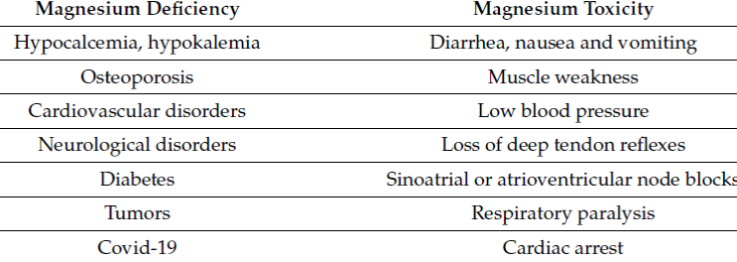
Hypo & hyper

