Slide 1
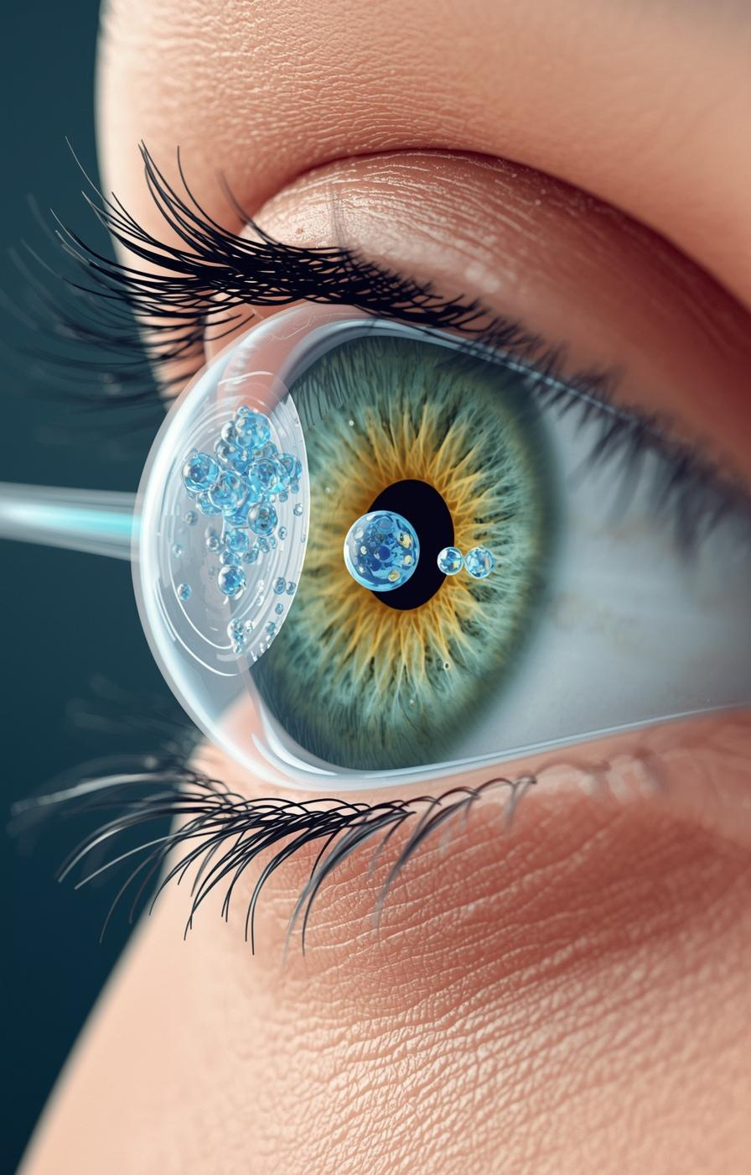

Polymeric nanomicelles as innovative platforms for ocular drug delivery :properties,advantages,and therapeutic application
”
Dr. Rawaa Mohammed Hussien

Slide 2
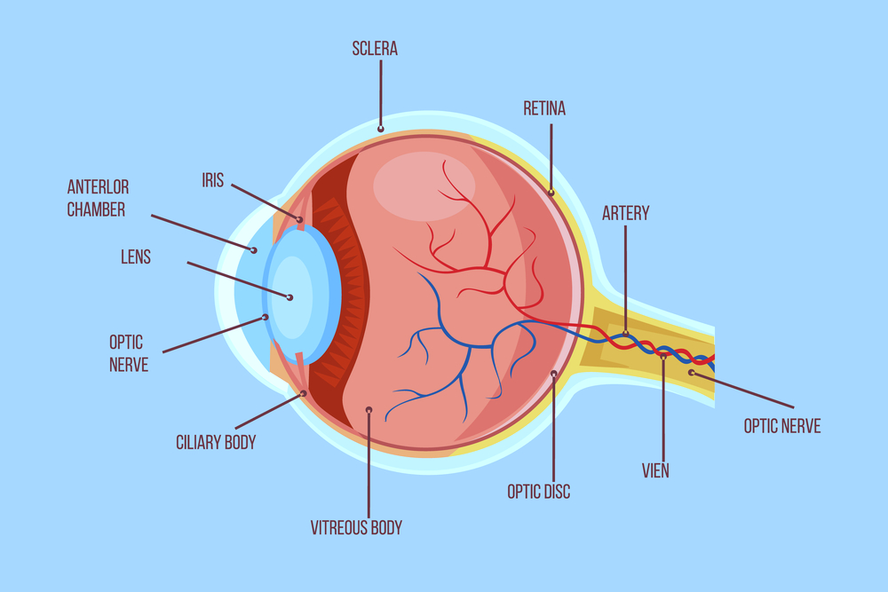
Structure of Human Eye
The eye’s structural and physiological barriers protect against pathogens but restrict drug delivery.
Anterior Segment : Includes cornea, aqueous humor, and lens Protected by Blood–Aqueous Barrier: Formed by iris and ciliary vessels with nonpigmented ciliary epithelium; limits drug penetration to intraocular space.
Posterior Segment: Protected by the Blood–Retinal Barrier, composed of retinal capillary endothelium and pigment epithelium; restricts systemic drug entry.
Notes:
• Precorneal barriers: tear film, blinking
• Corneal epithelium: rate-limiting
• Blood-aqueous barrier
• Blood-retinal barrier

Slide 3

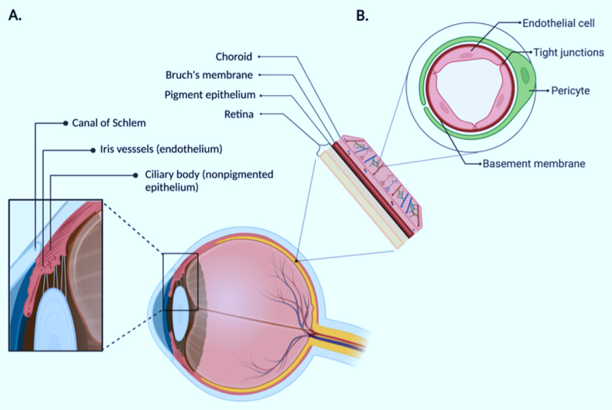
Structure of Human Eye
Outer Epithelium: Lipophilic
Middle Stroma: Hydrophilic
Inner Endothelium: Lipophilic

Slide 4
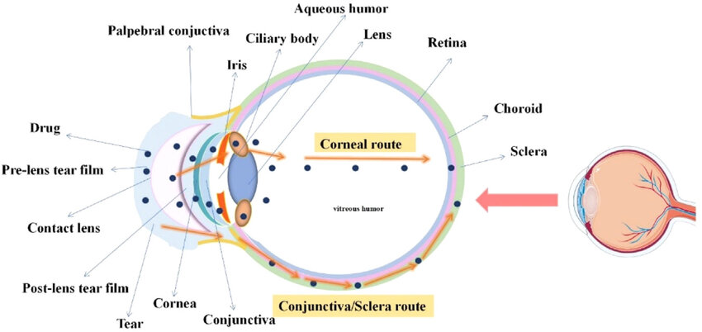
Ocular Absorption Pathways
Corneal Absorption: Rate-limiting barrier via corneal epithelium.
Non-Corneal Absorption: Via sclera & conjunctiva — often non-productive due to systemic absorption.
Transport: Transcellular between epithelium & stroma.

Slide 5
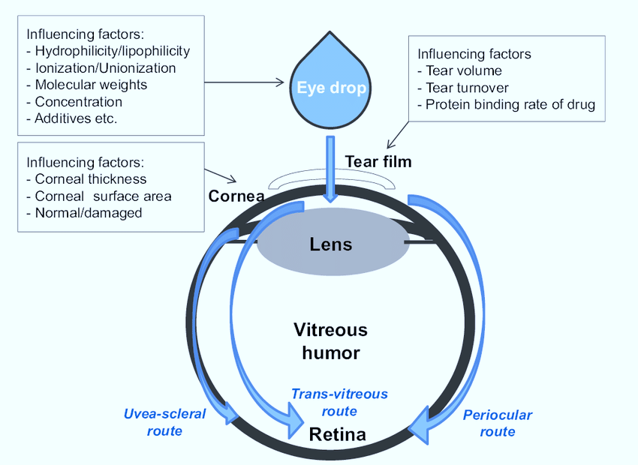
Factors Affecting Intraocular Bioavailability
Flow of lacrimal fluid
Naso-lacrimal drainage
Protein binding in tear film
Tear dilution

Slide 6
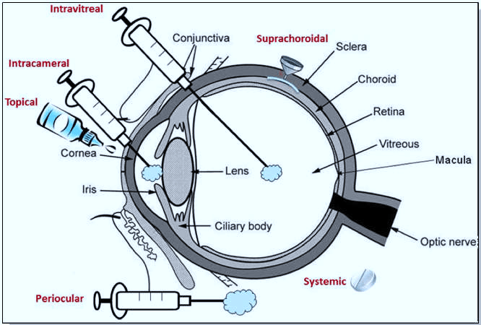
Routes of Ocular drug Administration
Topical, Systemic, Intravitreal, Subconjunctival, Retrobulbar, Intracameral, Subretinal
Advantages & Limitations vary by depth and tissue accessibility.

Slide 7
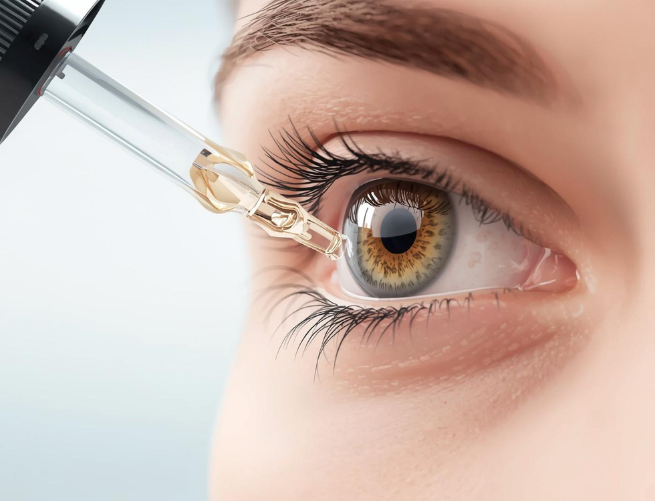
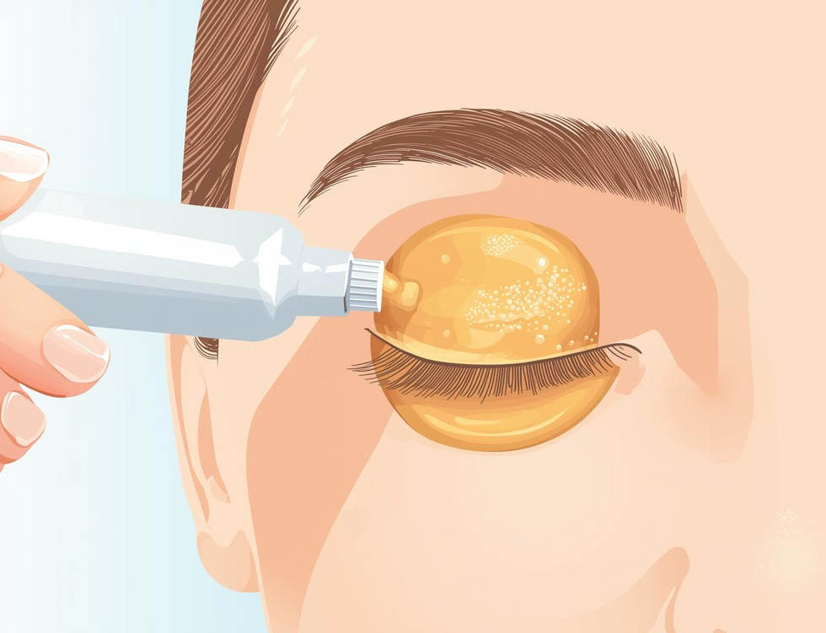
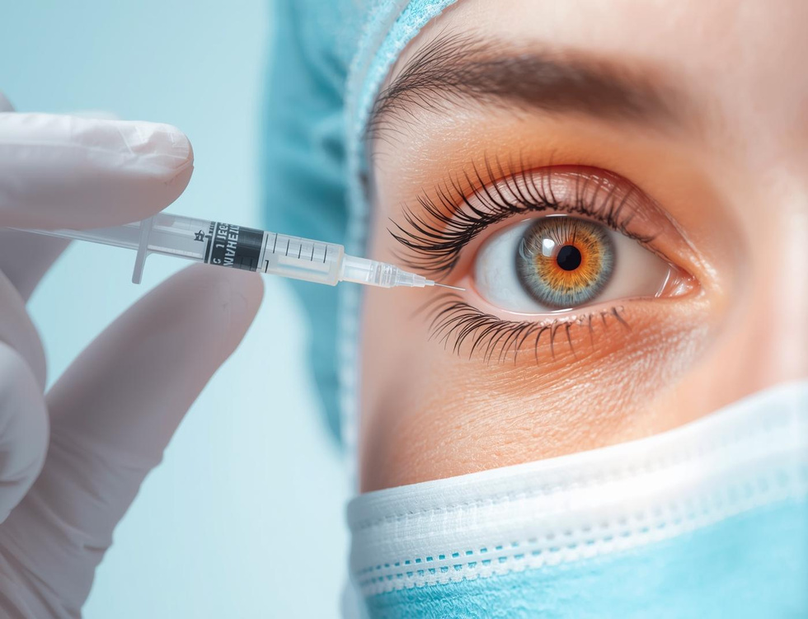
Ocular Delivery Methods
Eye Drops
Ointments
Injections
Eye drops offer a simple application method, allowing for easy self-administration and convenience.
Ointments provide a prolonged contact solution, enhancing drug retention on the ocular surface for better efficacy.
Injections allow for direct delivery of medication, ensuring rapid absorption and targeted treatment efficacy.

Slide 8
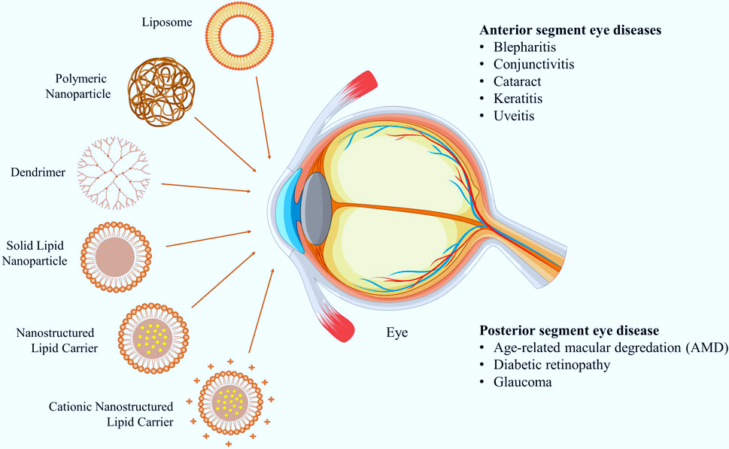
Need for Innovation
Innovations focus on overcoming the eye's anatomical barriers, increasing bioavailability, and providing sustained, controlled release

Slide 9
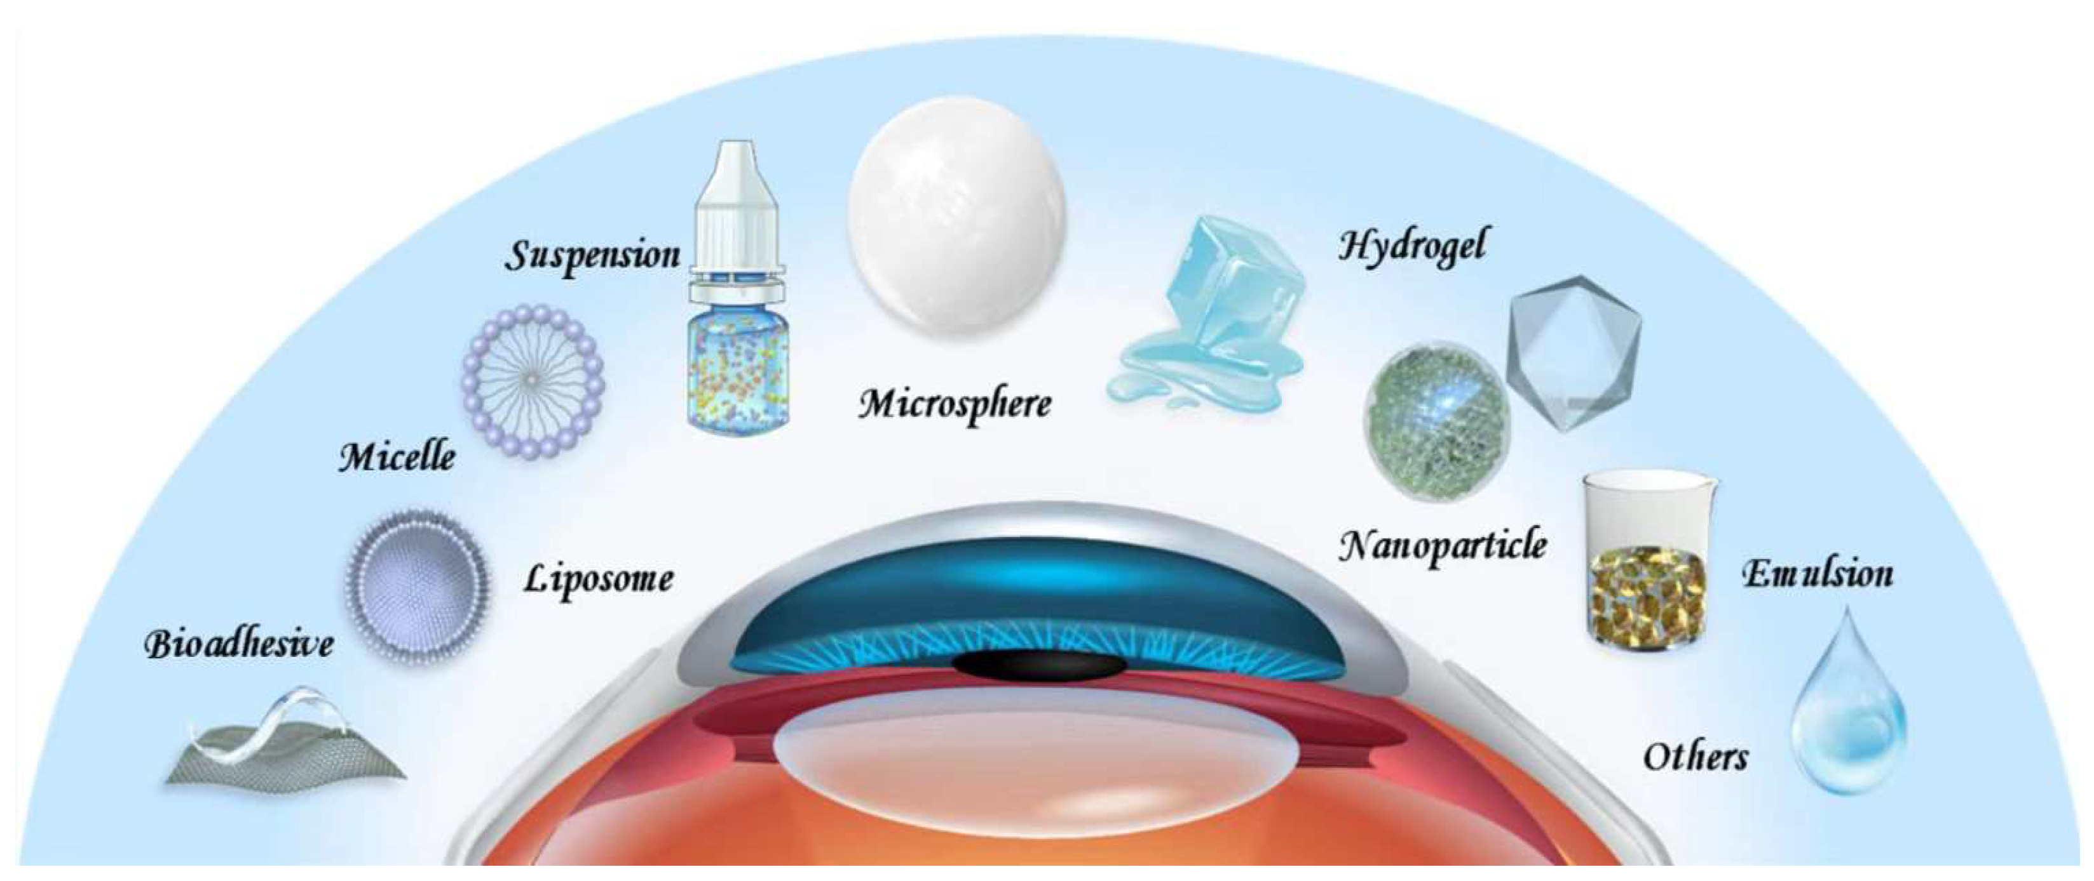
Advanced Ocular Delivery Systems
Controlled systems: implants, hydrogels, dendrimers, nanosuspensions
Vesicular systems: liposomes, niosomes, pharmacosomes
Particulate systems: nanoparticles, microparticles, SLN, NLC

Slide 10
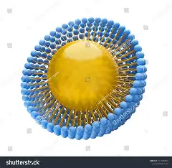
Polymeric Nano micelles
Polymeric nanomicelles are formed by self-assembly of amphiphilic block copolymers in aqueous media
Nanosized colloidal carriers (10–100 nm)
Consist of a hydrophobic core and hydrophilic shell
Suitable for solubilizing poorly water-soluble drugs

Slide 11
Structure of Polymeric Nanomicelles
Hydrophobic coreActs as a reservoir for poorly water-soluble APIs
Hydrophilic shell (corona)Provides colloidal stabilityReduces protein adsorption and opsonization

Slide 12
Key Properties
Small particle size and narrow size distribution
High drug loading capacity
Thermodynamic and kinetic stability
Controlled and sustained drug release

Slide 13
Advantages for Ocular Delivery
Improved solubility of hydrophobic drugs
Enhanced corneal permeation
Prolonged precorneal retention time
Reduced dosing frequency and side effects

Slide 14
Physicochemical and Functional Properties
Critical micelle concentration (CMC): Low CMC ensures stability against dilution in tear fluid.
Size: Typically10_100 nm; small size enhances penetration through corneal and conjunctival barriers.
Zeta potential: Surface charge modulates adhesion to ocular epithelium.
Drug loading efficiency & release kinetics: Optimized for controlled, sustained, or stimuli-responsive release.

Slide 15
Biocompatibility and Safety
Prepared from biocompatible and biodegradable polymers
Minimal ocular irritation and toxicity
Suitable for chronic ocular therapy
Improved patient compliance

Slide 16
Prolonged Precorneal Residence Time
Polymeric micelles can interact with ocular mucin or be formulated in in-situ gelling systems
which extend the residence time on the corneal surface, improving drug absorption.

Slide 17
Targeted Drug Delivery
appropriate functionalization (e.g., cationic or ligand-decorated micelles)
drugs can be preferentially delivered to anterior segment tissues (cornea, conjunctiva) or posterior segment tissues (retina, choroid), addressing diseases like dry eye syndrome, glaucoma, diabetic retinopathy, and age-related macular degeneration.

Slide 18
Reduced Systemic Exposure and Side Effects
Localized delivery through ocular polymeric micelles
minimizes systemic absorption and potential off-target effects, enhancing the safety profile of potent drugs.

Slide 19
Therapeutic Applications
Treatment of ocular infections
Management of glaucoma
Delivery of anti-inflammatory drugs
Ocular antifungal and antiviral therapy

Slide 20
Therapeutic Applications
Anterior Segment Delivery
Dry eye disease: Hydrophilic cationic micelles improve retention on the corneal surface.
Keratitis and ocular infections: Antifungal or antibacterial drugs encapsulated in micelles achieve sustained concentrations in corneal tissues.

Slide 21
Therapeutic Applications
Posterior Segment Delivery
Age-related macular degeneration and diabetic retinopathy: Tailored micelles or conjugated polymeric systems allow drugs to cross ocular barriers for retinal delivery.
Glaucoma: Controlled release micelles ensure sustained intraocular pressure-lowering effects.

Slide 22
Therapeutic Applications
Innovative Platforms
In-situ gelling micelles: Combine micelle encapsulation with thermosensitive or pH-sensitive polymers for triggered gelation upon instillation, enhancing retention and bioavailability.
Cationic polymeric micelles: Positively charged surfaces improve adhesion to negatively charged ocular epithelia, enhancing transcorneal penetration and therapeutic efficacy.

Slide 23
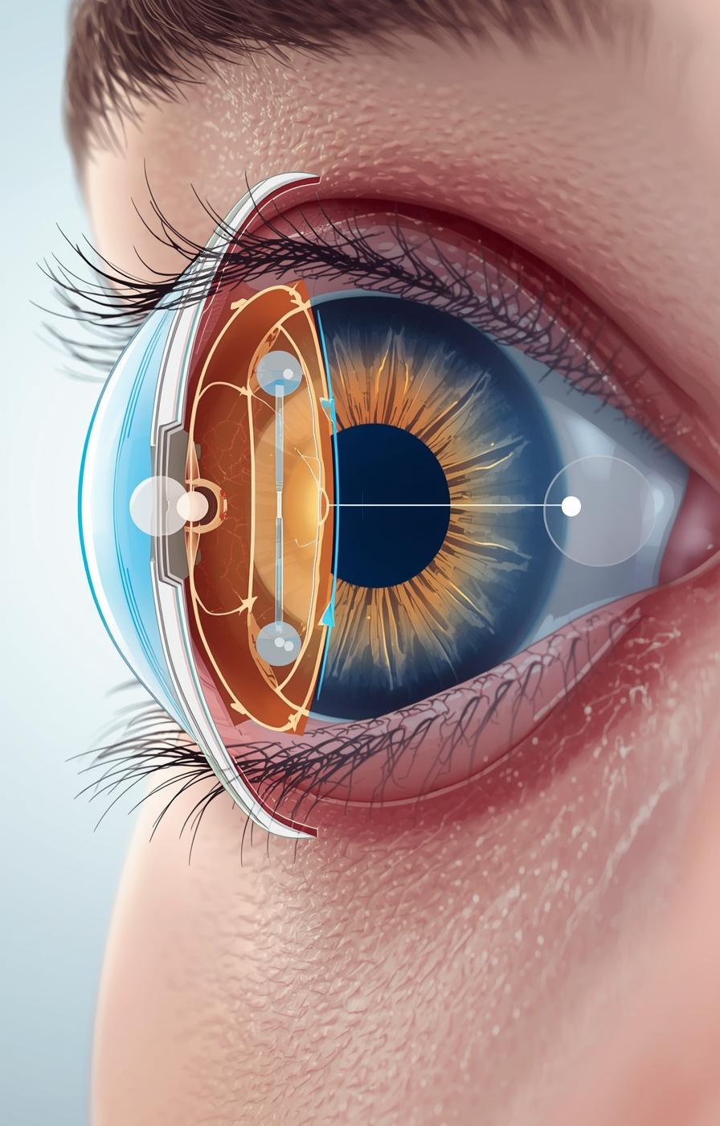

Questions?
Thank you

