Slide 1


Correlation Between Serum Platelet‑Derived Growth Factor, Angiopoietin‑1, and the Severity of Coronary Heart Disease
Ph.D. Student:Adel Abdulsahib Assi
Supervisor’s Name: Prof. Dr. Eman Saadi
Department of Clinical Laboratory Sciences
College of Pharmacy –University of Baghdad

Slide 2
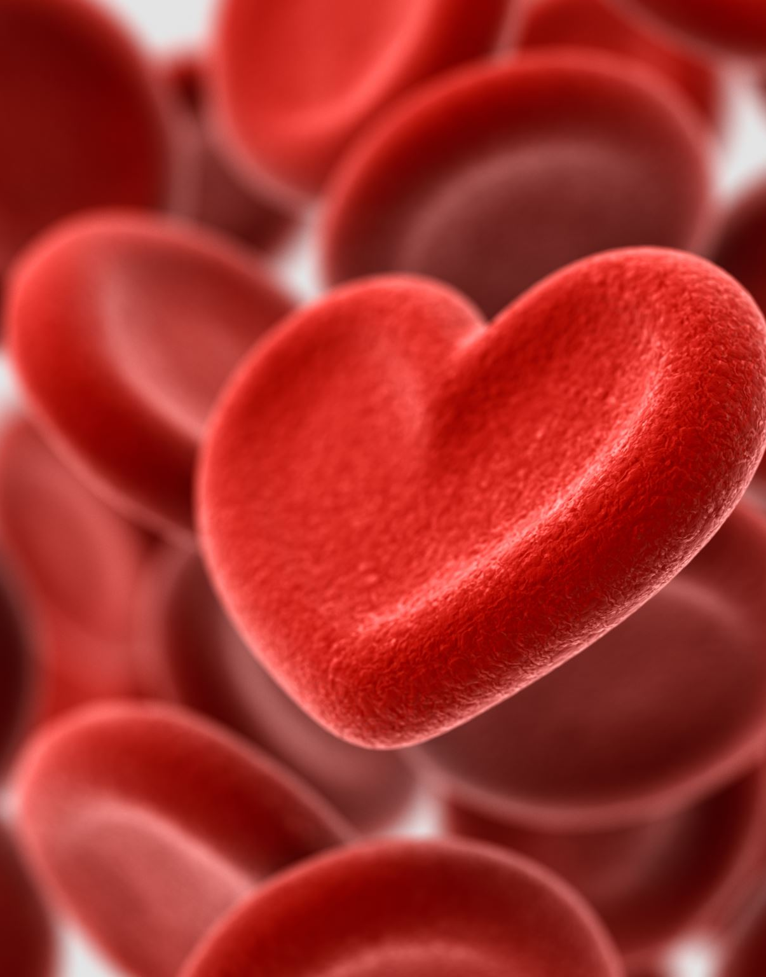
Introduction
• Coronary heart disease (CHD) is the leading global cause of death
• Caused primarily by atherosclerosis, a chronic condition where lipids and inflammatory cells accumulate inside coronary, causing narrowing and reduced blood flow.
Recently, researchers have focused on circulating biomarkers that reflect vascular damage and plaque activity.
Among the most important are angiogenic growth factors such as Platelet-Dervied Growth Factor (PDGF), and angiopoietin-1 (Ang-1), which play key roles in vascular remodeling and disease progression.

Slide 3
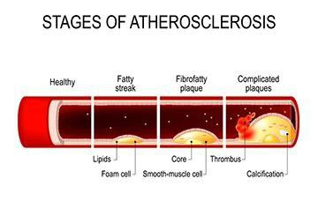
This image illustrates the progressive stages of atherosclerosis, starting from a healthy artery, followed by lipid accumulation and foam cell formation (fatty streak), progression to fibrofatty plaque with smooth muscle proliferation, and finally complicated plaques characterized by thrombosis and calcification that can obstruct blood flow

Slide 4

Pathophysiology of CHD
• Endothelial dysfunction
• Lipid deposition
• Inflammation
• Smooth muscle proliferation
• Plaque formation and stenosis
Atherosclerosis begins with endothelial injury caused by factors such as hypertension, diabetes, smoking, and hyperlipidemia. This damage allows LDL cholesterol to infiltrate the vessel wall, triggering inflammation.
Monocytes migrate into the intima, transform into foam cells, and promote plaque formation. As plaques enlarge, they reduce oxygen supply to the myocardium, worsening ischemia.

Slide 5

Role of Angiogenesis
• Triggered by ischemia and hypoxia
• Promotes collateral circulation
• Causes plaque neovascularization
• Linked to plaque instability
When oxygen supply decreases, the body activates angiogenesis to compensate. Growth factors such as VEGF, PDGF, and angiopoietins stimulate new vessel formation within plaques and ischemic myocardium.
However, plaque neovessels are fragile and prone to leakage, increasing the risk of plaque rupture and acute coronary syndromes.

Slide 6
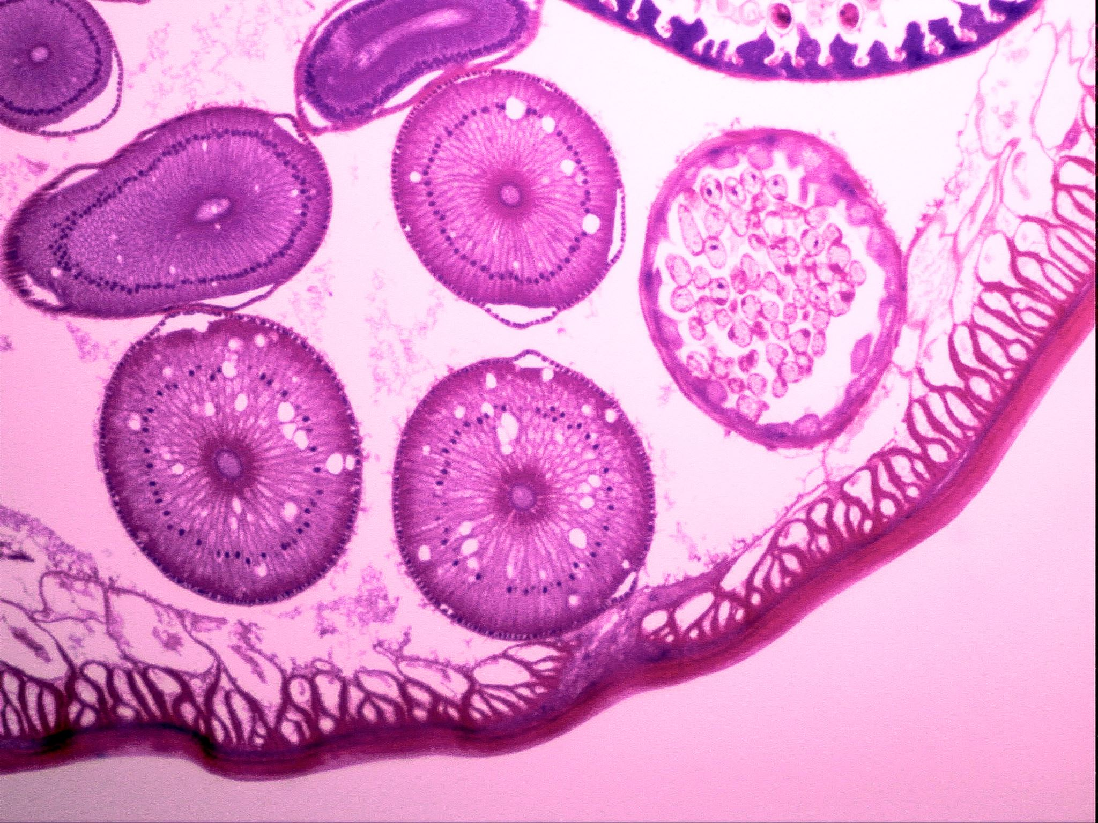
Platelet‑Derived Growth Factor (PDGF)
• Released from platelets and vascular cells
• Stimulates VSMC proliferation
• Promotes intimal thickening
• Contributes to plaque growth
Cont.:
PDGF is released from platelets, endothelial cells, macrophages, and vascular smooth muscle cells. It binds to tyrosine kinase receptors (PDGFR-α and PDGFR-β), activating intracellular signaling pathways.
These signals regulate cell proliferation, migration, and survival — all essential processes in vascular repair and remodeling

Slide 7
PDGF and CHD Severity
• Elevated in CAD patients
• Correlates with Gensini score
• Associated with SYNTAX score
• Higher in multivessel disease
PDGF promotes migration and proliferation of vascular smooth muscle cells into the intima, contributing to intimal thickening and plaque enlargement.
Clinical studies show that serum PDGF levels correlate with angiographic severity scores such as Gensini and SYNTAX and are higher in multivessel disease and acute coronary syndromes.

Slide 8
Angiopoietin‑1 (Ang‑1)
• Ligand of Tie‑2 receptor
• Promotes endothelial survival
• Stabilizes blood vessels
• Regulates vascular maturation
Ang-1 is produced mainly by pericytes, fibroblasts, and vascular smooth muscle cells. It binds to the Tie-2 receptor on endothelial cells.
This interaction promotes endothelial survival, vessel maturation, and structural stability.

Slide 9
Ang‑1 and CHD Severity
• Linked to collateral vessel formation
• Reflects ischemic burden
• Associated with advanced stenosis
• May indicate vascular repair response
Ang-1 has a dual role in coronary disease.
On one hand, it stabilizes endothelium, reduces inflammation, and protects vessels. On the other, it supports plaque neovascularization, which may contribute to plaque progression.
Its serum levels vary depending on disease stage and severity.

Slide 10
PDGF & Ang‑1 Interaction
• PDGF recruits smooth muscle cells
• Ang‑1 stabilizes new vessels
• Work together in angiogenesis
• Reflect plaque remodeling activity
Angiogenesis requires coordination between endothelial cells and mural support cells.
PDGF recruits smooth muscle cells and pericytes to developing vessels, while Ang-1 stabilizes and matures these vessels via Tie-2 signaling.
Together, they promote vascular remodeling and plaque progression.

Slide 11

Clinical Implications
• Potential severity biomarkers
• Aid risk stratification
• May predict prognosis
• Possible therapeutic targets
Measuring PDGF and Ang-1 may help:
-Assess disease severity
-Predict prognosis
-Identify high-risk patients before angiography
They also represent potential therapeutic targets for limiting plaque progression and restenosis.

Slide 12

Research Gaps
• Limited dual‑biomarker studies
• Small sample sizes
• Lack of longitudinal data
• Need multicenter research
Current limitations include:
-Few dual-biomarker studies
-Small sample sizes
-Lack of longitudinal data
-Limited regional population data
More large-scale prospective studies are needed.

Slide 13

Conclusion
• PDGF and Ang‑1 correlate with CHD severity
• Reflect angiogenesis and plaque progression
• Combined assessment may improve evaluation
• Further studies required
CHD progression is driven by angiogenesis and vascular remodeling.
PDGF promotes smooth muscle proliferation and plaque growth, whereas Ang-1 regulates endothelial stability and vessel maturation.
Evaluating both biomarkers together may provide a more accurate assessment of coronary disease severity and future risk.

