Slide 1
Lipid-Based Nanocarriers: Unlocking Targeted Therapy in treatment of wound Infections
By
Taha A. Basheer
Phd student

Slide 2
Wound healing problems
Poor wound environment: reduced blood supply, infection, biofilm formation, chronic inflammation, and oxidative stress delay healing
Biological dysfunction: impaired tissue regeneration prevent progression of normal healing phases.
Therapeutic limitations: conventional treatments suffer from poor drug penetration, short residence time, systemic patient factors, and risk of abnormal scarring.

Slide 3
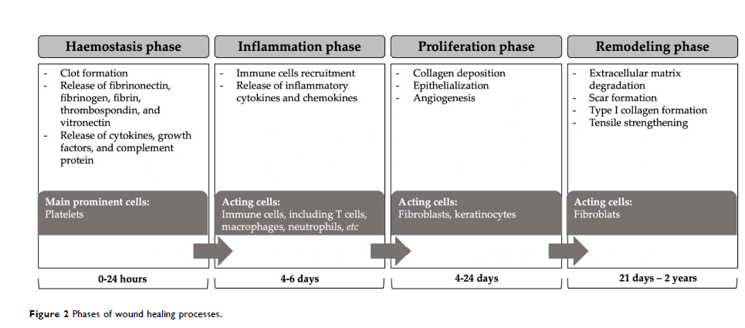
Phases of wound healing

Slide 4
Wound Healing and Drug Delivery Problems
Wound healing, especially in chronic and non-healing wounds (like diabetic ulcers), remains a major clinical problem worldwide.
Conventional therapies often fail because drugs degrade too fast, don’t reach the wound site at effective levels, or release too quickly.
Chronic wounds need sustained medication delivery to maintain therapeutic levels over time.
This sets the stage for nanotechnology-based carrier systems, with nanostructured lipid carriers (NLCs) emerging as a particularly promising option.

Slide 5
Nanostructured Lipid Carriers (NLCs)?
NLCs are a nanoparticle drug delivery system made from a mix of solid lipids and liquid (oily) lipids and surfactants
This mixture creates a disordered internal matrix that enhances the loading and controlled release of drugs.
NLCs typically range from ~10 nm to ~1000 nm in size and are biocompatible and biodegradable.
They evolved from earlier lipid nanoparticles like solid lipid nanoparticles (SLNs) by adding liquid lipids to improve drug incorporation and stability.

Slide 6
Why Lipid-Based Nanocarriers for Wound Healing?
Compared to traditional drug forms, NLCs offer multiple therapeutic advantages:
✅ Improved Drug Stability
Many active compounds (e.g., growth factors, antioxidants) degrade rapidly in biological environments.
NLC encapsulation protects them from enzymatic breakdown at the wound site.
✅ Enhanced Solubility and Bioavailability
NLCs can increase the effective solubility of poorly water-soluble drugs, improving how much drug is available at the wound surface.

Slide 7
Why Lipid-Based Nanocarriers for Wound Healing?
✅ Sustained Drug Release
The lipid matrix allows drugs to be released slowly over time, maintaining therapeutic levels longer and reducing frequent application needs.
✅ Compatibility with Skin Tissue
Lipids are generally well tolerated and can even blend with skin lipids, reducing irritation and supporting natural healing
Targeted drug delivery system

Slide 8
NLC Formulation and Composition
the structure of an NLC is built from
Solid lipids (e.g., glyceryl monostearate)
Liquid lipids (oils that prevent tight crystalline packing)
Surfactants (to stabilize the particles)
This results in a matrix with imperfections (voids) that:
Increase drug loading
Reduce leakage during storage
Enhance control over drug release at the wound site

Slide 9
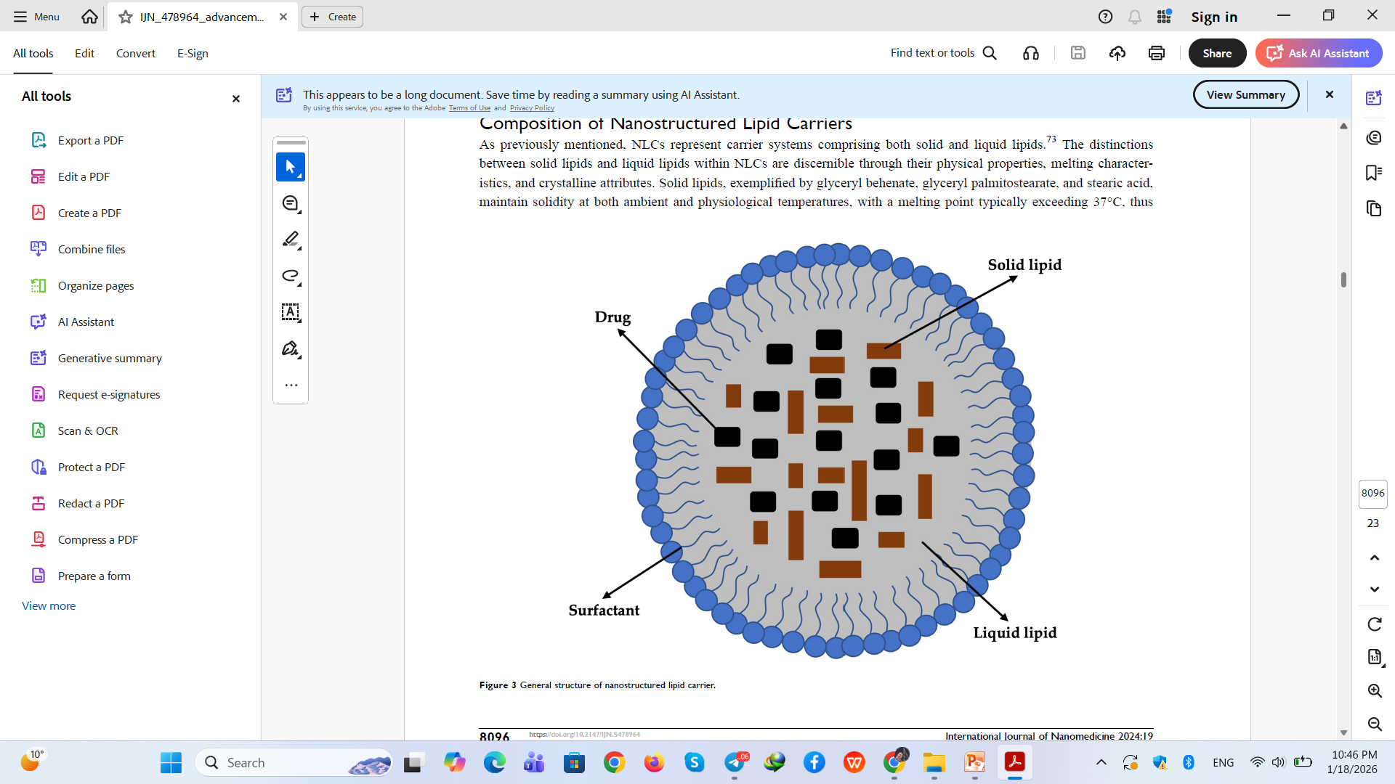

Slide 10
different internal types of NLCs:
Imperfect crystal model
higher drug loading,
Lower stability, as the system tends to undergo structural breakdown due to the tendency of solid lipid crystallization.
Amorphous model
minimizes drug expulsion,
In the amorphous type, the solid lipid constituents loaded into the system exist in an amorphous state, thus averting the risk of leakage caused by crystallization.

Slide 11
Multiple Type
In this type, liquid oils serve as prominent high-dissolved drug reservoirs..
Given that drugs are housed within the oil phase, their release proceeds at a slower rate.
Consequently, this type is exceptionally well-suited for the administration of controlled-release drugs

Slide 12
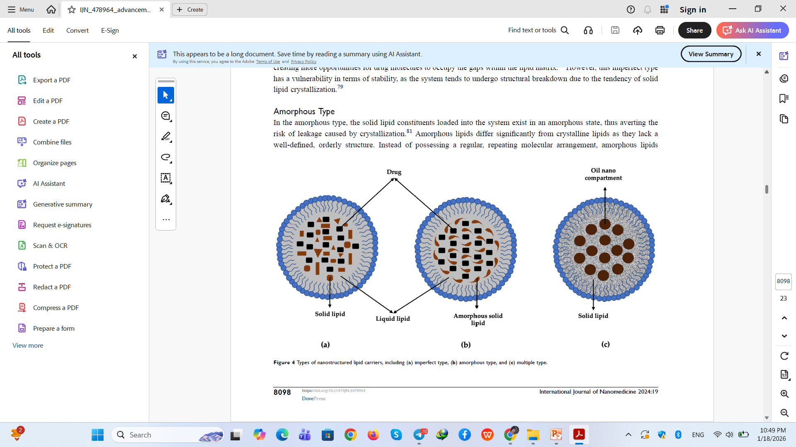

Slide 13
Mechanisms Why NLCs Improve Wound Healing
NLCs offer a gradual and sustained drug release compared to direct topical application, reducing peaks and valleys in drug concentration at the wound site.
🟢 Protection of Bioactive Agents
Growth factors and antioxidants — often unstable — remain active longer when protected within lipid nanoparticles.
🟢 Enhanced Penetration
The nano size allows better penetration into deeper wound regions, which is critical in chronic wounds with thickened tissue or biofilms.
🟢 Enhanced Antioxidant and Anti-Inflammatory Activity
Certain drugs (e.g., curcumin or plant extracts) that suffer from low solubility get boosted by NLC incorporation, enhancing their therapeutic action

Slide 14
Challenges in Clinical Translation
⚠️ Manufacturing and Scale-Up
Producing uniform, stable NLC batches at large scale is technically complex.
⚠️ Regulatory Approval
Regulatory bodies require rigorous safety and efficacy data, which can be resource-intensive.
⚠️ Stability and Storage
Lipid nanoparticles must remain stable during storage, transportation, and use — which can be difficult for some formulations.
⚠️ Cost
Advanced nanocarrier systems can be more expensive than traditional dressings or creams, affecting accessibility.

Slide 15
Conclusion
✔ Nanostructured lipid carriers are biocompatible nano-carriers offering enhanced drug delivery.
✔ They improve drug stability, penetration, and sustained release, important for acute and chronic wound healing.
✔ Research supports their efficacy in preclinical models, but clinical translation still faces challenges.
✔ With further development, NLC-based therapies could meaningfully improve wound care outcomes.

