Slide 1
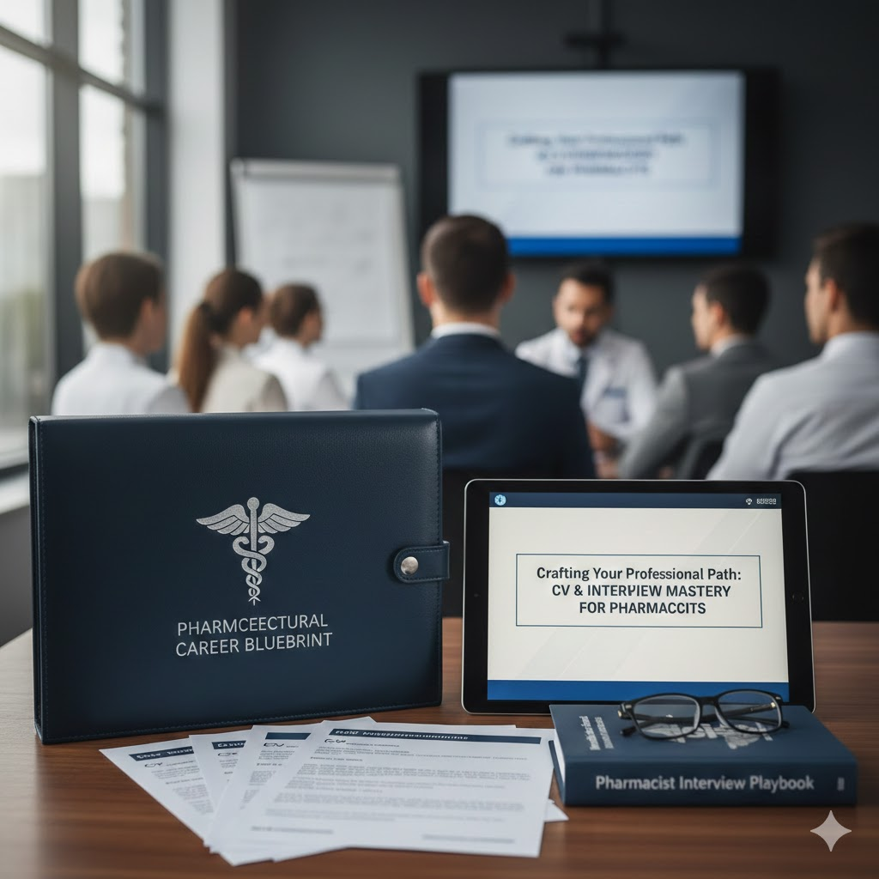
Creating a Professional CV
& Interview Skills
How to Present Your Skills & Experience Effectively

Slide 2
What Is a Professional CV?
Formal personal marketing document
Summarizes skills, experience, and achievements
Creates the first impression with recruiters

Slide 3
Why a Strong CV Matters
Recruiters scan CVs in seconds
Professional design increases interview chances
Shows clarity and confidence

Slide 4
Essential CV Sections
Contact Information
Professional Summary
Work Experience
Education and Skills

Slide 5
Professional Summary
3–4 lines overview
Highlights experience and value
Customized for each role

Slide 6

Personal Photo
High-quality, clear photo (no filters or heavy editing)
Plain, neutral background (white, light grey)
Head and shoulders framing, face centered
Professional attire (business or business-casual)
Natural expression with slight professional smile
Neat grooming and minimal accessories
JPG or PNG format, passport-style ratio
Avoid selfies, casual clothing, busy backgrounds

Slide 7
Work Experience
Reverse chronological order
Focus on achievements
Use numbers and results

Slide 8
Skills Section
Technical skills
Soft skills
Digital competencies

Slide 9
Design Best Practices
Clean and consistent layout
Professional fonts
One page for most roles
Save as PDF

Slide 10
Common Mistakes
Spelling and grammar errors
Long paragraphs
Unprofessional emails
Irrelevant information

Slide 11
Final Checklist
Proofread carefully
Tailor for each job
Professional formatting
PDF format

Slide 12
Conclusion
Your CV represents your personal brand
Small improvements create big opportunities

Slide 13
Job Interview Tips – Before the Interview
Research the company, role, and industry
Review the job description carefully
Prepare answers for common questions
Practice your self-introduction
Prepare examples using the STAR method
Print your CV and bring necessary documents
Dress professionally and appropriately
Arrive 10–15 minutes early (or test online setup)

Slide 14
Job Interview Tips – During & After the Interview
Greet confidently with eye contact and smile
Listen carefully before answering
Speak clearly and stay concise
Highlight achievements, not just duties
Show enthusiasm and positive attitude
Ask thoughtful questions about the role
Avoid negative comments about past employers
Thank the interviewer and follow up professionally

