Slide 1
Visual Acuity techniques
Dr. Amed M.Hasan
M.B.Ch.B. CAB(Ophth.) ICO HDLM-Ophth.

Slide 2
اهداء
الى روح الدكتور محمد كريم ظاهر

Slide 3
Introduction
The spatial resolving capacity of the visual system.
The ability to distinguish two separate points as distinct (Minimum Separable Acuity).
Ocular anatomy
Ocular refractive media
Visual pathway
Visual Acuity
Clinical
significance
Notes:
Today we will cover the fundamental vital sign of ophthalmology: Visual Acuity (VA). We will move beyond just "reading the chart" to understanding the optics, anatomy, and the clinical significance of various testing methods.
VA is effectively a test of the central vision (foveal function). It assesses the integrity of the optical media (cornea/lens) and the neural pathway (retina to cortex).

Slide 4
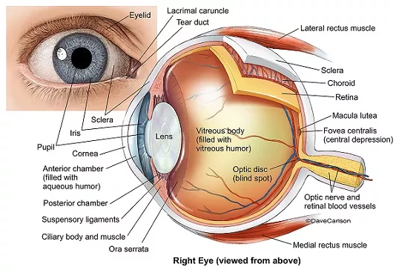
Anatomy of the eye

Slide 5
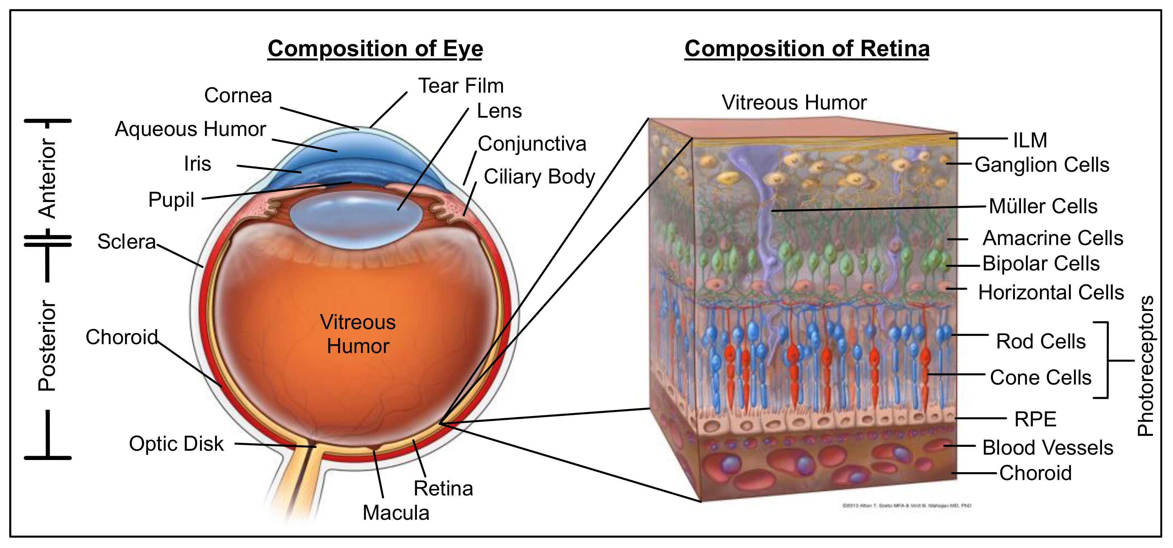
Retina

Slide 6
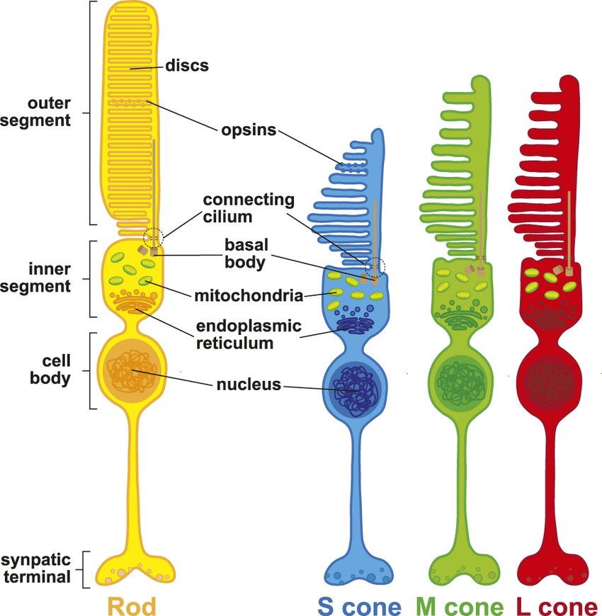
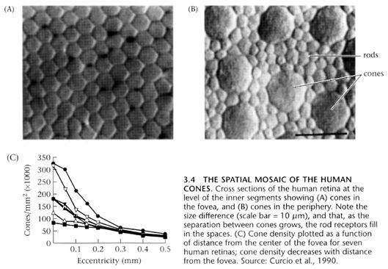

Slide 7
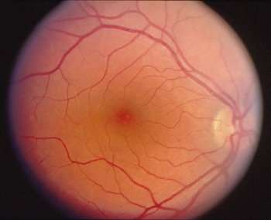
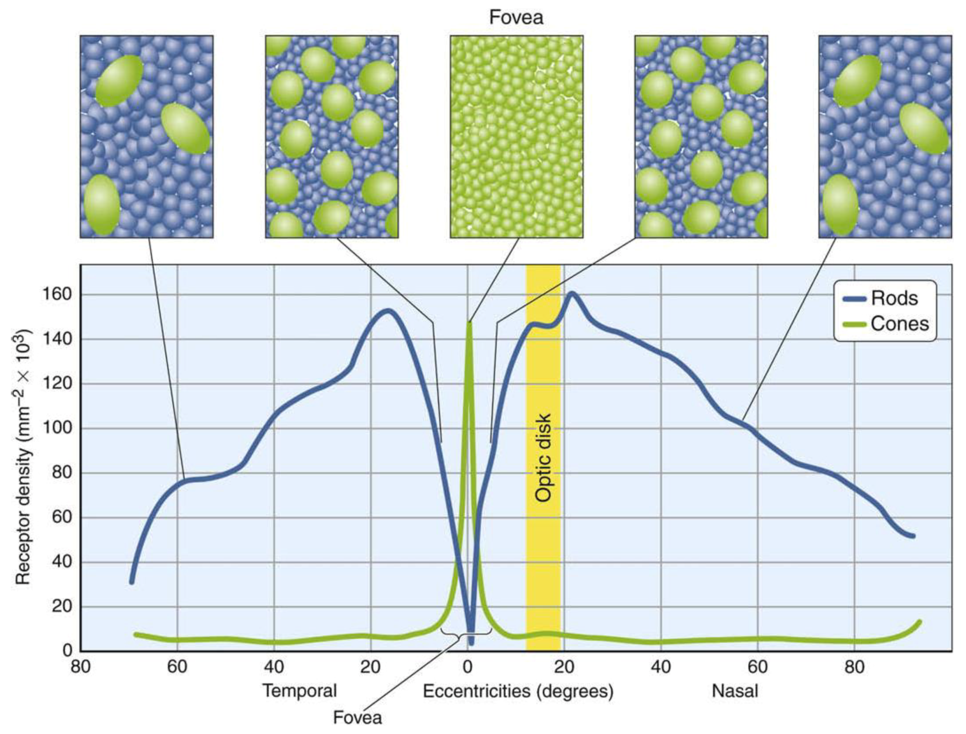
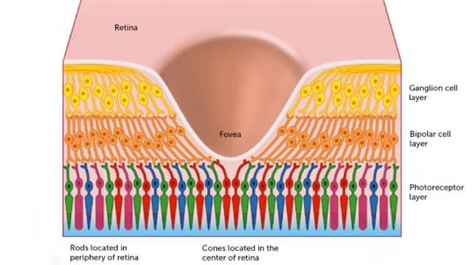
Fovea

Slide 8
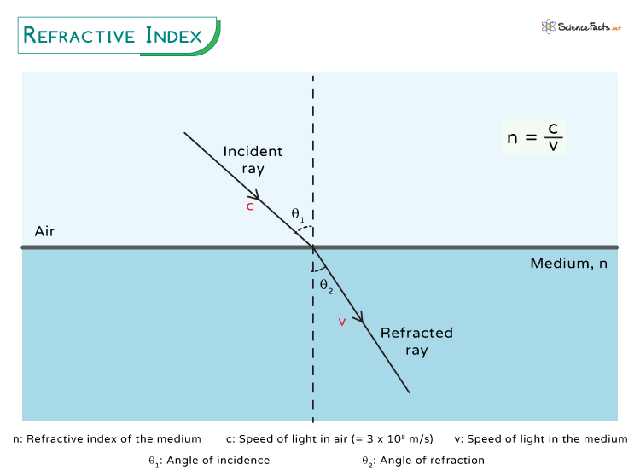
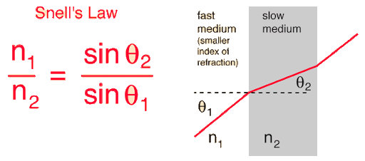
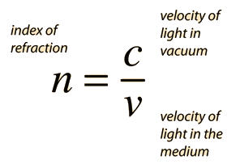
Ocular refractive media
Notes:
The refractive index is a measure of how much light bends, or refracts, when passing from one medium to another

Slide 9
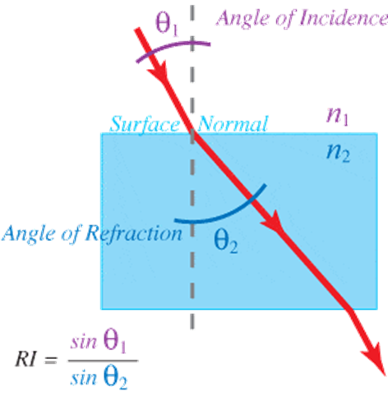
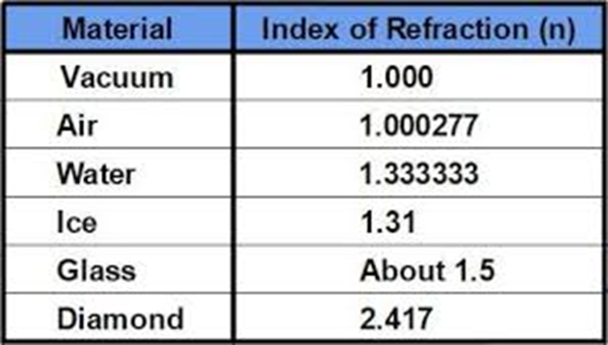

Slide 10
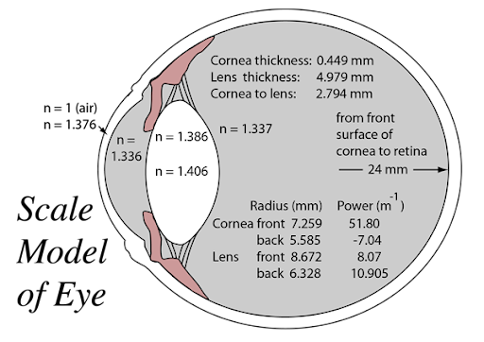
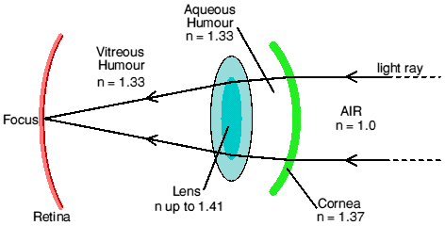
Ocular refractive media
Cornea: The transparent outer layer at the front of the eye. It provides the majority of the eye's refractive power.
Aqueous humor: A clear fluid that fills the space between the cornea and the lens (the anterior chamber).
Lens: A flexible, transparent structure located behind the iris. It fine-tunes the focus of light by changing its shape through a process called accommodation.
Vitreous humor: The clear, gel-like substance that fills the large space behind the lens (the vitreous chamber) and maintains the shape of the eyeball.

Slide 11
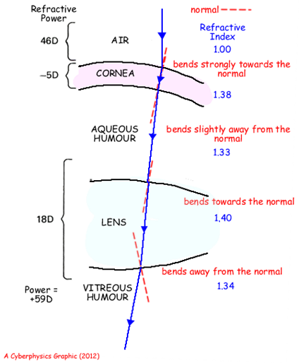

Slide 12
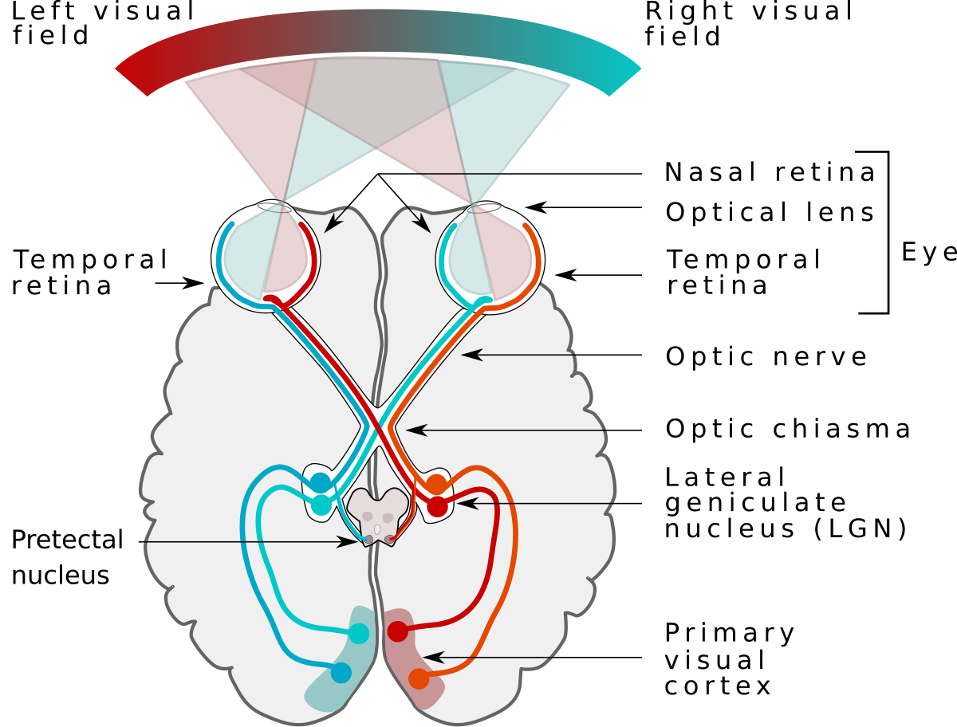
Visual pathway
Retina
Optic Nerve
Optic Chiasm
Optic Tract
Lateral Geniculate Nucleus (LGN)
Optic Radiation
Primary Visual Cortex

Slide 13
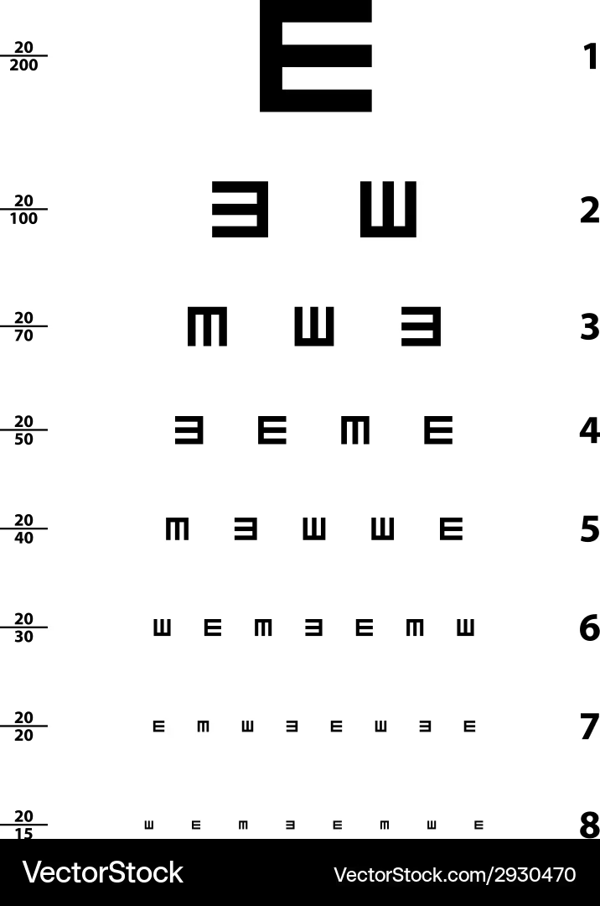
Visual Acuity
A visual acuity test measures the clarity and sharpness of vision, most commonly using a chart with letters or symbols from which reading the smallest line seen from a set distance of 6m. The results are expressed as a ratio, such as 6/6. It is used to screen for visual impairments, diagnose refractive errors like nearsightedness and farsightedness, and monitor vision changes

Slide 14
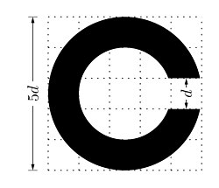
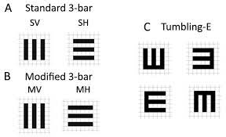
Optotype structure
Notes:
Subtends: The whole letter subtends 5 minutes of arc at the specified distance.
Stroke Width: Each stroke subtends 1 minute of arc.
6/6 letter is designed so that at 6meters, the limbs of the letter are separated by 1 minute of arc, which is the resolution limit of a standard human retina.

Slide 15
Visual Angle and Notation
Snellen Fraction: d / D
d: Test distance (6 m).
D: Distance at which a "normal" eye can read the letter.
Example: 6/12 means the patient sees at 6 m. what a normal person sees at 12m.

Slide 16
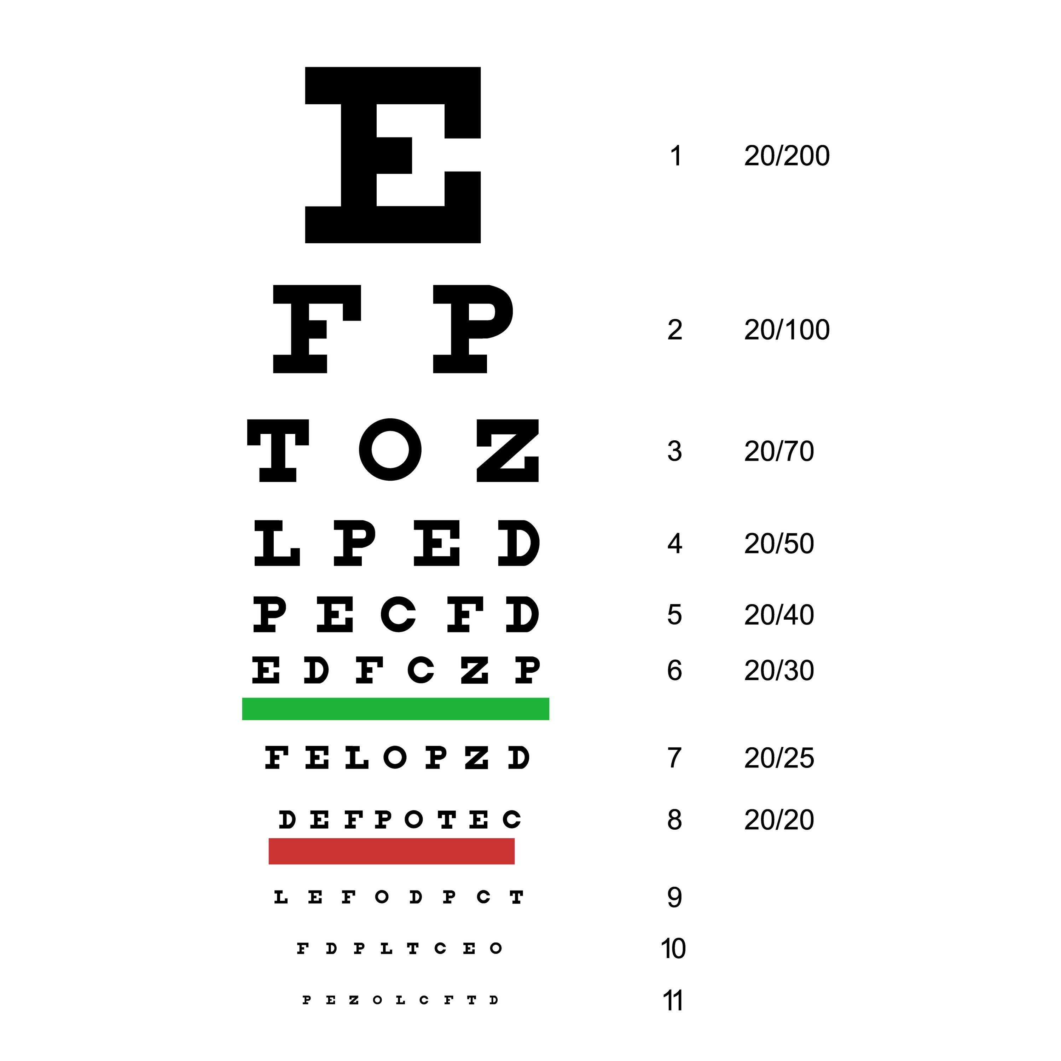
Snellen Chart
Origin: Developed by Hermann Snellen (1862).
Features: Serif letters; variable number of letters per line.
Progression: Irregular size progression between lines.
Pros: Universally recognized, fast.
Cons: "Crowding phenomenon" varies; not accurate for low vision.
Standard Methodology
The visual acuity test is a standardized process designed to ensure consistent results.
Distance: The patient sits or stands exactly 20 feet (6 meters) from the chart.
Monocular Testing: One eye is covered (occluded) with a paddle or hand while the other is tested. This prevents the stronger eye from compensating for the weaker one.
Reading: The patient reads the letters row by row, from top to bottom, until they can no longer distinguish the characters.

Slide 17
The Procedure (Step-by-Step)
Visuals: Flowchart of the process.
Position: Patient 20ft (6m) from chart.
Correction: Patient wears their current distance glasses/contacts.
Occlude: Cover the Left Eye (OS) to test the Right Eye (OD) first.
Read: Ask patient to read the smallest line possible.
Push: If they miss a letter, encourage them to guess.
Switch: Cover Right Eye, test Left Eye.
Binocular: Test both eyes together (optional, but helpful for functional vision).

Slide 18
Testing Environment
Patient Preparation
Quiet room
Proper illumination
Correct chart distance
Correct refraction
One eye at a time
Use occluder properly

Slide 19
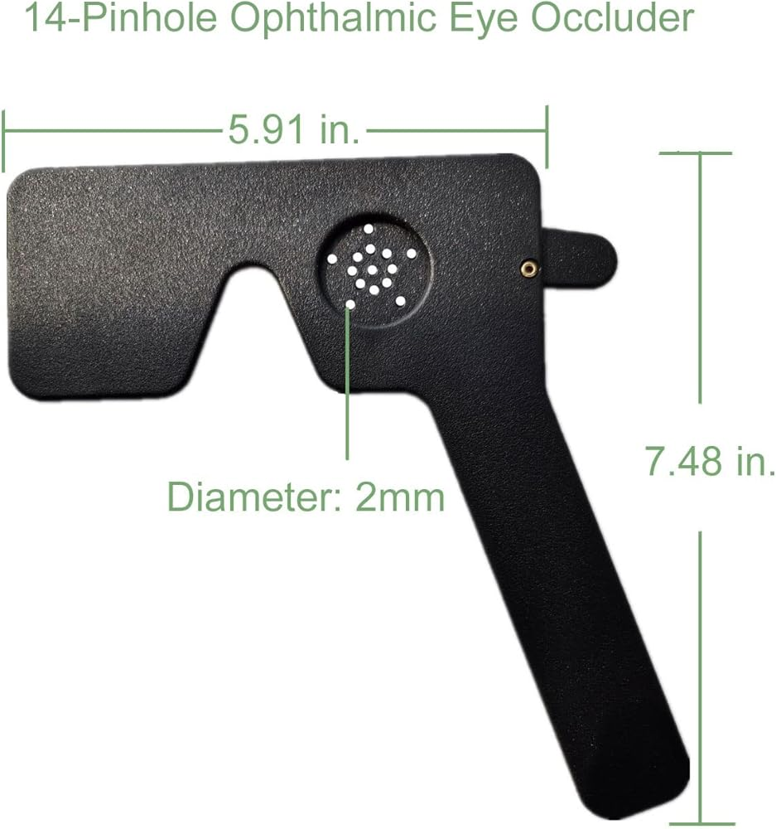
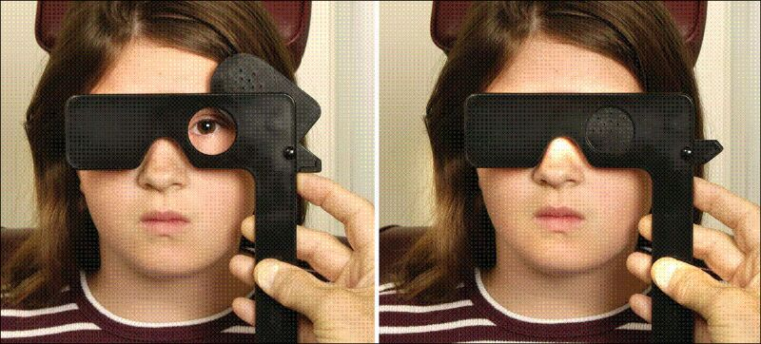
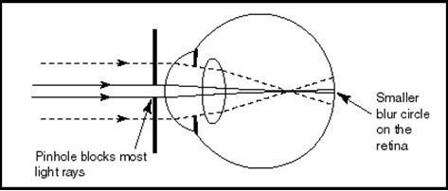
Pinhole Test
Helps identify refractive error
Improves clarity if refractive cause
Simple screening tool

Slide 20
Factors affecting VA

Slide 21
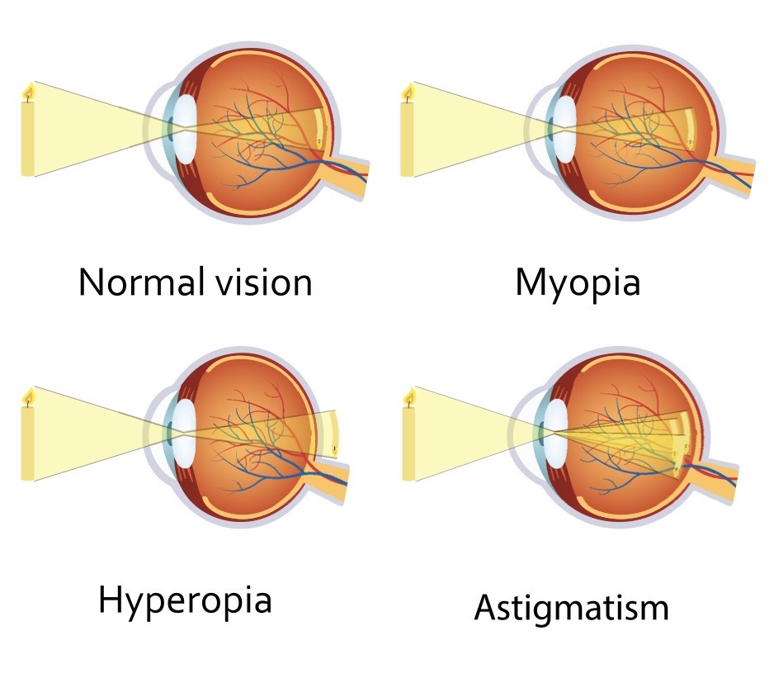
Refractive Errors

Slide 22
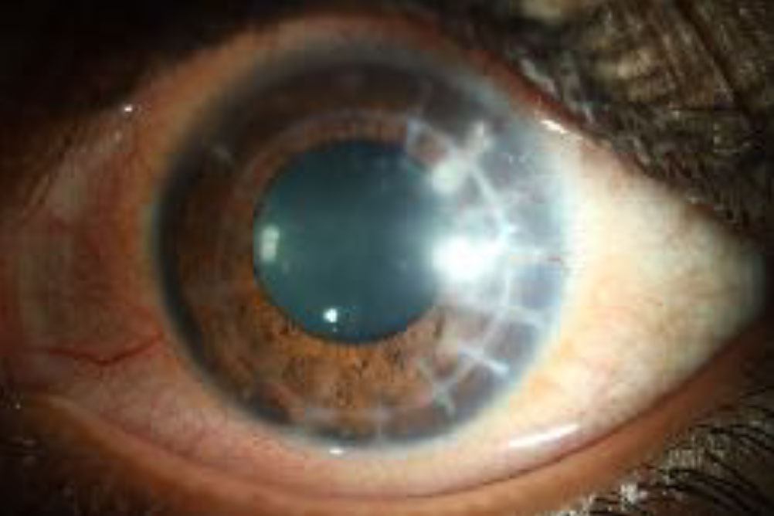
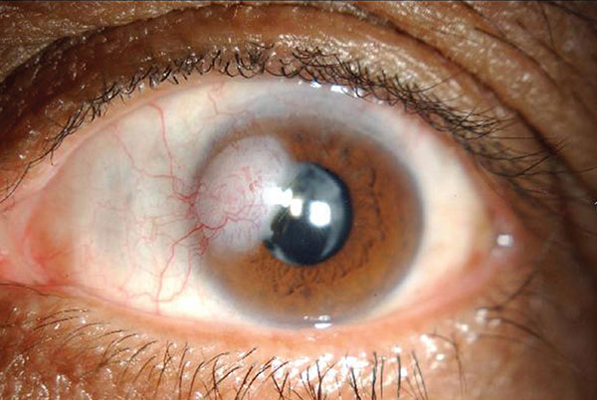
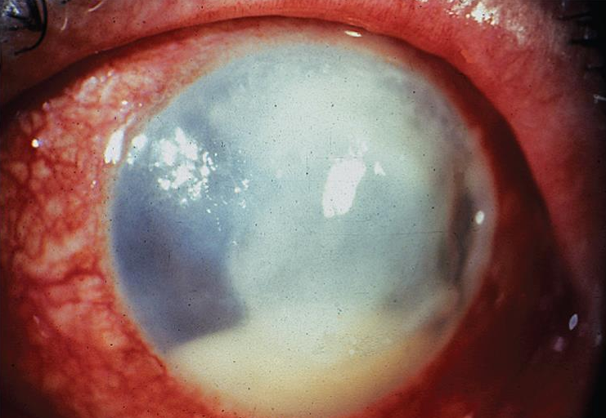
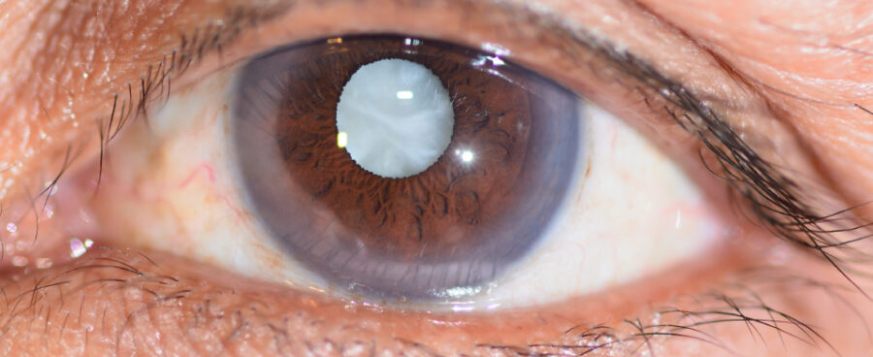
Media opacities

Slide 23
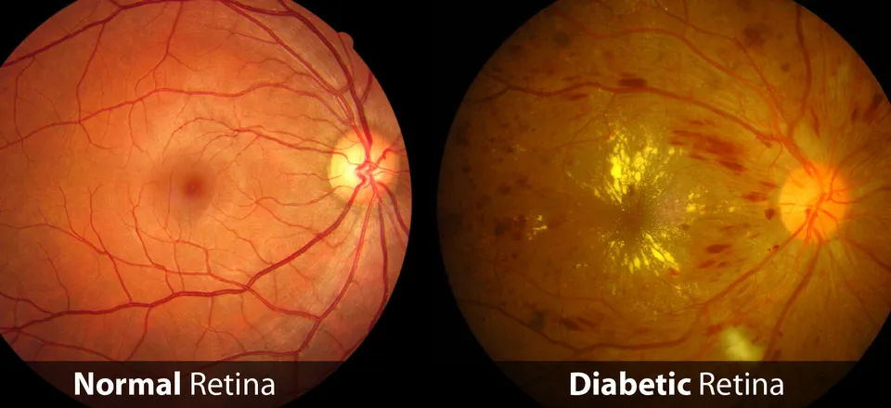
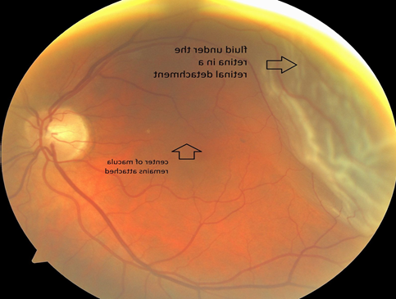
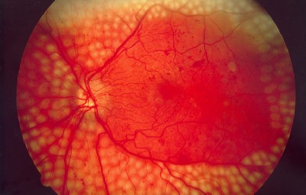
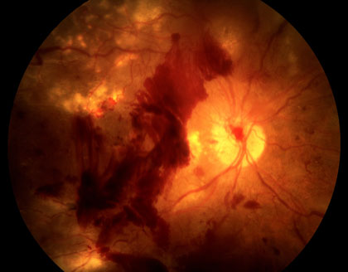
Retinal disease

Slide 24
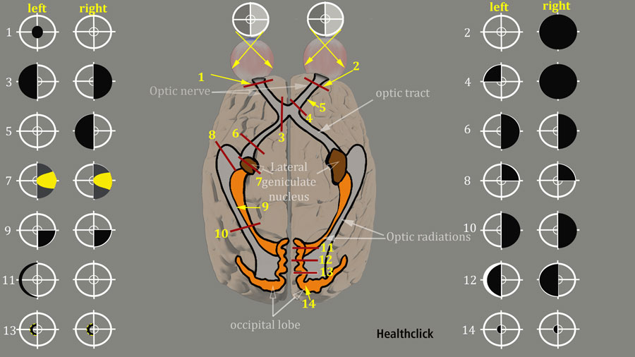
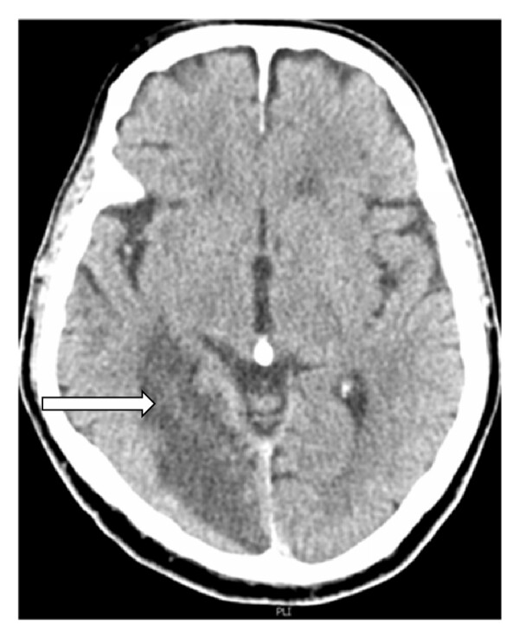
Neurological factors
Amblyopia
Systemic conditions

Slide 25
Common Errors
Incorrect distance
Improper occlusion
Guessing letters
Poor illumination
Dirty lenses
Uncalibrated chart

Slide 26
Clinical Significance
Baseline assessment
Tracks progression
Screens for pathology
Legal vision standards
Driving vision
Occupational requirements
Notes:
Teaching notes for: Clinical Significance I

