Slide 1
Quantitative Real time PCR
Presented by
Lecturer Dr Aminah Ali Abid Al-Juboori
College of Pharmacy, University of Baghdad

Slide 2
Content
PCR and in vivo DNA replication
Protocol steps and component involved in the PCR
RT-PCR (Reverse Transcription-Polymerase Chain Reaction)
RT-PCR (Real Time-Polymerase Chain Reaction)
Applications of PCR

Slide 3
PCR
In vitro enzymatic DNA replication technique
Used to amplify (make multiple copies) a specific DNA segment of interest.
Multiple rounds of amplification of DNA using template DNA, specific primers and the enzyme DNA dependent DNA polymerase
Products of the previous rounds used as template for the subsequent rounds, hence chain reaction

Slide 4
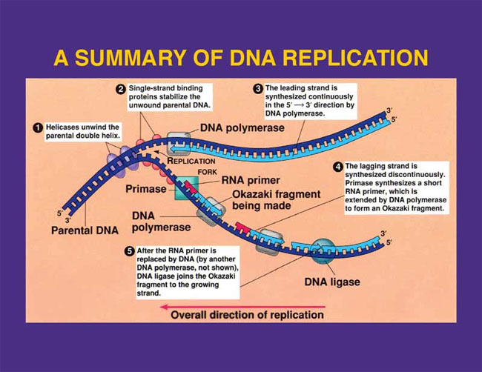
Overview of DNA Replication (in vivo)

Slide 5
 | DNA Replication | PCR
Place for DNA polymerase to attach to DNA strand | RNA:DNA | DNA:DNA
Separates the two strands of DNA | Helicase | Heat
Name of enzyme that elongates new strand of DNA | DNA polymerase | Taq DNA polymerase
What the primers are made out of (DNA or RNA?) | RNA | DNA

Slide 6
Steps Involved in the PCR
Denaturation: 95⁰C/ dsDNA into separate strands
Annealing: 55-65⁰C/ Anneal primers to flanking regions of single stranded DNA . Also extends the primer at a slow rate.
Extension: 72⁰C/ Extends primers with DNA polymerase
5’
3’
3’
5’
5’
3’
3’
5’
5’
3’
5’
3’
3’
5’
3’
5’
5’
3’
5’
3’
5’
3’
3’
5’
Repeat cycle for 30-40 times

Slide 7
PCR protocol example
1X
35X
1X
95ºC
95ºC
3 min
10 s
72ºC
30 sec
Initial denaturation
of DNA
60ºC
15 sec
denaturation
4ºC
extension
hold
annealing

Slide 8
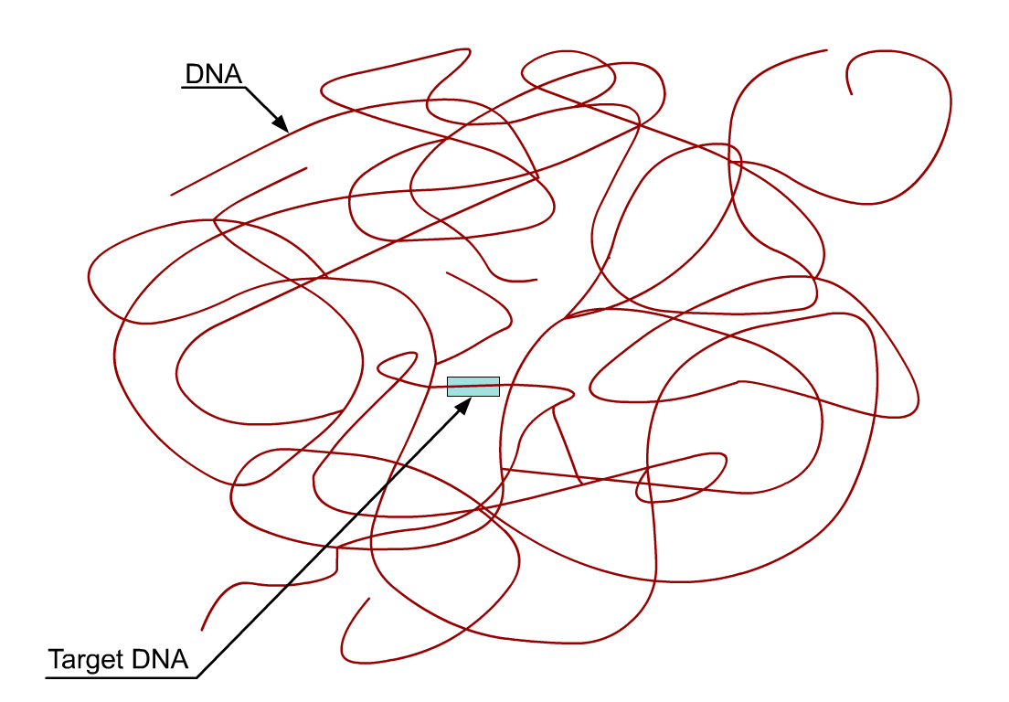

Slide 9
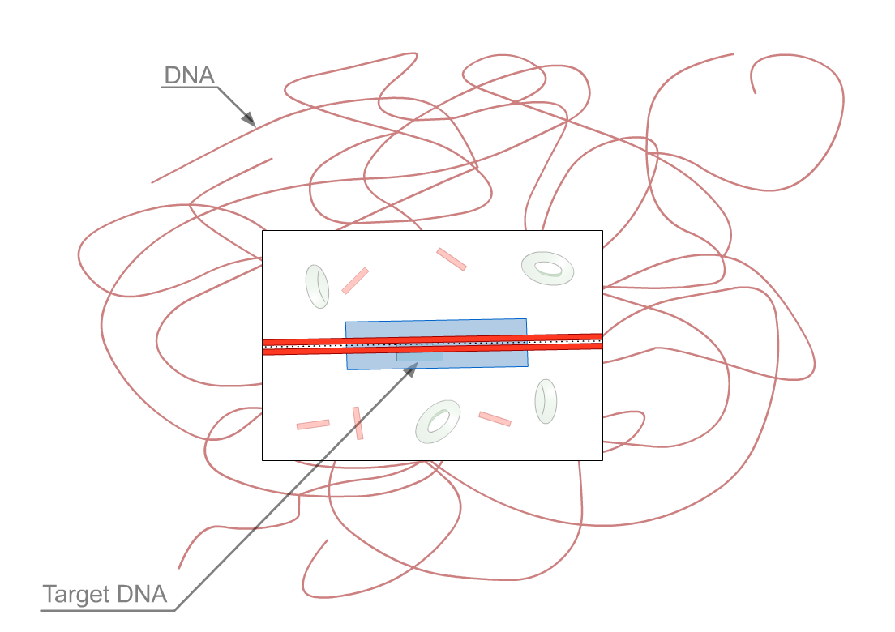

Slide 10
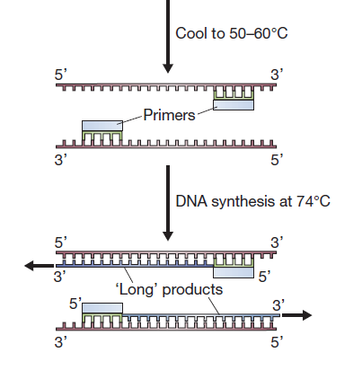
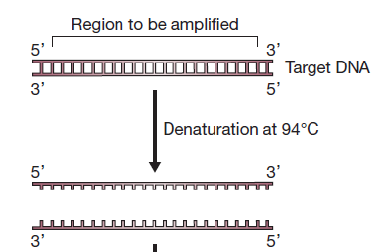
1st cycle of PCR

Slide 11
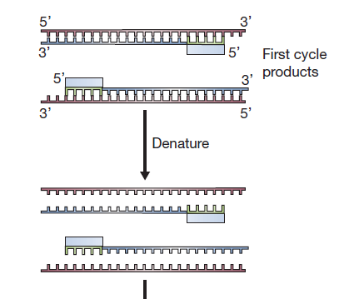
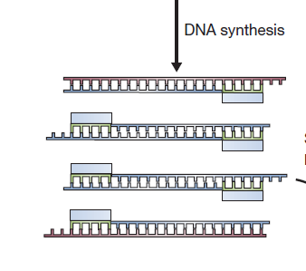
2nd cycle of PCR

Slide 12
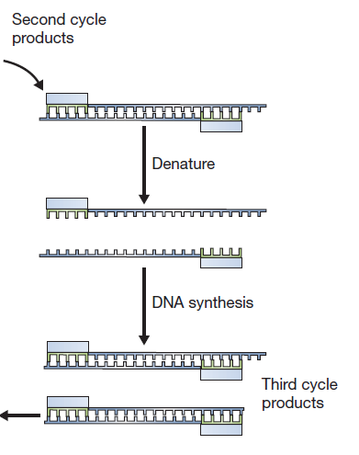
3rd cycle onwards
Short product -
accumulates in an
exponential manner

Slide 13
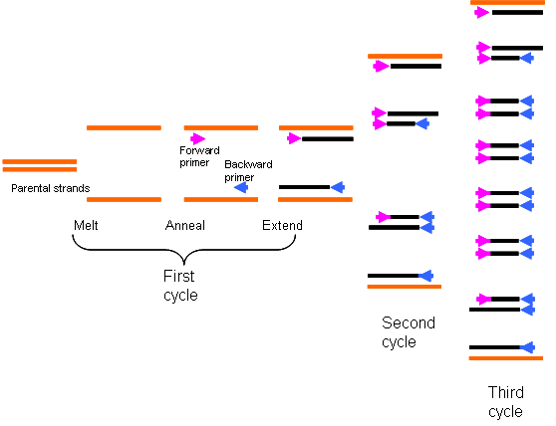

Slide 14
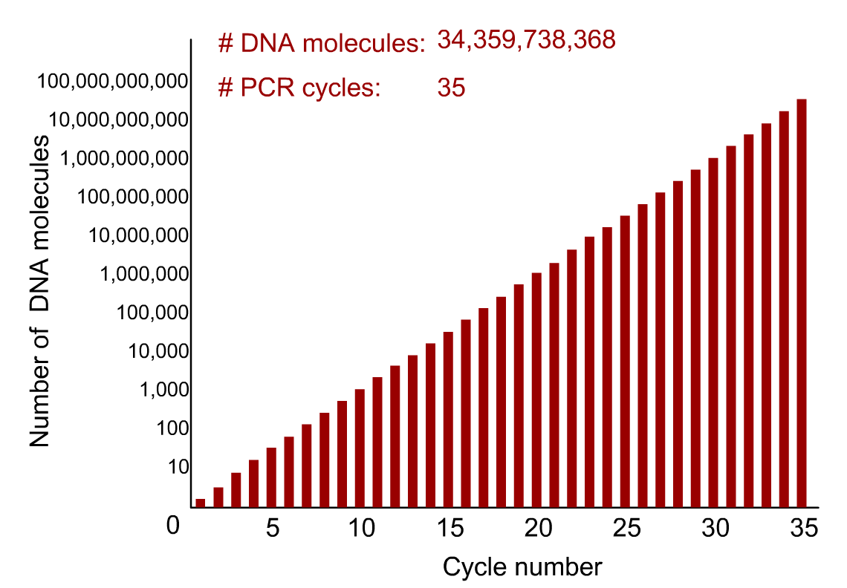

Slide 15
Components of PCR
Template DNA
50-100 ng of pure DNA; Should be free of proteins and lipids
Can be isolated from blood, tissues, cultured cells, hair and so on...
Taq Polymerase (Thermostable DNA Polymerase)
DNA dependent DNA polymerase derived from Thermus aquaticus
Half life of 45 minutes at 95⁰C .
Extension rate: 2kb-4kb/min
Processivity: 50-60 bases
Why is Taq so stable?
a. Increased hydrophobicity of the core of the enzyme
b. Improved stabilization of electrostatic forces

Slide 16
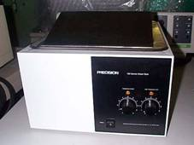
PCR before Taq and thermal cyclers
Initially PCR used the Klenow fragment of E. coli DNA polymerase - inactivated by high temperatures
95º C
5 min
55º C
3 min
72º C
5 min
DNA polymerase
35 times

Slide 17
Components of PCR
Primer pair:
Oligonucleotides, 18-25 in length usually.
Complementary to flanking sequences on template
No complementarity between forward and reverse primers as well as no self complementarity within a primer
Forward and Reverse primers should have Tm within 3⁰C of each other
GC content of primers should be 40-60 %

Slide 18
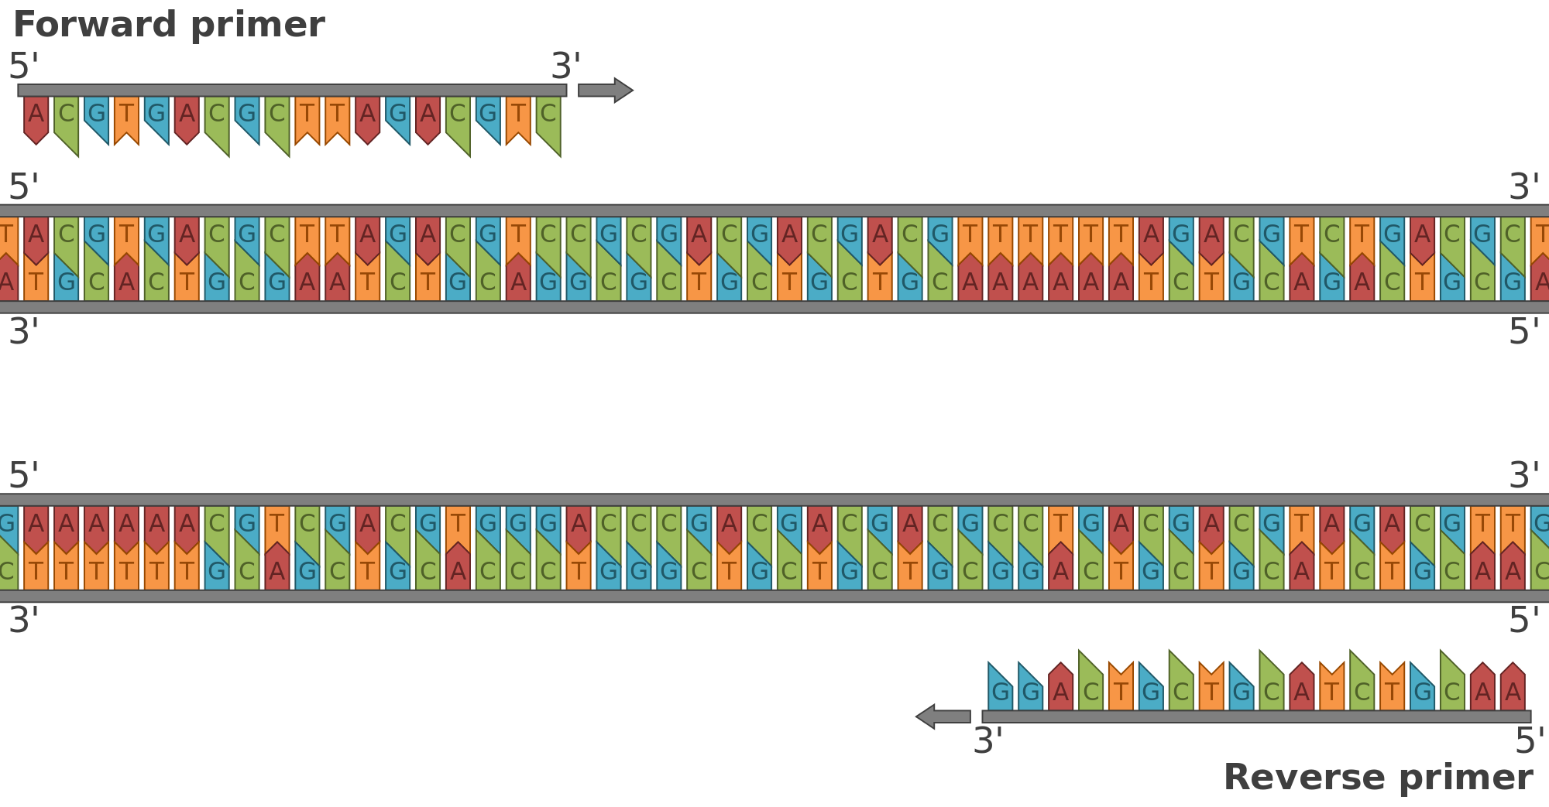
short sequence of artificially synthesized oligonucleotides which binds to a specific region in the DNA.
directionality of binding
sense-antisense
directionality of reading/scanning : 3’to 5’
directionality of synthesis : 5’ to 3’

Slide 19
Components of PCR
Buffer:
Tris-Cl buffer to maintain the pH. Usually contains divalent cations like Mg²⁺ which is a cofactor for Taq polymerase.
dNTPs:
Equimolar concentrations of dATP, dCTP, dGTP and dTTP are used.
The ideal pH of Tris-Cl buffer for PCR is 8.4.
For long templates, a higher pH (pH 9.0) is suggested.

Slide 20
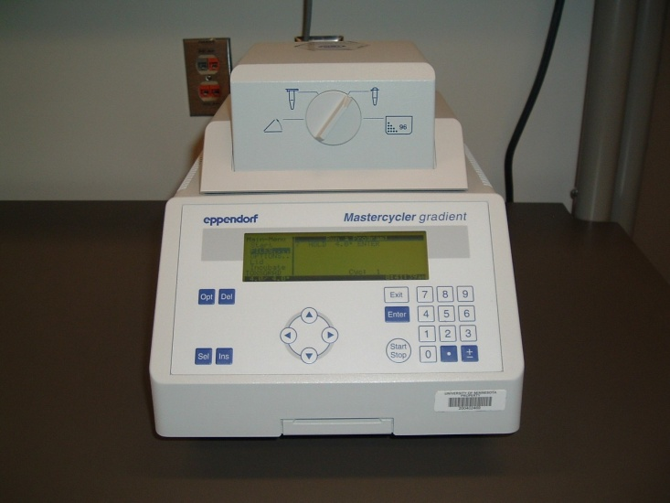
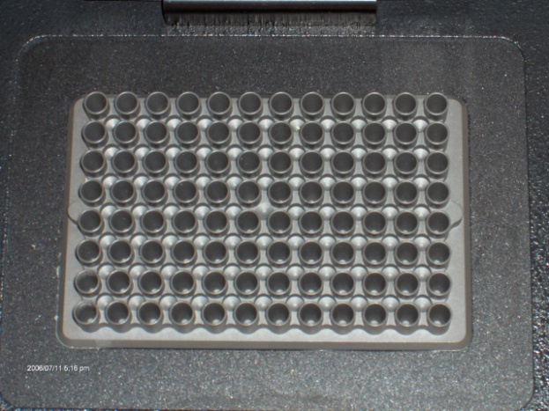
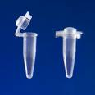
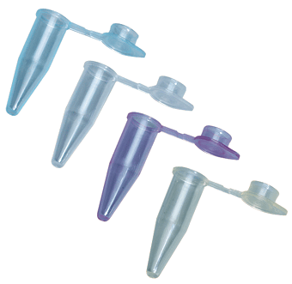
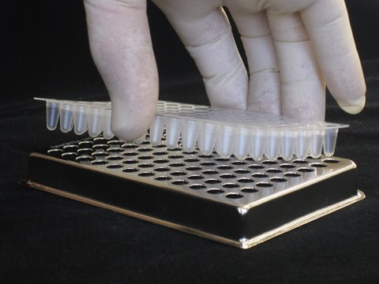
Components of PCR
PCR machines or thermal cyclers are used to vary the temperatures cyclically thus helping in automation of the process.
PCR tubes: thin walled plastic tubes or plates

Slide 21
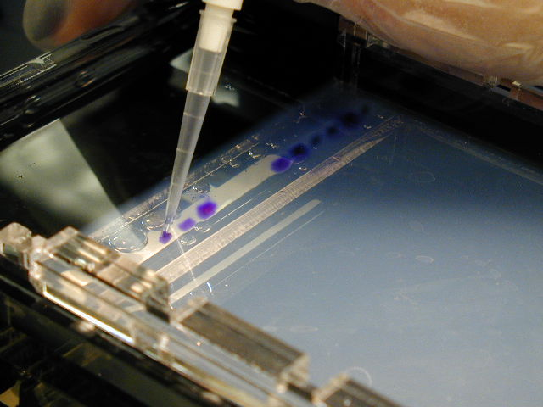
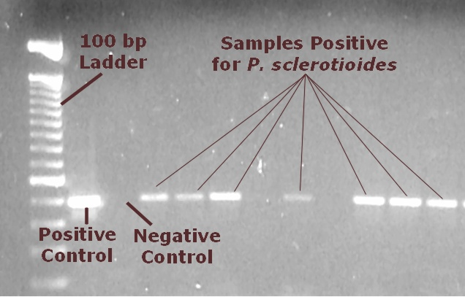
Confirmation of a successful PCR
What information do we derive from the above image ?
Specificity of PCR
Presence/absence of disease
Quantitation
Importance of controls

Slide 22
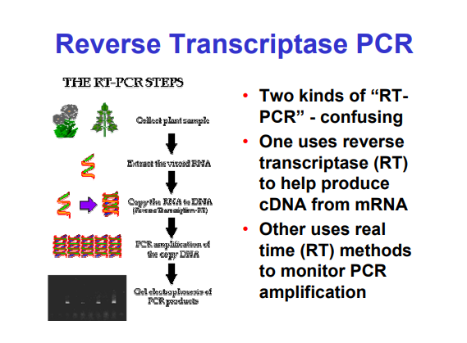
Two types of tem RT-PCR

Slide 23
Reverse Transcription
Reverse transcriptase – Present in retroviruses like HIV; Converts RNA to DNA (known as cDNA).
Enzyme used for Reverse transcription is usually MMLV RT/AMV RT (Moloney strain of murine leukemia virus reverse transcriptase/ Avian myeloblastosis virus)
RNA dependent DNA polymerase
Reverse transcription is done at 37-42⁰C using DNA primers like oligo dT or random hexamers or gene specific primers.

Slide 24
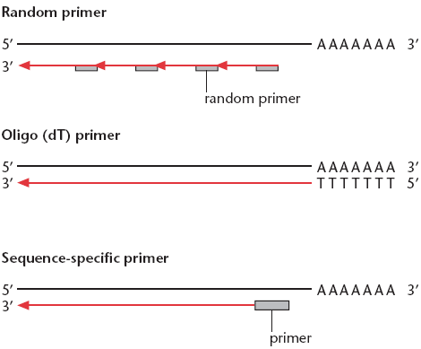
Reverse transcriptase reaction – Priming strategies
Converts all RNA to cdNA
Converts mRNA to cdNA
Converts specific RNA to cdNA

Slide 25
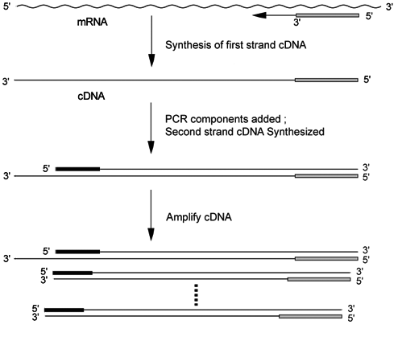
RT-PCR

Slide 26
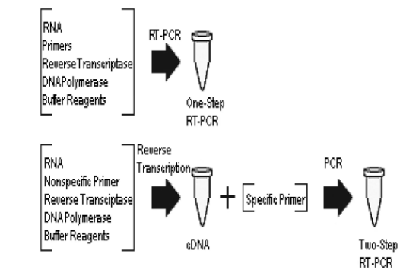

Slide 27
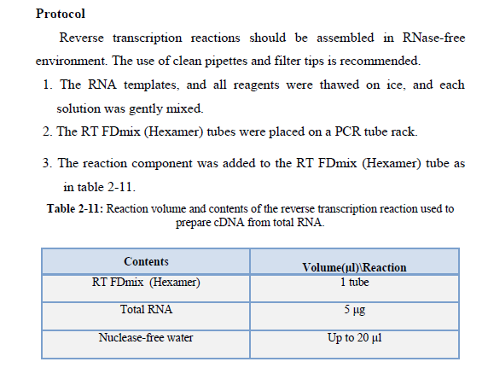
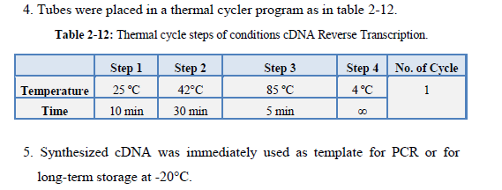

Slide 28
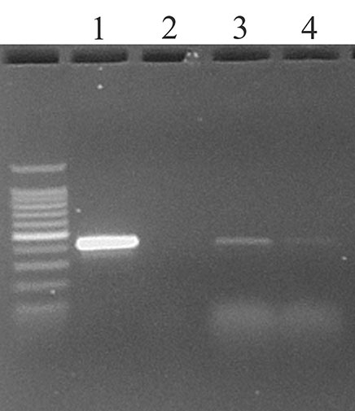
Applications of RT PCR
Used in detection/quantitation of RNA viruses e.g. HIV viral load
To study mRNA expression levels in cells, tissues.
To study for the presence of active infection e.g. TB
RNA isolated from blood of 4 suspected HIV patients
Reverse Transcription using 500 ng of RNA from all suspected patients
HIV p24
PCR for HIV p24
(400 bp amplicon)
25 cycles

Slide 29
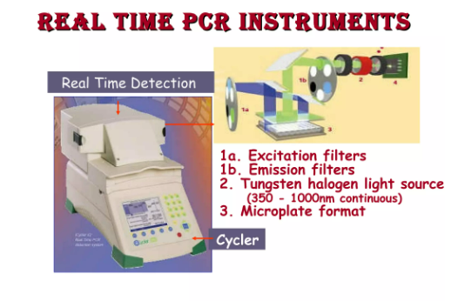
Real time PCR

Slide 30
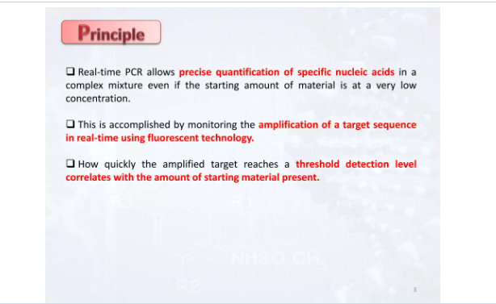
Principle Real time PCR

Slide 31
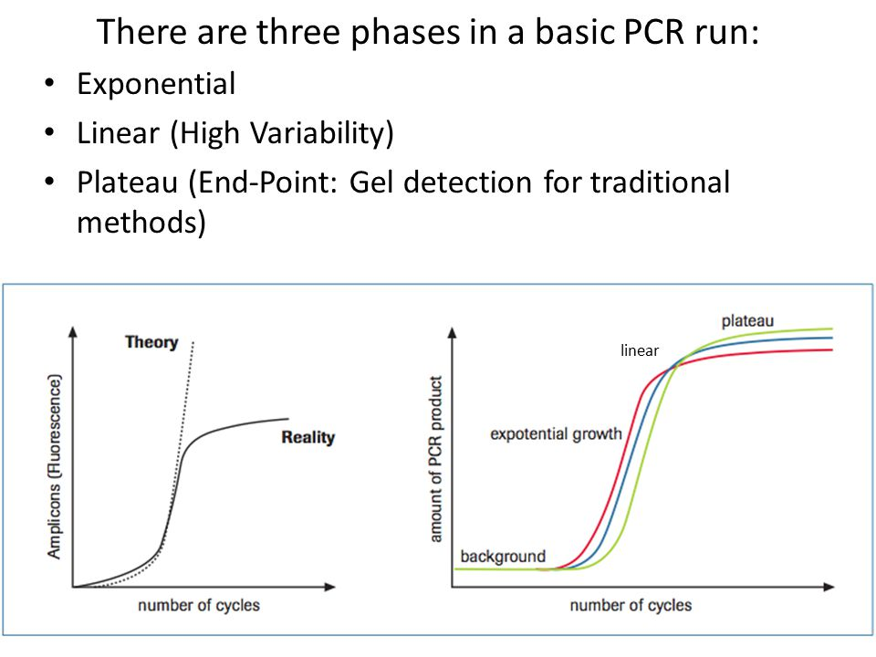
Real time PCR

Slide 32
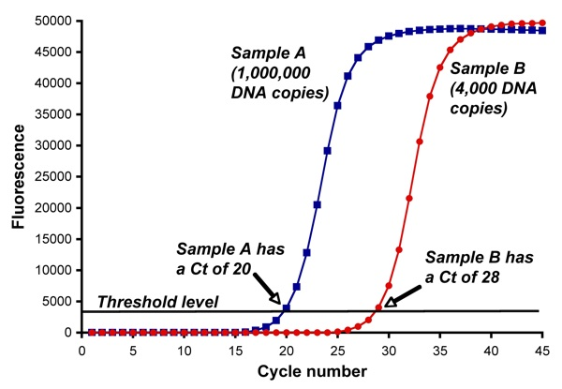
(Initial)
(Initial)
CT value = Represents how many PCR cycles are required for the sample fluorescence to reach the threshold level.
Threshold level of fluorescence = fluorescence level is above background = detectable
Ct value is determined by initial amount of template in sample

Slide 33
Real time PCR
Traditional PCR has advanced from detection at the end-point of the reaction to detection while the reaction is occurring (Real-Time).
Real-time PCR uses a fluorescent reporter signal to measure the amount of amplicon as it is generated. This kinetic PCR allows for data collection after each cycle of PCR instead of only at the end of the 20 to 40 cycles.

Slide 34
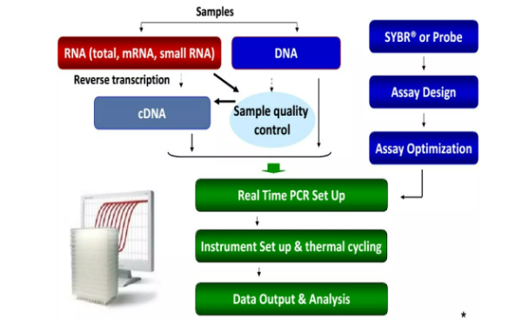

Slide 35
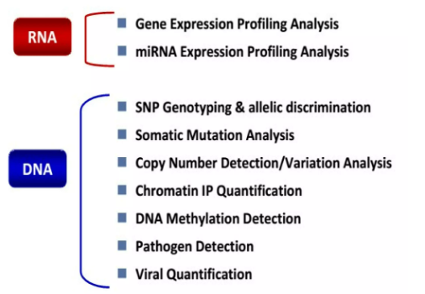

Slide 36
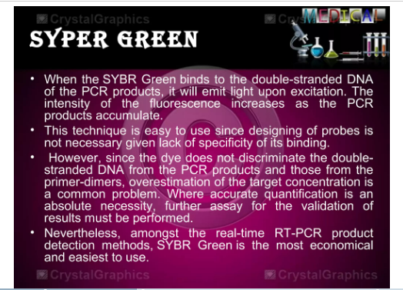

Slide 37
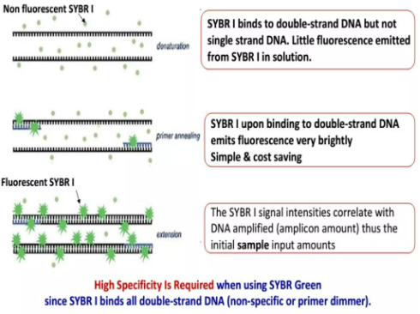

Slide 38
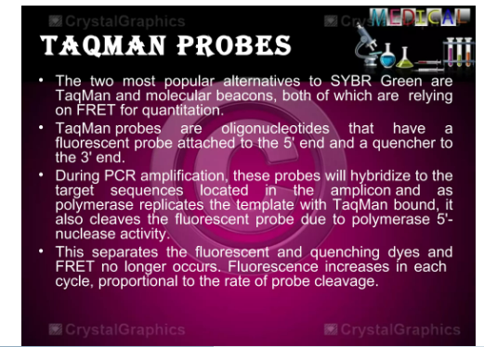

Slide 39
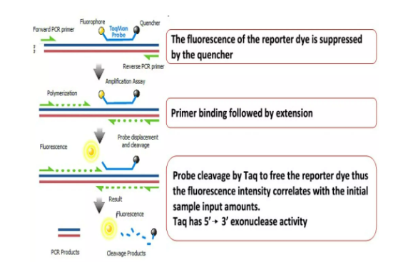

Slide 40
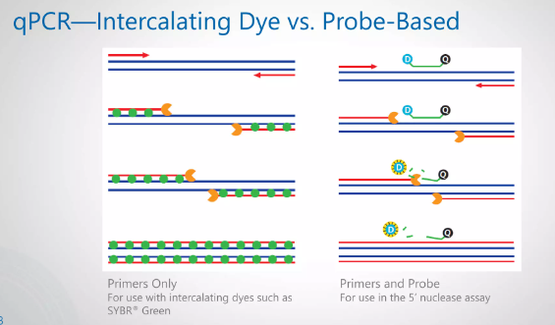

Slide 41
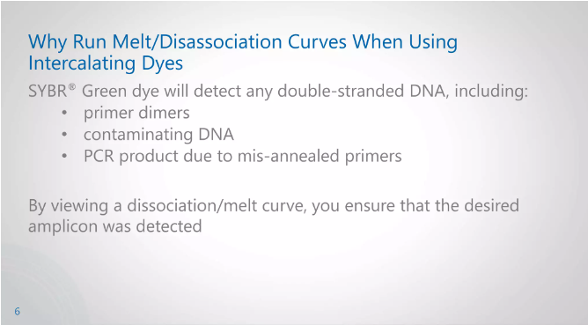

Slide 42
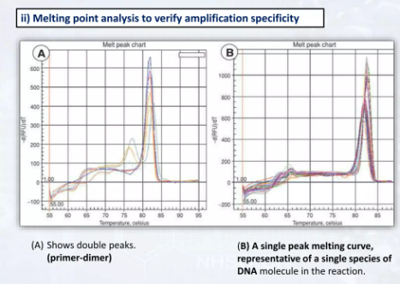

Slide 43
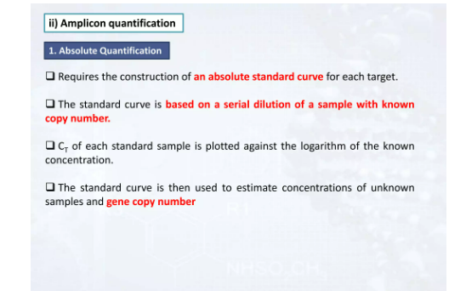

Slide 44
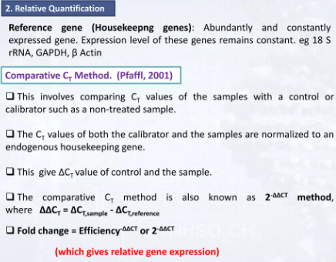

Slide 45
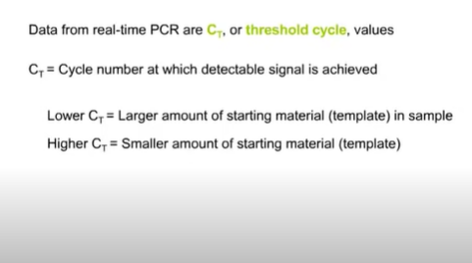

Slide 46
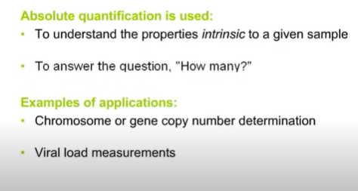

Slide 47
Advantages of Real Time PCR
Amplification can be monitored in real time
Specificity and sensitivity
Detection is capable down to < 2-fold change
No post run processing of products
Confirmation of specific amplification by melt curve analysis

Slide 48
Limitations of Real Time PCR
Setting up requires high technical skill and support
High equipment cost
Average change in gene expression
Assumptions: housekeeping gene is constantly expressed
Change in mRNA level might not reflect change in protein level

Slide 49
Applications of PCR
Basic Biomedical Research
Amplifying specific DNA for downstream applications like
Cloning and expression of recombinant proteins
Diagnosis of genetic diseases
Sickle cell anemia (normal, carrier, diseased)
Infectious diseases diagnosis
Mycobacterium tuberculosis – infection/drug resistance
HIV – RT-PCR

Slide 50
Applications of PCR
Cancer biology
BRCA1 mutation, BCR-ABL translocations
Gene expression
Evolutionary Studies
DNA from fossils PCR amplified, sequenced and analyzed for homology
Forensics
Crime Scene Investigation
Paternity testing

Slide 51
Reference
Yasumasa Kimura et al. Optimization of turn-back primers in isothermal amplification (http://www.ncbi.nlm.nih.gov/pmc/articles/PMC3089485/
R. Manojkumar and Mrudula Varanat(2006) Polymerase Chain Reaction: Types and Its Application in theField of Biology. International journal of tropical medicine 1 (4):156-161
Voet,D, Voet,J. Biochemistry Vol.1 3rd ed.
Alberts, Johnson, Lewis. Molecular Biology of The Cell 4th ed.
Introduction to Plant Biotechnology By- H.S. Chawala
http://arbl.cvmbs.colostate.edu/hbooks/genetics/biotech/enzymes/hotpolys.html
http://www.pubmedcentral.nih.gov/articlerender.fcgi?artid=146123&rendertype=abstract
http://www.fermentas.com/techinfo/pcr/dnaamplprotocol.htm
http://www.fermentas.com/techinfo/pcr/pcrprotocolpfu.htm

Slide 52
THANK YOU

