Slide 1
How to find and choose Evidence-based studies
Assistant Professor Ali A Abdulkareem
BDS, MSc, PhD (UK)

Slide 2
Systematic reviews/ Meta-analysis
Level of evidence
RCT, CCT and CT
Bias level?
Cohort
Case-control
Observational
Cross sectional
In vitro, experimental animals studies
Pre-clinical

Slide 3
Past
Present
Future
Cross-sectional
Cross-sectional
Exposure
Prospective cohort study
Outcome
Retrospective cohort study
Exposure
Outcome
Case-control study
Prospective RCT
Treatment
Outcome
Retrospective RCT
Treatment
Outcome

Slide 4
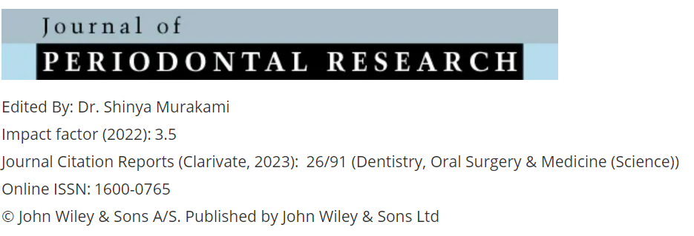
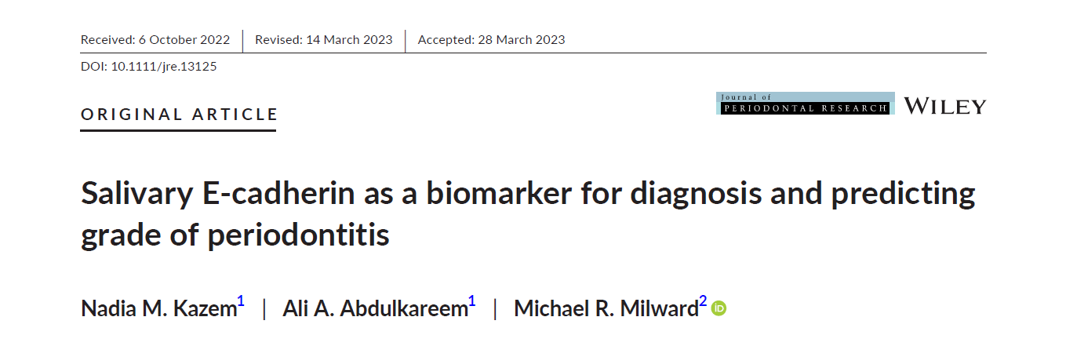

Slide 5
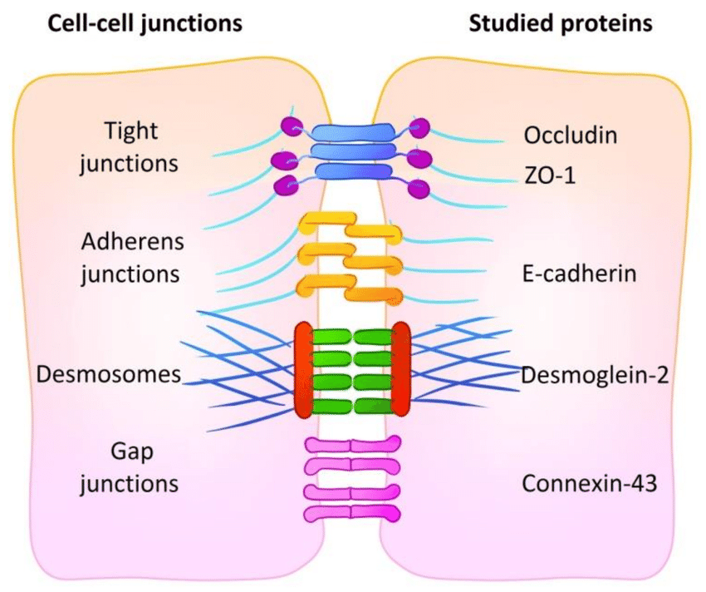
Cell to cell junctions
Tight junctions
Adherens junctions
Desmosomes
Gap junctions
Each one is build-up by a unique protein

Slide 6
Cell membrane
E-cadherin complex
The Major unit of Adherens junctions
Intracellular
Extracellular
p120
Actin filament
Transmembrane
β-catenin
Stability of β-catenin is crucial

Slide 7
Building the evidence
Increased soluble E-cadherin level was demonstrated in different disease models and was effectively used to differentiate many types of cancers using serum samples.
Is this applicable to periodontitis?

Slide 8
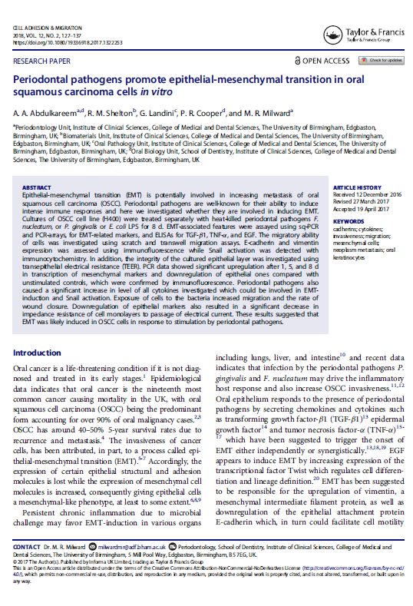
Cell Adhesion & Migration
Impact factor: 3.255
Publisher: Taylor & Francis
Exposure of cancer H400 keratinocytes to periodontal pathogens led to:
Acquisition of EMT phenotype
Decrease E-cadherin expression
Periodontal pathogens could be responsible for aggravating cancer metastasis by inducing Type 3 EMT

Slide 9
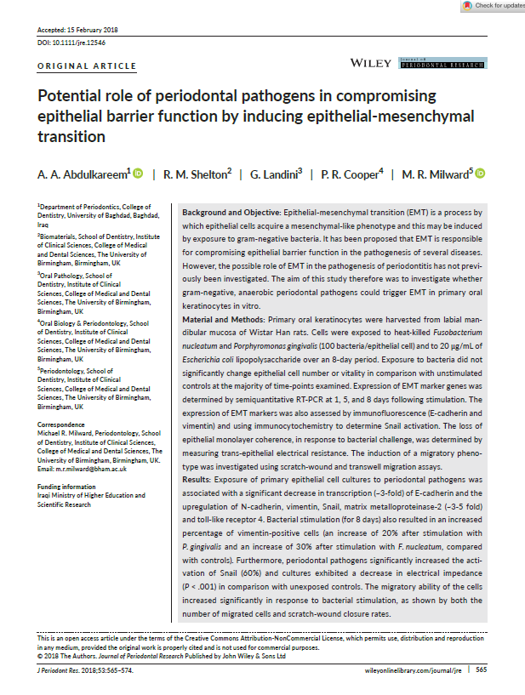
Journal of Periodontal Research
Impact factor: 3.946
Publisher: Wiley
Exposure of rat primary gingival epithelial cell cultures to periodontal pathogens led to:
Acquisition of EMT phenotype
Loss of epithelial barrier function

Slide 10
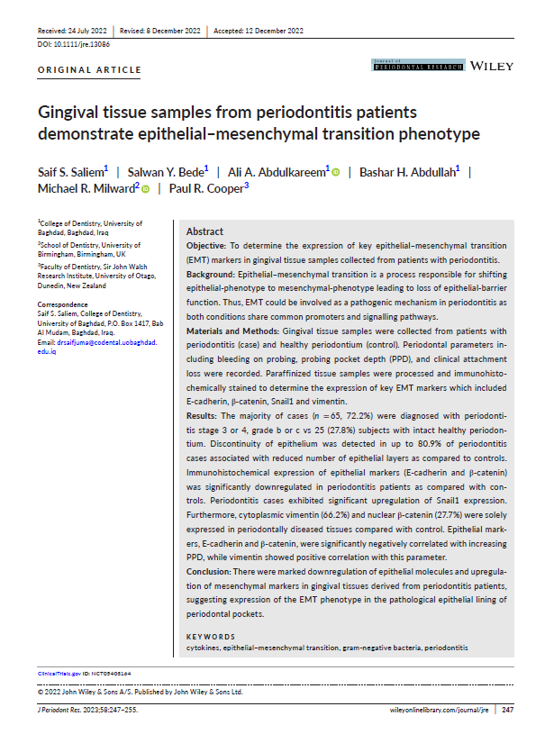
Journal of Periodontal Research
Impact factor: 3.946
Publisher: Wiley
Tissue samples were collected from periodontitis patients.
The downregulation of E-cadherin expression was evident in periodontitis tissue samples
What happened to dissolved components?

Slide 11
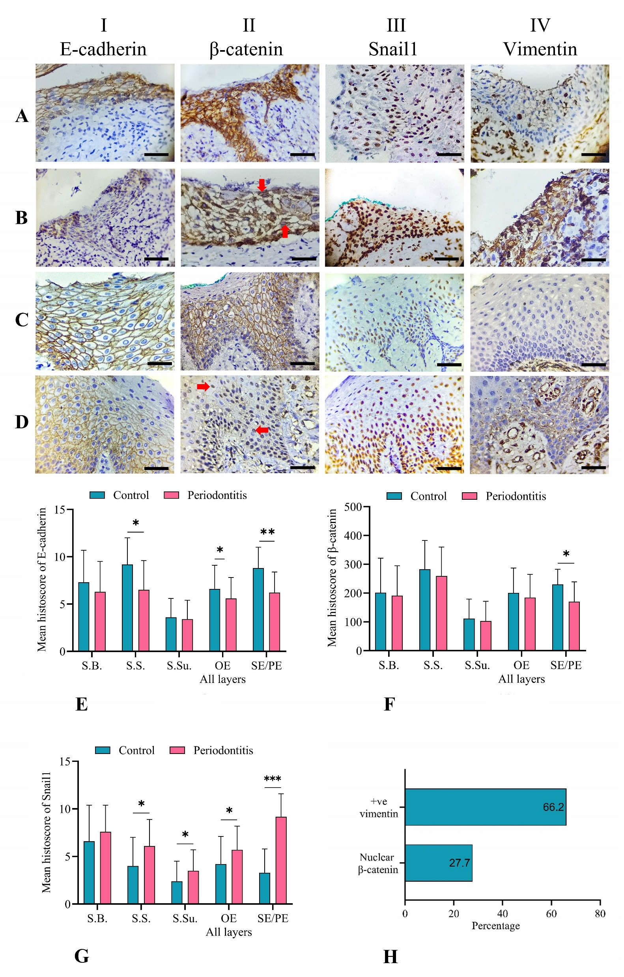
Sulcular epithelium
Pocket epithelium
Oral epithelium healthy
Oral epithelium periodontitis

Slide 12
Hypothesis
Periodontitis-associated destructive events are responsible for increasing E-cadherin level in oral fluids.

Slide 13
What is the best design to test the stated hypothesis?
Case-control

Slide 14
A total of 98 patients were included representing:
Individuals with healthy periodontium (Controls)
Patients with periodontitis (Cases)
Saliva was selected and the level of E-cadherin was assayed with ELISA

Slide 15
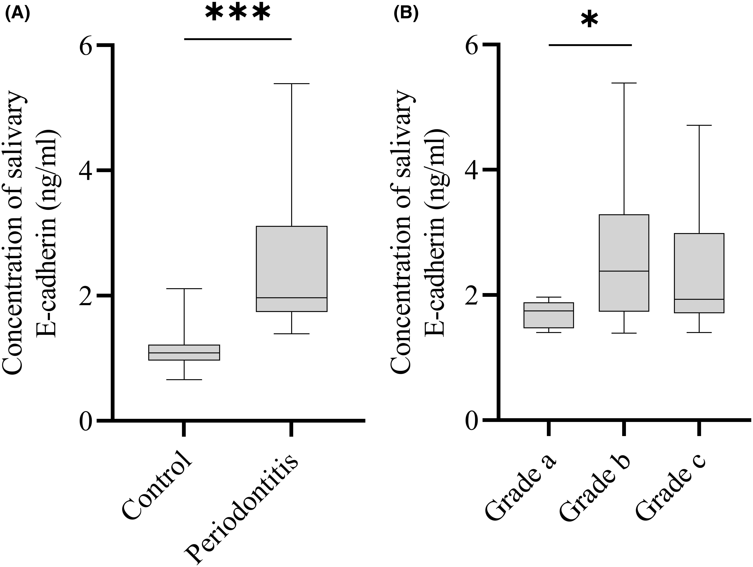
Results

Slide 16
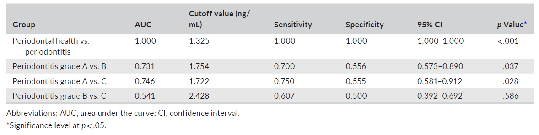
E-cadherin showed high accuracy to differentiate periodontal health from periodontitis

Slide 17
What if other designs would be considered?
Cohort?
Track E-cadherin level changes in oral fluids of periodontitis cases over time till terminal stages of disease!
Any issues?
RCT?
- Impact of periodontal therapy on E-cadherin level in oral fluids (ongoing)

Slide 18
What is next?
Increasing the number of literature to a sufficient level to perform Systematic review and Meta-analysis to support generalization of results

Slide 19

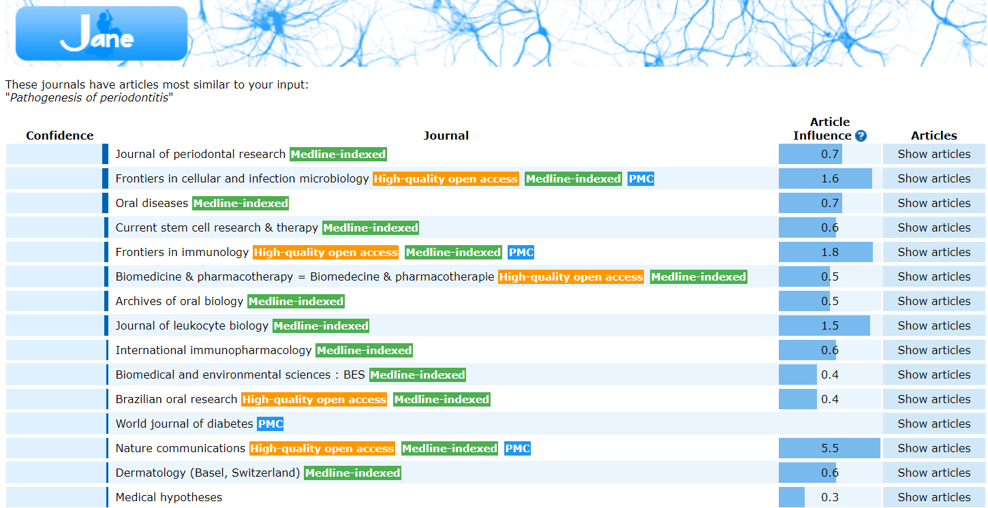
How to select a good journal?
Ask JANE

Slide 20
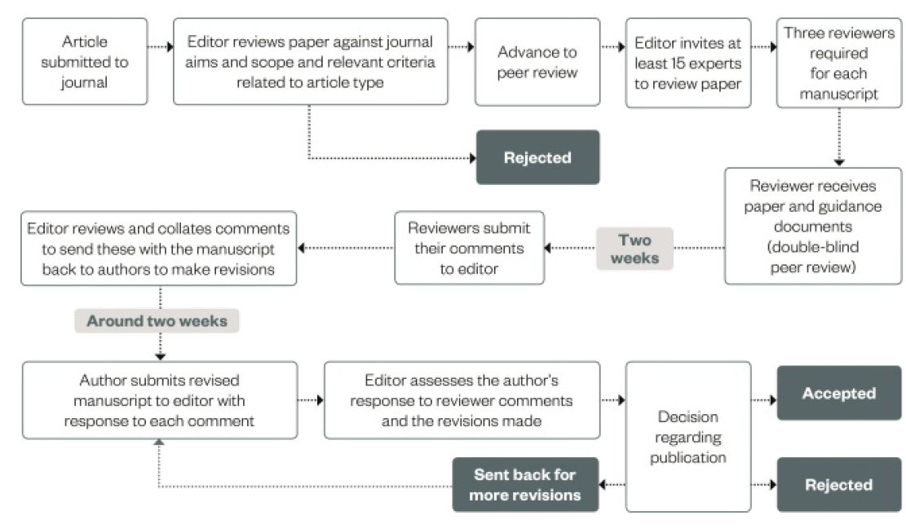
DR
PPR
PER

Slide 21
Major reasons for rejection

Slide 25
Thank You

