Slide 1
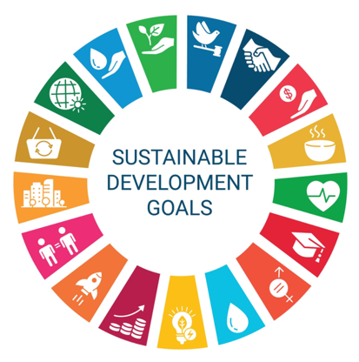
Language and environmental development
The Role of Education in Promoting a Culture of Sustainability

Slide 2
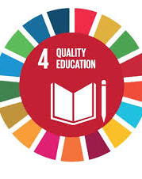
Presented by :
Asst.Lect. Zainab Ayad Ali
Lect.Dr.Aseel Kareem Mohammed
Asst.Lect.Duaa Hamid Ali

Slide 3
Introduction
Today, I want to talk about something that connects deeply with how we live, think, and communicate — the link between language, education, and our planet’s future. When we talk about environmental issues, we usually think of things like climate policies, renewable energy, or recycling programs. But behind all those efforts lies something more subtle — the way we speak and learn about the environment.. That’s where education comes in. Education doesn’t just teach us facts — it shapes our mindset, our values, and our sense of responsibility toward the world around us.

Slide 4
1. How Language Shapes Environmental Awareness
Language is not just a tool we use to describe the world — it plays an active role in shaping our reality. Consider how the words we use influence how we think and act. For example, when we speak of 'natural resources,' it implies that nature exists primarily for our exploitation — to be used, managed, or consumed. On the other hand, when we refer to Earth as 'our home' or describe nature as a 'living system' that we are an integral part of, the relationship changes dramatically. In certain Indigenous cultures, the Earth is not viewed as 'it' or 'something,' but rather as 'she' — a being to be respected, cared for, and honored. The linguistic choices we make, whether consciously or unconsciously, shape how we see the world and our place within it.

Slide 5
2. Education as the Heart of Sustainability
Education is the foundation where values take root and where we learn to live responsibly in the world.
Sustainability education has three key goals: 1. Understanding — It aims to help students understand how ecosystems function and how human actions impact these delicate systems. 2. Caring — It nurtures a sense of moral and emotional responsibility for the planet. Students develop empathy for nature and an understanding of their role in protecting it. 3. Acting — It empowers students with the confidence and practical skills to make sustainable choices in their daily lives, from reducing waste to advocating for greener policies.
.

Slide 6
3. Bringing Sustainability into the Classroom
Environmental education must not be confined to a single subject or isolated lesson. Sustainability should be integrated into every part of the curriculum — from science and art to history and economics.
Here are a few ways sustainability can be brought into the classroom: - Creative Writing and Poetry: Students can write stories or poems about their local environment, exploring the beauty of nature and the challenges it faces. - Community Projects: Organizing local initiatives such as tree planting, reducing plastic waste, or testing local water quality empowers students to engage in hands-on environmental stewardship. - Debates on Global Issues: Debating topics like climate change, energy solutions, or the concept of sustainable cities fosters critical thinking and active engagement with the pressing issues of our time.

Slide 7
4. Challenges and the Way Forward
While there is significant progress, there are still challenges to overcome:
Technical Jargon: The language of sustainability can often be technical or academic, making it difficult for everyday people to understand.
Curriculum Gaps: In some education systems, environmental education is treated as an optional subject — something that can be added if there’s time.
Cultural Differences: Every culture has its own relationship with nature, and sustainability education must respect and build upon these diverse perspectives.

Slide 8
5. Case Study: The Green School, Bali — Language, Culture, and Sustainability in Action
The Green School in Bali, Indonesia is an inspiring example of how language and education can unite to build a culture of sustainability. Founded in 2008, the school’s mission is to prepare young people to be green innovators — individuals who not only understand environmental science but also live its principles every day.

Slide 9
. Conclusion
True environmental progress doesn’t begin with technology. It starts with the language we use and the education we provide. Because the words we use not only shape the stories we tell but also shape the world we live in. If we teach young people to speak of the Earth with respect, to think critically about sustainability, and to act with compassion, we are not just protecting the environment — we are reimagining what it means to be human. Let’s continue to teach, to question, and to inspire a world where language and learning guide us toward a truly sustainable future.

Slide 10

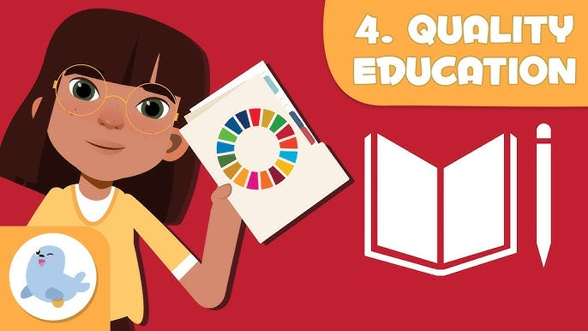
THANK YOU

