Slide 1
Drug Addiction Awareness Discourse on Social Media: A Corpus Linguistic Study in the Context of Sustainable Development Goals
BY
Asst. Prof. Eman Adil Jaafar
20th Oct 2025

Slide 2
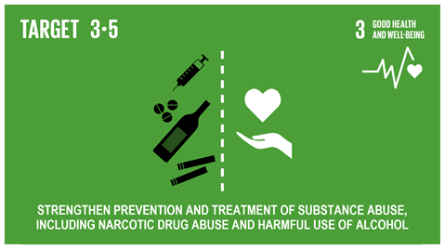
Drug addiction, also called substance use disorder. World Health Organization (WHO, 2024) defines it as a disease that affects a person's brain and behavior and leads to an inability to control the use of a legal or illegal drugs. The perils of addiction extend beyond the individuals, profoundly affecting families, communities, and the socio-economic landscape of societies (Masenga, 2017; Colman, 2019).

Slide 3
Health Communication & Corpus Linguistics

Slide 4
Health Communication studies the use of communication strategies to inform and influence individual and community decisions that enhance health across the lifespan(Brookes& Collins, 2023).

Slide 5
Sustainable Development Goals (SDGs) &Drug Addiction Awareness Discourse
Sustainable Development Goals (SDGs), particularly Goal 3
“Good Health and Well-Being”,
connected with drug addiction awareness, and that is why awareness discourse matters within this study.

Slide 6
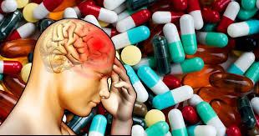
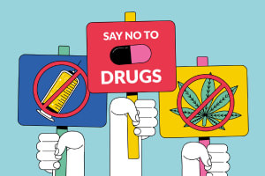
Drug Addiction Awareness Discourse
Educating people about the causes, effects, and
prevention of drug dependence.
Increasing public understanding of how drugs
abuse harms physical and mental health,
relationships, and society.

Slide 7

Social Media
In today’s world, social media plays a vital role in spreading drug addiction awareness.
Various social media platforms such as YouTube are used to share educational posts, personal recovery stories, and prevention campaigns.
Platforms help organizations and individuals quickly reach large audiences, challenge stigma, and encourage those with addiction to seek support.

Slide 8
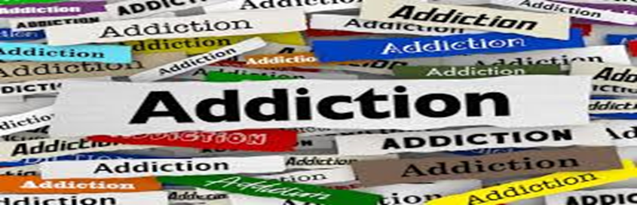
Objective of the Study The study aims at : - Investigating the most prominent language patterns in the drug addiction awareness videos? Research Question -What are the most prominent language patterns in the drug addiction awareness videos?

Slide 9

Data
The corpus consists of 50,000 tokens from four YouTube awareness videos (2015–2024).
The first video offers an overview of drug addiction and its treatment challenges (TED-Ed, 2024).
The second video raises awareness about the perils of addiction(TED, 2015).
The third addresses misconceptions surrounding drug addiction.
The final video features a public health expert discussing harm reduction strategies(TED Talk, 2018).

Slide 10
Corpus linguistics and the Corpus Tool
Corpus linguistics is an empirical approach to studying language that uses large, machine-readable collections of real-world text and speech, called corpora, to analyze patterns in language use.is a systematic method for analysing extensive collections of text, which helps uncover underlying linguistic structures and prominent language patterns(Hadi & Jaafar, 2025; Csomay &Crawford, 2024).
AntConc helps identify the language patterns associated with the target term.
Concordances and collocations.

Slide 11
Data & Methods
Semantic prosody
Metaphorical Framing Analysis: This technique examines how metaphors function as reasoning tools and framing devices in discourse. It looks at how attributes from one domain (e.g., war) are mapped onto another (e.g., addiction). Frame and metaphorical analysis combined with corpus linguistics

Slide 13
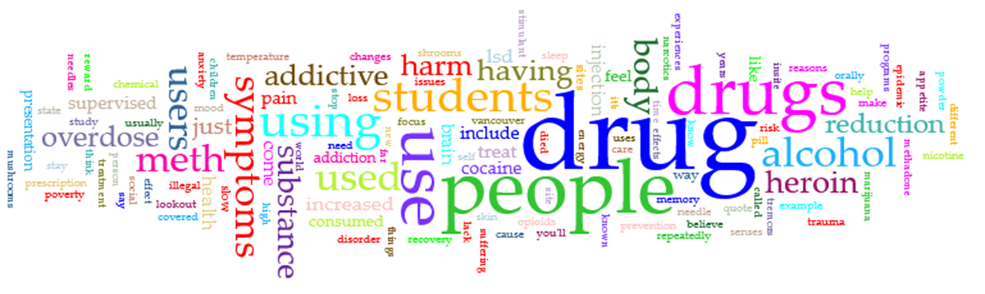
RESULTS AND DISCUSSION Several metaphors and frames shape the discussion around drug addiction in the selected corpus of the study, these include: Addiction as a "Battle" or "War" o "The battle against addiction" o "Fighting addiction" o "War on drugs" The "battle" frame suggests a conflict that must be won, which can reinforce punitive policies but also inspire hope for recovery.

Slide 14
Addiction as a "Disease" or "Health Condition":
"Drug addiction is a disease"
"Addiction treatment is healthcare"
"Recovery is possible with medical support"
"Addiction is an illness«
“Drug is a poison that kills ambition’’

Slide 15
Awareness drug addiction discourse and Stigma The corpus demonstrates a discourse rooted in harm reduction and empathy that decreases stigma The awareness discourse employs a compassionate and humanizing tone that reframes addiction as a public health issue rather than a moral failing or criminal act. This rhetorical shift mirrors current research showing that the way society talks about addiction directly influences stigma and treatment outcomes. Examples: “these drug users are our children,” “We must understand that as we approach people with so much trauma,” “Offering someone a clean needle or a safe place to inject is the first step to treatment and recovery”

Slide 16
CONCLUSION It is concluded that media language emphasizing harm reduction, scientific evidence, and humanization fosters a supportive language that reduces stigma. Corpus linguistic approach facilitates the identification of linguistic patterns that are associated with the target term “ drug addiction” . It is evident that substance or drug addiction is closely associated with negative connotations that delineate the dangers this addiction poses to individuals and society as a whole.

Slide 17
References Biber, D., Conrad, S., & Reppen, R. (1998). Corpus linguistics: Investigating language, structure and use. Cambridge University Press. Brookes, G., & Collins, L. C. (2023). Corpus linguistics for health communication: A guide for research. Routledge. Colman, A. (2019). Drugs and the addiction aesthetic in nineteenth century literature. Palgrave Macmillan. Csomay, E., & Crawford, W. J. (2024). Doing corpus linguistics (2nd ed.). Routledge. Hadi, M. A., & Jaafar, E. A. (2025). A corpus linguistic study of drug addiction perils in William Burroughs’ Junky. Midad Al-Adab Journal, 15(40) 2723- 2754 https://doi.org/10.58564/ma.v15i40.1853 Masenga, P. P. (2017). The impact of drug abuse on academic performance in public secondary schools in Kishapu District, Tanzania (Master's dissertation). The Open University of Tanzania. http://repository.out.ac.tz/id/eprint/1985 Who (2024, June 25). https://www.who.int/teams/mental-health-and-substance-use/alcohol-drugs-and-addictive-behaviours/monitoring Teachings in Education. (2020, April 16). Student drug and alcohol awareness [Video]. YouTube. https://www.youtube.com/watch?v=HxXgVbYXVEs TED. (2015, July 9). Everything you think you know about addiction is wrong | Johann Hari | TED [Video]. YouTube. https://www.youtube.com/watch?v=PY9DcIMGxMs TED. (2018, May 9). The harm reduction model of drug addiction treatment | Mark Tyndall [Video]. YouTube. https://www.youtube.com/watch?v=cfzkBGgxXGE TED-Ed. (2024, March 19). What causes addiction, and why is it so hard to treat? - Judy Grisel [Video]. YouTube. https://www.youtube.com/watch?v=hBC7i-vHWsU

