Slide 1
Sustainability From the Cognitive Linguistic Perspective
Asst. Prof. Dr. Rana H. Al-Bahrani & the MA Candidate, Fanan Faris Sabah

Slide 2
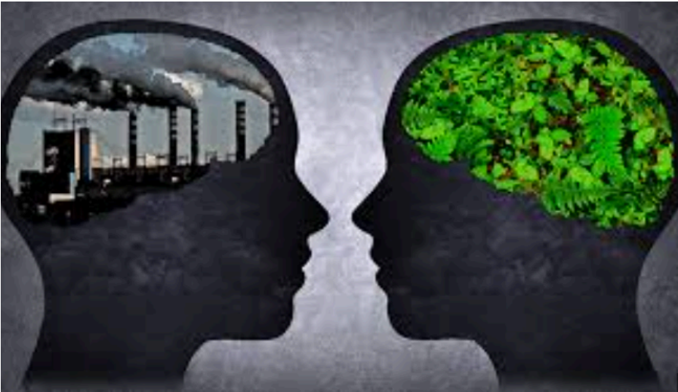
The Concept of Sustainability
https://www.queenelizabeths.kent.sch.uk/assets/Documents/Attachments/Agnes-M-Economics-Essay.pdf
The core concept of sustainability is the notion that human growth

Slide 3

The Concept of Sustainability
For Brundtland (1987), this definition emphasizes how social and economic progress must coexist with environmental preservation.
https://dornsife.usc.edu/wrigley/2024/12/17/green-growth-and-sustainable-consumption/
Notes:
These three factors are often referred to as the "three pillars" of sustainability

Slide 4
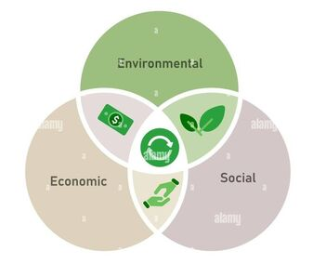
The Concept of Sustainability
The economic, social, and environmental, has become the basis for the long-term well-being of the planet and the human race (Sakalasooriya, 2021).
https://www.mrgscience.com/ess-subtopic-13-sustainability.html

Slide 5

The Concept of Sustainability
sustainability is a moral duty and a guiding principle for taking care of the living world, present and future, by enjoying the planet's resources.
https://www.c-mw.net/sustainability-a-moral-responsibility-and-it-starts-with-us/

Slide 6
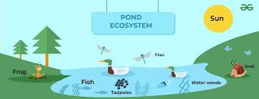
Sustainable Linguistics
Sees language systems as living, interdependent parts of our human and environmental environments.
https://www.geeksforgeeks.org/social-science/what-is-an-ecosystem-how-do-human-beings-influence-ecology/
Notes:
Linguistic competence and ecological ethical consciousness

Slide 7
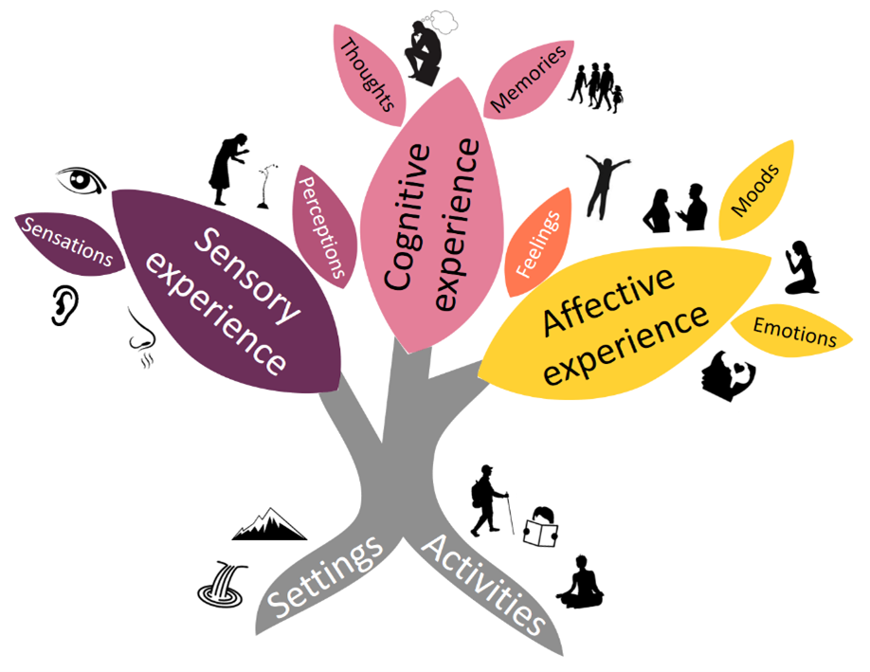
Sustainable Linguistics
According to this theory, language is similar to an ecosystem in that it is dynamic, flexible, and dependent on diversity to survive.
https://relationalthinkingblog.com/2021/12/08/plain-language-summary-it-is-not-all-in-your-head-why-sensing-and-feeling-are-as-important-as-thinking-for-cultural-ecosystem-services/
Notes:
Linguistic competence and ecological ethical consciousness

Slide 8
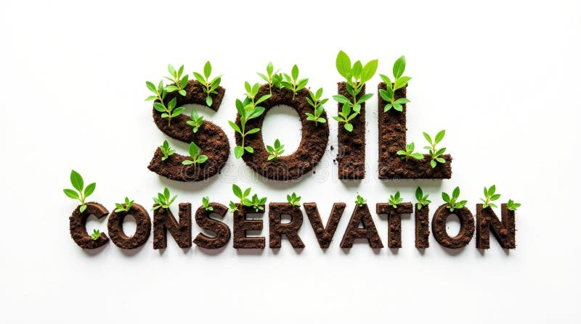
Sustainable Linguistics
The soil in which our ideas about the world take root, influencing people's views and actions toward the natural world.
https://www.dreamstime.com/illustration/soil-conservation.html
Notes:
Linguistic competence and ecological ethical consciousness

Slide 9
Sustainable Linguistics
Ecolinguistics demonstrates how language and metaphor impact environmental actions. Gul (2025) argues that the way we express ourselves in language can promote or sustain environmental exploitation
Notes:
Linguistic competence and ecological ethical consciousness

Slide 10
Sustainable Linguistics
Thinking
Teaching
Living
1
2
3
Notes:
Linguistic competence and ecological ethical consciousness

Slide 11
Sustainability in Language Studies
Environmental Awareness
Enhancing Cultural Values
Providing global challenges-based resources
4
5
6

Slide 12

Sustainability in Language Studies
The use of activities, resources, and conversations that relate the process of language acquisition to in actual world obstacles and to understanding of other cultures
language programs
Classroom design
7
8
9

Slide 13
Sustainability in language studies refers to the practice of teaching language for the world rather than teaching language about the world

Slide 14
Match the idiom to what its meaning:
Speak the same language
Actions make change
Shows how language reflects values, history, and truth — worth preserving.
"Keep the flame alive"
Highlights the power of shared understanding; also implies the danger of monolingual thinking
Words carry weight
Pass the torch
Encourage continuous use and teaching of a language.
"Where there’s a will, there’s a way
Represents passing language and culture to younger generations.

Slide 15
Sustainability From the Cognitive Linguistic Perspective
Asst. Prof. Dr. Rana H. Al-Bahrani & the MA Candidate, Fanan Faris Sabah

Slide 16
References
Al-Nagheya, M. (2023). Approaching Sustainable Linguistic Development via Addressing Digital Natives' L1 Dominance in EFL Writing. Journal of Sustainable Development in Social and Environmental Sciences, 2(1), 16-30. doi: 10.21608/jsdses.2023.184589.1013
Bastardas-Boada, A. (2014). Linguistic sustainability for a multilingual humanity. Sustainable Multilingualism, 5, 134–149. https://doi.org/10.7220/2335-2027.5.5
Gul, W., Abadgewd Elismariy, W. A., & Riaz, B. (2025). Eco-linguistics and sustainability: Language as a tool for environmental responsibility. ASSA Journal, 4(1), 1776–1787. https://doi.org/10.55966/assaj.2025.4.1.097
Hall, S., & Liebenberg, L. (2024). Qualitative description as an introductory method to qualitative research for master’s-level students and research trainees. International Journal of Qualitative Methods, 23, 1–5. https://doi.org/10.1177/16094069241242264
Kuhlman, T., & Farrington, J. (2010). What is sustainability? Sustainability, 2(11), 3436–3448. https://doi.org/10.3390/su2113436
Lim, W. M. (2024). What Is Qualitative Research? An Overview and Guidelines. Australasian Marketing Journal, 33(2), 199-229. https://doi.org/10.1177/14413582241264619 (Original work published 2025)
Maijala, M., Gericke, N., Kuusalu, S.-R., Heikkola, L. M., Mutta, M., Mäntylä, K., & Rose, J. (2024). Conceptualising transformative language teaching for sustainability and why it is needed. Environmental Education Research, 30(3), 377–396. https://doi.org/10.1080/13504622.2023.2167941

