Slide 1




Linguistics and Environmental Sustainability Subtitle: A Systematic Review of How Education and Media Discourse Address Environmental Pollution
Dr. Nawal Fadhil Abbas & Noor Ahmed Symposium: Linguistics and Sustainable Development Goals

Slide 2



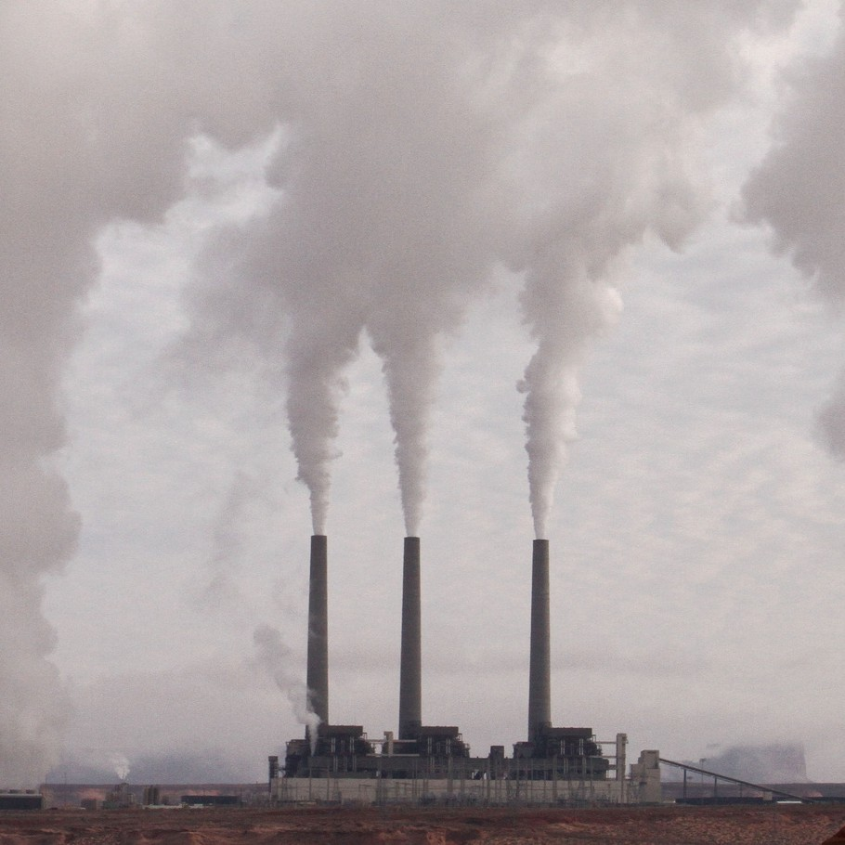

Introduction
Environmental pollution is a global concern that transcends science and policy.
Linguistics contributes by studying how language frames ecological responsibility.
Ecolinguistics (Stibbe, 2015) views language as an
ecological tool.
Environmental studies require a multidisciplinary framework that integrates scientific, political, and media perspectives (Dryzek, 2013)
There is a need for synthesis: studies are
scattered across media, education, and discourse.

Slide 3









Methodology
Systematic review (Feb–Apr 2025).
Initial pool: 230 → 31 final studies.
Thematic categories: Media discourse Educational discourse
Ecolinguistic & metaphorical
analysis
Eco-neologisms

Slide 4





Findings – Media Discourse
Media framing shapes public understanding of environmental issues. Common metaphors: war, battle, resilience, adaptation (Skinnemoen, 2009; Schäfer & O’Neill, 2017).
“climate change is war”
Risks: oversimplification, greenwashing (Zanaty, 2023).
Positive narratives also appear: Baral et al. (2024) show that Nepali media promotes hopeful, solution-oriented stories that raise awareness and motivate public action on climate issues.
Local examples promote civic pride and communal identity (Maseko & Siziba, 2024).

Slide 5




Findings – Educational Discourse
Environmental themes are underrepresented in textbooks (Kosasih, 2016; Chen & Zhi, 2024).
In the Cerdas Berbahasa textbooks(Kosasih, 2016,2017):
Grade X: 1 of 56 themes (1.8%) on environmental issues.
Grade XI: 7 of 29 themes (17.2%) on environmental issues. When included, they reflect institutional ideology, not action.
Education can cultivate ethical and emotional engagement with sustainability.

Slide 6





Dicussion&Conclusion:
Media and education jointly shape public ecological understanding. Media: raises visibility but may obscure accountability.
Education: fosters ethics and long-term ecological values.
Language via both can reveal and conceal environmental issues. Sustainability is also a linguistic concern — words shape awareness and action.
Calls for critical, inclusive, sustainability-driven communication.
Together, education and media can transform how societies talk, teach, and imagine the environment.

Slide 7





Suggestions:
Encourage ecolinguistic themes in education and teacher training.
Promote responsible media framing and avoid greenwashing.
framing environmental topics not just as knowledge, but as actionable values that promote collective responsibility.
Foster collaboration between linguists, educators, and environmental policymakers.

Slide 8




Thank you!

