Slide 1
Embedding Green Teaching Practice: A Linguistic Approach
Aalaa Yaseen Hassan
University of Baghdad/ College of Education for Women.

Slide 2
Introduction
This study aims to demonstrate the awareness of integrating green teaching within educational settings by utilizing nature-based education and environmentally friendly materials within the linguistic approach.
It highlights the importance of using a curriculum that includes health, safety, and natural environmental systems within academic settings.
Such teaching will help develop a student's critical thinking and more considerate conduct toward the environment.
These educational practices help students achieve better academic results and develop the necessary attitudes and skills for responsible citizenship.

Slide 3
Linguistics and Sustainability
• Ecolinguistics examines how language influences our relationship with nature.
• Example: shifting from 'exploiting resources' to 'protecting ecosystems'.

Slide 4
Sustainability and Development
Pedagogy: Methods encouraging discussion and reflection on teaching; includes peer education and holistic learning (YAFNAW, 2023; Hirst, 1975).
Holistic Learning: Integrates ecological, social, economic, and worldview dimensions to foster sustainability awareness (United Nations, 1987).
Systems Thinking: Emphasizes interconnectedness of society, environment, and individuals; forms the basis of sustainable development (Ward & Dubos, 1972; Meadows, 2009).
Adventure-Based Learning: Enhances intrapersonal skills, leadership, and pro-environmental behaviors (Priest, 1990; Martin et al., 2020).
Civic Participation: Engages youth in governance, community service, and environmental action to create socially responsible leaders (Michelsen et al., 2002; YAFNAW, 2023).

Slide 5
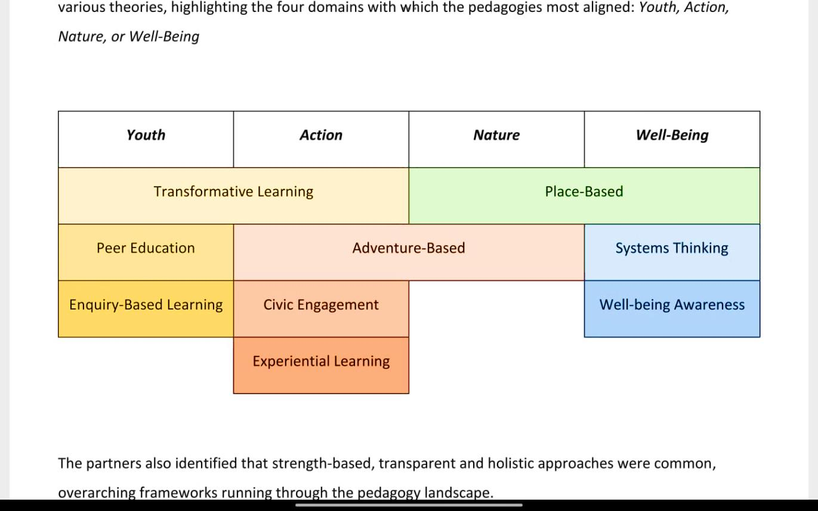

Slide 6
Green Pedagogy & Sustainable Education
Definition & Goal: Green pedagogy integrates environmental awareness, sustainability, and active learning to develop eco-conscious knowledge, perspectives, and principles (Chatterjee & Gol, 2024; Aithal & Rao, 2016).
Methods: Reflection, collaboration, analysis, discussion, study trips, recycling, composting, and problem-solving activities.
Learning Principles:
  Learner-centered, interactive, self-directed, and metacognitive (Vygotsky, Piaget, Weinert).
  Encourages conceptual change, inquiry-based learning, and accommodation of new knowledge.
Complex Systems & System Competency:
  Understanding interconnected environmental, social, and economic systems (De Haan & Harenberg, 2008; Luhmann, 1984).
  Knowledge as multidimensional resource: practical, interactive, identity, orienting.

Slide 7
Competency-Based Approach:
  Focuses on social, emotional, analytical, and creative skills.
  Promotes multi-perspectivity, collaboration, reflection, and problem-solving (Heyse & Erpenbeck, 2008; Büchter, 2008).
Implementation: Micro-didactic exercises addressing environmental, financial, and social challenges through individualized, reflective, and collaborative learning (Forstner-Ebhart, 2018).
Takeaway: Green education fosters sustainable thinking, system competence, and self-regulated learning to prepare students for ecological, social, and economic challenges.

Slide 8
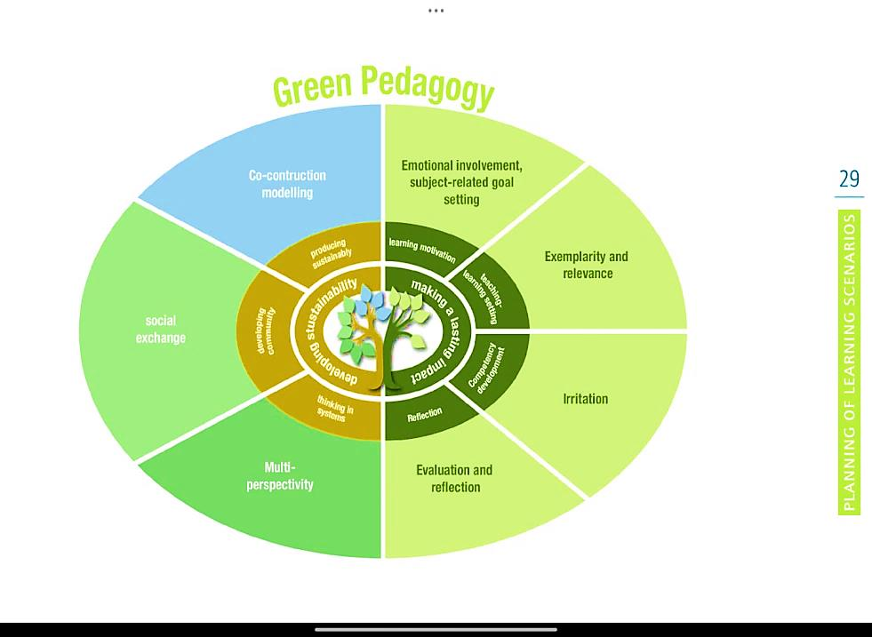

Slide 9
Embedding Green Practices in the Classroom
• Practical steps:
– Use digital tools instead of paper.
– Integrate environmental themes across subjects.
– Encourage collaboration and critical thinking about sustainability.

Slide 10
Green Pedagogy in Practice
Being part of global sustainability actions, such as using digital copies instead of hard copies, reducing plastic consumption, and using eco-friendly packaging, is crucial for creating a peaceful climate for learning.
Both teachers and students need to work together to find solutions to ecological problems from an educational perspective (Riordan & Klein, 2010).
Therefore, learners should focus on improving their skills and knowledge and maintaining better environmental settings (Hauschild et al., 2012).

Slide 11
Case Study / Example
In this study, the researchers will present the University of Exeter's Environment and Climate Emergency Policy Statement as a model for Iraqi universities and discuss its applicability.

Slide 12
Challenges and Opportunities
Challenges:
• Limited training and resources.
• Digital inequality and infrastructure gaps.
Opportunities:
• Professional development for teachers.
• Interdisciplinary collaboration.
• Global movement for sustainable education.

Slide 13
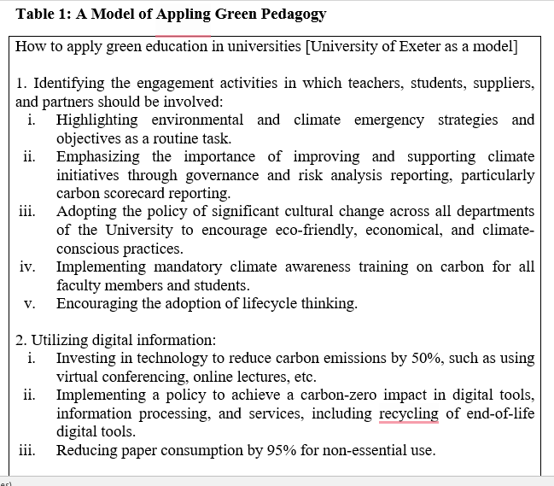

Slide 14
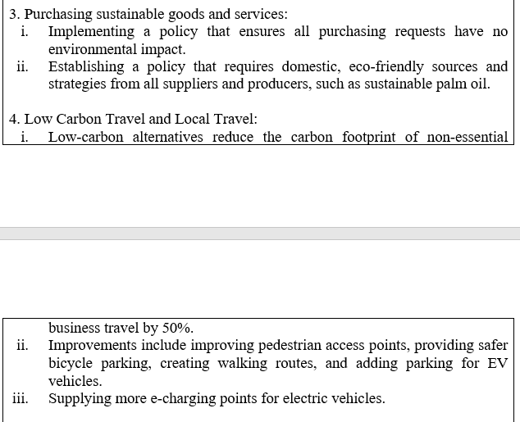

Slide 15
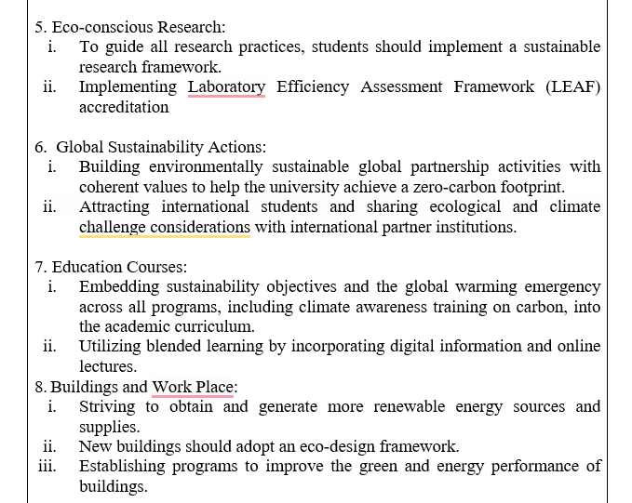

Slide 16
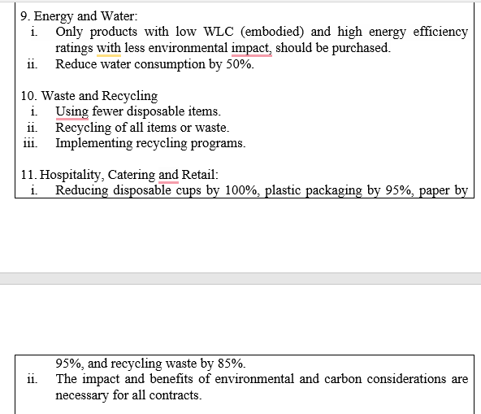
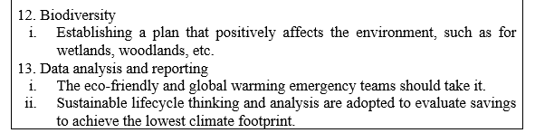

Slide 17
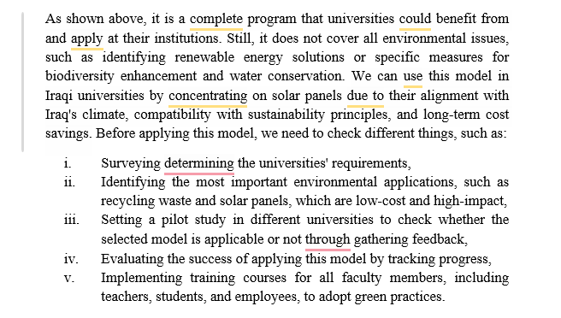

Slide 18
Conclusion and Recommendations
• Green teaching connects environmental responsibility with language use
University of Exeter Model for Green Pedagogy
Comprehensive Sustainability Program: Integrates teaching, research, campus operations, and governance.
Key Practices: Climate awareness, digital & low-carbon solutions, eco-friendly buildings, waste reduction, biodiversity, and sustainability in curricula.
Collaboration: Teachers, students, and partners work together on ecological challenges.
Application in Iraq:
  Focus on solar panels for climate suitability and cost-effectiveness.
  Steps: survey → identify applications → pilot study & feedback → evaluate → training.
Outcome: Develops critical thinking, environmentally responsible behavior, and a holistic eco-conscious learning environment.

Slide 19
“Language shapes the world we wish to sustain.”

