Slide 1
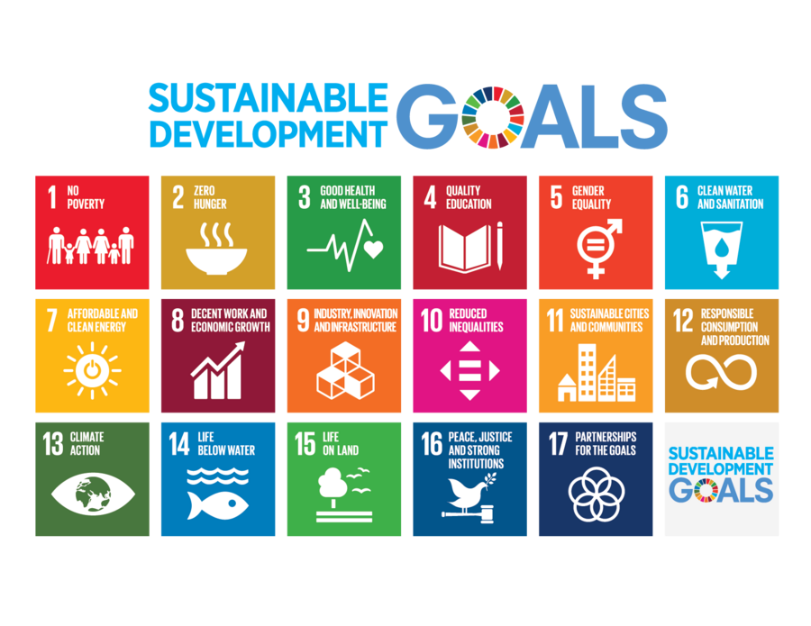
The Role of Linguistics in Promoting Sustainable Development
Prof. Dr. Huda Hadi Khalil
& MA Candidate
Mariam Mohammed Jasim

Slide 2
Sustainable Development
Sustainable development means meeting our current needs without harming the ability of future generations to meet their own. It includes environmental protection, economic growth, and social equality.

Slide 3


Most people tend to associate sustainability primarily with fields such as science or technology, as well as with practices like recycling, and the use of green energy. However, language and communication are just as important. Language shapes how we think, how we share knowledge, and how we work together. So, linguistics, the scientific study of language, can actually help us achieve many of the United Nations’ Sustainable Development Goals (SDGs).

Slide 4
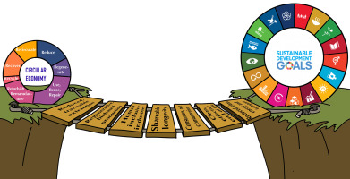
1. Bridging Communication Gaps in Multilingual Societies
Around the world, people speak over 7,000 languages, according to UNESCO. Many of them are spoken by small communities, and some are disappearing fast.
This diversity is beautiful, but it also creates communication barriers. For development programs to work, everyone needs to understand information about health, education, safety, or climate.
Linguists help by studying and documenting local languages so governments and organizations can communicate more effectively.
For example, during health campaigns in Africa and Southeast Asia, information about diseases like COVID-19 or malaria was translated into local languages, making it easier for people in rural areas to understand and follow safety instructions.

Slide 5

2-Preserving Indigenous Knowledge and Cultural Heritage
Many indigenous languages carry centuries of knowledge about the environment, plants, farming, and medicine. When these languages disappear, this wisdom can be lost forever. Linguists document endangered languages by creating dictionaries, recording stories, and studying grammar to preserve cultural and ecological knowledge.
Example: Quechua and Aymara in the Andes have special words for weather and soil that help farmers manage crops sustainably.

Slide 6

3. Promoting Multilingual Education for Equity and Inclusion
Education is a key tool for sustainable development, but children often struggle if taught in a language they don’t speak at home. Linguistic research shows that learning in one’s mother tongue improves understanding, keeps students in school longer, and boosts performance.
Example: Ethiopia and Papua New Guinea improved literacy and reduced dropout rates by using local languages in schools.

Slide 7

4- Enhancing Climate Action through Linguistic Research
Climate change is a major global challenge, but solutions rely on clear communication. Scientific terms are often complex, so linguists translate them into local languages, helping communities act, for example, understanding drought warnings or recycling rules.
Linguistics also preserves traditional ecological knowledge. Many indigenous communities have words for local animals, weather, and land management that scientists can learn from.
Example: The Sami people in Northern Europe have over 100 words for snow, which helps scientists track Arctic environmental changes.

Slide 8

5-Facilitating Economic Development through Cross-Cultural Communication
Economic growth often involves communication across cultures and languages in business, trade, or technology.
Linguistics helps make this possible by improving cross-cultural communication.
For example, businesses use linguists to localize their products, not just translating words but adapting messages to fit local culture.
Think of mobile phone companies that design multilingual apps for Africa or Asia, allowing users to access technology in their own language. That’s linguistic inclusion supporting economic growth.

Slide 9

6. Supporting Social Inclusion and Gender Equality
Language shapes how people see the world and treat others. Linguists promote gender-neutral terms to reduce bias and protect minority languages, ensuring everyone feels respected.
By making language fair and inclusive, linguistics helps build societies where no one is left behind, supporting equality, social justice, and sustainable development

Slide 10

7. Advancing Technological Innovation for Sustainability
Linguistics is crucial for technology. Tools like AI, translation apps, and voice assistants rely on linguistics to understand human language. Linguists help design these tools so everyone, regardless of language, can access information.
For example, a farmer can use a voice assistant in their local language to get weather or farming advice. This makes technology inclusive, reduces inequality, and supports innovation and sustainable living.

Slide 11

8. Strengthening Global Collaboration through Language Policy
International cooperation requires clear and fair communication, and language policy is key. Linguists help design policies that respect all languages and encourage participation.
For example, the European Union recognizes 24 official languages, allowing citizens to speak and access information in their own language.
By valuing all languages, linguistics promotes unity in diversity, helping countries work together toward global sustainability and peace.

Slide 12
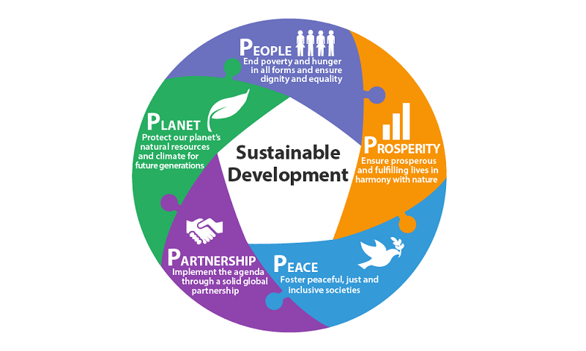
THANK YOU

