Slide 1

How to Use Artificial Intelligence with Machine Learning in Analyzing Scientific Research Data
Presented by Dr. Ahmed Abduljabbar Jasim
University of Baghdad
College of Agricultural Engineering Sciences
Department of Soil Sciences and Water Resources

Slide 2
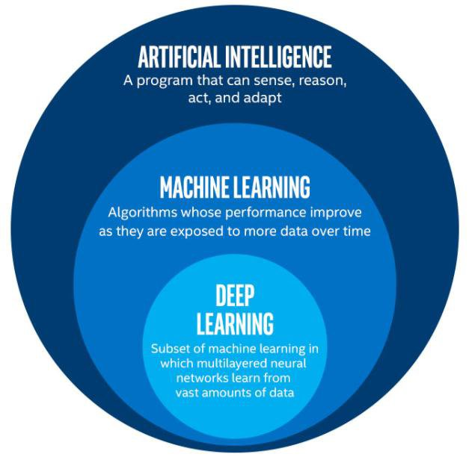
Artificial Intelligence (AI): The science of building machines capable of intelligent behavior.
Machine Learning (ML): A branch of AI that focuses on systems learning from data.

Slide 3
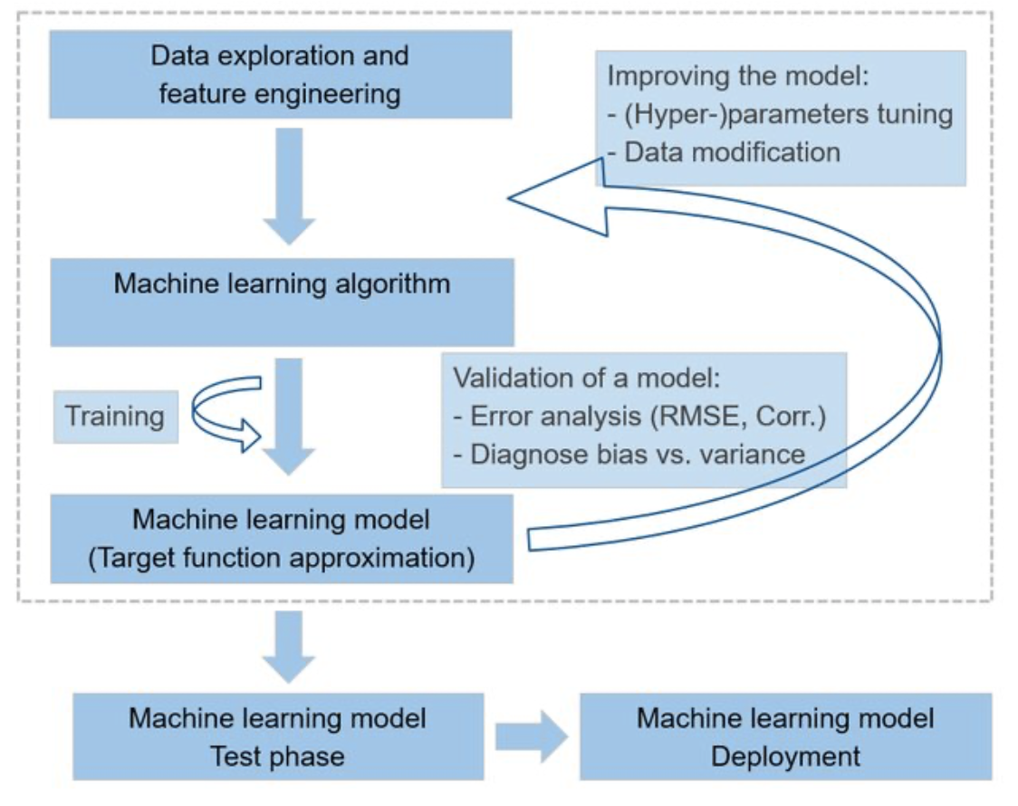
Why AI Enhances Machine Learning
AI strengthens ML by:
Automating feature engineering.
Improving model accuracy with advanced algorithms.
Handling complex data like images, videos, and text.

Slide 4
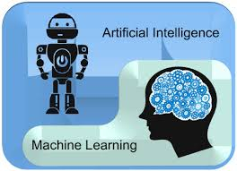
Core Steps in AI-Driven Machine Learning
Data Preparation: AI cleans and organizes raw data efficiently.
Model Development: AI assists in selecting and optimizing models.
Deployment: Enables real-time analytics and adaptation.
Monitoring: AI ensures models stay accurate over time.

Slide 5
Code Generation & Auto-Completion – AI-powered tools like GitHub Copilot and ChatGPT can suggest or generate R code, speeding up development.
Bug Detection & Debugging – AI can help identify errors, suggest fixes, and optimize performance in R scripts.
Data Analysis & Visualization – AI can generate complex R plots, statistical analyses, and summaries based on user input.
Automating Repetitive Tasks – AI can assist in automating data cleaning, transformation, and workflow automation in R Studio.
Learning & Documentation – AI can explain functions, suggest best practices, and provide real-time documentation to improve coding efficiency.

Slide 6

Real-World Applications of AI in R
Automated Data Cleaning – AI can detect missing values, outliers, and inconsistencies, making data preprocessing more efficient
AI-Assisted Statistical Analysis – AI tools can suggest appropriate statistical models, run simulations, and interpret results
Machine Learning & Predictive Modeling – AI can help build, tune, and optimize machine learning models in R

Slide 7
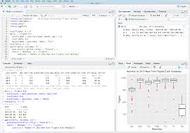
Popular AI Tools for R
GitHub Copilot – Provides real-time code suggestions and auto - completion based on context.
ChatGPT & Other LLMs – Can generate R code, explain functions, and debug errors.
R Packages with AI Integration – Libraries like caret (machine learning), tidymodels (modeling), and keras(deep learning).

Slide 8
Future of AI in R Programming
AI-Driven Code Optimization – Future AI tools may suggest more efficient code and resource management strategies.
Automated End-to-End Data Science Pipelines – AI may handle everything from data ingestion to model deployment.
Enhanced AI Collaboration – Integration of AI with RStudio and other IDEs for seamless, intelligent coding assistance.

Slide 9


