Slide 1



Microsoft copilot in power point
Presented by dr.shaima jabbar

Slide 2

Introduction
Microsoft Copilot is an AI-powered assistant integrated into Microsoft 365 apps.
In PowerPoint, it helps users create, edit, and refine presentations with natural language prompts.
Saves time, enhances productivity, and improves presentation design.

Slide 3
How it work
Open PowerPoint.
Click the Copilot icon.
Choose: Create, Summarize, Rewrite, or Q&A.
Enter your prompt or file.
Review and refine the AI-generated slides.

Slide 4
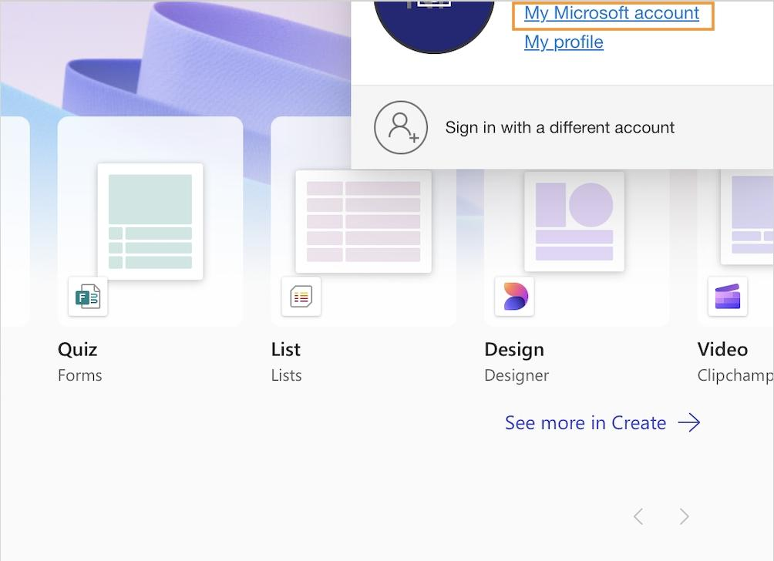

Slide 5
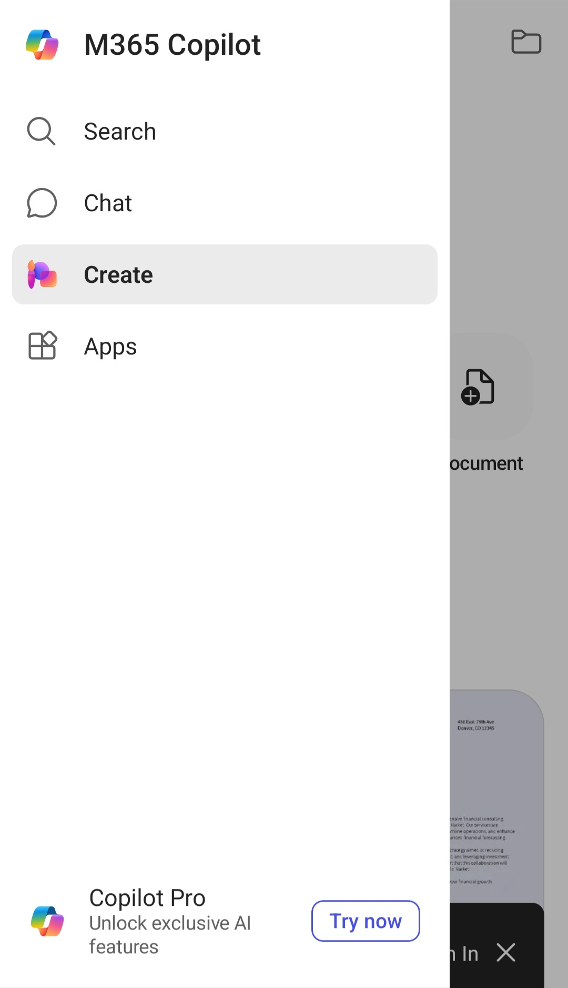
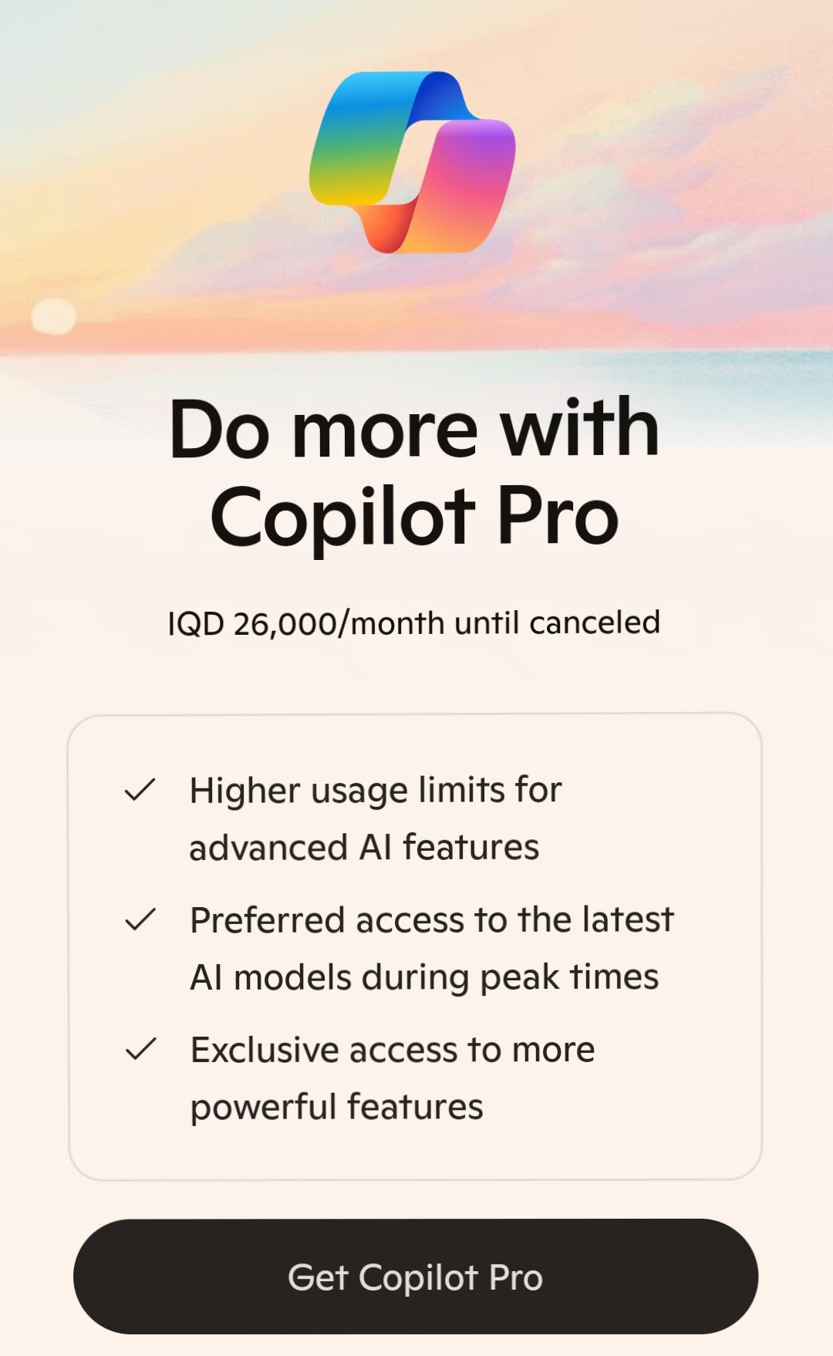

Slide 6
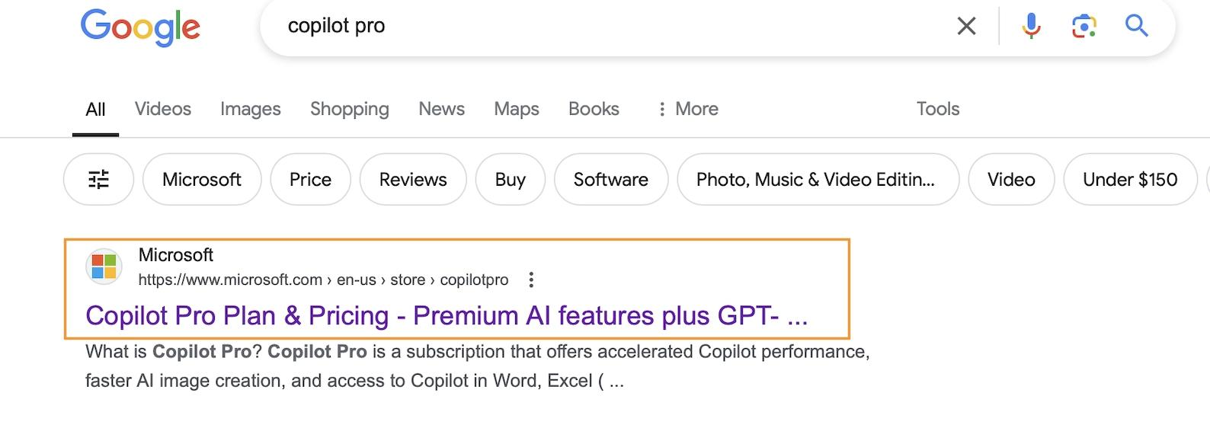

Slide 7
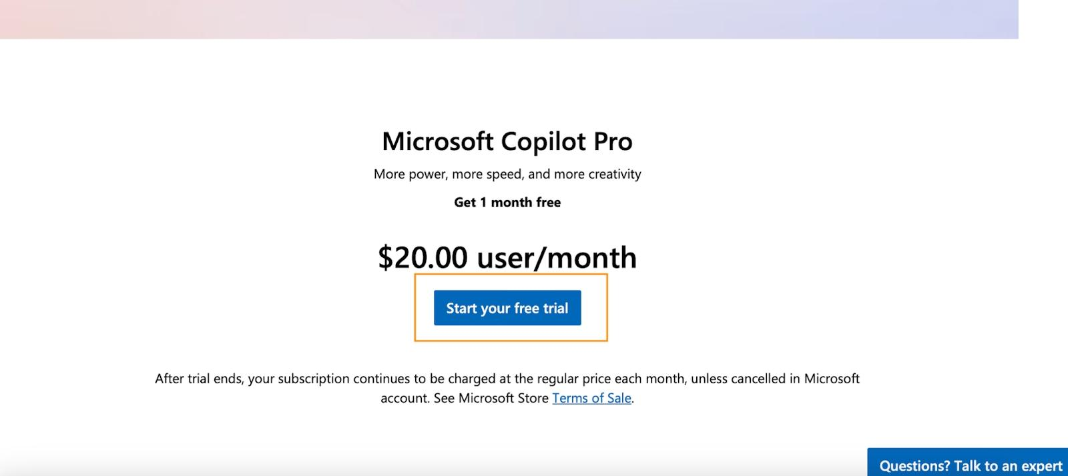

Slide 8
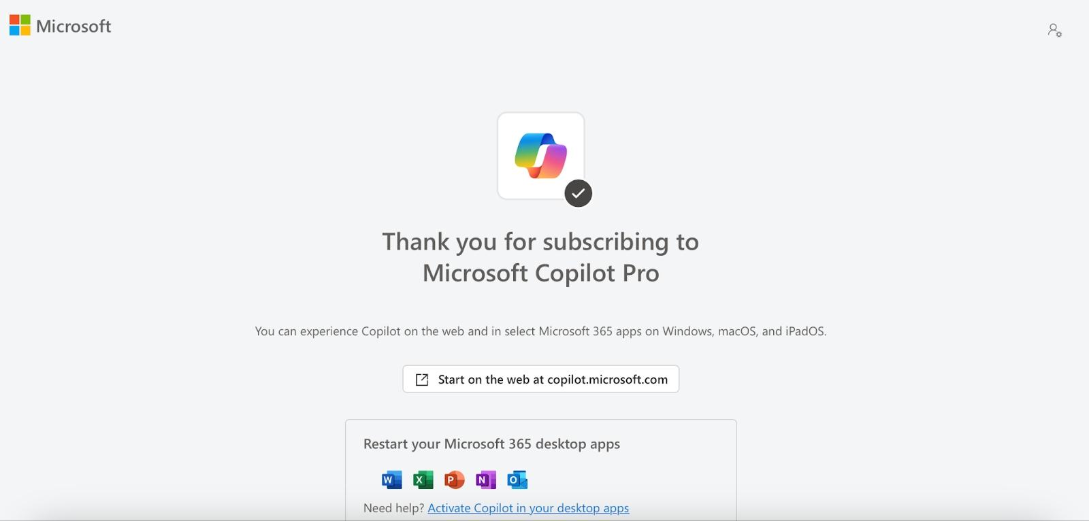

Slide 9
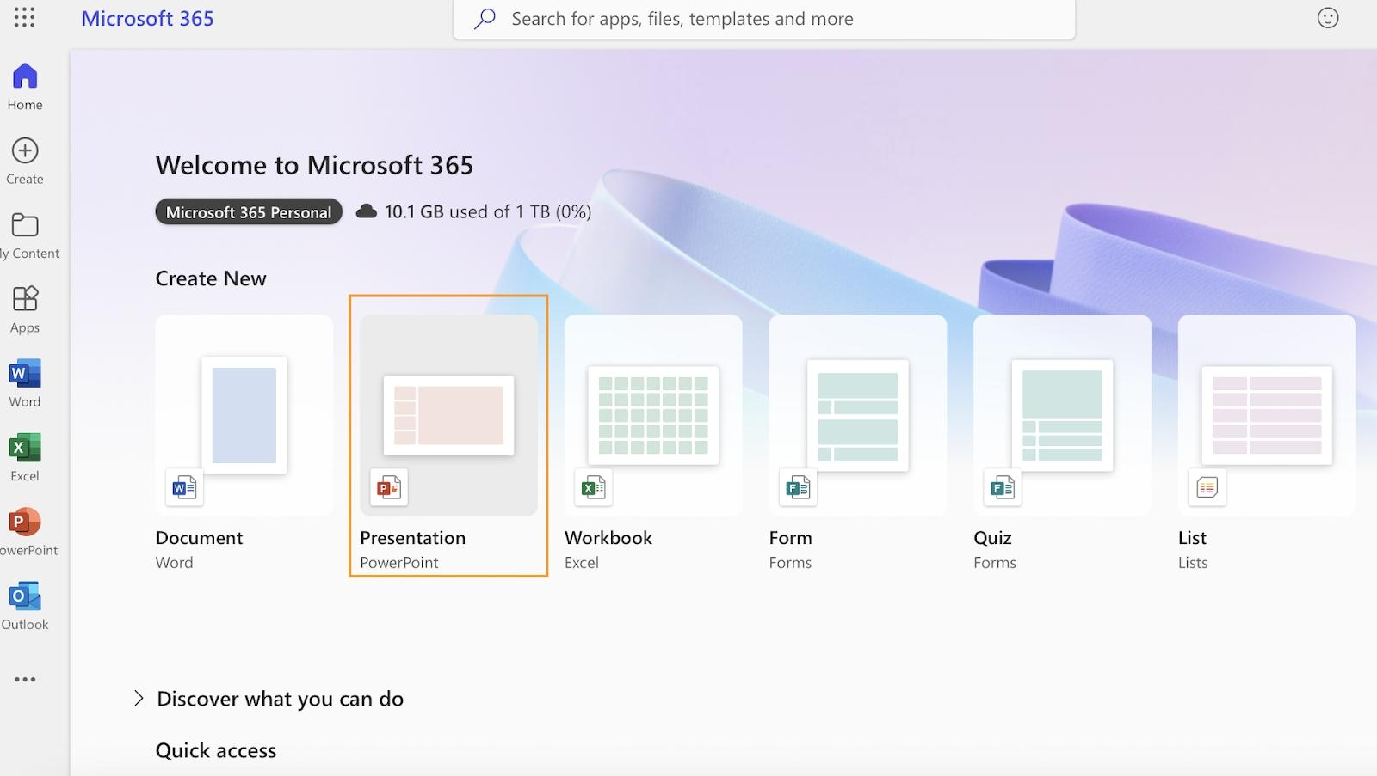

Slide 10
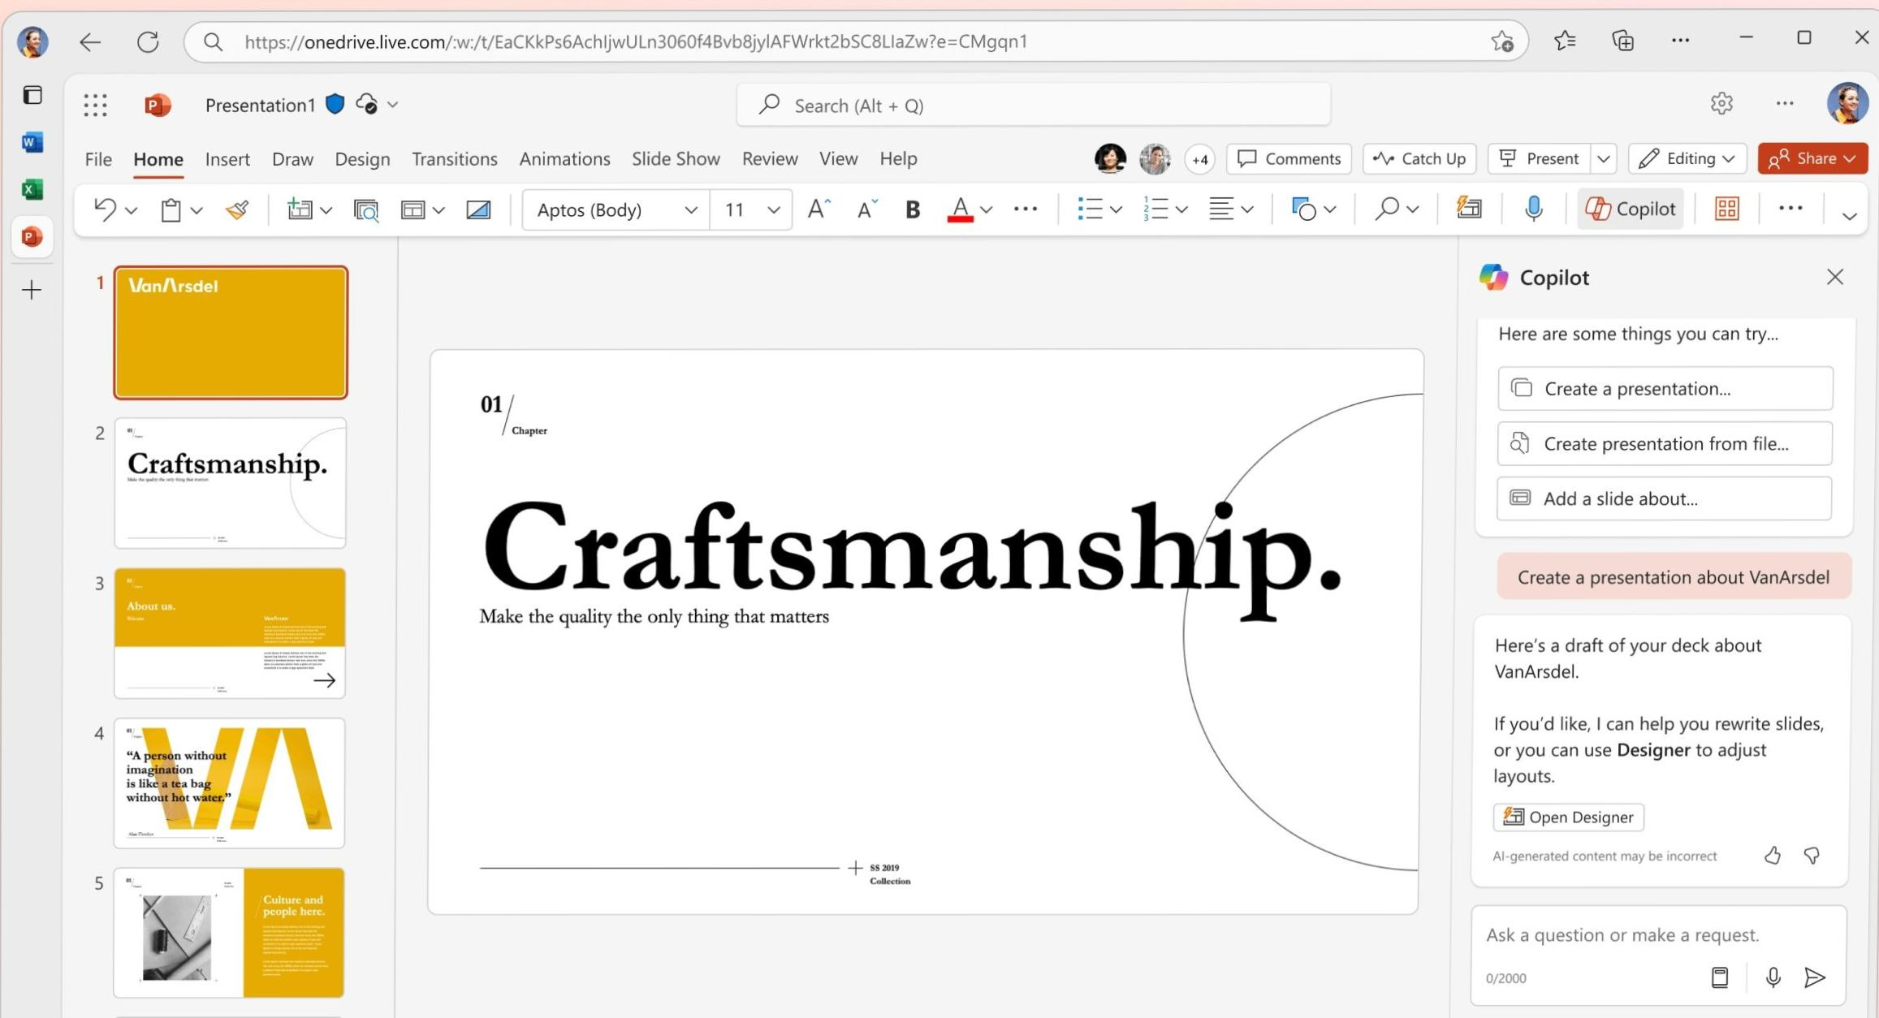

Slide 11
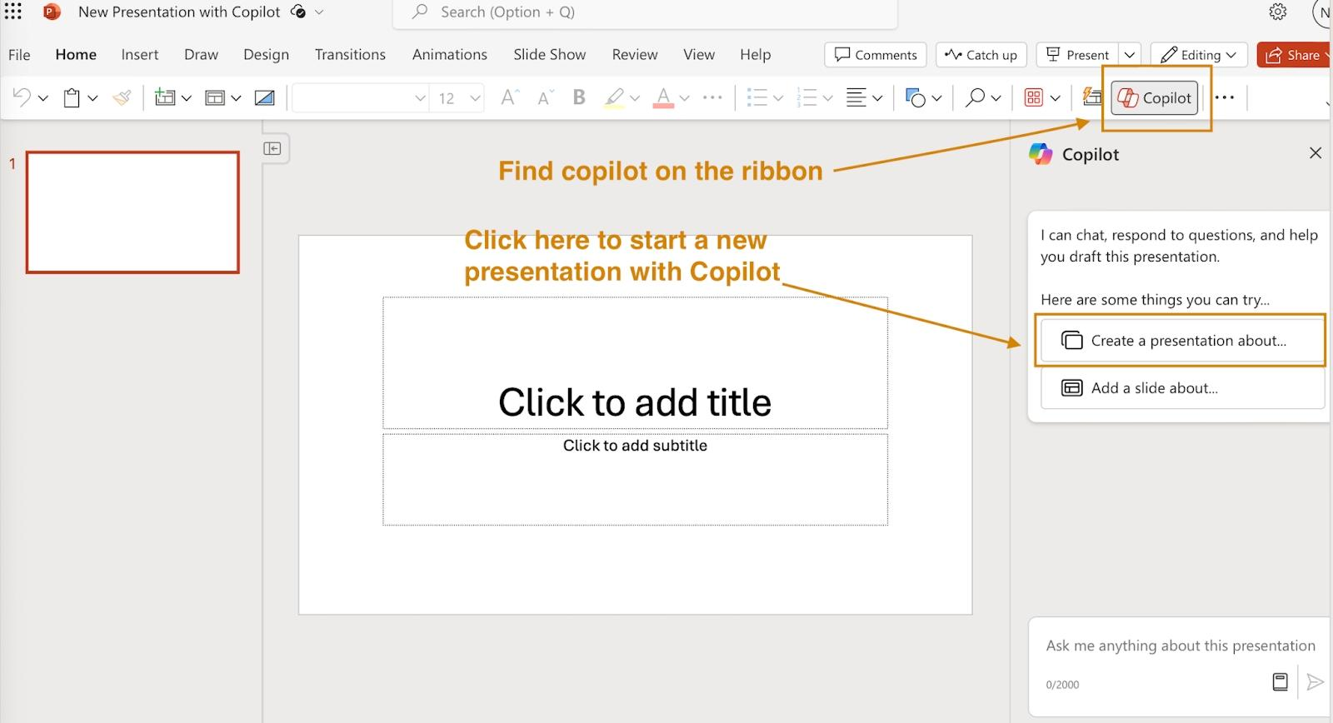

Slide 12
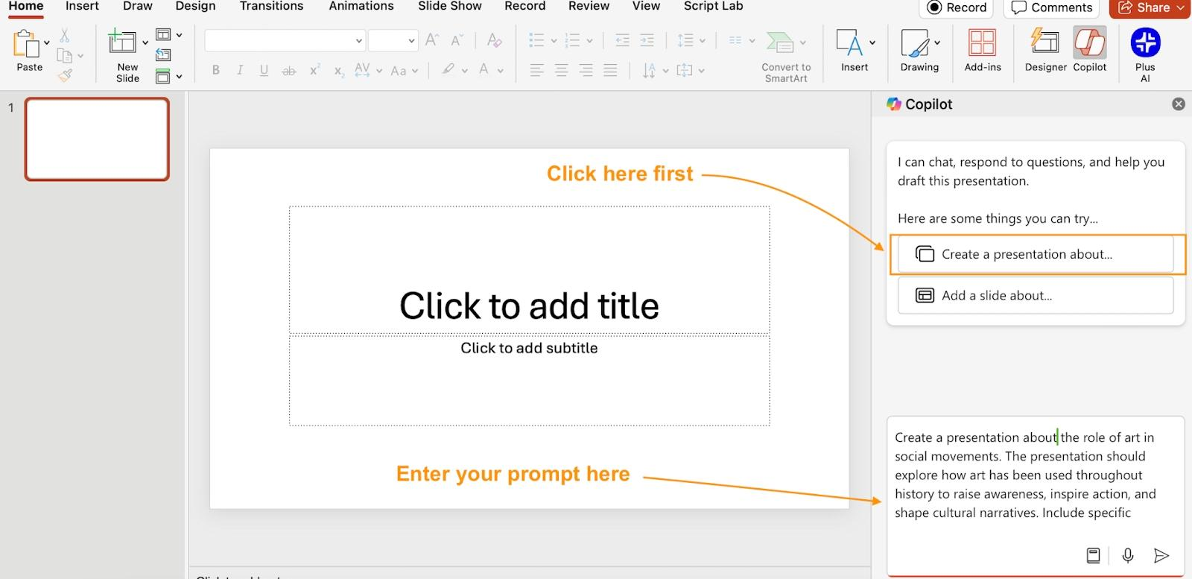

Slide 13
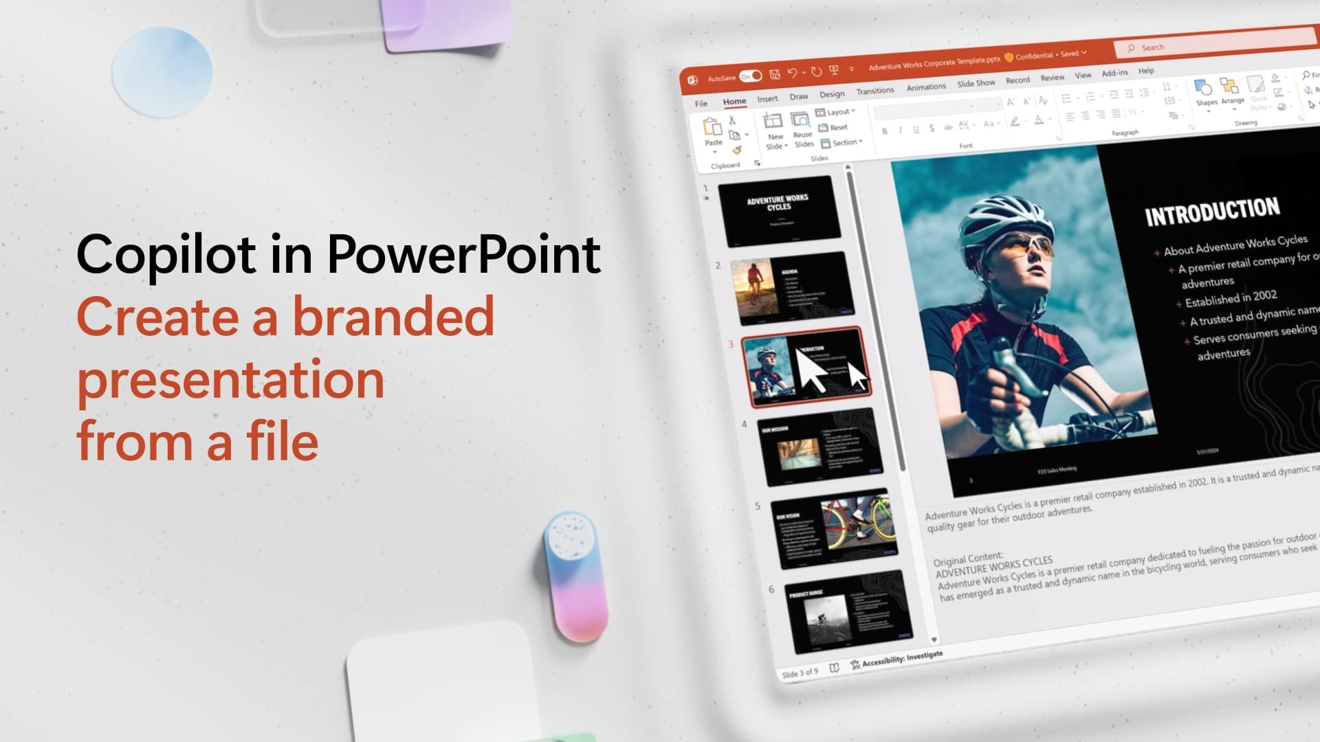

Slide 14
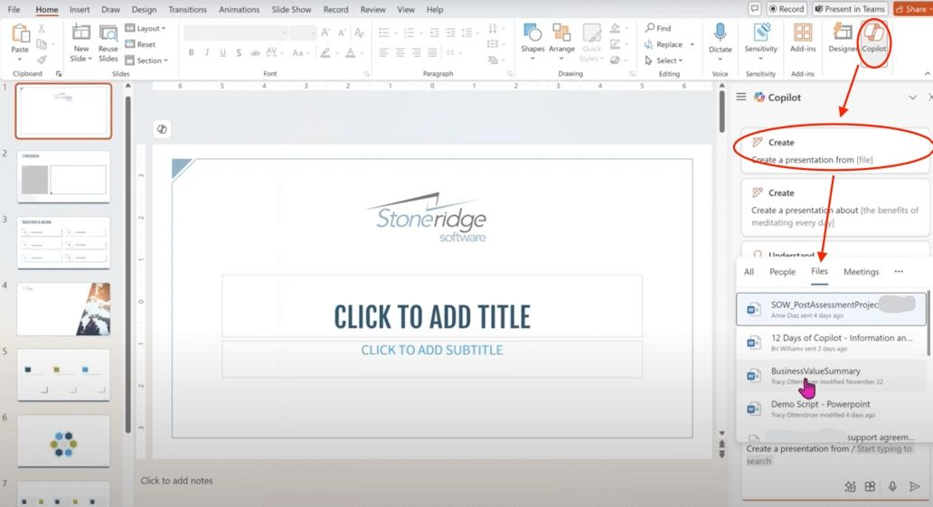

Slide 15


