Slide 1

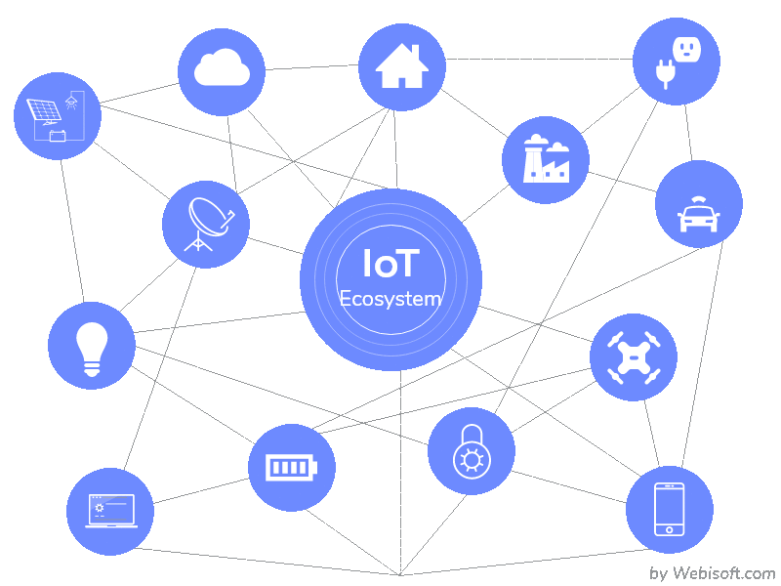
Security over IoT Technology
By:
Dr. Ahmed Noori Al-Naami

Slide 2

Introduction to IoT
IoT Applications
IoT Security Practices

Slide 3
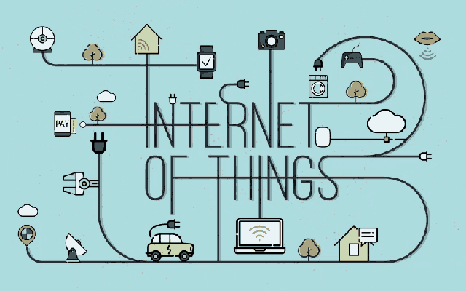
INTRODUCTION
IoT or Internet of Thing is influencing our lifestyle from the way we react to the way we behave.
IoT is a giant network that with connected devices.
These devices gather and share data about how they are used and the environment I which they are operated.

Slide 4
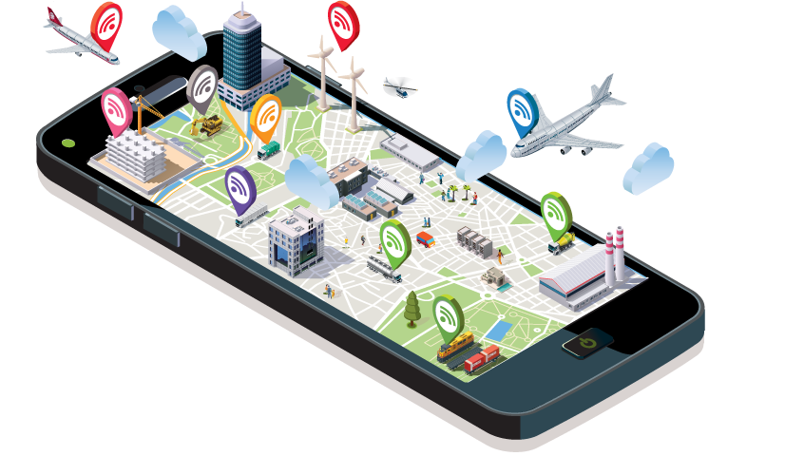
INTRODUCTION
These sensors continuously emit data about the working state of the devices.
It is all done using sensors that are embedded in every physical devices like:
Mobile phone
Electrical appliances
Traffic lights.
and everything that you come across in day to day life.

Slide 5
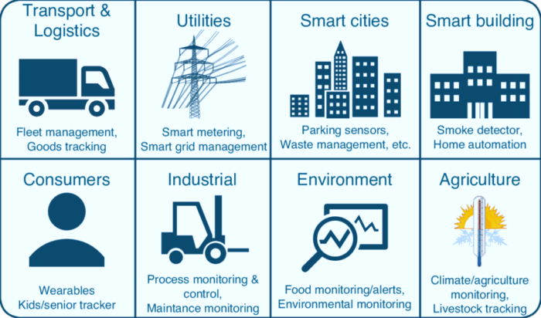
IoT APPLICATIONS

Slide 6
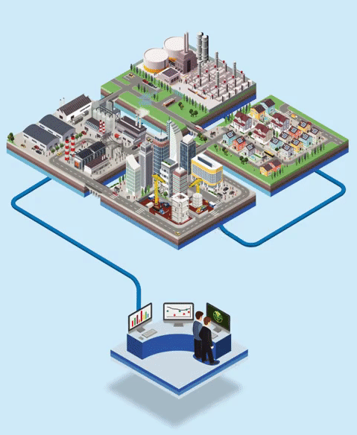
IoT IN INDUSTRY

Slide 7

IoT IN HEALTHCARE

Slide 8

SMART HOME

Slide 9


Slide 10

IOT SECURITY PRACTICES
One of the biggest challenges with the Internet of Things (IoT) is the security headache that comes with it.
This issue is exacerbated in the enterprise, where connected devices often control large, dangerous machines, or send and receive sensitive data.
While the IoT can bring new data and helpful insights, it also introduces new vulnerabilities into your organization.

Slide 11

IOT SECURITY PRACTICES
Securing an IoT infrastructure requires a rigorous security-in-depth strategy.
This strategy requires you to:
secure data in the cloud,
protect data integrity while in transit over the public internet,
and securely provision devices.

Slide 12

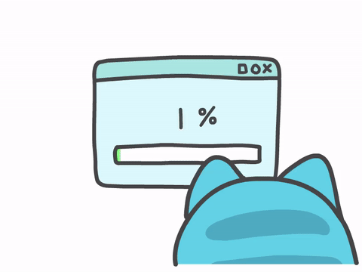
IOT SECURITY PRACTICES
Making hardware tamper-resistant
Provide for firmware updates/patches

Slide 13


IOT SECURITY PRACTICES
Perform dynamic testing
Specify procedures to protect data on device disposal

Slide 14


IOT SECURITY PRACTICES
Use strong authentication
Use strong encryption and secure protocols

Slide 15

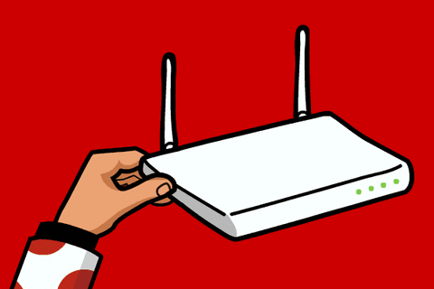
IOT SECURITY PRACTICES
Minimize device bandwidth
Divide networks into segments

Slide 16

Thanks and Regards

