Slide 1

University of Baghdad
Alkawarizmi College of Eng.
Mechatronics Dept.
Hydrogen Fuel Cars: Driving the Future of Clean Mobility
Assist Prof. Dr. Ahmed Mahrous

Slide 2
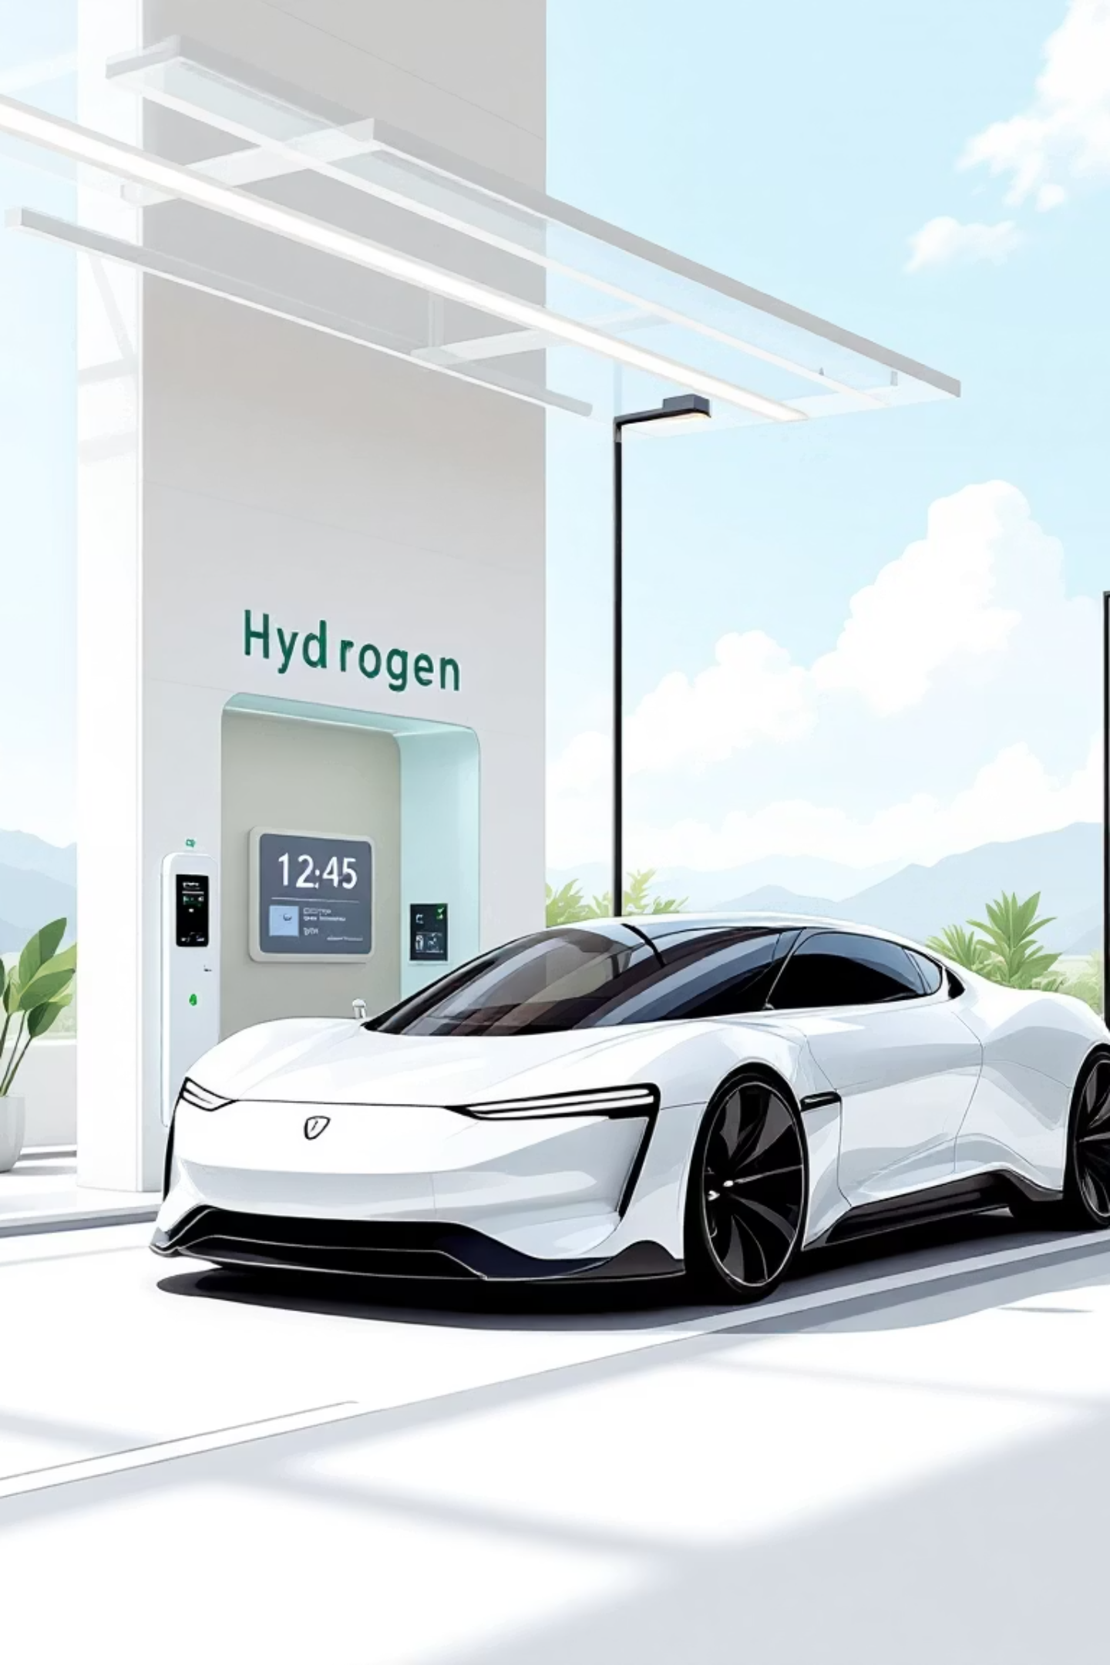
What Are Hydrogen Fuel Cell Vehicles (FCEVs)?
Zero Emissions
Electric Efficiency
Powered by hydrogen gas converted into electricity via fuel cells, FCEVs produce only water vapor and warm air, emitting no harmful pollutants.
These vehicles leverage efficient electric motors, offering a smooth and responsive driving experience similar to battery electric vehicles.
Fast Refueling
Unlike battery EVs, FCEVs offer rapid refueling times, mirroring the convenience of traditional gasoline cars, making them ideal for long journeys.

Slide 3
How Do Hydrogen Fuel Cells Work?
01
02
03
Hydrogen Intake
Oxygen Supply
Electrochemical Reaction
Hydrogen gas (H₂) is stored in high-pressure tanks on board the vehicle and fed into the fuel cell stack.
Oxygen (O₂) from the surrounding air is drawn into the fuel cell, where it reacts with the hydrogen.
Inside the fuel cell, an electrochemical process splits the hydrogen molecules into protons and electrons.
04
05
Electricity Generation
Water Byproduct
The separated electrons flow through an external circuit, generating electricity to power the vehicle's electric motor.
Protons then pass through a membrane and combine with oxygen and electrons to form water (H₂O), which is expelled as clean exhaust.

Slide 4
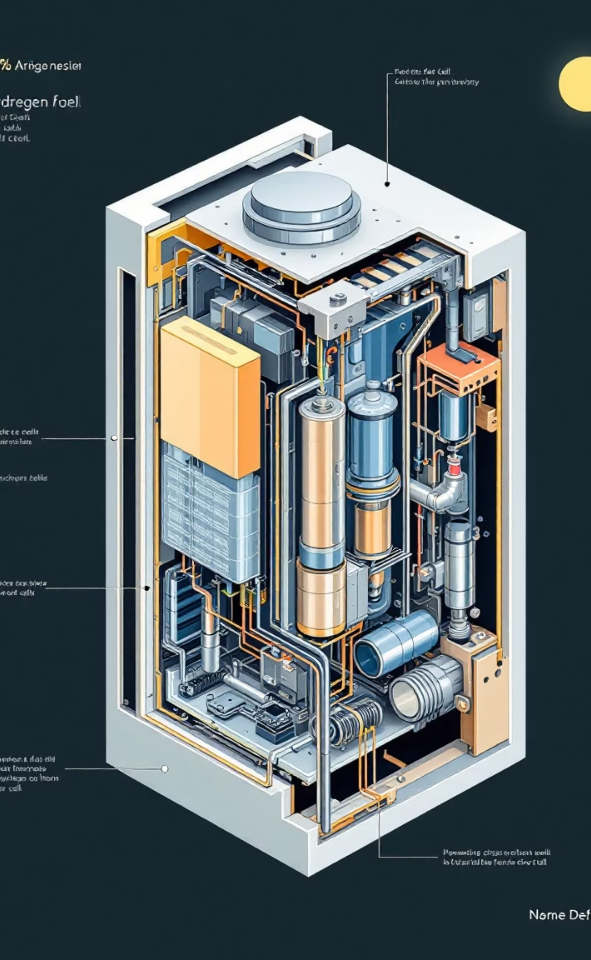

The Inner Workings: Hydrogen Fuel Cell Stack
Electricity output
Hydrogen (H2) input
External circuit delivers power
Supplies fuel at the anode
Oxygen (O2) input
Hydrogen Fuel Cell Stack
Anode
Air supplied to cathode
Oxidizes hydrogen to protons
Cathode
Proton Exchange Membrane
Combines protons with oxygen
Conducts protons to cathode
This diagram illustrates the elegant simplicity and efficiency of a hydrogen fuel cell, converting chemical energy directly into electrical power.

Slide 5
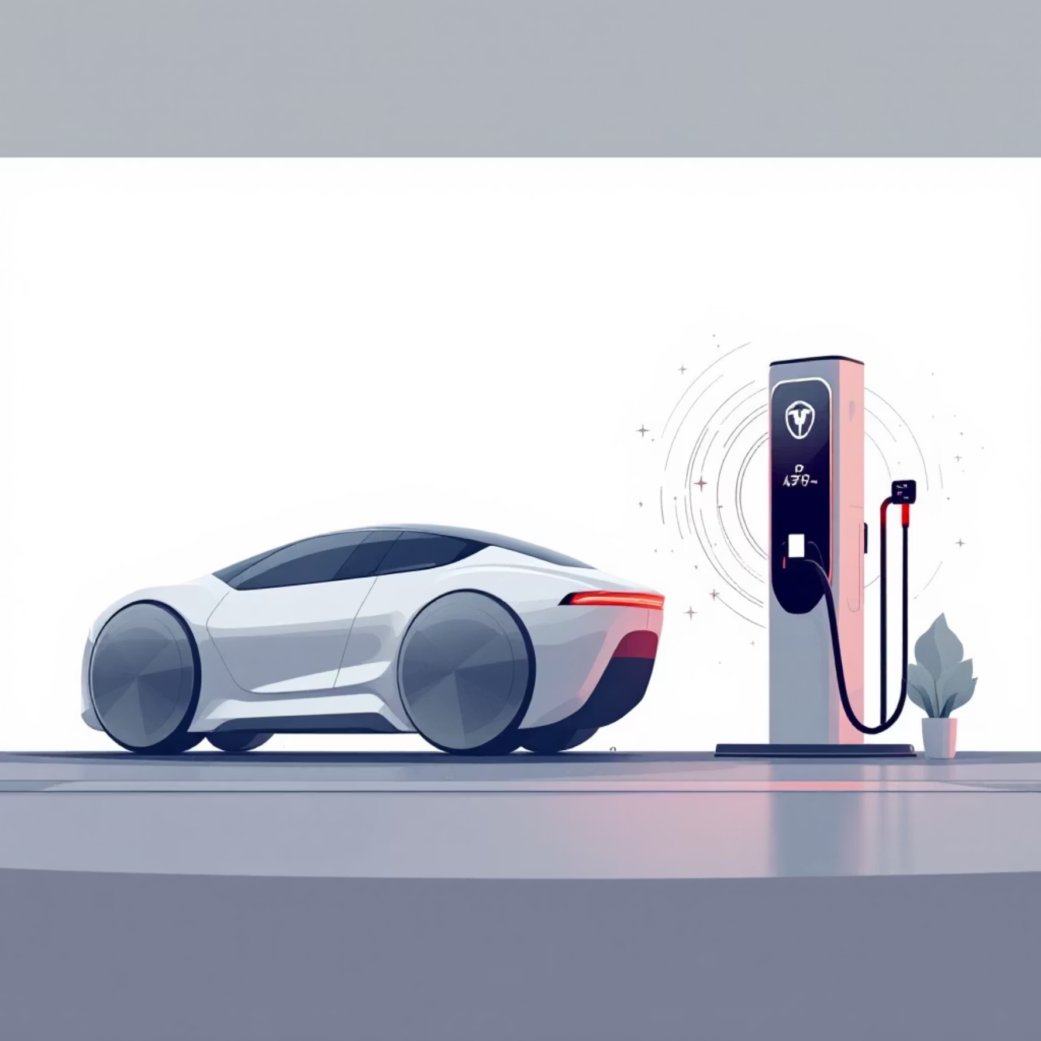


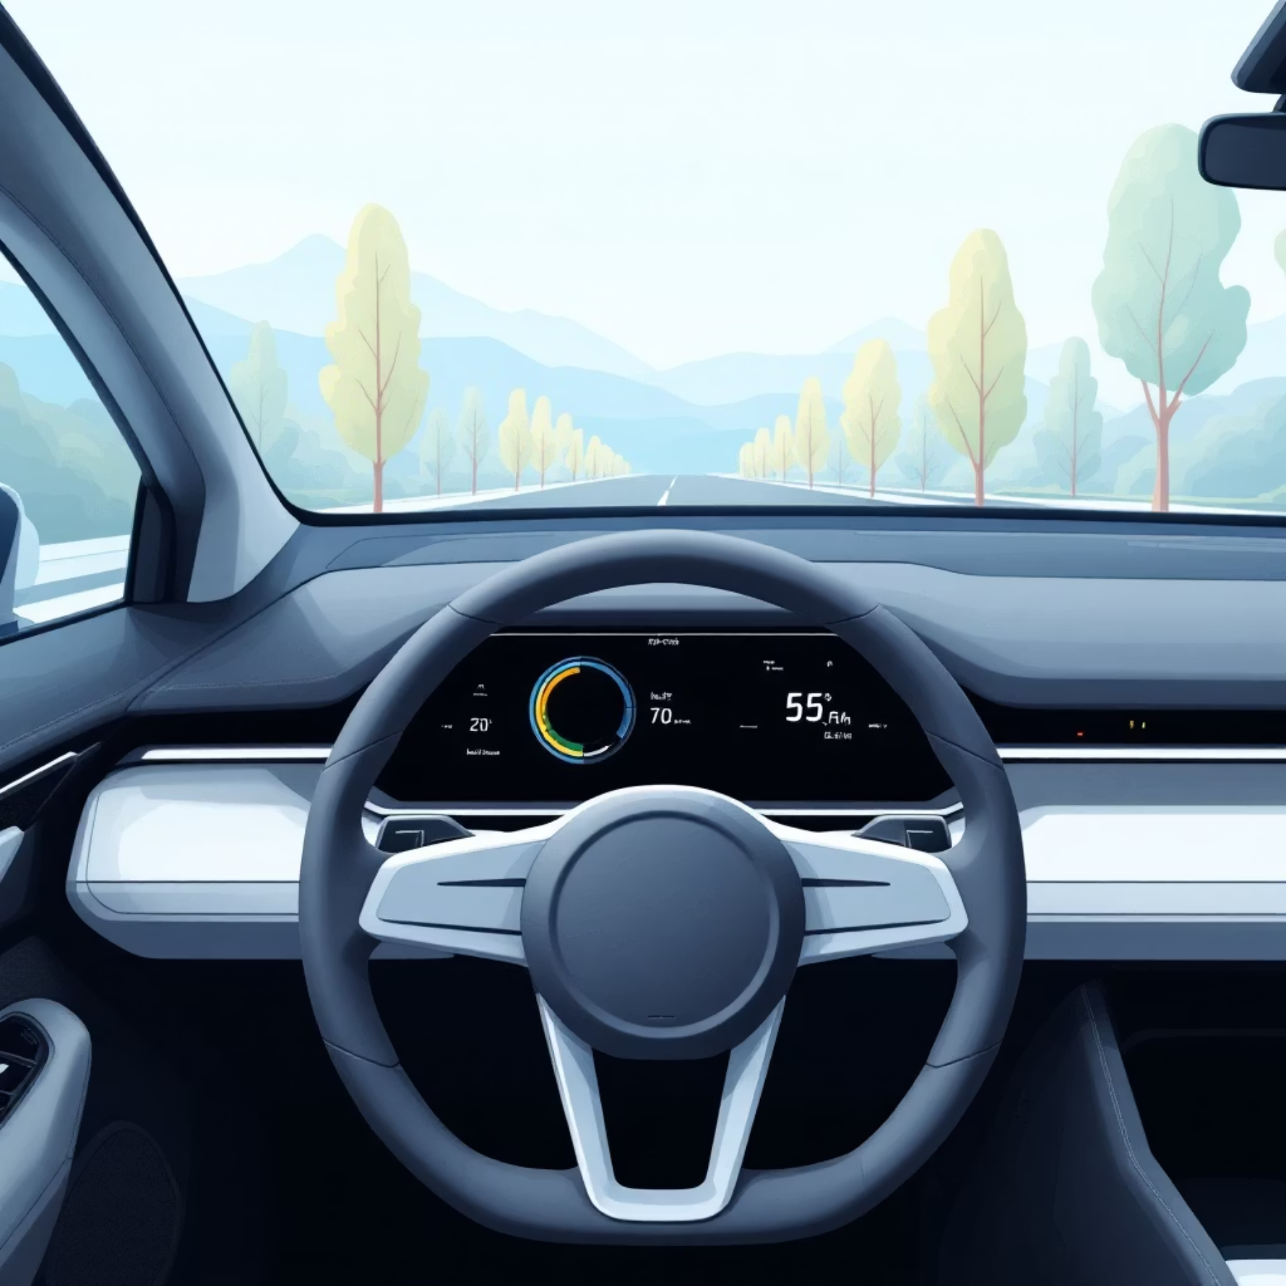
Advantages Over Conventional and Battery Electric Vehicles
Extended Range
Rapid Refueling
Enjoy a driving range of over 300 miles on a single
tank, comparable to gasoline cars and ideal for
long-distance travel.
Refuel an FCEV in just 3-5 minutes, a stark contrast to the
hours required for many battery electric vehicles.
FCEVs are typically lighter than battery EVs due to
smaller, lighter energy storage systems, enhancing
performance and efficiency.
Experience instant torque and smooth, quiet power delivery, characteristic of electric drivetrains, without the weight penalty of large batteries.
Lighter Vehicle Weight
Dynamic Performance

Slide 6
Current Market Leaders & Models
Hyundai Nexo
Toyota Mirai
Honda CR-V FCEV
The global best-seller in the FCEV market, with over 10,000 units sold by 2022, known for its sleek design and impressive range.
A pioneering fuel cell sedan that continues to be a strong performer, with over 3,200 units sold in 2022.
Expanding its presence in select markets, Honda's offering combines SUV practicality with fuel cell technology.
While the market is still nascent, the refueling infrastructure is gradually expanding in key regions like California, Korea, Japan, and parts of Europe, paving the way for wider adoption.

Slide 7


Challenges Facing Hydrogen Fuel Cars
Production Methods
A significant challenge is that approximately 95% of hydrogen is currently produced from fossil fuels (primarily via steam methane reforming), which negates some environmental benefits.
Green Hydrogen Imperative
There's an urgent need to scale up green hydrogen production through renewable electrolysis to truly achieve a zero-carbon footprint for FCEVs.
Refueling Infrastructure
The sparse network of refueling stations remains a major barrier to consumer adoption outside of concentrated areas.
Cost Barriers
Both the initial vehicle cost and the infrastructure development costs are higher compared to conventional gasoline cars and even some battery EVs.

Slide 8
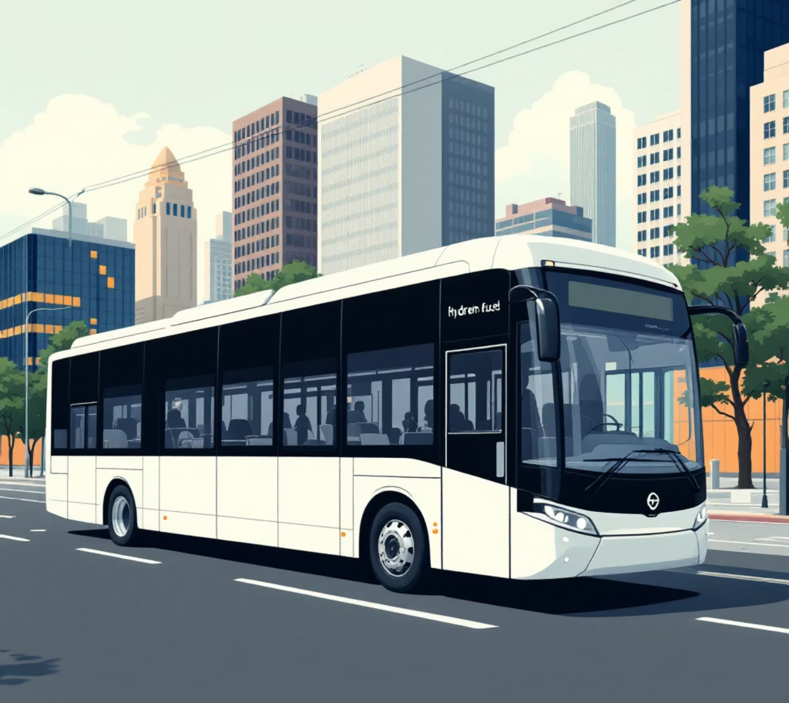
Hydrogen in Public Transport: Fuel Cell Buses
Global Adoption
Extended Range
With over 7,000 fuel cell buses worldwide by mid-2023, led by China and Korea, hydrogen is making significant inroads in public transportation.
1
These buses offer impressive ranges of 500-600 km, perfectly suited for urban routes.
Quick Turnaround
2
Refueling takes only about 10 minutes, ensuring minimal downtime and efficient service.
Superior Efficiency
3
Fuel cell buses demonstrate 30-141% better fuel economy than their diesel counterparts, reducing operational costs and emissions.
Growing investments are accelerating the expansion of hydrogen bus fleets across Europe and North America, highlighting their potential as a sustainable urban transit solution.

Slide 9


The Road Ahead: Scaling Up Hydrogen Mobility
Government Investments
1
The U.S. Department of Energy and global partners are heavily investing in research and development to make hydrogen technology more affordable and safer.
2
Infrastructure Expansion
Ambitious plans are in place to significantly expand hydrogen station networks in key regions worldwide by 2030.

Slide 10
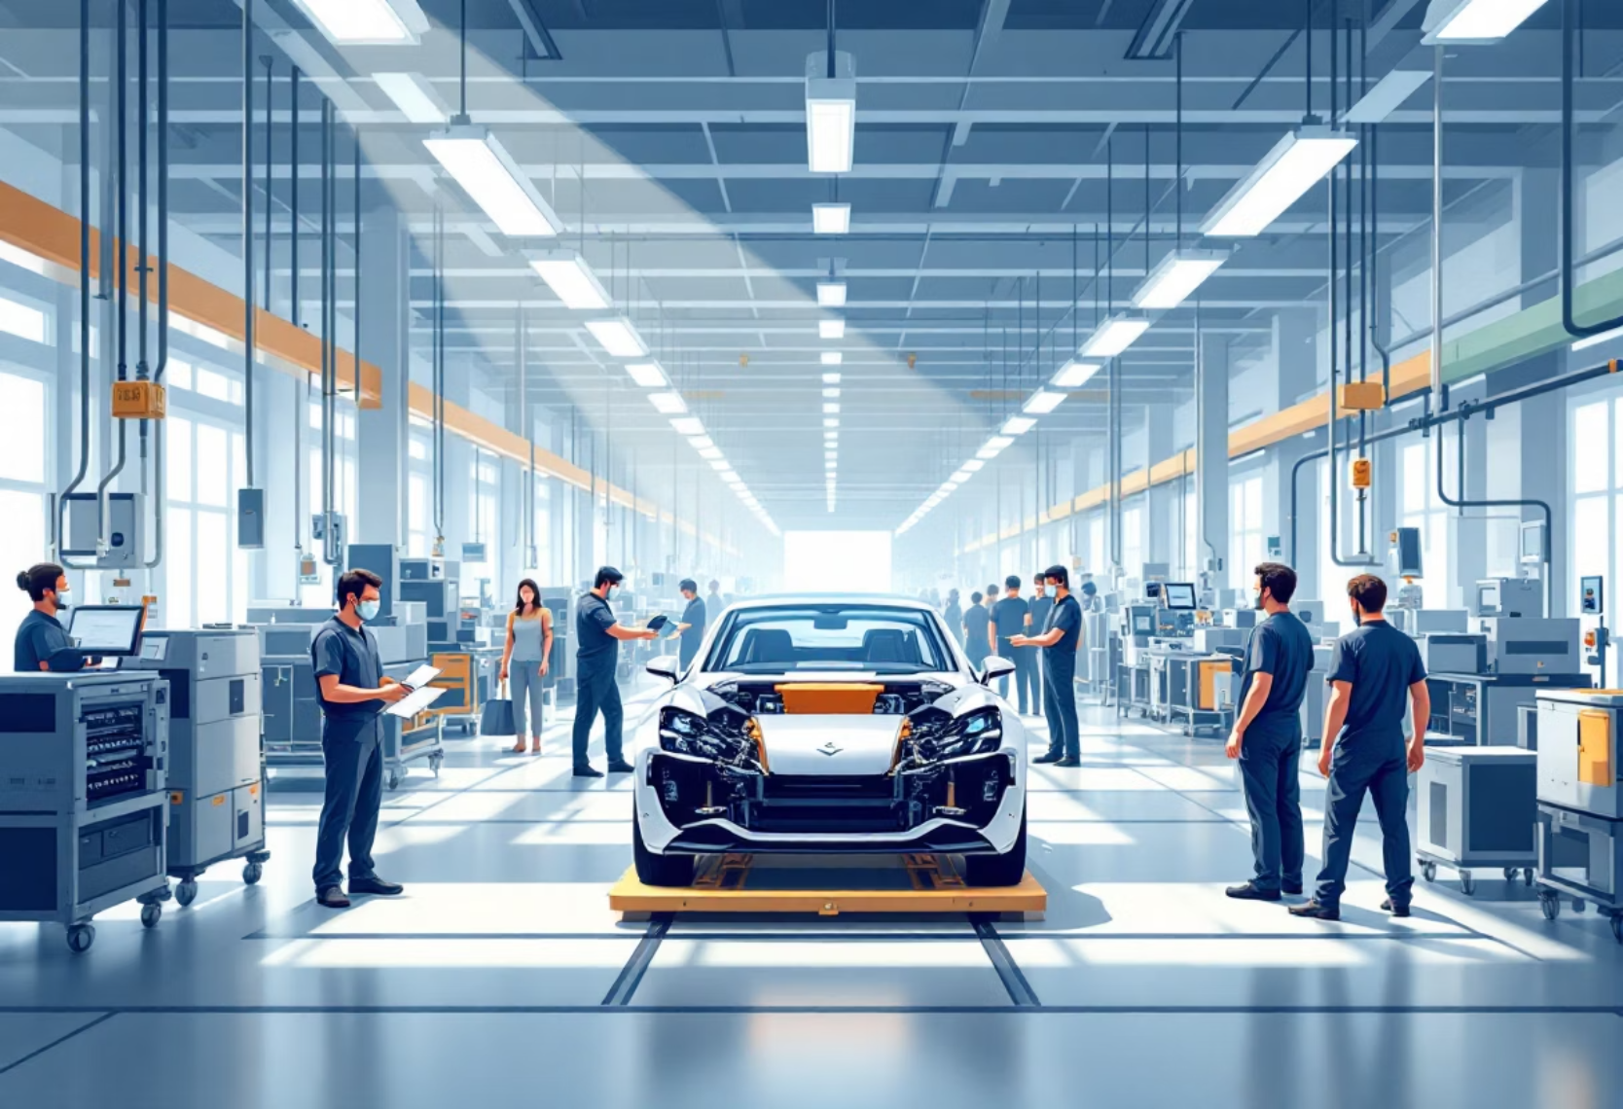
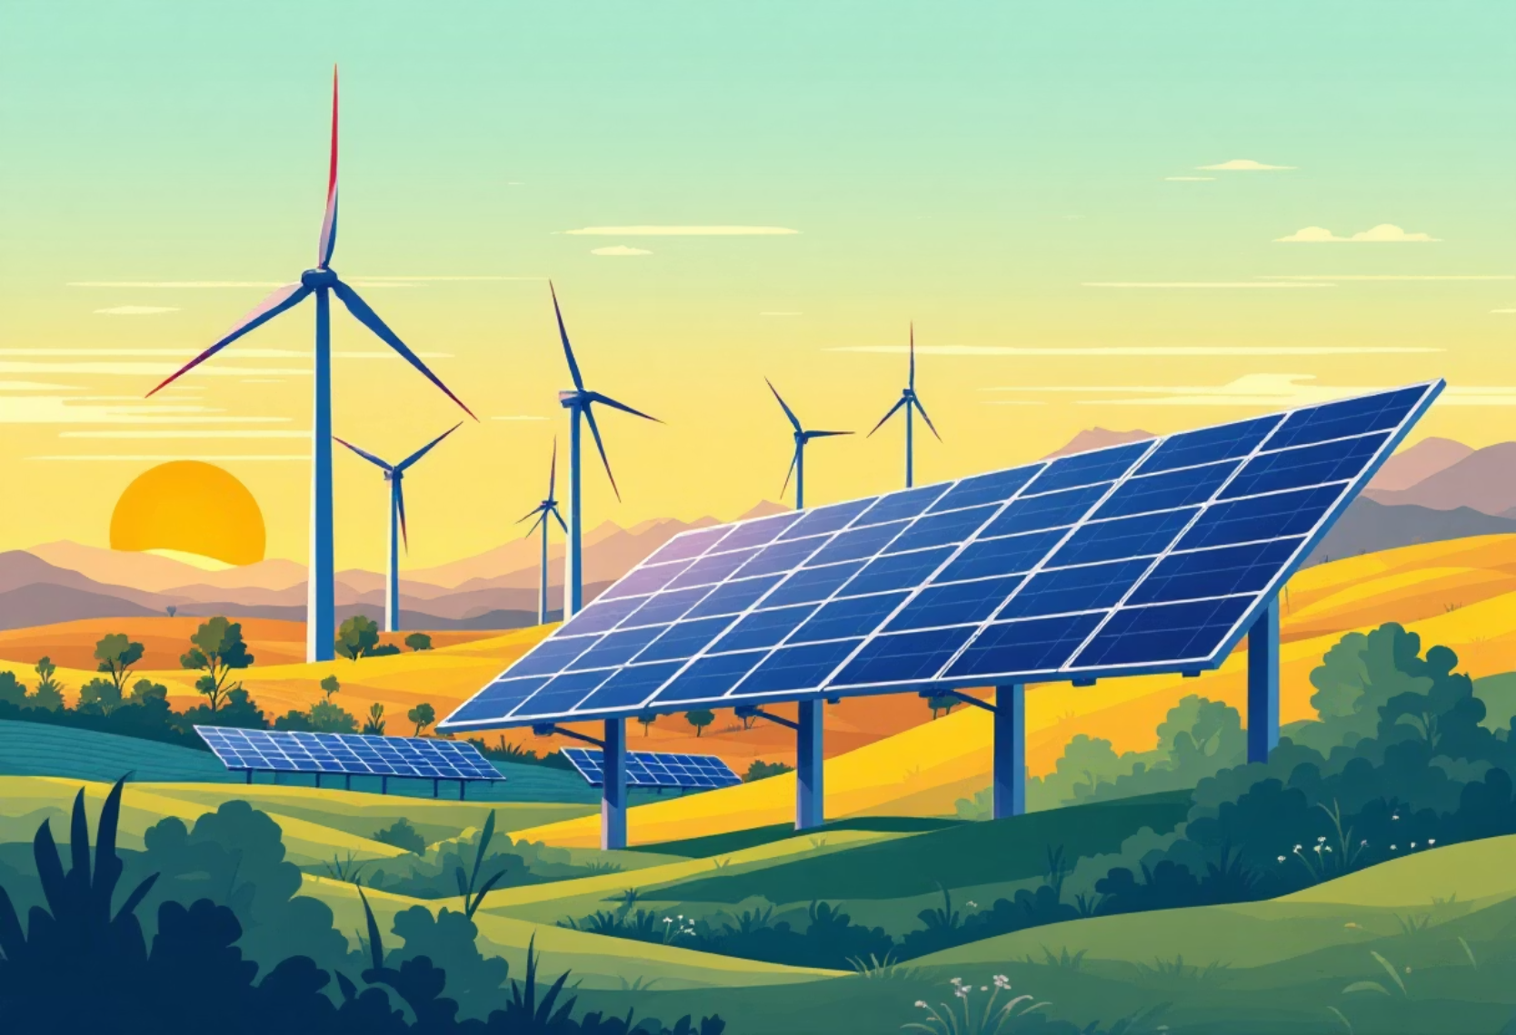
The Road Ahead: Scaling Up Hydrogen Mobility
Automaker Commitment
3
Leading automakers are committed to introducing a wider range of FCEV models and driving down production costs to boost accessibility.
4
Green Hydrogen Breakthroughs
Breakthroughs in green hydrogen production are critical to realizing a truly zero-emission future for hydrogen-powered transportation.

Slide 11












Hydrogen Fuel Cars: Clean, Fast, and Ready to Transform Transportation
Electric Performance
Quick Refueling
Enjoy the silent power and instant torque of electric driving.
Replenish your range in minutes, just like a gasoline car.
The Future is Now
Long Range
Embrace the next generation of transportation.
Travel hundreds of miles on a single fill, minimizing range anxiety.
Holistic Solution
Zero Emissions
A vital complement to battery EVs and renewable energy in the sustainable mobility ecosystem.
Contribute to a cleaner planet with only water as a byproduct.
The future is hydrogen-powered — are you ready to drive it?

