Slide 1

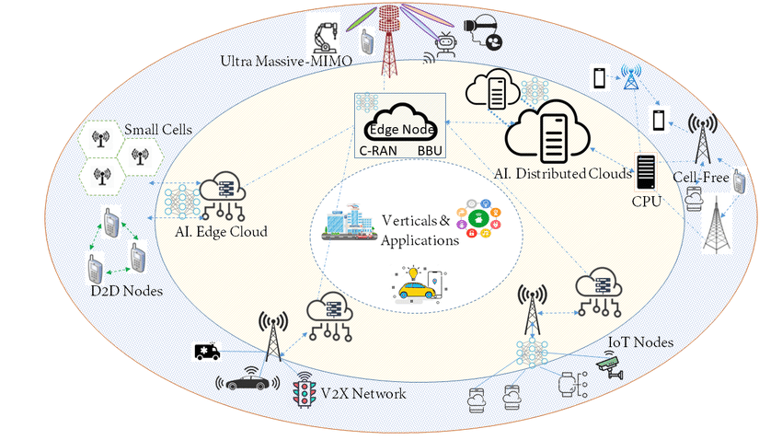
Network Slicing for 6G Mobile Network
By:
Dr. Ahmed Noori Al-Naami

Slide 2

Introduction
6G Technology
Network Slicing

Slide 3

INTRODUCTION
Network slicing enables operators to run multiple isolated end-to-end networks on the same hardware, from:
  Radio Access Network (RAN).
  Transport Network.
  Core Network.

Slide 4
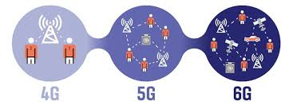
6G Technology
6G is the future evolution of mobile communication, expected around 2030, building on 5G but going far beyond it in capability, intelligence, and integration.

Slide 5
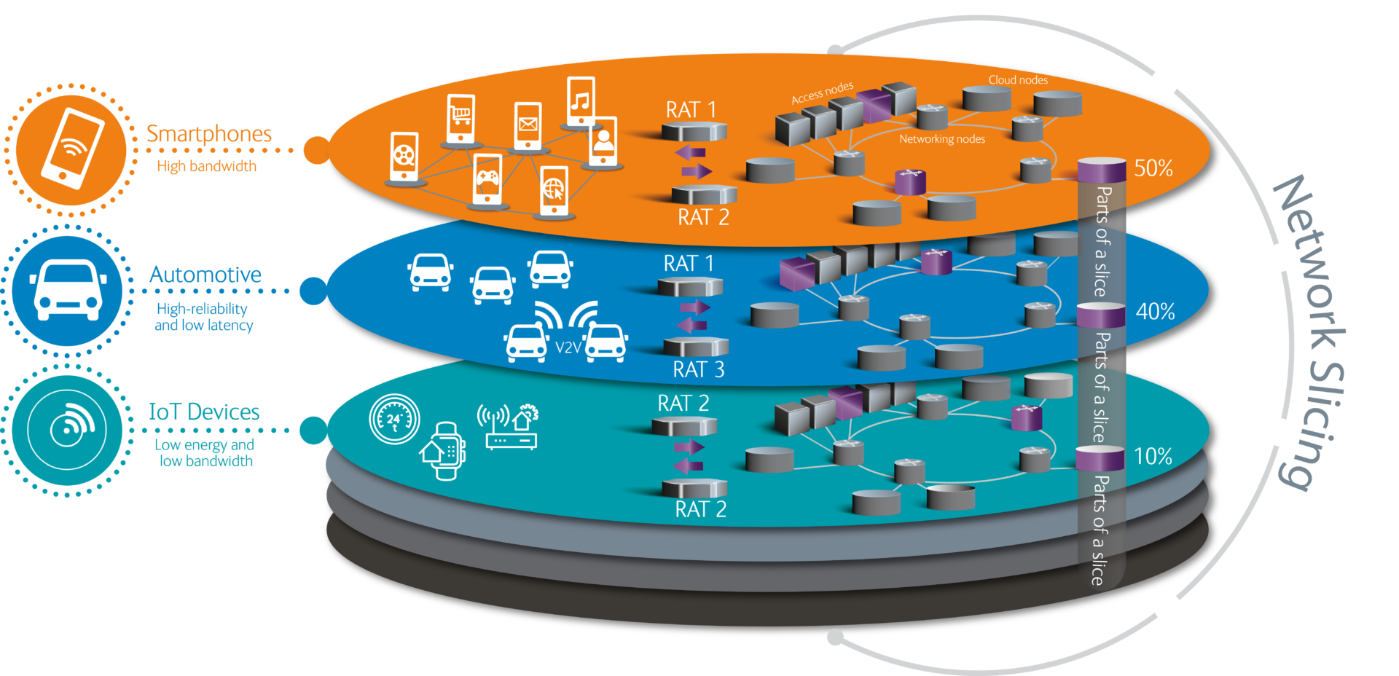
NETWORK SLICING
Network slicing is a 5G/6G technology that divides a single physical network into multiple independent, virtual logical networks (slices) on shared infrastructure.

Slide 6
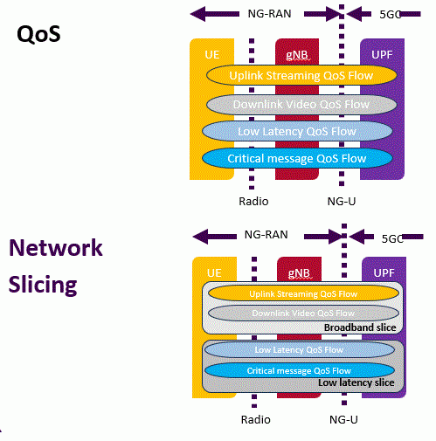
Network Slicing
Network slicing and QoS are tightly coupled concepts in 5G/6G networks.
Network slicing provides logical separation, while QoS ensures performance guarantees within each slice

Slide 7
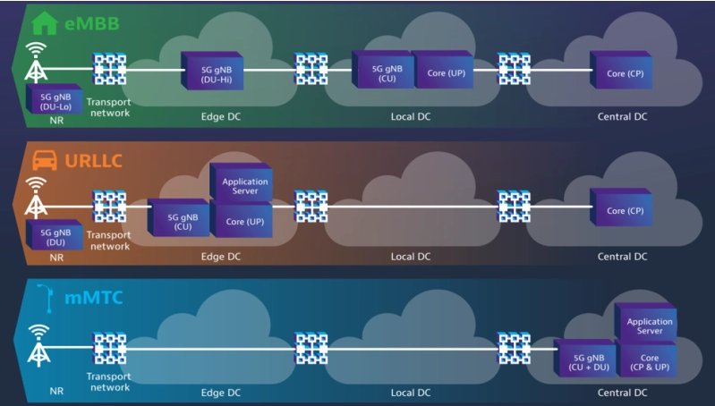

Slide 8
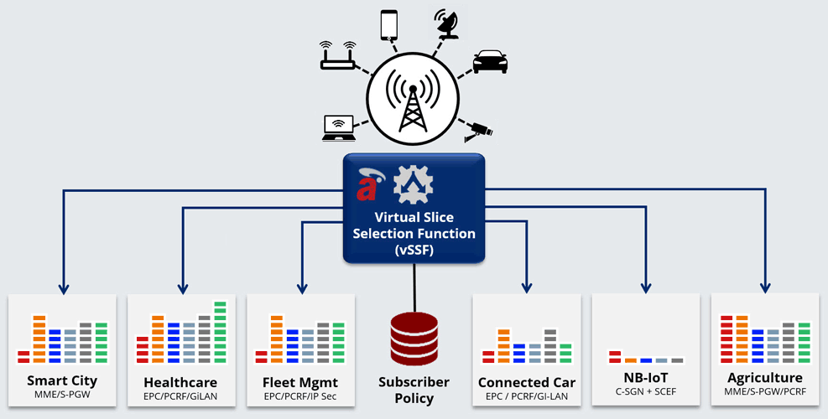

Slide 9

eMMB

Slide 10

URLLC

Slide 11
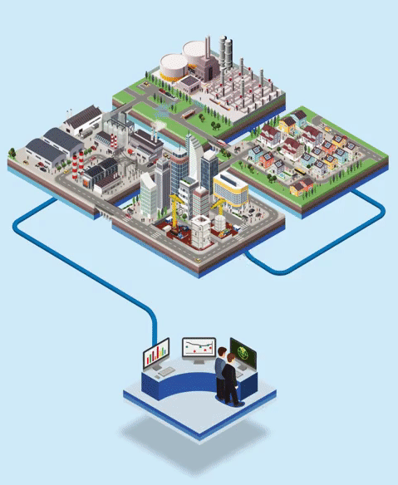
mMTC

Slide 12

Thanks and Regards

