Slide 1

Artificial intelligence and sustainable development
ا.م هبة خالد حسين م. بسمة لؤي مهدي

Slide 2
Introduction
Artificial Intelligence has become one of the most powerful tools supporting sustainable development around the world. Through data analysis and intelligent decision-making, AI can:
Reduce waste and optimize resource use
Improve agricultural productivity
Support renewable energy systems
Enhance environmental protection
Strengthen health, education, and smart city planning
Purpose of the Presentation: To highlight how AI contributes to sustainable development and to examine the challenges and future opportunities in this field.

Slide 3
TABLE OF CONTENTS
AI Enhancements in Renewable Energy
Smart Agriculture Through AI
AI in Climate Change Mitigation
AI and Sustainable Urban Development
Challenges of AI in Sustainable Development
Conclusion

Slide 4


Slide 5
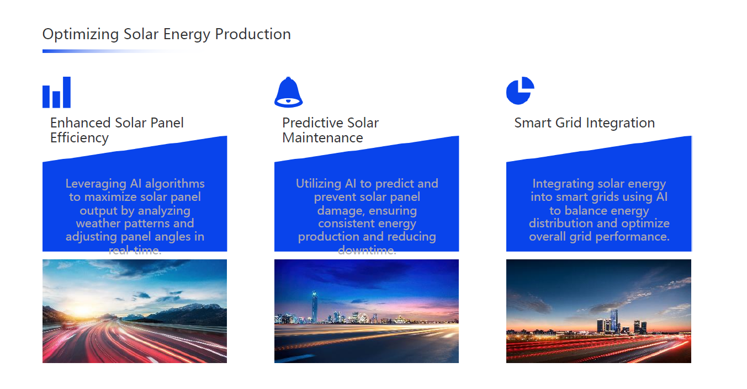

Slide 6
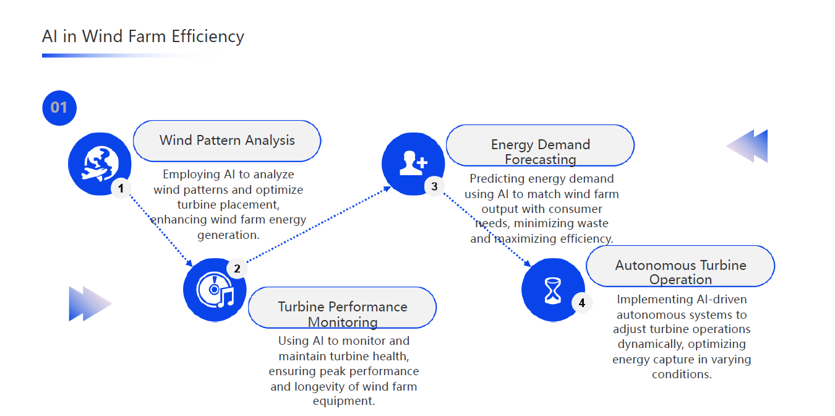

Slide 7
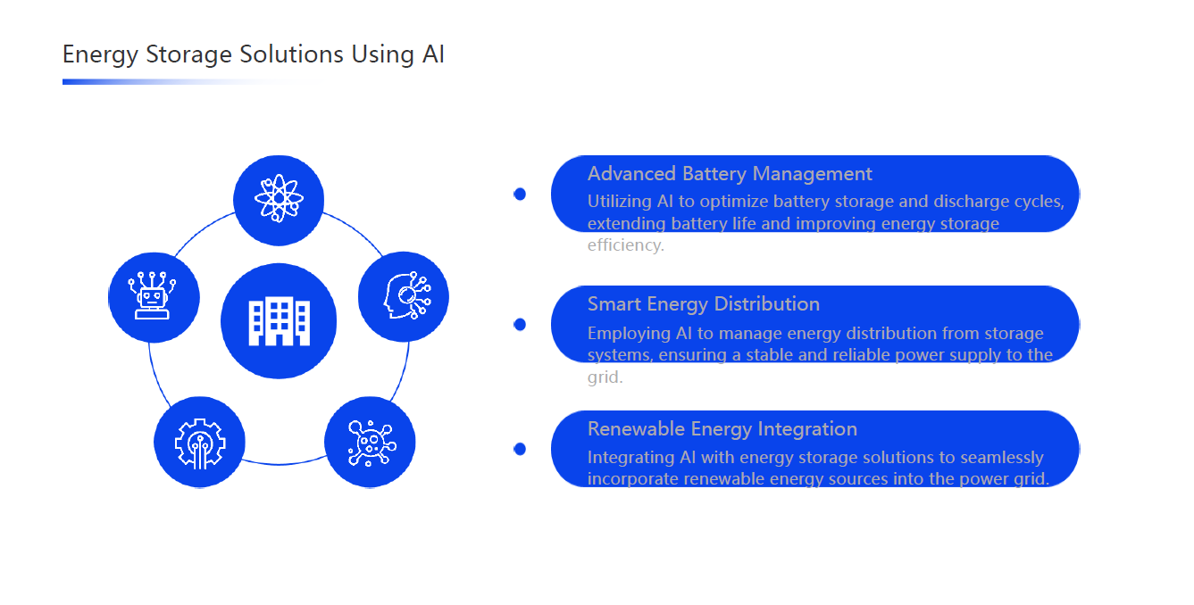

Slide 8
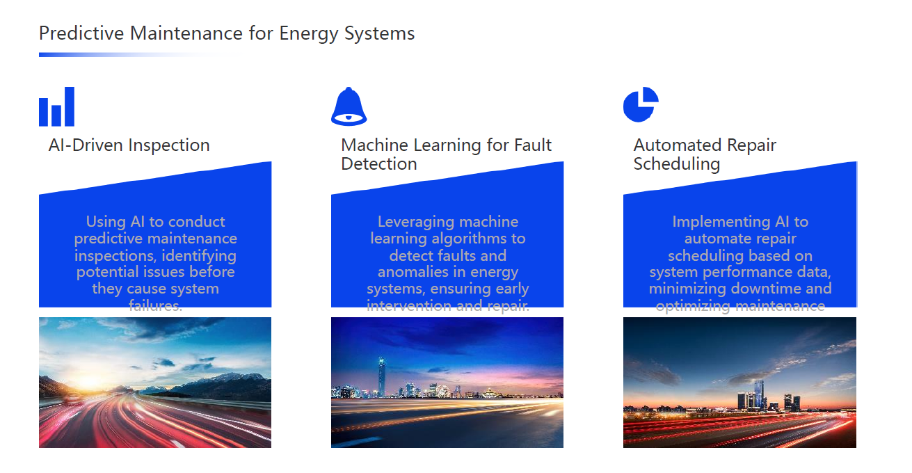

Slide 9
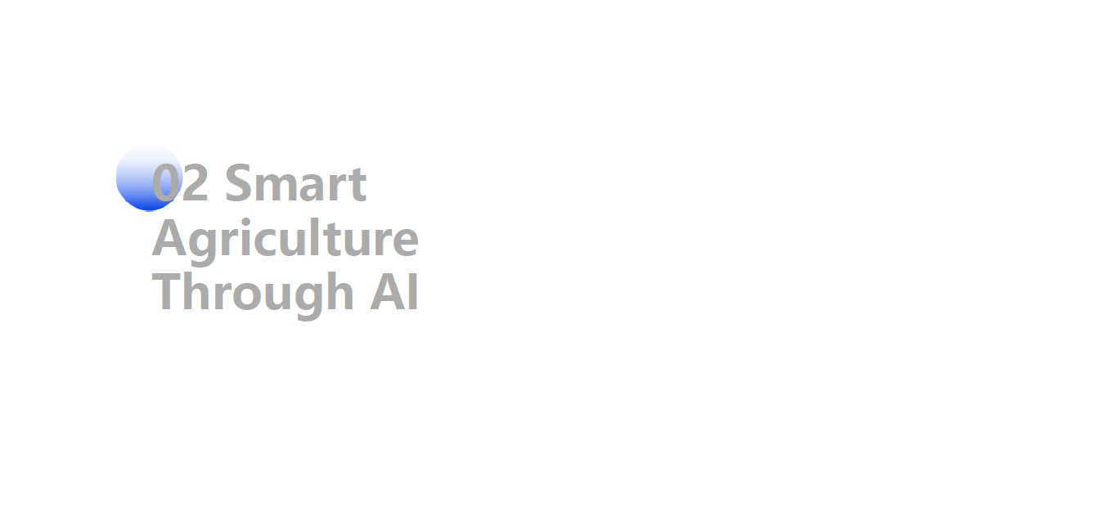

Slide 10
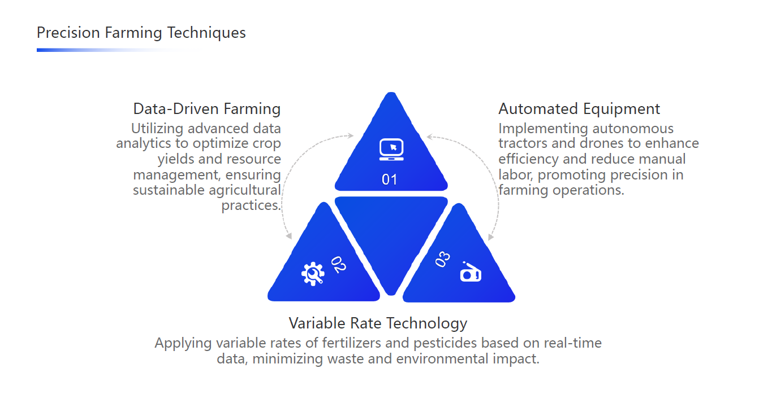

Slide 11
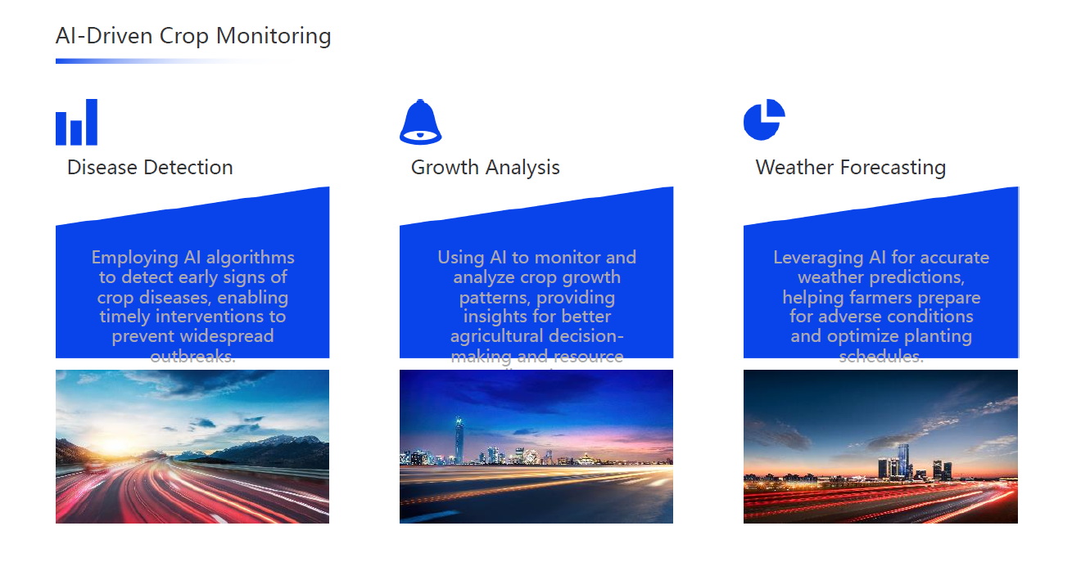

Slide 12
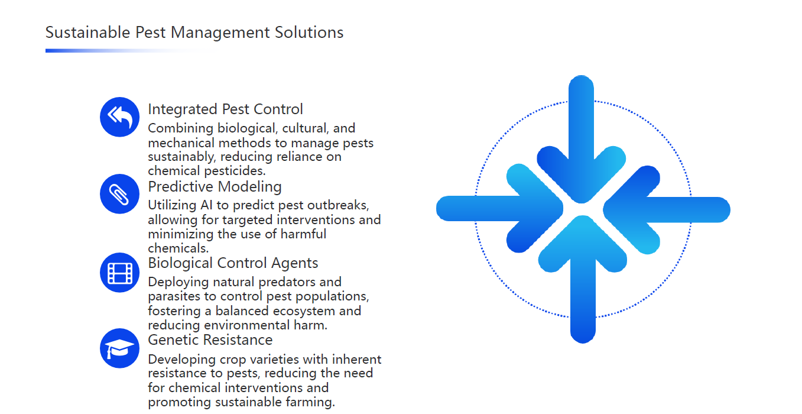

Slide 13
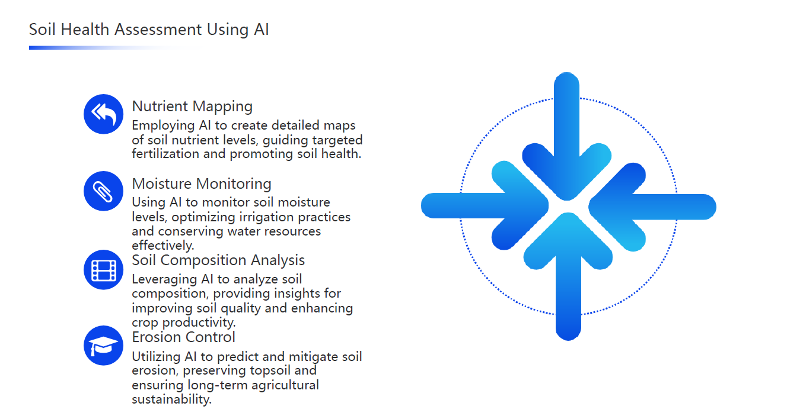

Slide 14


Slide 15
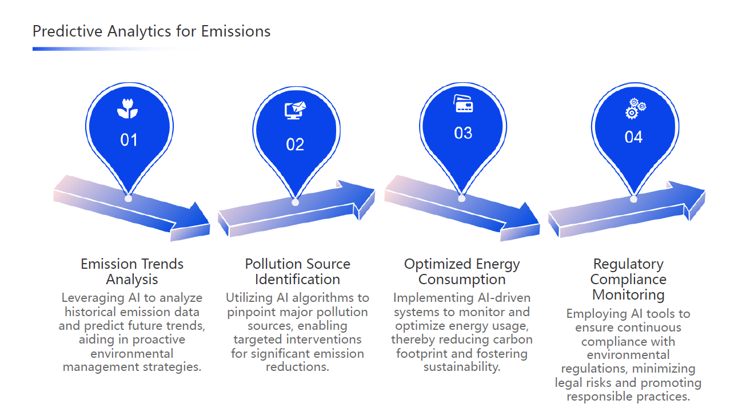

Slide 16
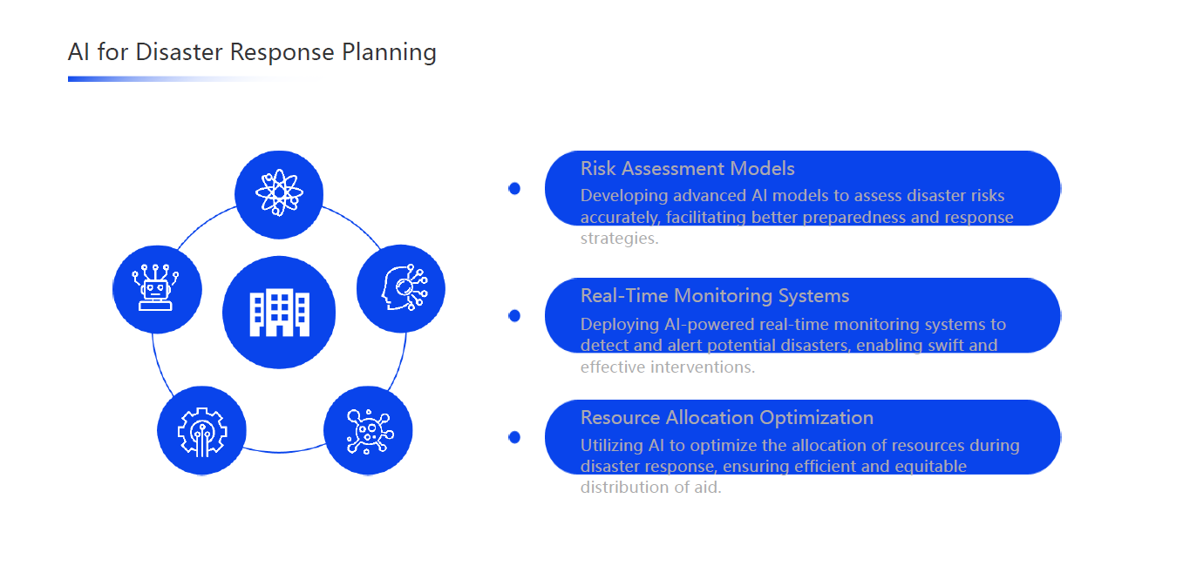

Slide 17
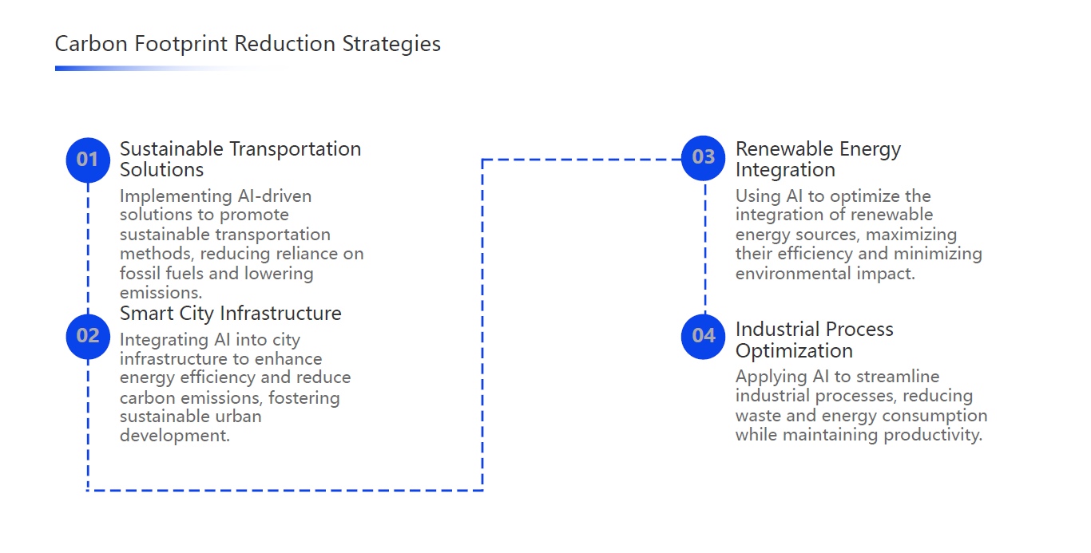

Slide 18
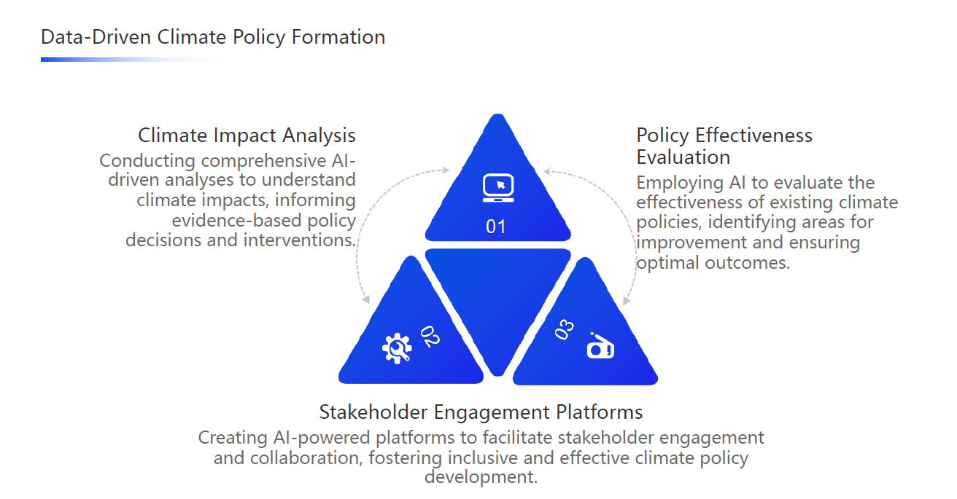

Slide 19


Slide 20
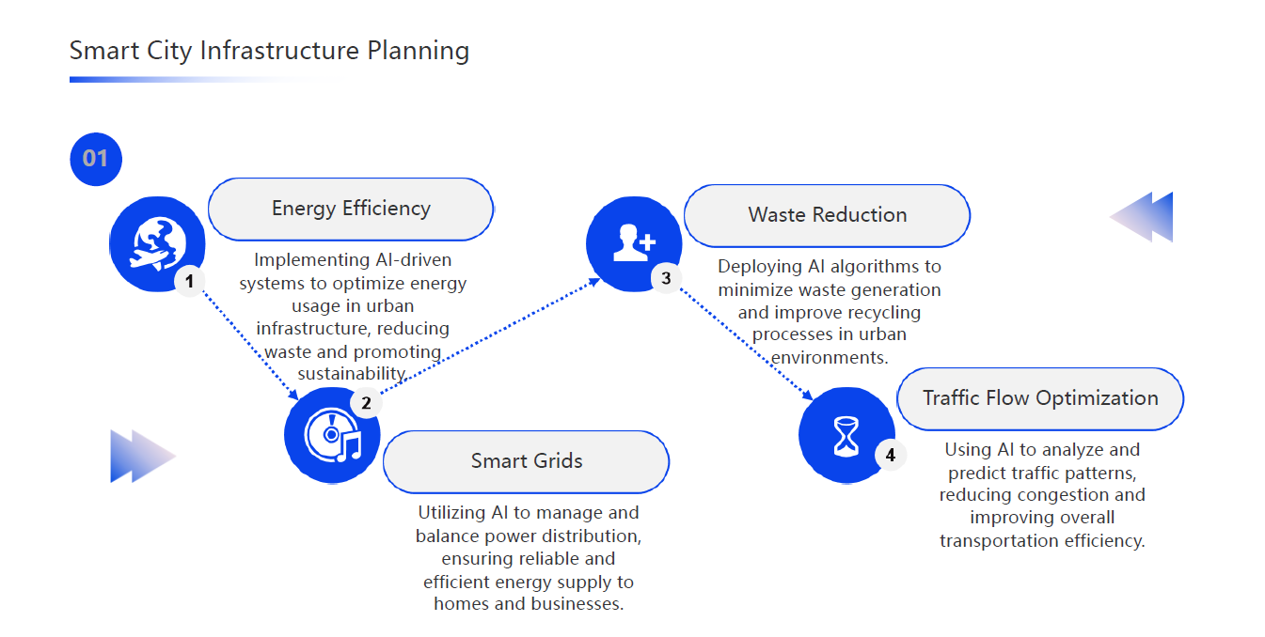

Slide 21
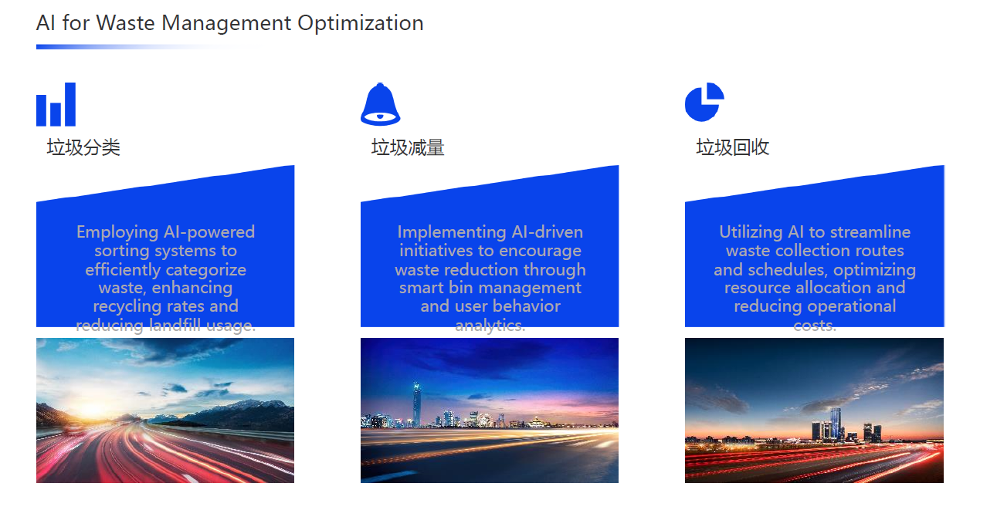

Slide 22
Challenges of Using AI for Sustainable Development
Lack of Accurate Data Many regions do not have reliable data required for effective AI systems.
High Implementation Costs Developing and deploying AI solutions requires significant financial and technical resources.
Weak Technological Infrastructure Some areas lack strong internet connectivity or advanced devices necessary for AI applications.
Privacy and Security Concerns Data collection and analysis involve risks related to confidentiality and information misuse.
Shortage of Skilled Professionals There is a global need for more experts who can design, operate, and manage AI systems.
Overdependence on Technology Relying too heavily on AI may reduce human involvement in critical decision-making.

Slide 23
Conclusion
Artificial Intelligence offers tremendous opportunities to advance sustainable development and improve living standards. However, to fully benefit from AI, it is essential to:
Strengthen digital infrastructure
Develop human skills and technical expertise
Establish ethical and privacy-protecting regulations
Invest in research and sustainable AI applications
In summary: AI is a powerful tool that, when used responsibly, can help build a greener, smarter, and more sustainable future for all.

Slide 24


