Slide 1

Using AI Tools to Manage Doctoral Students' References
Revolutionizing Academic Research with Smart Technology

Slide 2
The Reference Challenge in Doctoral Research
Volume & Accuracy
Time-Consuming Process
Doctoral theses often require managing hundreds, even thousands, of references accurately and consistently.
Manual referencing is notoriously time-consuming, diverting valuable energy from core research activities.
Error Proneness
AI's Promise
Human error in formatting, citation, and bibliography creation can lead to significant rework and academic integrity concerns.
AI tools offer a powerful solution to streamline this critical but often tedious aspect of scholarly work.

Slide 3

Why Use AI for Reference Management?
Automated Efficiency
AI automates citation formatting and bibliography creation, saving countless hours.
Consistency Across Styles
It helps maintain consistency across diverse referencing styles (APA, Harvard, Vancouver, Chicago, MLA).
Enhanced Organization
AI tools support dynamic organization of sources for easier retrieval and review throughout the research process.

Slide 4


Spotlight on Two Popular AI Tools
Cite This For Me
Zotero
Web-based: No download or installation required.
Desktop App: Robust features with browser extension for seamless integration.
Simplicity: Ideal for quick, single reference citations via DOI or URL.
Bulk Import: Efficiently handles large collections of sources and PDFs.
Ease of Use: Very low learning curve, perfect for beginners.
Organization: Advanced features for categorizing and tagging research materials.
Tradeoff: Cite This For Me offers immediate simplicity for individual references, while Zotero provides powerful, comprehensive management for extensive research.

Slide 5
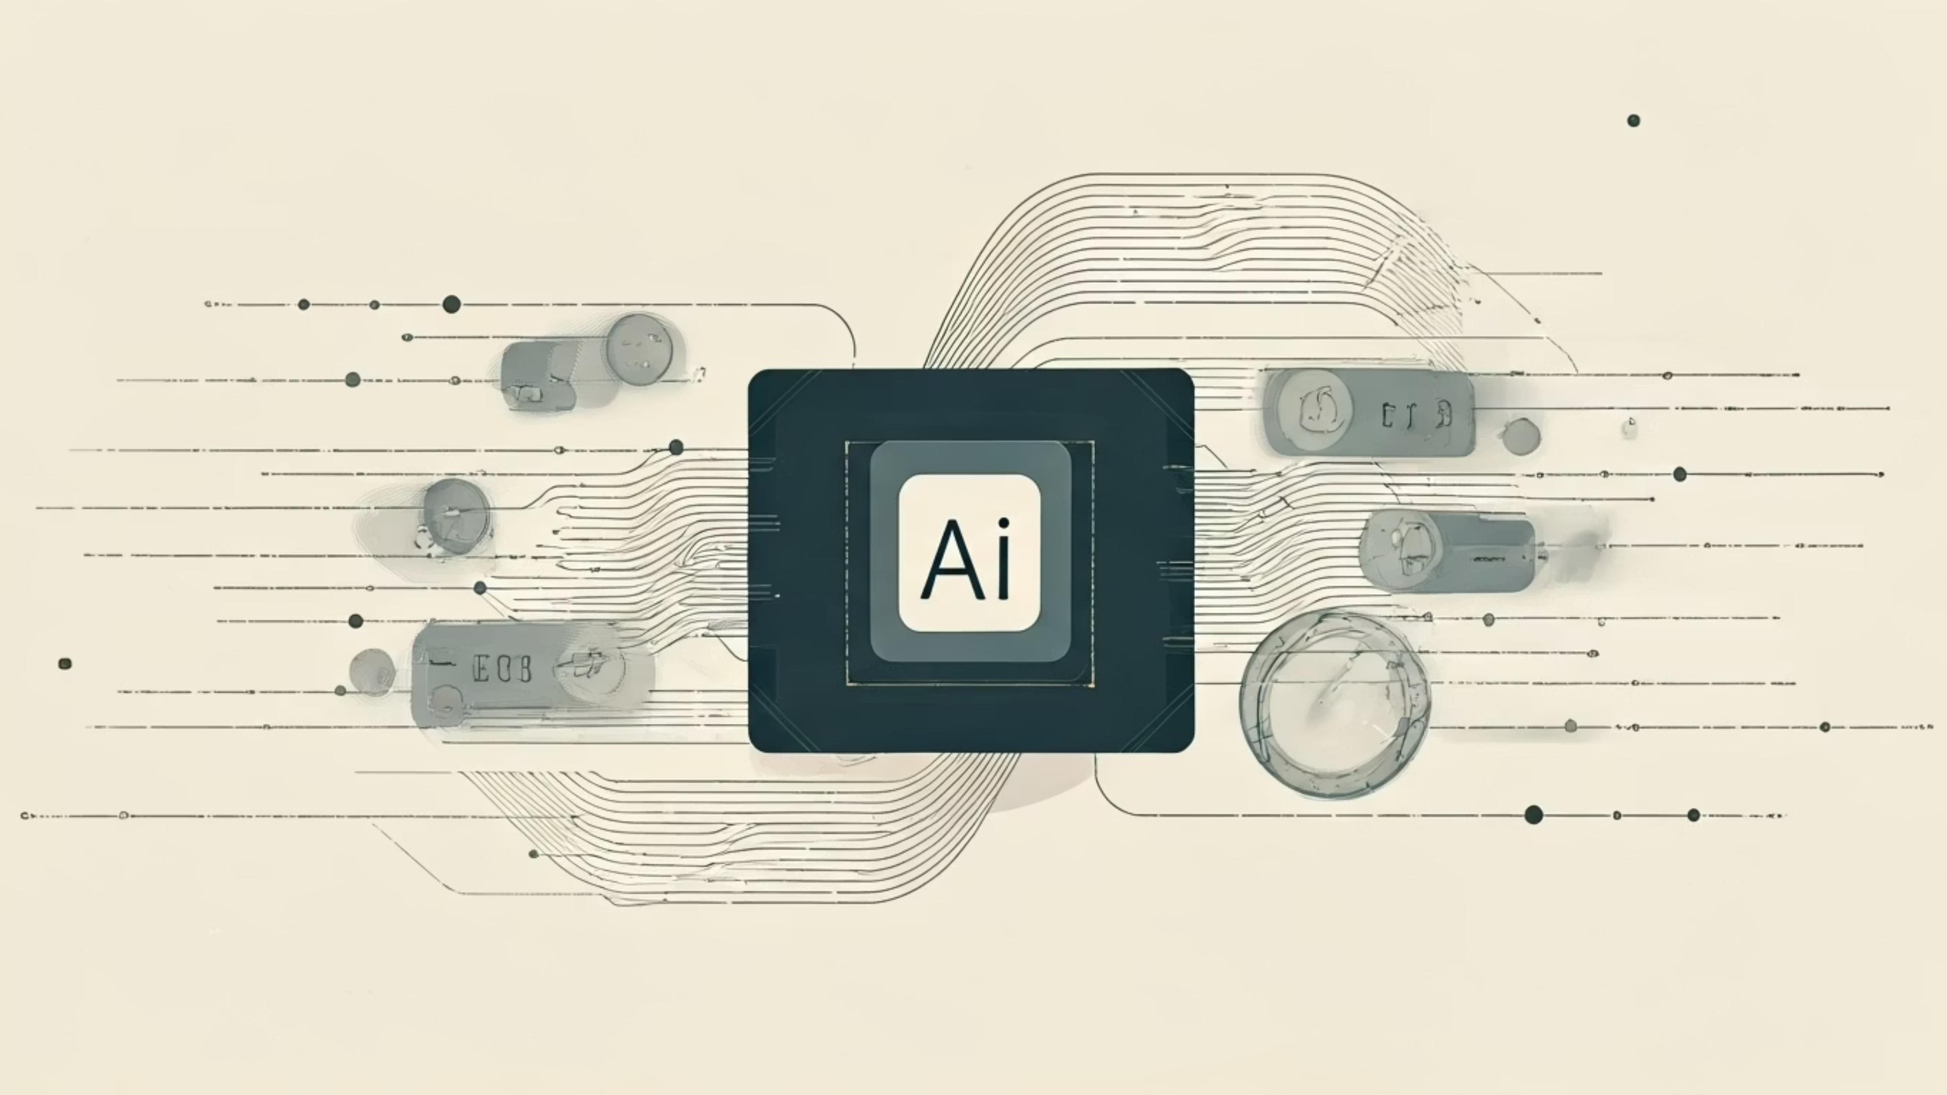
Emerging AI Citation Tools in 2025
Sourcely
AI Blaze
Scite AI
Automates bulk citation creation with advanced metadata extraction and real-time error checks for maximum accuracy.
A specialized Chrome extension for instant, on-the-fly web-based citations in popular styles like APA and MLA.
Goes beyond basic citation by showing how papers are cited, providing context on supporting or disputing evidence.
These innovative tools are poised to further enhance accuracy, speed, and contextual understanding for large, complex bibliographies.

Slide 6

Integrating AI Tools into Doctoral Workflow
Synergistic Approach
Early Adoption
Combine literature mapping tools like ResearchRabbit or Connected Papers with AI citation managers for a truly comprehensive research ecosystem.
Begin using AI tools from the initial stages of your research to build and meticulously organize your reference library.
Continuous Learning
Manual Verification
Stay updated on new AI features and best practices to optimize your workflow and maximize efficiency.
Always prioritize academic integrity by manually verifying all AI-generated citations against original sources and official style guides.

Slide 7

Real-World Impact: Saving Time & Reducing Stress
10+ hours
90% less
Weekly time saved by PhD students on citation tasks, redirecting focus to research depth.
Formatting errors for supervisors to correct, allowing them to focus feedback on content and critical analysis.
"Using Zotero’s bulk import and auto-formatting features cut my reference list preparation from days to just a few hours. It was a game-changer for my thesis defense."
— Dr. Anya Sharma, Recent PhD Graduate

Slide 8



Limitations & Risks of AI Reference Tools
Accuracy & Completeness
Learning Curve & Bulk Processing
Ethical Use & Transparency
AI tools can sometimes produce inaccurate or incomplete citations, making human oversight absolutely essential.
Some advanced tools may have a steep learning curve, and not all are optimized for massive bulk processing.
Responsible use requires transparency in citation practices and strict adherence to academic integrity standards.

Slide 9



Best Practices for Using AI in Reference Management
Choose Wisely
Verify Thoroughly
Stay Updated
Select tools that align seamlessly with your existing workflow and technical comfort level.
Always cross-check all AI-generated references against official style guides and original sources.
Continuously explore new AI tools and features to leverage advancements and improve your efficiency.
Embrace AI as a powerful assistant, not a substitute for critical academic rigor.

Slide 10

Conclusion: Empower Your Doctoral Journey with AI
AI tools are powerful assistants, designed to augment, not replace, the scholarly rigor in your referencing.
By leveraging AI smartly, you can transform reference management from a daunting burden into a strategic strength, freeing you to focus on the impactful core of your research.
Start experimenting with these transformative tools today to save time, reduce errors, and amplify the impact of your doctoral research.

