Slide 1

University of Baghdad
Institute of Laser for
Postgraduate Studies
جامعة بغداد
معهد الليزر للدراسات العليا
Laser Pulses Aesthetics of Skin Disorder
By : DINA AHMED KAFI

Slide 2
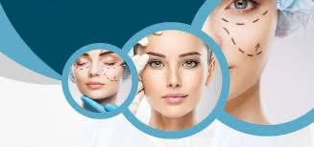
Laser Pulses Aesthetics of Skin Disorder

Slide 3
Introduction to Skin Lesions and Laser Treatment
Common types of skin lesions include:
Acne
Warts
Moles (nevi)
Birthmarks
Pigmented lesions
Scars
Why laser treatment ?
precision and damage
pain and recovery
Effectiveness
Selective Photothermolesis
Notes:
Skin lesions are abnormal changes in the skin's appearance or texture.
Common type are showen like acne and so
Why Choose Laser as a Treatment Modality
High precision and minimal damage to surrounding tissue
Reduced pain and faster recovery time
Effective for both cosmetic and medical conditions
Can target specific chromophores (e.g., melanin, hemoglobin)

Slide 4
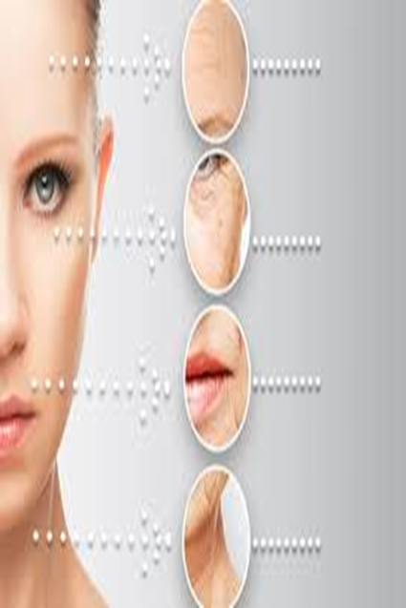
Problem and Significance
Scientific Gap
Importance
Expected Benefits
Aim of the study
Notes:
: Limited understanding of laser-tissue interaction models to optimize treatment parameters.
• Importance: Proper use of laser radiation enhances clinical outcomes, reduces surgical complications, and improves patient safety.
• Expected Benefits:
- Enhance wound healing and reduce blood loss.
- Decrease inflammation and surgical range.
- Enable precision in targeting tissue, avoiding damage to surrounding areas.
- Support the development of personalized laser treatments.
• Aim: To determine the ideal laser parameters for treating different skin lesions across various skin phototypes without side effects.

Slide 5
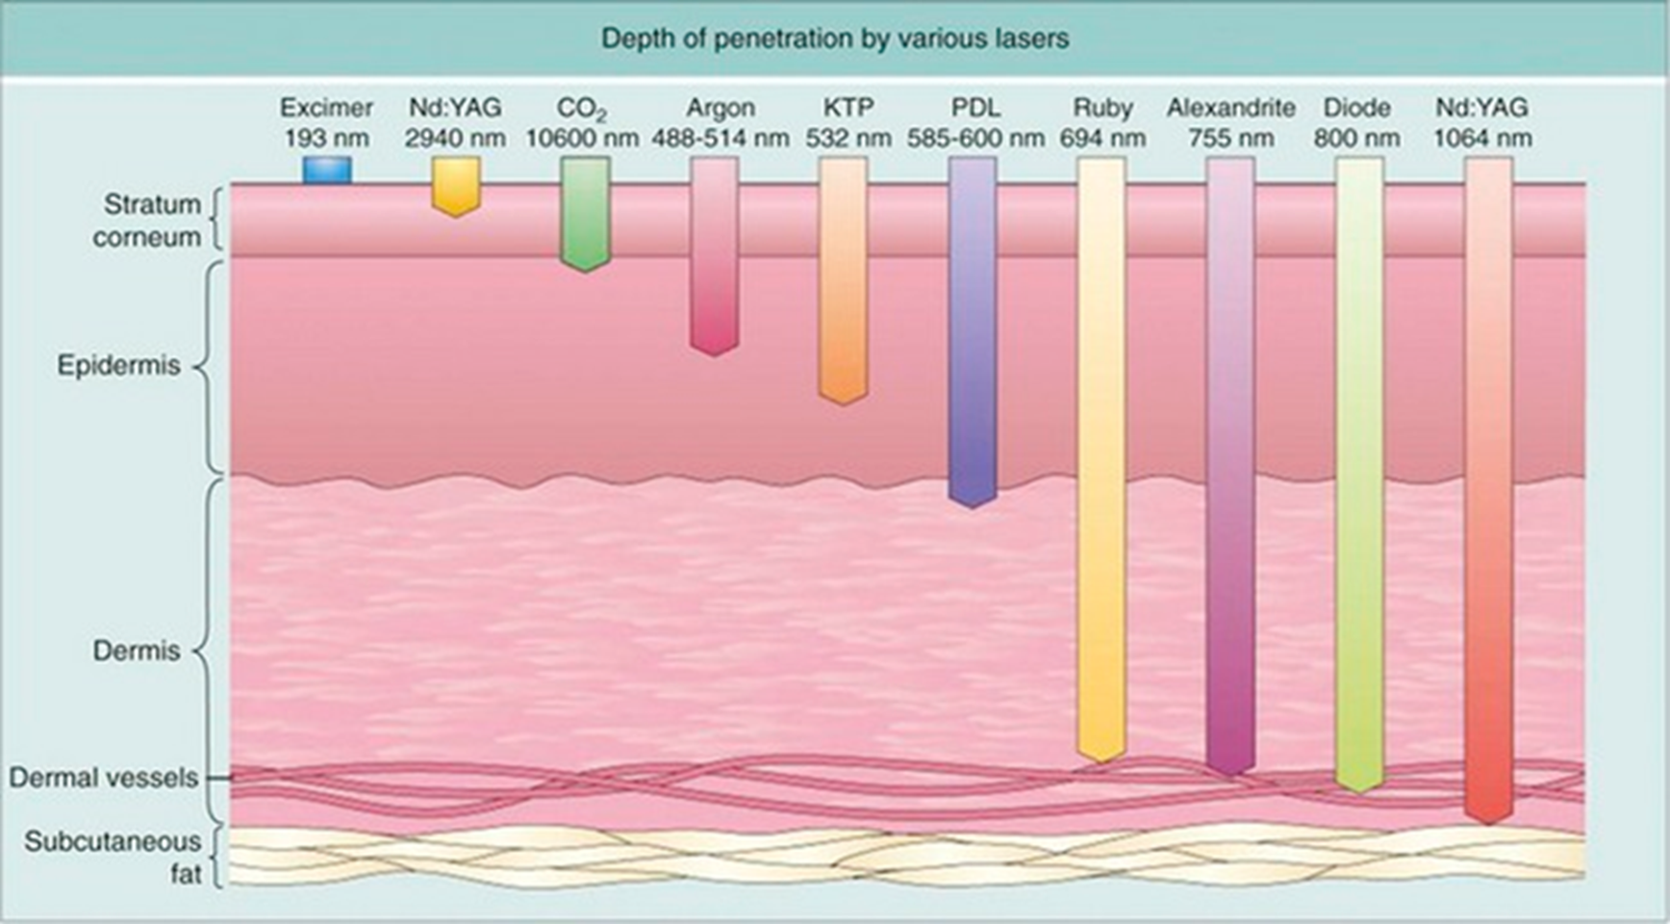
Lasers in Dermatology
Notes:
CO₂ Laser: Used for deep skin resurfacing, scars, and surgical removal. Ideal for thick lesions but requires longer healing.Er:YAG Laser: Suitable for superficial to moderate resurfacing with minimal thermal damage.Nd:YAG Laser: Penetrates deeply; effective for vascular lesions and hair removal in darker skin types.Alexandrite (755 nm): Best for hair removal in light skin; also used for pigmented lesions.Ruby Laser (694 nm): Targets dark tattoo ink and deep pigmentation.Pulsed Dye Laser (PDL): Treats superficial vascular lesions like rosacea and port-wine stains.Fractional Lasers: Divide the beam for precise, faster-healing rejuvenation; used for scars and wrinkles.Laser selection depends on:Type and depth of the skin conditionSkin phototype (I–VI)Desired clinical outcome and healing time

Slide 6
Properties governing the treatment
Laser parameter
Tissue parameter
Wavelength
Fluence
Intensity
Pulse duration
Spot size
skin Cooling
skin phototype (Melanin)
Target location within the skin
Thermal properties of the target tissue
Skin optics
Notes:
Optical features of tissues; such as reflection, scattering, and absorption can, together, determine to define the transmission of the biological tissue at a specific laser wavelength[31]. Tissues’ thermal features and laser parameters (wavelength, pulse duration, focal spot size, fluence, and intensity), on the other hand, govern this interaction.

Slide 7
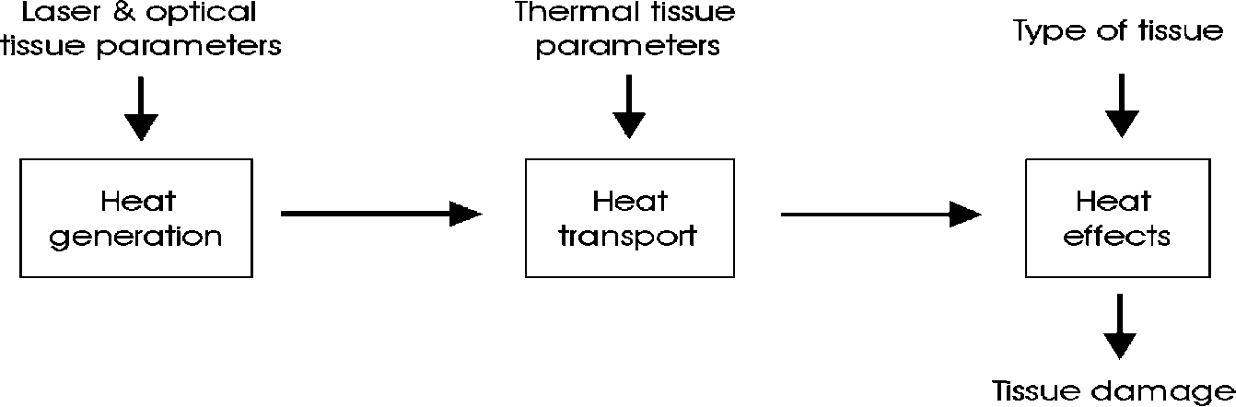
Laser Tissue Interaction
Flow chart with important parameters for modeling thermal interaction
Notes:
this Flow chart present important parameters for modeling thermal interaction
Heat generation is determined by laser parameters such as intensity, pulse duration, and optical tissue properties. While heat transport is governing by the thermal properties of the tissue as well as exposure time

Slide 8
Heat generation : Skin optics
The geometry of reflection, scattering, transmission, and absorption
Notes:
At almost perpendicular fallen, a small part of the incoming radiation is reflected because of the modification in the refractive index among air and stratum cornea This fallen beam reflectance from normal skin is for the spectral range 250-3000 nm; for both black and white skins the rest of incident radiation on the skin layers may be scattered or absorbed. These are the essential process taken altogether to find laser depth under the surface, as well as the remittance of scattered radiation from the tissue

Slide 9
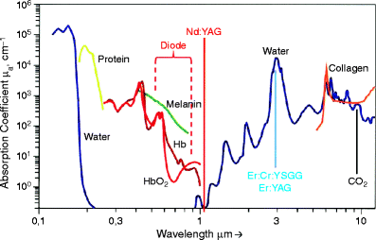
Absorption of Light by different tissue components
Notes:
Melanin presents the skin essential pigment and it is very important epidermal chromophores. Its absorption coeﬃcient across the visible spectral toward the ultraviolet; taking into account the skin photo-type and its Melanosomes per unit volume [58]. Hemoglobin is dominate in vascularized tissue. Its relative absorption peaks are almost 420nm, 280nm, 540nm, and 580nm, and then manifest a cut-oﬀ at about 600nm. Common merit of utmost biomolecules present in their complex band structure among 400nm and 600nm[59]. As neither macromolecules nor water sharply absorbs within the NIR, a “curative window” is condoned between 600nm and 1200nm. In this electromagnetic range, radiation breaking through biological tissues with minimal losses, thus enabling treatment of deeper tissue structure

Slide 10
Calculation
με = mel % x μ₁ + (1-mel %) μ2 ………………………….(2.1)
µa der = blood % µa (blood) + water % µa (water) …….. (2.2)
Iᵪ =I˳ exp. (- µₐ χ) ………………………………………...(2.3)
F = R Fo + Io ………………………………………...…… (2.4)
T = [F µ/c r] [t/t + τ] 1/g…………….…………………..(2.5)
Notes:
Determine Effective Absorption in the Epidermis Estimate melanin concentration in the patient’s skin to calculate the epidermal absorption coefficient:USING EQ (2.1)Calculate Dermal Absorption Based on Tissue Composition Use the proportion of blood and water in the dermis to determine total dermal absorption coefficient: USING EQ(2.2)Apply Beer-Lambert Law for Intensity Attenuation with Depth Calculate the laser intensity at depth 𝜒χ in the tissue: (2.3)Determine Total Incident Fluence on Skin Estimate (from both absorbtion and scattering) and absorption to estimate temperature increase (ΔT) at the lesion:Δ (2.5)This structured method ensures precise modeling of how laser light interacts with skin layers, enabling effective and safe dermatological treatments.

Slide 11
Study Methodology
Study Design:
This is a clinical, interventional study.
Participants:
Fifteen volunteers aged 20–70 years with Fitzpatrick skin types I–IV and various dermatological conditions
Laser parameters were tailored to the patient’s skin type and lesion depth, ensuring safe fluence and pulse durations. Skin was prepared pre-treatment and protected post-treatment according to standard protocols.
inclusion/Exclusion Criteria:
Treatment Protocol:
Laser parameters were tailored to the patient’s skin type and lesion depth, ensuring safe fluence and pulse durations. Skin was prepared pre-treatment and protected post-treatment according to standard protocols.
.

Slide 12
Study Methodology
Devices Used:
Elite+™ Nd:YAG (1064 nm & 755 nm) ACTION II™ Er:YAG (2940 nm) 1927 nm fractional thulium laser (LASEMD™) 980 nm diode laser Dana Magnum Q-Switched Nd:YAG

Slide 13
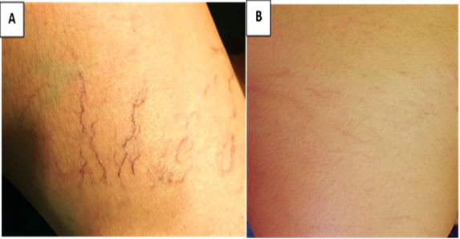
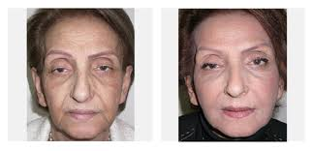
Some of the cases treated
Vein treatment
Non ablative resurfacing
Notes:
Non-ablative laser treatments using 1064 nm Nd:YAG and 2940 nm Er:YAG lasers showed significant efficacy in treating enlarged veins and wrinkles with minimal downtime. Higher fluence levels were required for deeper veins and lighter skin tones, while darker skin types needed careful adjustment to avoid overheating. Er:YAG offered faster healing due to minimal residual thermal damage, while Nd:YAG enabled deeper dermal penetration with lower risk to melanin. Overall, both lasers provided safe, effective outcomes across various skin types with minimal side effects.

Slide 14
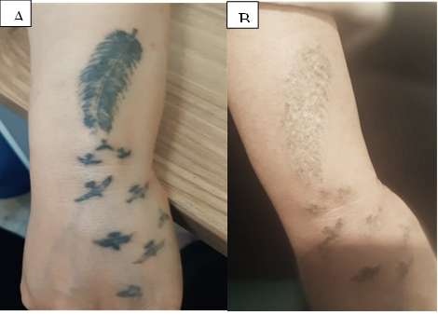
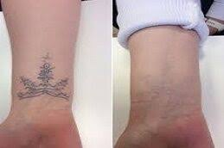
Tattoo removal result
Notes:
The 1064 nm laser has moderate photo-acoustic shock waves strength that didn’t cause blood micro-vessel burst. Throughout the treatment sessions, no significant adverse effects were reported. The patient did not experience blistering, scarring, or permanent textural changes. There was, however, temporary frost-like whitening that appeared immediately after the laser exposure, which resolved within 10 days. The skin healed well, showing no long-term complications. Mild redness and slight purpura were noted in the treated areas due to dermal blood capillary damage, particularly when using higher-intensity pulses, as seen in Figure

Slide 15
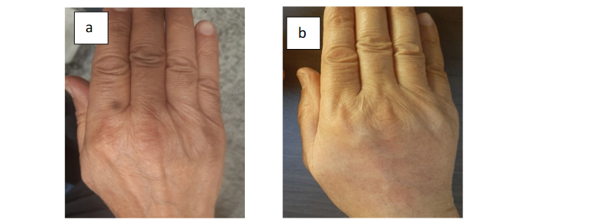
Fractional Laser Result (Ablative)
Notes:
Course wrinkle treatment with fractional 2940 nm laser The thermally ablated tissue can rebuild by fibrous activity of neo-collagenases and epidermal stem cell reproduction, much like in invasive laser resurfacing. Fractional resurfacing has fewer side effects and a quicker recovery time than ablative resurfacing. Even so, most erythema and edema go away in a few days. After three treatment sessions spaced four weeks apart, there was an excellent improvement in the wrinkles of subjects as illustrated in figures

Slide 16
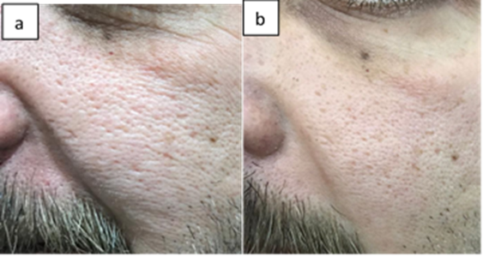
Non-Invasive Fractional 1927nm laser
Notes:
The non-invasive 1927 face resurfacing was used to smooth face texture. This laser is intended to address hyperpigmentation brought on by aging and sun damage, as well as to improve texture, mild to moderate wrinkles, and acne scars. The fractional pattern of the lasers helps with the safety and downtime profile, as well as the treatment's efficacy, as Figure

Slide 17
Comparison Between Fractional 2940 nm and 1927 nm Lasers
Wavelength & Mechanism:
Treatment Outcomes:
Recovery and Side Effects:
Patient Comfort
Notes:
Wavelength & Mechanism:2940 nm (Er:YAG): High water absorption, precise ablation, minimal thermal damage (~20–50 µm).1927 nm: Targets water with shallow, wide thermal zones; leaves stratum corneum intact.Treatment Outcomes:2940 nm: Greater wrinkle and texture improvement, even after one session (Fig. 4.15).1927 nm: Moderate results in wrinkles, texture, and pigmentation after three sessions.Recovery and Side Effects:2940 nm: Slightly more aggressive, minor downtime, occasional mild purpura.1927 nm: Milder, minimal redness/swelling, safe for darker skin.Patient Comfort:Both used topical anesthetics; moisturizers aided healing.

Slide 18
Conclusion
Precise Laser Parameters
Clinical Efficacy
Scientific Approach
Advanced Technologies
Notes:
Precise Laser Parameters: Accurate calculation of laser settings and tissue temperature rise minimizes damage and enhances treatment safety.
Clinical Efficacy: Long Pulse Nd:YAG and Er:YAG lasers effectively treat varicose veins, skin rejuvenation, and tattoo removal with high success and minimal side effects.
Scientific Approach: Using pre-determined parameters provides a reliable alternative to trial-and-error methods, ensuring consistent outcomes and patient safety.
Advanced Technologies: Fractional Er:YAG and 1927 nm diode lasers are effective tools in modern aesthetic treatments, particularly for skin and vascular conditions.

Slide 19
Thank you

