Slide 1
Anchorage Is the resistance to unwanted tooth movement. As the active components are applying force to move the teeth, another force equal in magnitude and in opposite direction, which must be lower than the force magnitude required to move the teeth. Anchorage is an imaginary component provided by the retentive components and the base plate contacting the teeth.

Slide 2
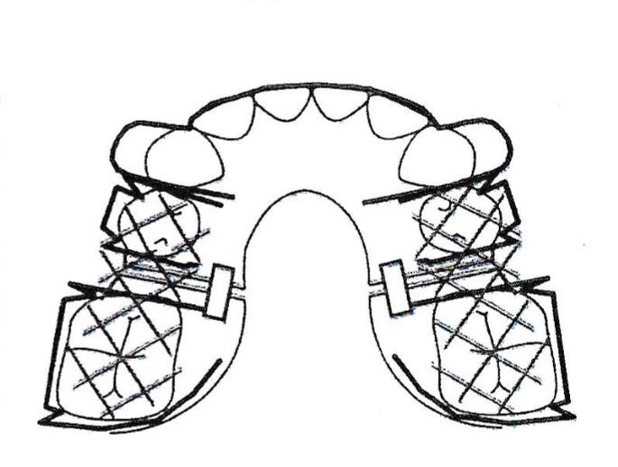
An appliance used to move the molars distally, to re open the space lost by drifting, will have adequate retention provided by the adam′s clasp. However, if the screws are activated at the same time there is a risk of having unwanted tooth movement, so the activation of the screws must be alternately

Slide 3
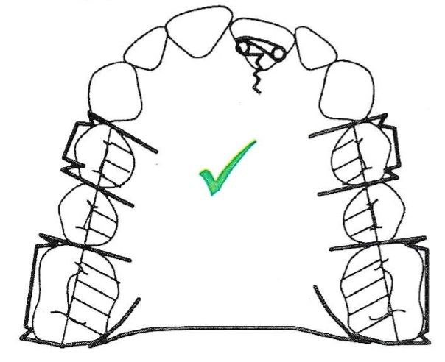
An appliance designed to move an upper incisor in cross bite, anterior retention in addition to posterior retention is always required.

Slide 4
When planning the design of an orthodontic appliance, it is important to follow the following:
If the patient has a bad habit( thumb sucking, lip biting, tongue thrust,…), the design should include elements that can relieve the patient from this bad habit.
The design features and adaptations of the device are designed to ensure the development of sufficient force and its application in the right direction.
If there are anomalies in the position of teeth and a lack of space in the dental arch, it is important to select elements that will help solve these problems.
Identify the required tooth movement. This will help in selecting the appropriate active components, and whether there is a need to add modification to the base plate or not.
Retentive components cannot be used on teeth that to be moved , except when the screw is used then fitted labial arch is placed on anterior teeth with a scrow to procline them.

Slide 5
Some Designs of Removable Orthodontic Appliances

Slide 6
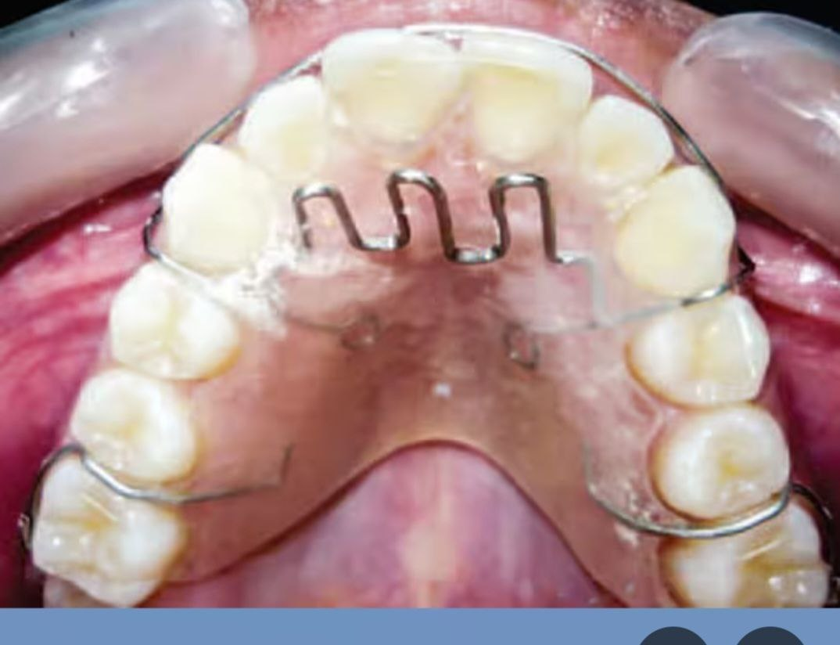
Habit breaker appliance
Components: Tongue cribs, Adam’s clasps, Hawley arch, Acrylic base plate

Slide 7
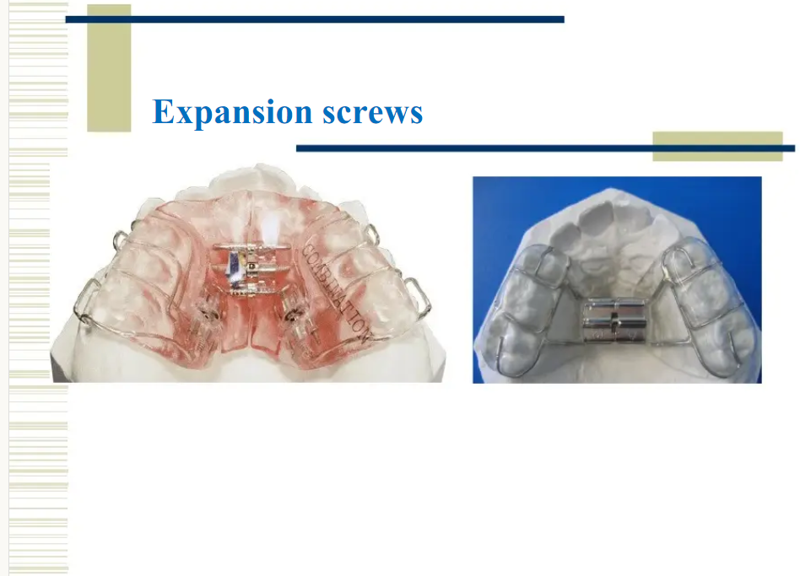
Removable Orthodontic Appliance with expansion screw designed for treatment of maxillary constriction

Slide 8
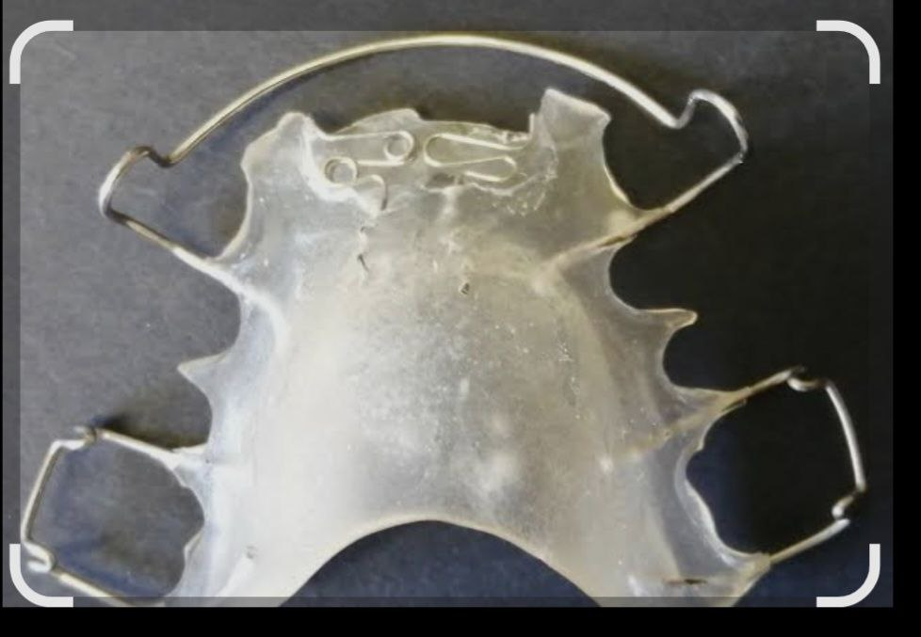
Removable Orthodontic Appliance designed to correct incisors rotation less than 90 degree

Slide 9
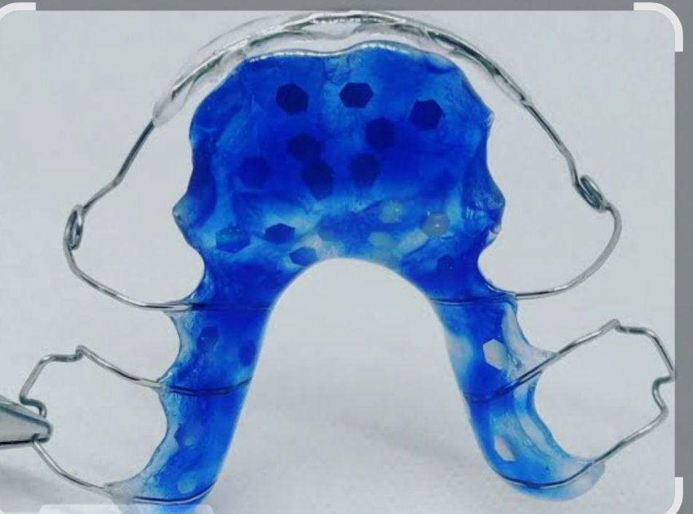
Removable Orthodontic Appliance Used to Retract the incisors when the overjet is more than 6 mm

Slide 10
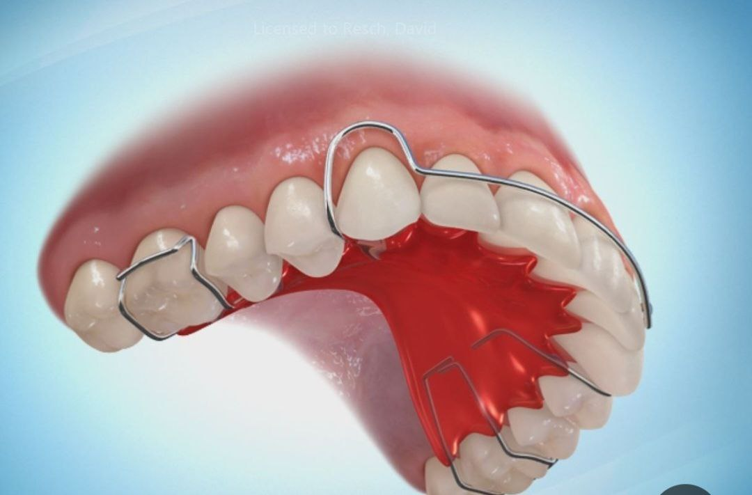
Hawley Retainer

Slide 11
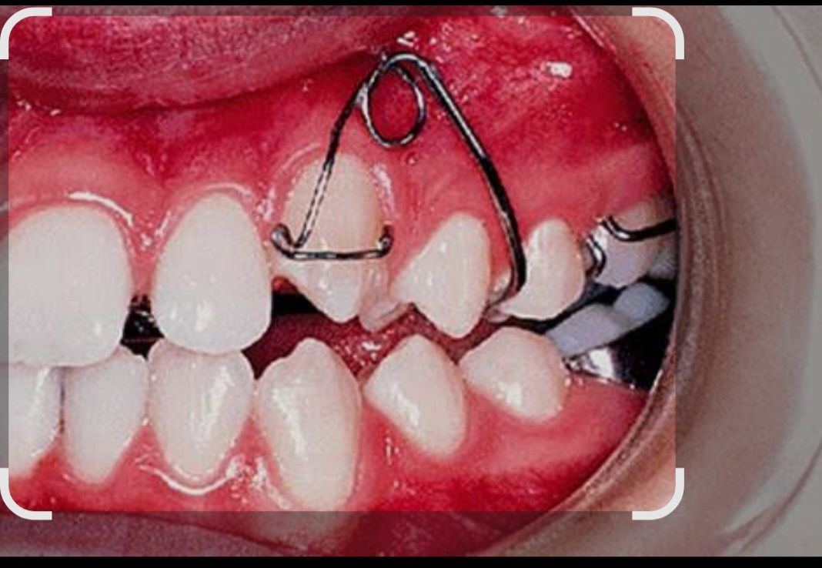
Removable Orthodontic Appliance Used to Retract the Canine Distally Composed of MBCR, Adam′s clasps and Acrylic Base Plate

Slide 12
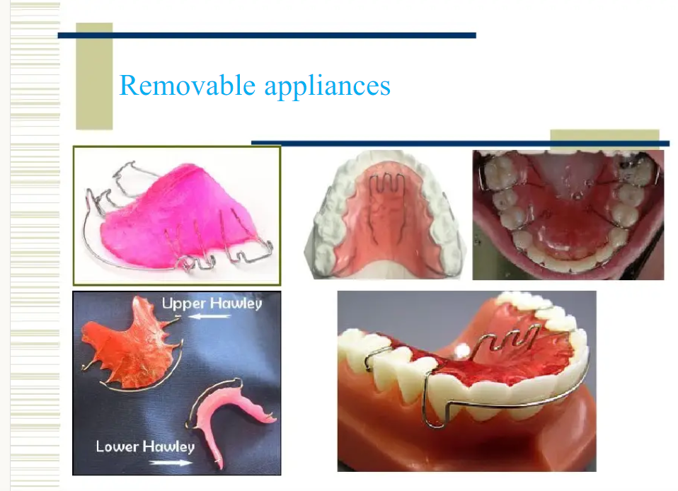

Slide 13


