Slide 1
Iatrogenic Effects of Orthodontic Treatment

Slide 2
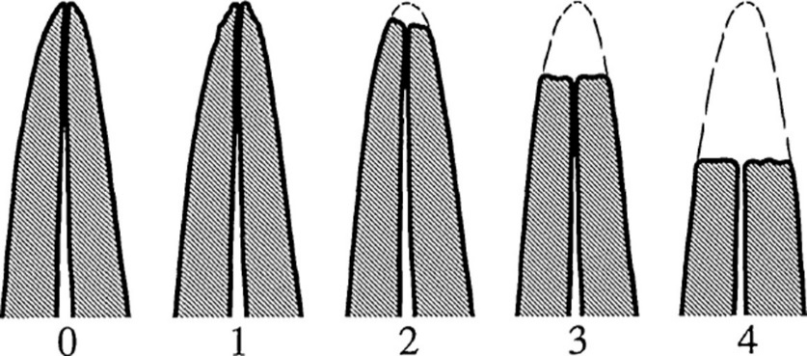
Iatrogenic effects are a reality with modern day
mechanotherapy, which can jeopardize long-term
effects of orthodontic treatment.

Slide 3
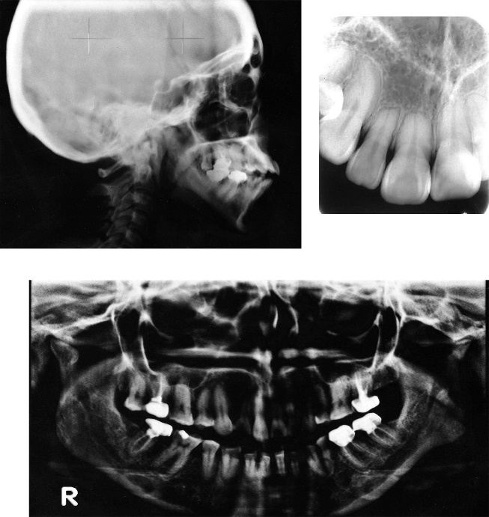
What are the causes of orthodontic
iatrogenic?
Several reasons should be analyzed to explain the
growing number of cases of iatrogenics in Orthodontics. Iatrogenics usually occurs due to inaccurate
growth prediction, incorrect choice of orthodontic appliances, technical failure by the dentist, poor
patient cooperation or lack of control of space and
anchorage, particularly when teeth are extracted for
orthodontic reasons

Slide 4
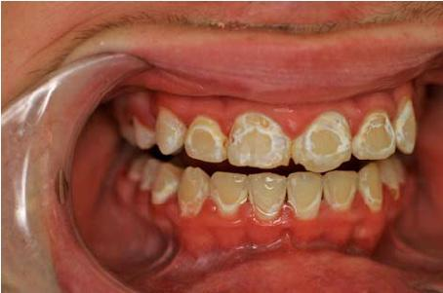
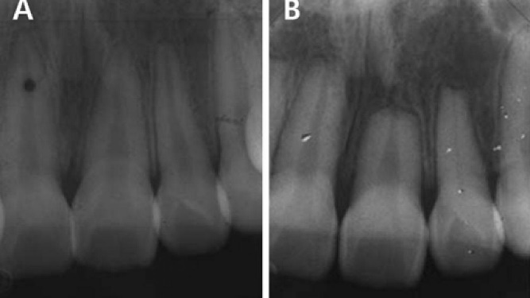
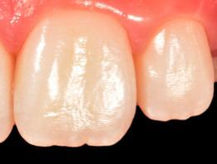
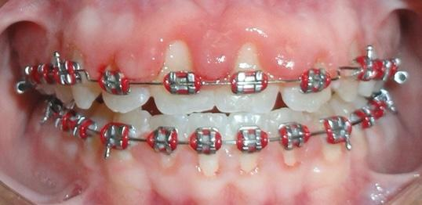
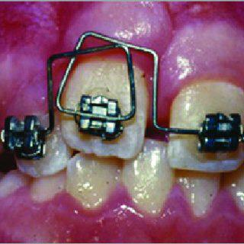
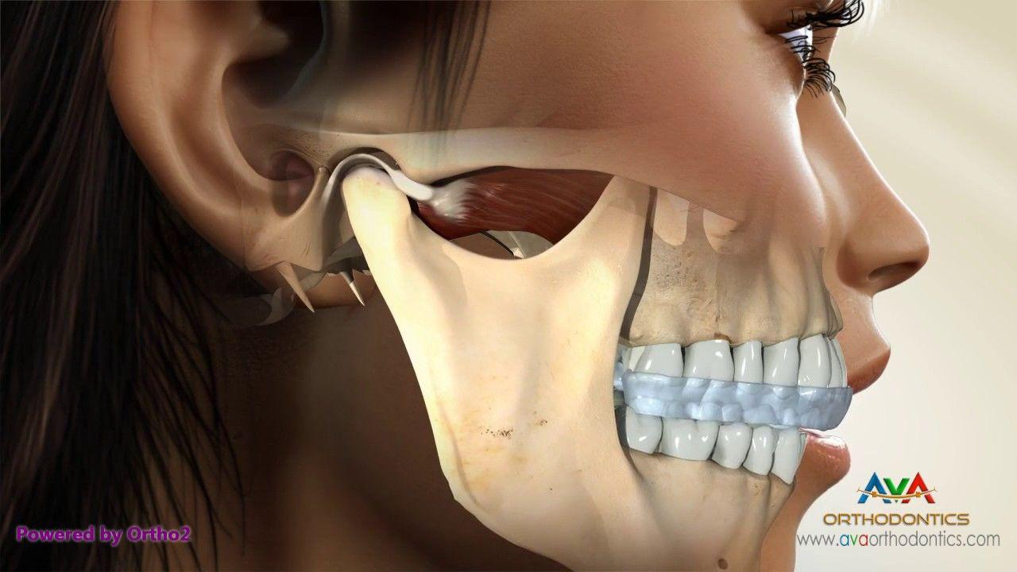
Enmal deminrization white spot lesion
External apical root resoption
Enemal wear,abration and fracture
Periodontal problemes
Injures from orthodontic appliaces
Tmj and orthodontic

Slide 5
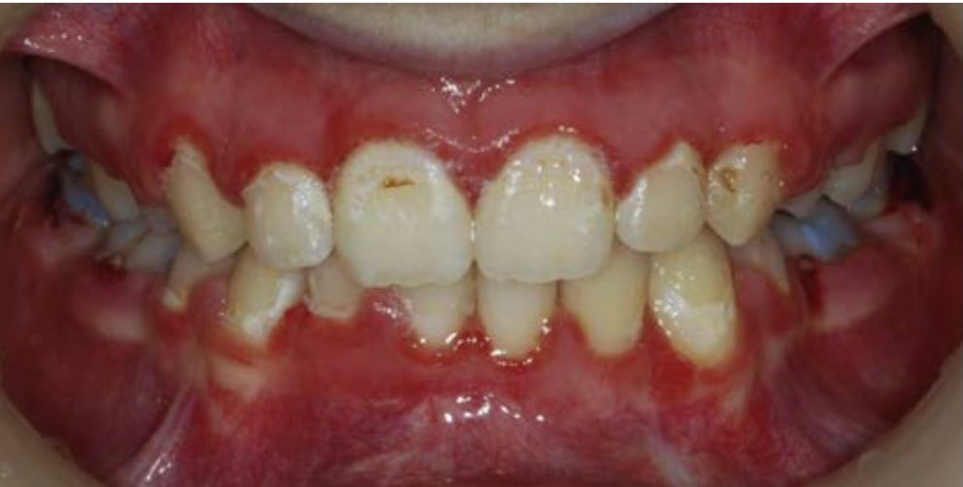
PREVENTION AND MANAGEMENT OF
DEMINERALIZED WHITE LESIONS*

Slide 6
Detection and Measurement of Demineralized White Lesions

Slide 7
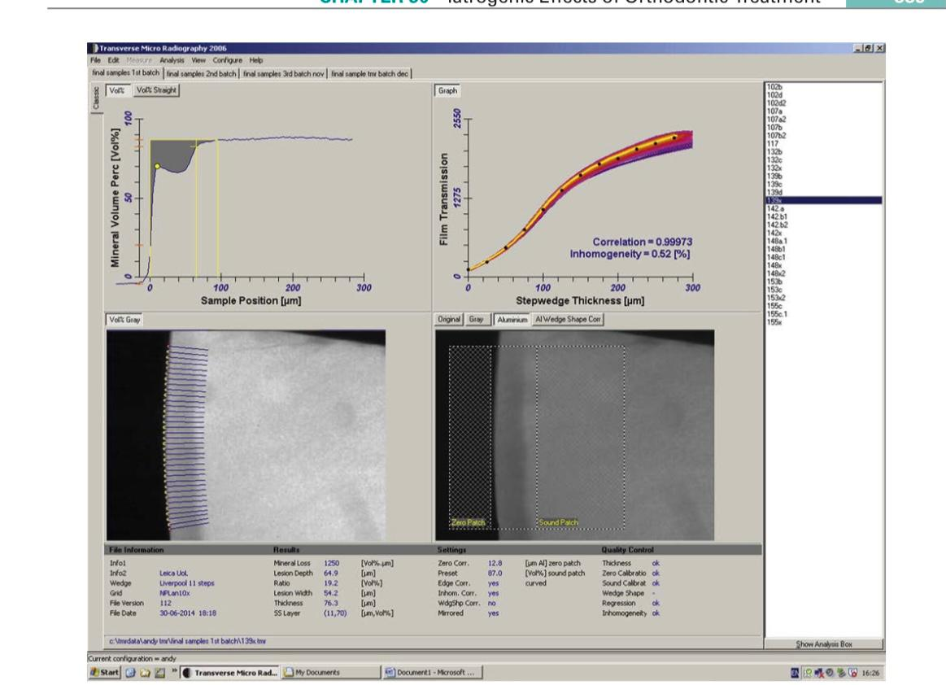
Output from dedicated transverse microradiography (TMR) software (Inspektor Research Systems, Bussum, Netherlands) illustrates subsurface mineral loss. (Courtesy of Inspektor Research Systems, Bussum

Slide 8
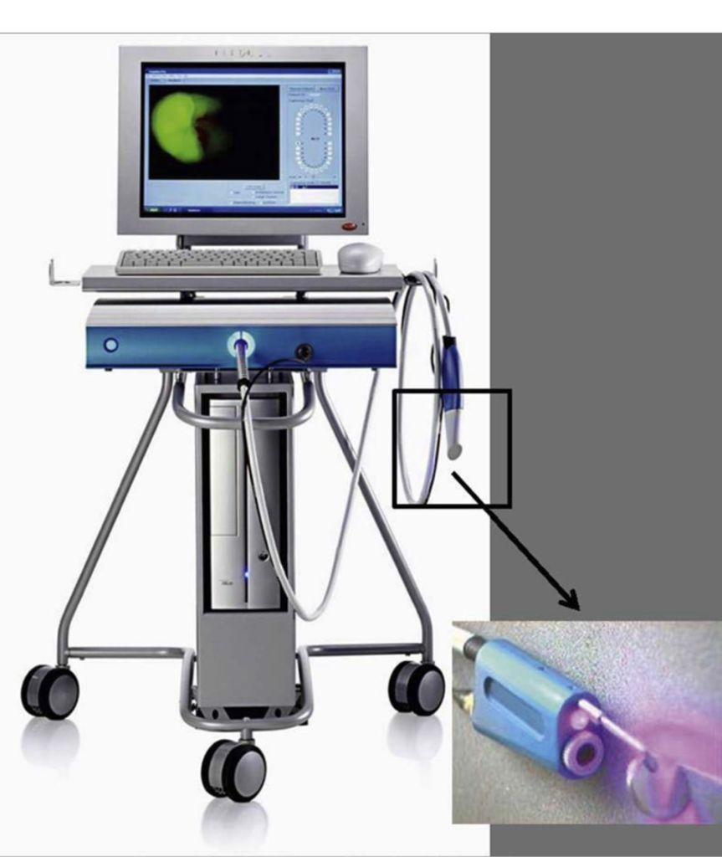
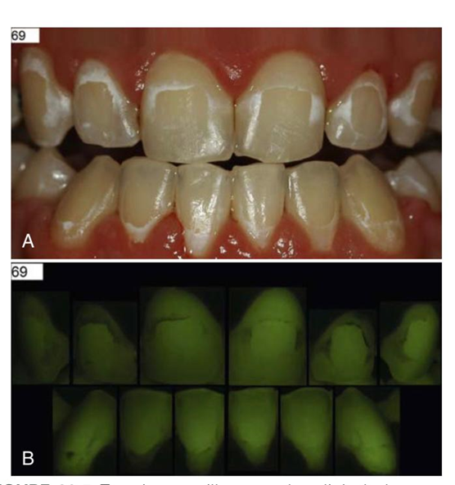
Quantitative Light-Induced Fluorescence

Slide 9
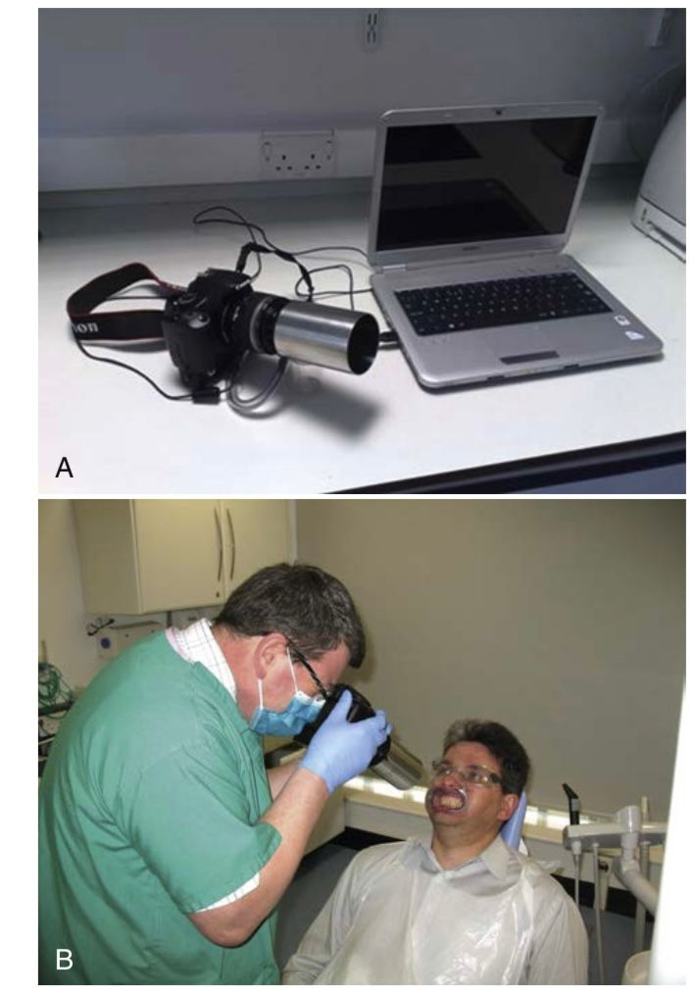
Quantitative Light-Induced Fluorescence–Digital

Slide 10
Reducing the frequent consumption of sugar (diet advice)
Sealing the enamel

Slide 11
Promoting the Uptake of Mineral into Enamel (Remineralization)
1-Increasing the availability of fluoride in the mouth.
Toothpaste.
Mouth Rinses.
Varnish.
Bonding Materials
. Elastics.
Slow-Release Devices.
Diet

Slide 12
Increasing the availability of calcium and phosphate. Ample evidence states that fluoride promotes the remineralization of enamel; however, this process also requires the presence of calcium and phosphate ions. Fluorapatite (chemical formula Ca10[PO4]6F2) contains three times more phosphate and five times more calcium than fluoride ions; therefore a relative deficiency of calcium and phosphate may delay or stop remineralization

Slide 13
Treatment of Demineralized White Lesions

Slide 14
Fluoride
Casein Phosphopeptide–Amorphous Calcium Phosphate
Resin Infiltration

Slide 15
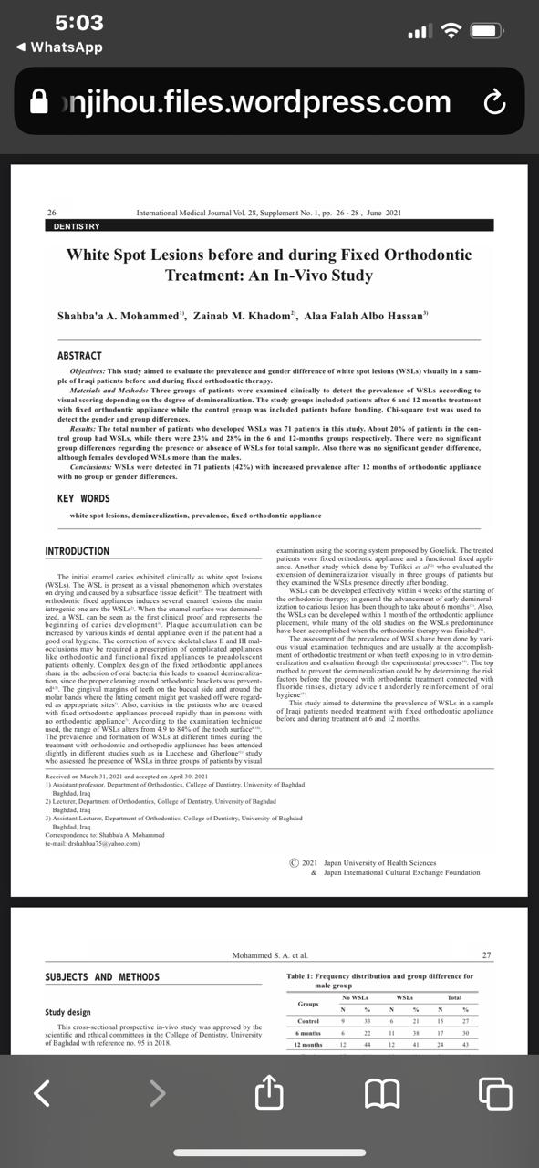

Slide 16
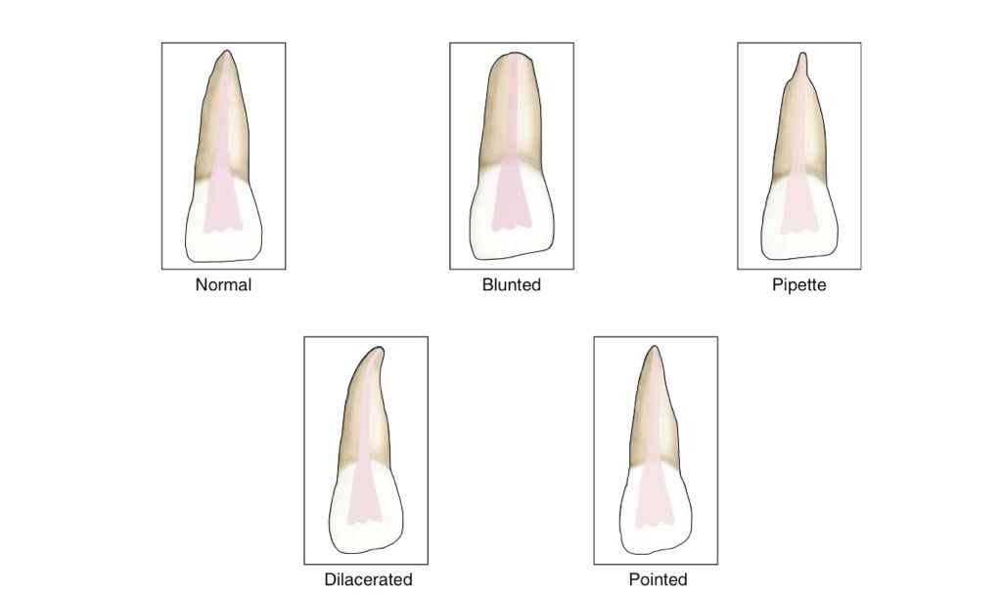
ROOT RESORPTION
Root resorption is an unwanted side effect seen with certain type of tooth movements, particularly intrusion. Fortunately, this is usually minimal, affecting the apical 1-2 mm only. It starts initially as either surface resorption or transient inflammatory resorption and if left unchecked, it further proceeds to progressive inflammatory resorption. Such resorption should not compromise the long-term health of the teeth. More severe resorption, where more than a quarter of the root length is lost, is rare and occurs in only 3% of patients.

Slide 17
The root apex is affected more than cervical or middle thirds of root because of the following reasons.
• The applied forces are concentrated on apex, particularly during intrusion.
• It is made of cellular cementum, which is less mineralized and easily capable of being resorbed.
• It depends on patent vascularization and is easily injured in faces of heavy forces with concomitant vascular stasis.

Slide 18
A genetic predisposition to root resorption has been recognized recently. Decreased IL-1 production in the case of IL-1B allele 1 may result in relatively less catabolic bone modeling (resorption) at the cortical bone interface with the PDL, which may result in prolonged stress concentrated in the root of the tooth, triggering a cascade of fatigue-related events subsequently leading to root resorption.

Slide 19
PULP DAMAGE AND LOSS OF TOOTH VITALITY
Various studies of changes in pulp tissue vascularity during orthodontic treatment, suggest that blood flow to the dental pulp decreases initially after orthodontic force application. However, it increases thereafter until it reaches a peak 7 days after the application of orthodontic force. These processes, depending on the degree of their disturbances, may cause changes in the metabolic cell activity, cell damage, or defense reactions. Orthodontic forces affect the dental pulp inducing vascular changes that are inflammatory in nature. As demonstrated in the rat model, the inflammatory vascular reactions subside within 3 weeks in all tissues.

Slide 20
DAMAGE TO THE INTRA-ORAL TISSUES
Mucosal trauma is fairly common during the orthodontic treatment and can be caused by many factors including ulceration by the brackets and the protruding archwires near the molar region, chemical burns from the acid-etchant and clumsy instrumentation. Prevention techniques include:
• Careful instrumentation.
• Cutting distal ends short.
• Using bumper sleeve on long spans of wire.
• Providing patients with wax to avoid mucosal irritation from the brackets.
• Using high volume suction and flushing with copious water after the acid etching procedure.

Slide 21
Soft Tissue Complications Related to Micro Implants
Micro-implants are highly useful in orthodontics for skeletal anchorage in critical anchorage situations. Their simple design and ease in implantation and removal makes them a good option for the some patients requiring skeletal anchorage. However, potential problems and soft tissue complications are common with their use. Impingements and trauma to soft tissue overlying the implant is fairly common causing soft tissue damage to the buccal mucosa and attached gingiva related to the implant site. Peri‑implantitis or inflammation of the gingiva around the implant can occur as a result of improper oral hygiene maintenance. Adequate oral hygiene must be ensured to prevent tissue inflammation around the implant site.

Slide 22
ENAMEL ABRASION
Stainless steel brackets tend to induce less enamel abrasion than ceramic brackets. It was also noticed that single crystal ceramic causes more enamel abrasion than polycrystalline ones . Ideally, cross bites must be corrected before placing ceramic brackets and ceramic brackets used on mandibular teeth must be kept out of occlusion to prevent enamel abrasion. In patients with deep bite, use of bite planes is advocated to minimize interference and the subsequent risk of enamel abrasion.

Slide 23
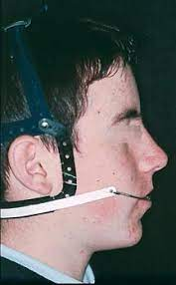
HEADGEAR INJURIES DUE TO CARELESS HANDLING

Slide 24
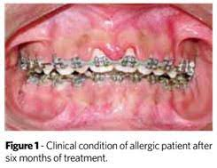
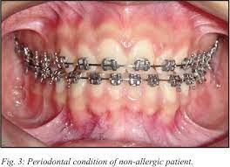
ALLERGIC REACTIONS FROM ORTHODONTIC APPLIANCES Orthodontic materials have the potential to induce allergic reactions in some patients. Nickel present in orthodontic appliances like brackets, bands, and archwires is responsible for causing allergic reactions in some patients. Latex present in gloves, elastics, and elastomeric ligatures may also cause reactions in a few patients allergic to the protein antigen present in rubber. Methyl methacrylate found in bonding agents and composite is also responsible for allergic reactions in rarely. The reactions might range from ulceration, erythematous lesions, or even anaphylactic shock, depending on the patient.

Slide 25
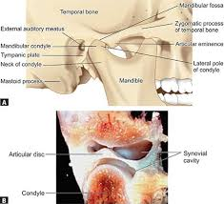
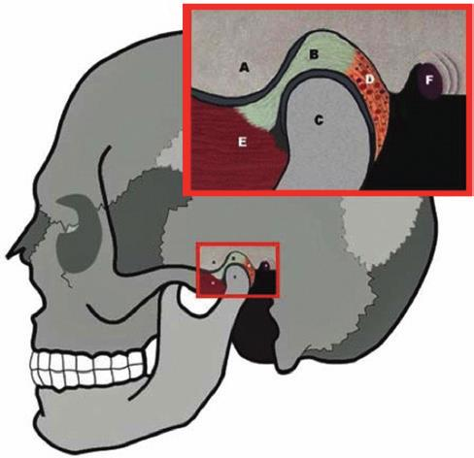
TMJ PROBLEMS
The role of occlusion in the development of temporo-mandibular disorders (TMD’s) has been well researched in the orthodontic literature and is a subject of high controversy. A review of the currently available literature regarding the relationship between morphologic and functional occlusal factors relative to TMD reveals that there is a relatively low association of occlusal factors in causing TMD.Severe skeletal anterior open bite, discrepancy between centric relation and centric occlusion (CR-CO discrepancy) greater than 4 mm, over-jet greater than 6 to 7 mm, unilateral lingual crossbite, and five or more missing posterior teeth are the conditions that have been associated with specific diagnostic groups of TMD conditions. It has been proposed by McNamara et al. that the first three factors often are associated with TMJ arthropathies and may be the result of osseous or ligamentous changes within the temporomandibular articulation

Slide 26
POTENTIAL ADVERSE EFFECTS TO THE PERIODONTAL TISSUES

Slide 27
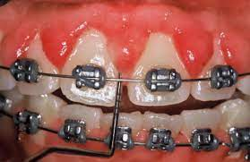
Gingival Inflammation
Plaque is the major etiologic factor in the development of gingivitis. Experimental animal studies have shown that in the absence of plaque, orthodontic forces and tooth movements do not induce gingivitis. In the presence of plaque, however, similar forces are capable of inducing angular bone defects and with tipping and intruding orthodontic tooth movements, attachment loss can occurn.In healthy, reduced periodontal tissue support regions, orthodontic forces kept within the biological limits do not cause gingival inflammation. The most important factor in the initiation, progression and recurrence of periodontal disease in reduced periodontium is the presence of microbial plaque.

Slide 28
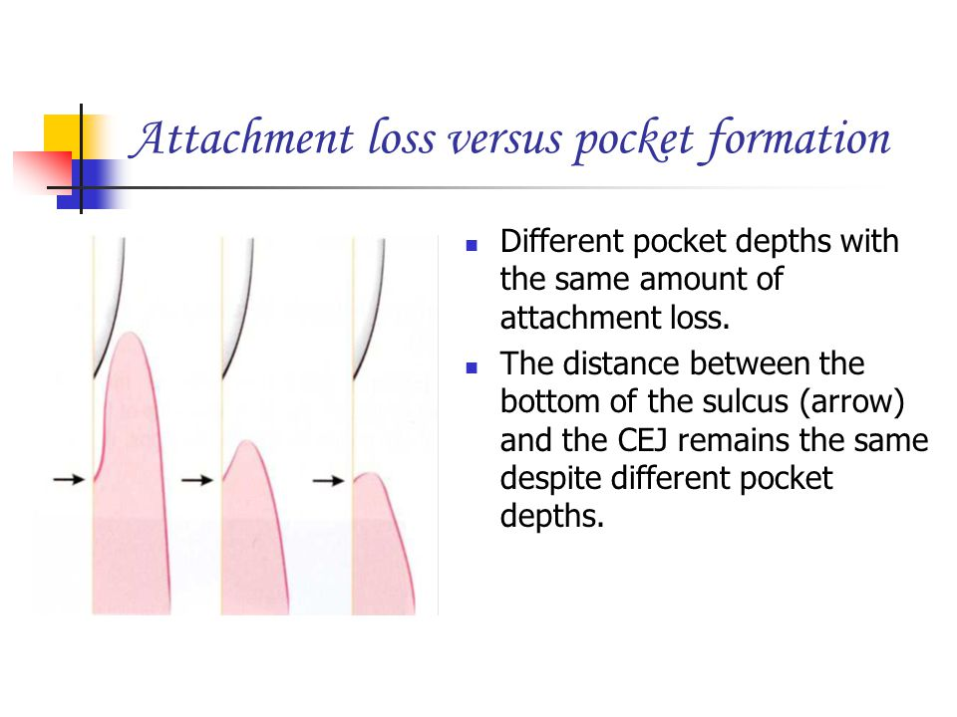
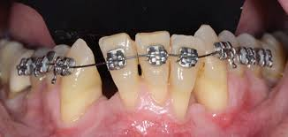
Attachment Loss
In many orthodontic patients, the principal reason for the associated gingival and periodontal inflammation involves mechanical irritation caused by the band or cement, in addition to trapped plaque. The risk of attachment loss can be anticipated when such iatrogenic irritations are present. Results of a histological study on human periodontal tissues confirm that the orthodontic banding have to be performed with great care along with excellent oral hygiene in order to avoid permanent periodontal destruction.

Slide 29
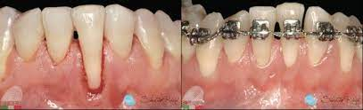
Gingival Recession
An adequate amount of attached gingiva is necessary for healthy gingival tissue and to deliver orthodontic treatment without adverse periodontal complications. The incisors showed apical displacement of the gingival margin with labial bodily movement. Loss of connective tissue occurred in the presence of preexisting untreated gingival inflammation was present. Therefore, if the tooth movement is expected to result in a reduction of soft tissue thickness and an alveolar bone dehiscence may have occurred in the presence of inflammation, gingival recession is a risk.

Slide 30
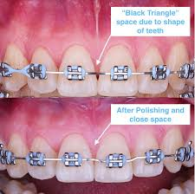
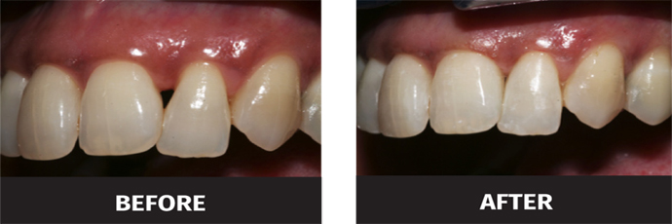
Black Triangles
Gingival embrasures are defined as the embrasure existing cervical to the interproximal contact. Open gingival embrasures exist when the embrasure space is not completely filled by the gingival tissueand can contribute to retention of food debris, thus adversely affect the health of the periodontium and are more common in adult patients with bone loss. Black triangle or open gingival embrasure can occur as potential complication in about than 1/3 of all adult orthodontic patients and should be discussed with patients prior to initiating orthodontic treatment. The key considerations in restorative and orthodontic treatment involve preserving the interdental papilla and avoiding black triangles in the gingival embrasures of the esthetic zone as open gingival embrasures are visibly un esthetic and adversely affect a person’s smile

Slide 31
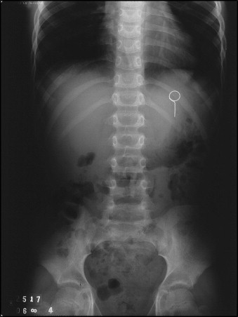
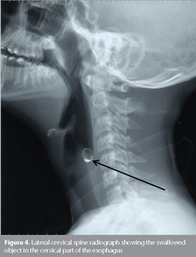
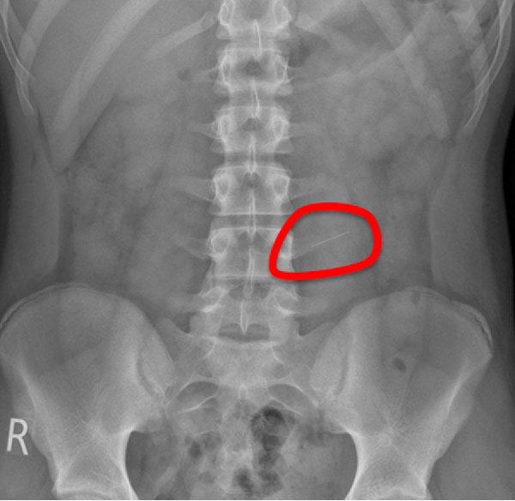
ACCIDENTAL SWALLOWING OF APPLIANCE COMPONENTS

Slide 32
PROLONGATION IN THE TREATMENT DURATION

Slide 33
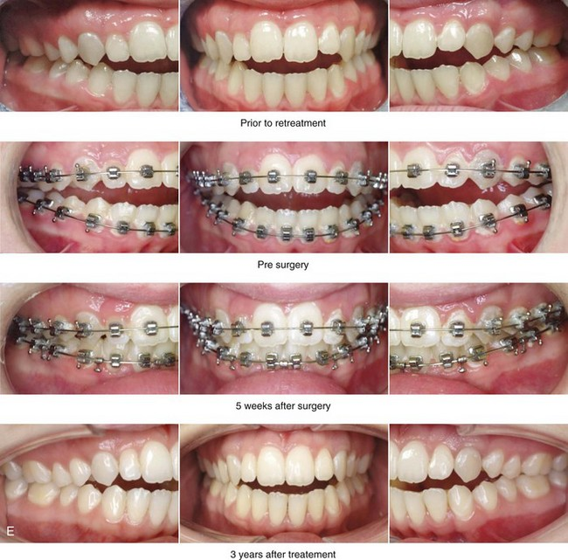
TREATMENT FAILURE AND RELAPSE
Failure to complete a course of orthodontic treatment is frustratingly common (4-23%). This may either be due to the patient’s insistence on removing the appliance earlier for personal reasons like marriage or the orthodontists’ opinion that further continuation of treatment may jeopardize the health of the dentition and the periodontal ligament, in the face of severe root resorption. Sometimes the patient might not be able to maintain oral hygiene in a satisfactory way as expected, resulting in worsening of the periodontal problem and the incidence of white spot lesions, requiring early appliance removal.

Slide 34
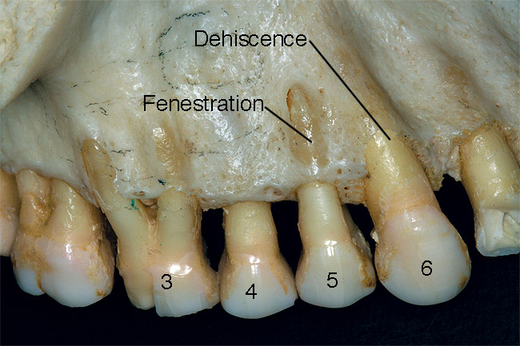

Slide 35
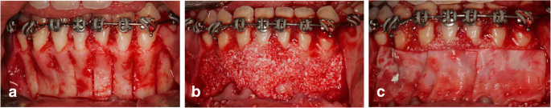
The description of the bone activation and GBR. a Performance of selective alveolar decortication. b Place bovine inorganic bone over the anterior region. c Place collagen membrane over the bone graft material)

Slide 36
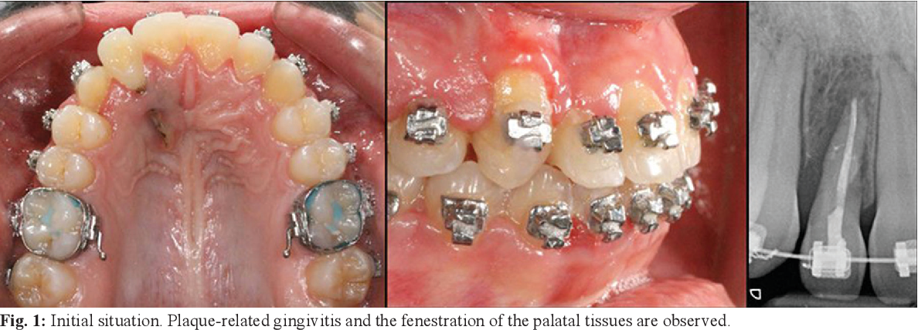

Slide 37
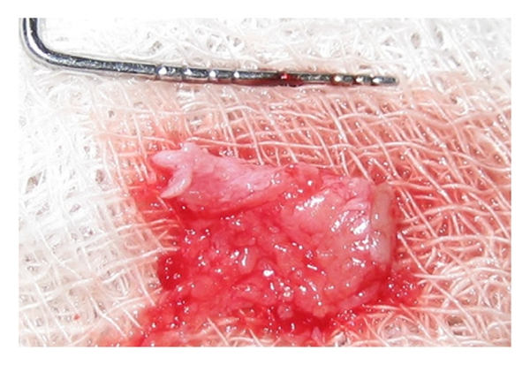
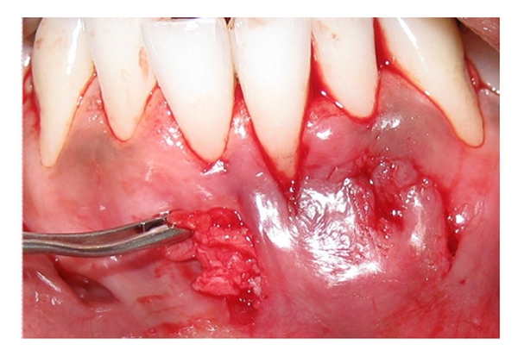
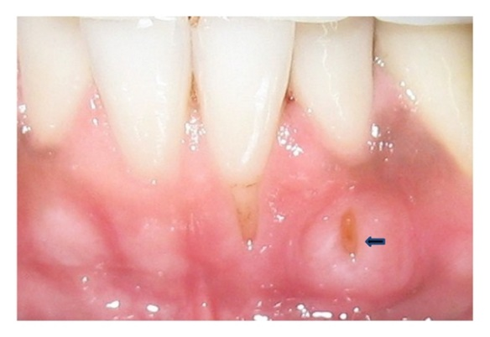
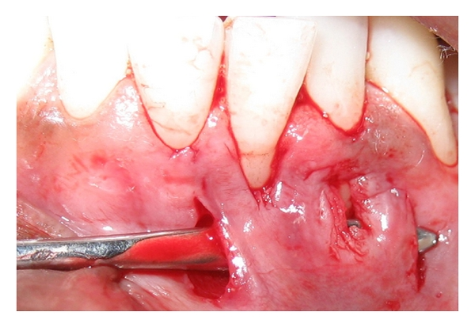
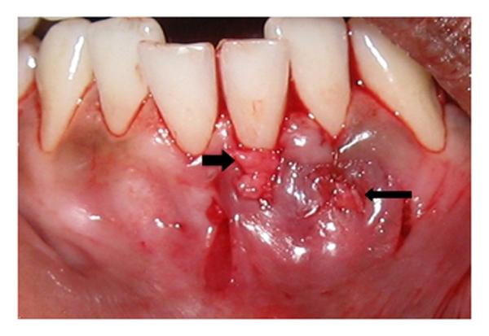
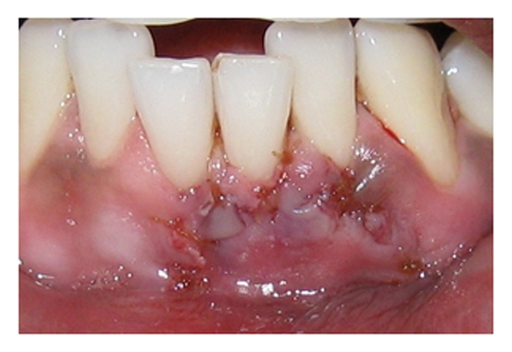
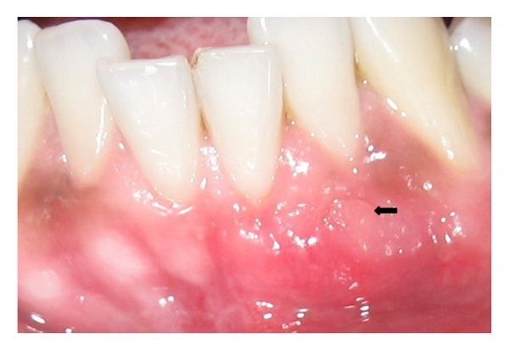

Slide 38


