Slide 1


التطبيقات الحديثة للأنظمة البايوكهروكيميائية في معالجة مخلفات المياه العادمه
اعداد
الأستاذ الدكتور علي حسين عبار
جامعة بغداد/ كلية الهندسة الخوارزمي/ قسم الهندسة الكيميائية الأحيائية

Slide 2
Bioelectrochemical systems (BESs)
Bioelectrochemical systems (BES) have been intensively studied as a new technology for wastewater treatment.
Bioelectrochemical systems (BESs) are unique systems, capable of converting chemical energy into electrical energy (and vice-versa) by employing microbes as catalysts.
The microorganisms play a crucial functional role in ensuring the success of electrochemical reactions in these devices.
Bioelectrochemical systems (BESs) are emerging technologies which use microorganisms attached to one or both bioelectrode(s) to catalyze the oxidation reaction in case of a bioanode and/or reduction reaction in case of a biocathode

Slide 3
Types of bio-electrochemical systems
Microbial electrolysis cells (MECs)
Microbial fuel cells (MFCs)
Microbial desalination cells (MDCs)
Enzymatic biofuel cells (EBCs)
Microbial reverse electrodialysis cells (MRECs)
Microbial solar cells (MSCs)
Among these different types, MFCs and MECs are commonly used for simultaneously treating wastewater and producing electricity or chemicals

Slide 4
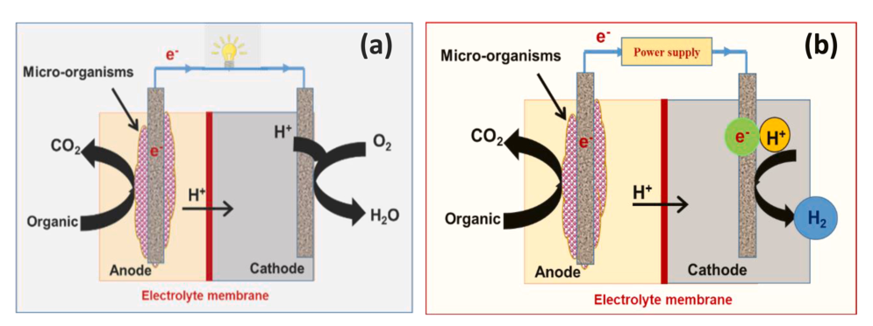
A BES is called a microbial fuel cell (MFC) if electrical power is harvested and is called a microbial electrolysis cell (MEC) if electrical energy is supplied to drive an otherwise nonspontaneous reaction. The schematics of microbial fuel and electrolysis cells, as typical examples of BESs are shown in Fig. 1. The figure shows that electricity is the main product from MFC, along with carbon dioxide and water. Meanwhile, hydrogen, carbon dioxide, and some other species are the main products from ME,
Fig. 1. Schematic diagram of bioelectrochemical cells, (a) microbial fuel cell MFC, (b) microbial electrolysis cell MEC.

Slide 5
Components of bioelectrochemical fuel cells
Electrode materials
An electrode is a solid electric conductor that carries the electric current in BESs. The electrodes in BESs are categorized into anode and cathode.
Materials ideal for the anode includes carbon felt, carbon mesh, graphite fiber brush, and carbon cloth.
In Microbial fuel Cell (MEC), Materials suitable for the cathode include platinum black, platinum, and graphite. Platinum coated electrodes are normally utilized due to their effectiveness and superiority in the generation of energy. Despite the high cost of the platinum (Pt) catalyst, it is the best-known catalyst for oxygen reduction reactions (ORR).
In Microbial Electrolysis Cell (MEC), Pt is also the best catalyst for hydrogen evolution reactions (HER). However, due to its high cost and easy poising, its application in such systems is limited, therefore different Pt-free catalysts were investigated in MEC such as stainless steel, nickel, and nickel alloys.

Slide 6
Ion exchange membrane
Different ion-exchange membranes were used in BESs, including porous and nonporous membranes.
Porous membranes include microfiltration, ultrafiltration, and nanofiltration membranes. These membranes transfer the neutral or charged species according to the pore size.
Noneporous membranes include cation exchange membranes (CEM), anion exchange membranes (AEM), and bipolar membranes (BPM). These types of membranes allow for the passage of charged pieces and prevent the oxygen crossover. Nafion, Flemion, Hyflon, polyarylene ether sulfone, polyarylene ether ketone, and polyarylene sulfone were used in BESs.

Slide 7
Substrates
The organic molecules, which microorganisms consume during cell operation, are referred to as substrates.
The substrate remains a key factor that affects the production of power. Substrates give energy to the bacterial cell to develop, which defines their pivotal role as a source for carbon energy.
The nature, constituents, and concentration of the substrate affect the microbial community and the energy that can be obtained from the BESs.
Different substrates have been considered as feedstock in BESs, including low molecular simple organic material. Complex carbohydrates, such as cellulose and starch have also been considered.
Glucose, cellulose, sodium acetate, oil refinery waste, agro process waste residuals, dairy, and vegetable waste, have all be explored as potential substrates for BESs

Slide 8
Microorganisms
Substrates that are organic in nature break down, with the aid of microorganisms, into various species and ions. This phenomenon affects the flow of electrons via the BESs.
These microorganisms are unicellular organisms with a simple or compartmented cell structure. A large number of microorganisms have proven their effectiveness as biocatalysts in BESs.
These include iron-reducing bacteria, such as Geobacter sulfurreducens, which produce high power at room temperature.
Some notable bacterial commonly used in BESs that uses glucose are Escherichia coli, Bacillus subtilis, and Proteus vulgaris. Escherichia coli, Proteus

Slide 9
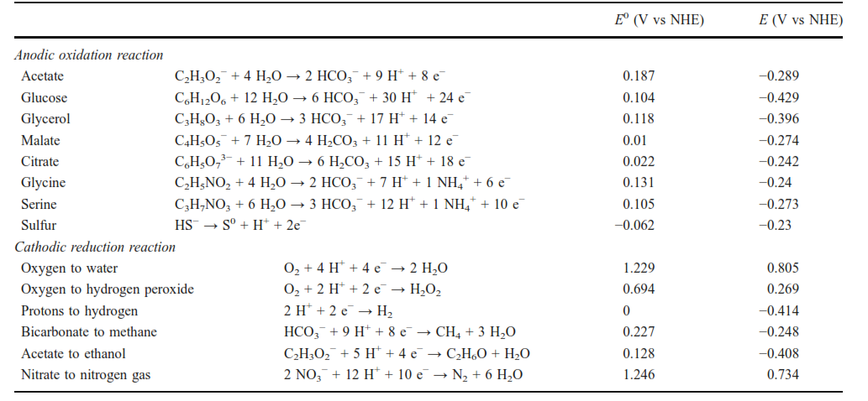
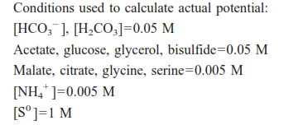
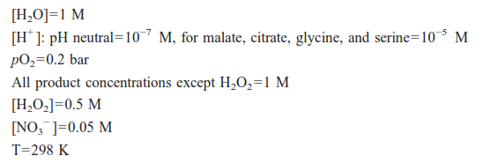
Table 1 Overview of reactions with standard potential (E0 ) and actual potential (E)

Slide 10
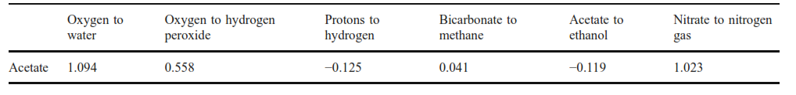
Table 2 The voltage that is gained or needs to be applied when linking acetate as the anode reaction to the different cathode reactions
Production of fuels and chemicals
Bioelectrochemical systems can be applied for the production of fuels and chemicals. For example production of hydrogen peroxide, hydrogen, methane, and ethanol .
The electrochemical reduction of carbon dioxide to methane is a complex reaction with only reasonable cathodic methane recovery on copper. The cathodic methane recovery depends on various conditions such as cathode potential, carbon dioxide concentration, and temperature .
Ethanol has been found as a byproduct in the electrochemical reductions of inorganics such as carbon monoxide. purely electrochemical reduction of organics to ethanol has not been described in literature

Slide 11
Application of BESs in wastewater treatment
Wastewater is discharged daily, with large amounts excreted from different sources, including all industrial, domestic, sewage, and agriculture sectors.
The conventional wastewater treatment technologies are cost-intensive and energy-consuming, with no valuable materials being regenerated (as the energy stored in organic wastes is useless).
Generally, around half of energy consumption occurs during aeration, while 15 % is consumed by pumping.
Bioelectrochemical systems (BESs) are unique systems, low cost with additional product as energy or material .
The proper treatment of domestic and industrial wastes and wastewater can be a useful source of energy.

Slide 12
Application of BESs in wastewater treatment
Microbial fuel cell
Microbial fuel cells are one of the most commonly exploited BESs. The application of MFCs is capable of transforming chemical energy into electrical energy via microbes. The microorganisms function as biocatalysts for the oxidation of chemical species in biodegradable substrates, with the aid of the electrodes.
These characteristics of MFCs contribute to their consideration as effective BESs for the generation of electricity .
Industrial wastewater, made up of simple and complex organic pollutants has been utilized as a substrate for MFCs.
The biofilm at the anode is complex and is usually made up of electroactive and fermentative microorganisms. The electroactive microorganisms are able to extract electrical energy from the breakdown simple organic molecules
Different types of wastewater were examined in MFC for producing electricity, as can be seen in Table 3. The table shows the effect of the anode or cathode type and/or modification on the power generation .

Slide 13
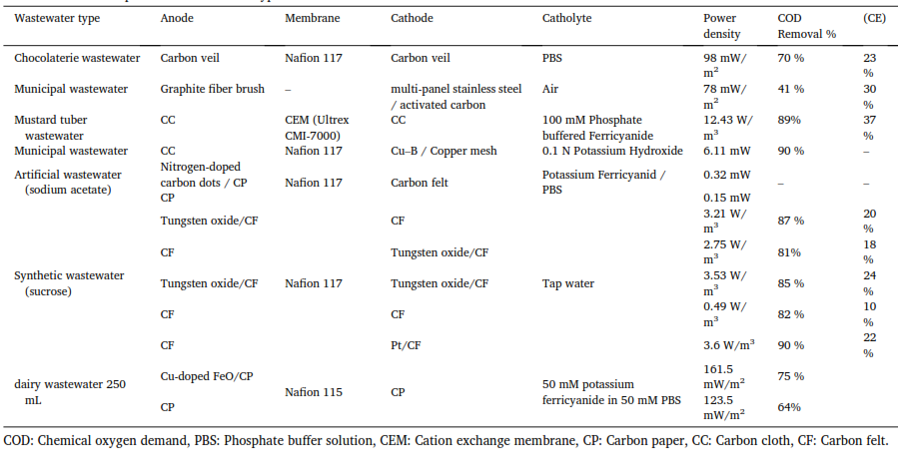
Table 3 Microbial fuel cells operated with different types of wastewater.

Slide 14
Microbial electrolysis cell (MEC)
The last decade has seen a considerable increase in research relating to microbial electrolysis cells for the production of hydrogen from waste.
MECs utilize biologically degradable organics as a source of electrons. MECs are designed to produce more hydrogen gas, due to their ability to exceed the fermentative barrier predominant in fermentation-based processes.
Although the progress and developments already achieved in MECs, there are still some challenges that need to be addressed before commercialization. Optimization of the technology to increase the hydrogen gas, along with a reduction in the overall cost of the technology are both critical for the eventual commercialization of this technology.
Wastewater from different sources was recently investigated as fuel to produce hydrogen in MECs. Different types of wastewater, electrode materials, and membranes were investigated to increase the COD removal efficiency, columbic efficiency, and hydrogen production rate. Table 4 summarizes some of the studies performed on hydrogen production by MEC from different wastewaters.
As clear from the Table that MEC is a viable option for simultaneous wastewater treatment and hydrogen production.

Slide 15
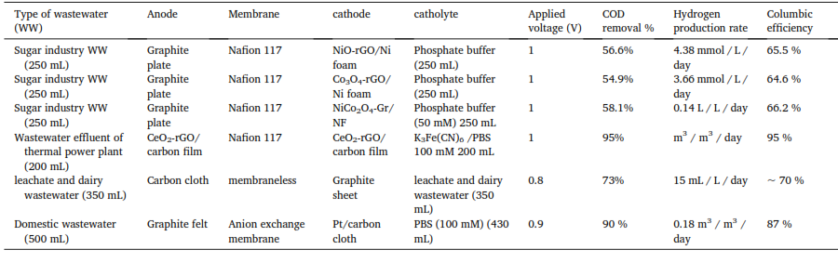
Table 4 Hydrogen production using wastewater in the microbial electrolysis cell

Slide 16
Metal removal and recovery using bioelectrochemical systems
The metal contaminated water posts great health and environmental concerns, because most metals are not biodegradable and can be accumulated in living tissues of plants, animals, and human bodies, causing diseases and disorders
Physical, chemical, and biological technologies have been developed to remove metals from wastewater, and more and more efforts have been made to possibly recover precious metals, so the treatment process can be cost-effective and sustainable.
The BES platform has recently demonstrated excellent performances in removing and recovering metals from different wastewaters, suggesting the use of electrode for metal recovery can be a new efficient and effective approach.

Slide 17
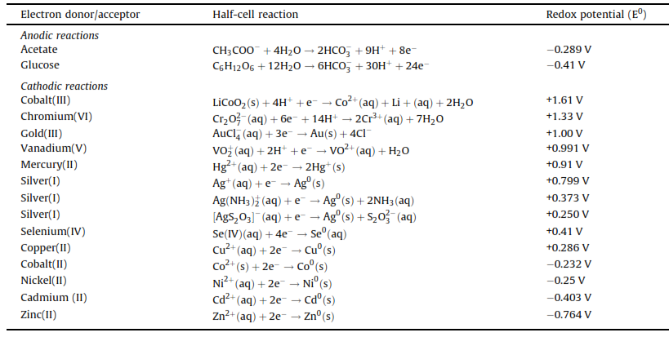
Table 5 Half-cell reactions at the anode and cathode of microbial bioelectrochemical systems used for removal and recovery of metal ions

Slide 18
All bioelectrochemically assisted metal recovery processes divides into four categories.
The first process involves direct reduction of the metals on an abiotic cathode for those with redox potential higher than the anode potential. Such metals include Au (III), V (V), Cr (VI), Ag (I), Cu (II), Fe (III), and Hg (II), etc., and their respective reduction products are shown in table 6 Fig. 2A. The reduction is thermodynamically favorable, and the metals can be directly used as the electron acceptor without any external power consumption
The second process requires an external power supply to force the electrons travel from the anode to the abiotic cathode, so metals with lower redox potentials than the anode potentials can be reduced. Such metals mainly include Ni (II), Pb (II), Cd (II), and Zn (II),etc., and their respective reduction products are demonstrated in table and Fig. 2B
The third mechanism is associated with microbial reduction of metal oxides on a cathode (Fig. 2C). For example, Cr (VI) was reduced with the assistance of microbial metabolisms on a biocathode
The last mechanism reported in literature is microbially assisted metal reduction with a poised potential (Fig. 2D), which is a combination of process 2 and 3. For instance, Cr (VI) can be reduced at a higher rate on a biocathode with poised potentials

Slide 19
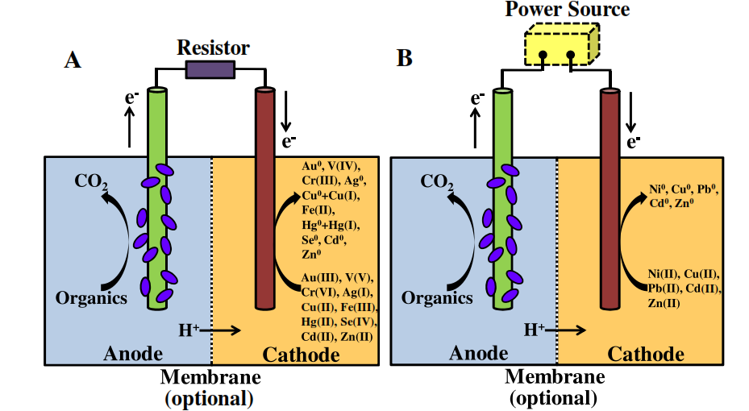
Fig. 2 metal recovery in bioelectrochemical systems. (A) Direct metal recovery using abiotic cathodes; (B) metal recovery using abiotic cathodes supplemented by external power sources. The membrane is optional.

Slide 20
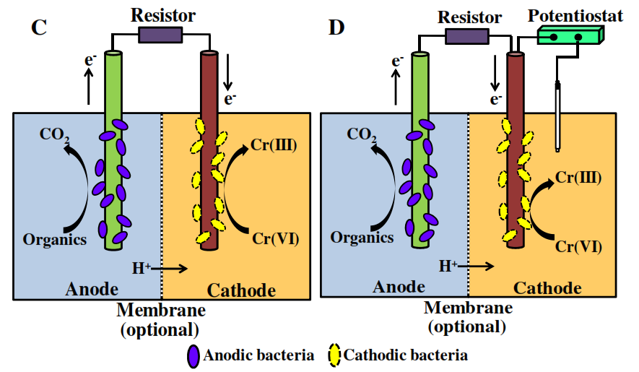
Fig. 2 metal recovery in bioelectrochemical systems. (C) metal conversion using bio-cathodes; (D) metal conversion using bio-cathodes supplemented by external power sources. The membrane is optional.

Slide 21
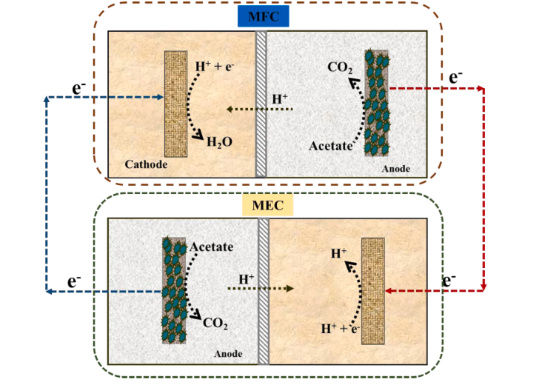
Future application
MEC Hybrid with other renewable energy sources
today many researchers are advocating for MFC being used with MEC in an integrated system as depicted in Fig. 3This technique has been used in hydrogen production in the absence of external power sources. With the aid of acetate as substrate
Fig. 3

Slide 22
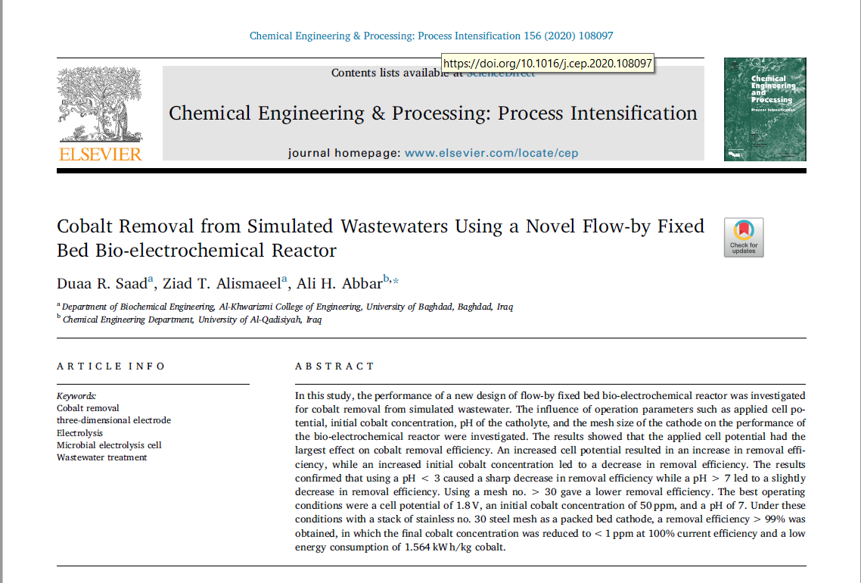
OUR CONTRIBUTIONS

Slide 23


Slide 24
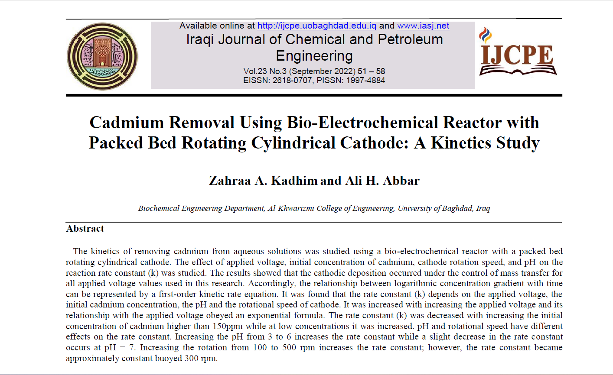

Slide 25


