Slide 1
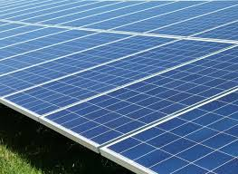
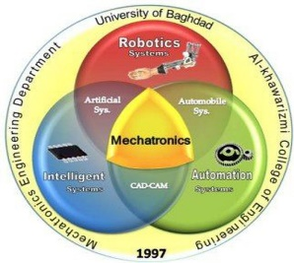

Methods and types of connecting photovoltaic systems
Presented by
Heba Furat Abdalsattar

Slide 2
Contents
1. Introduction
2. Main solar system components
3. Description of system components
4. Comparison of PV panel types
5. Main types of PV solar power system connection

Slide 3
Introduction of Photovoltaic System
One of the most important sources of renewable energy is solar energy or what is called clean energy because it depends mainly on solar radiation.
Electricity produced by solar cells is clean and silent. Because they do not use fuel other than sunshine, PV systems do not release any harmful air or water pollution into the environment, deplete natural resources, or endanger human health.
A PV system can be constructed to any size based on energy requirements.
Long term energy - PV systems often have a long lifespan and a good durability. At the same time, there is often a guarantee of minimum 20 years on solar panels.

Slide 4
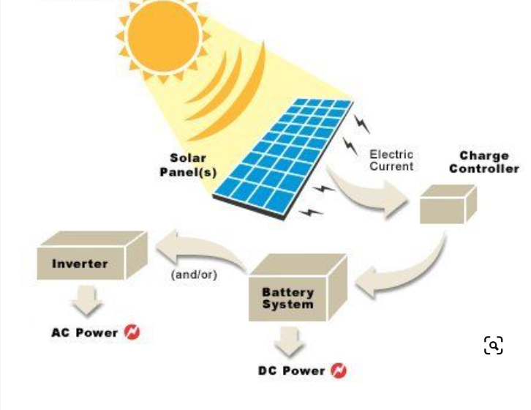

Slide 5
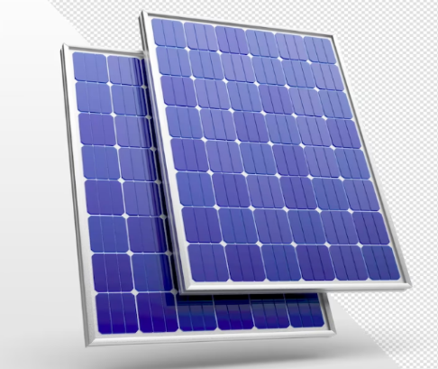
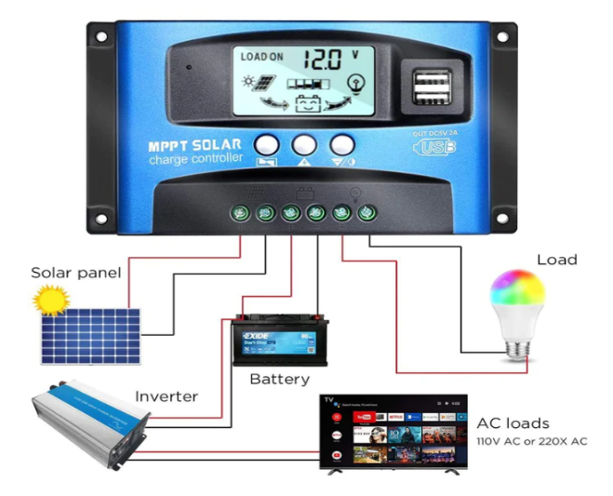
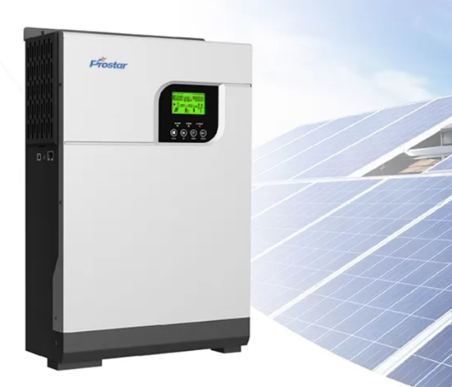
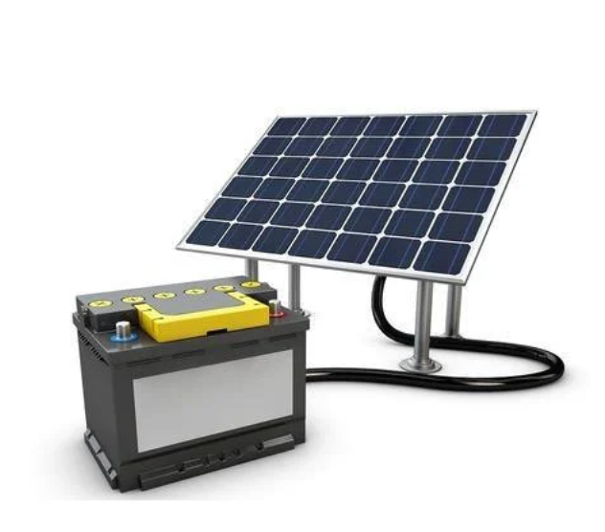
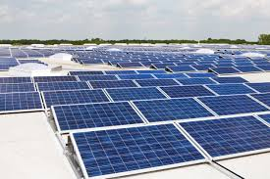
Main Solar system components
Solar panels Controller
Solar inverter Solar Batteries

Slide 6
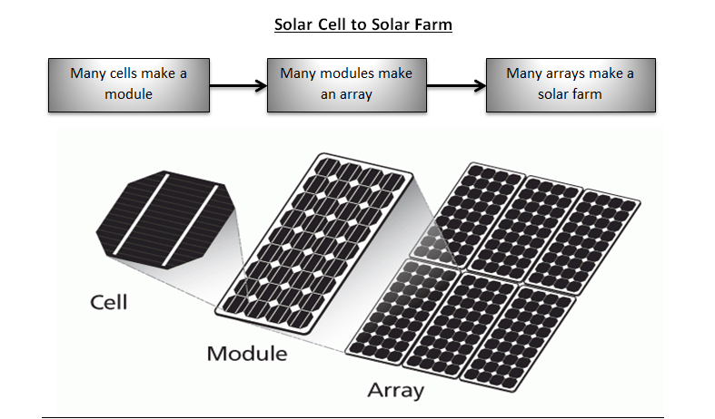
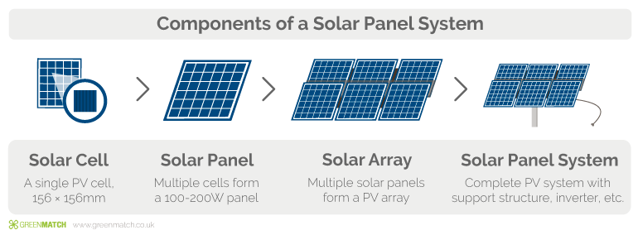
Description of System Components
PV cell

Slide 7
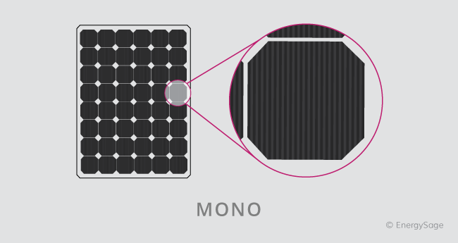
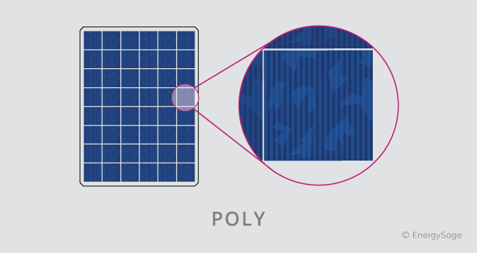
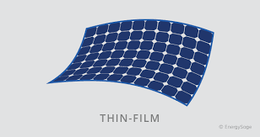
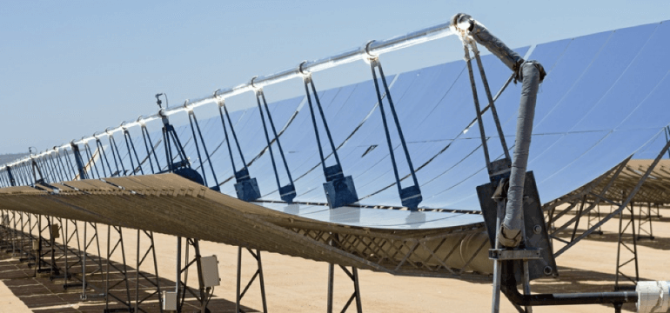
Types of PV Cell
Monocrystalline panels Polycrystalline Solar Panels Thin-Film Solar Cells
Concentrated PV Cell

Slide 8
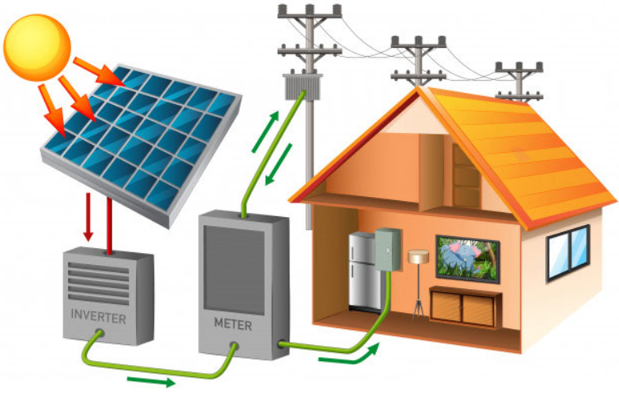
Main types of PV solar power system connections
ON- Grid Connected PV System: On-grid solar systems, also known as grid-tied systems, connect to the electric grid. They provide a reliable power source ,Grid access is useful when your PV solar system are not producing enough energy or when the batteries that store unused solar power have been depleted and need time to recharge.

Slide 9
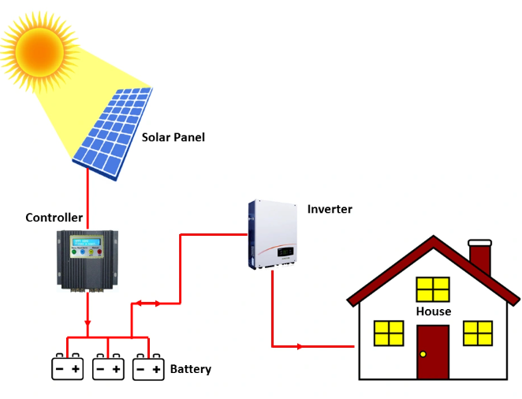
Stand-Alone PV System :
This system is not connected to the electric grid and are instead entirely self-sufficient. As a result, they are often helpful in remote locations where it is not practical or feasible to connect to the grid. They’re also popular among homeowners who want to be completely independent of the grid.

Slide 10
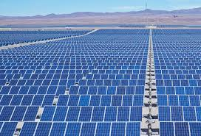
Thank you!

