Slide 1
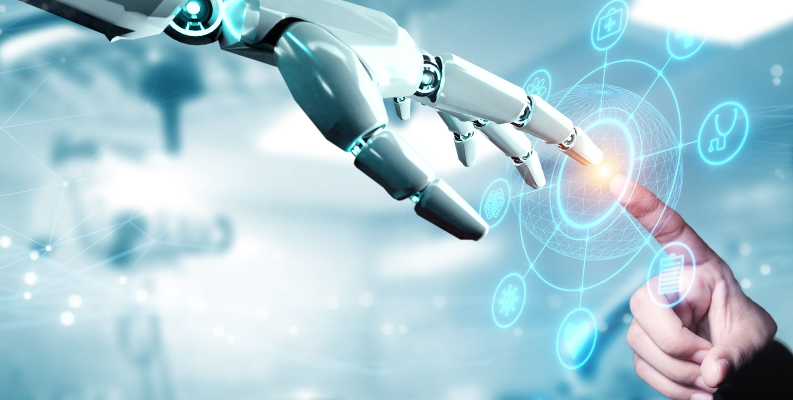
Medical Image processing Challenges
Dr.omar adel AL-JUBOURI

Slide 2




Outlines
Introduction
Motivation
Problem Statements
Aims of Project
Methodology
Results
Conclusions
Future Works

Slide 3
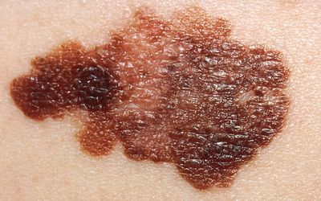
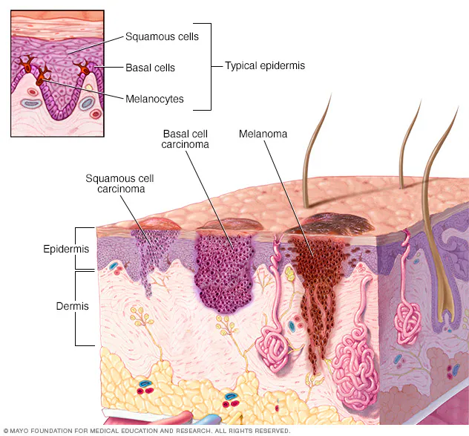
What is Skin Cancer ?
Skin cancer begins in the cells that make up the outer layer of the skin, called the epidermis. One type of skin cancer called basal cell carcinoma begins in the basal cells. Basal cells make skin cells that keep pushing older cells toward the surface. As new cells move up, they become squamous cells. Skin cancer that starts in the squamous cells is called squamous cell carcinoma of the skin. Melanoma, another type of skin cancer, comes from the pigment cells, called melanocytes.

Slide 4

Motivations
The field of cancer is under research and development to overcome its challenges.
To know how watermarking algorithm works with detecting cancer cells?
The Passion for programming some of the procedures performed by artificial intelligence.

Slide 5

Problem Statements
Detecting Skin Cancer by using Watermarking algorithm.
The results should be acceptable.
The range of images (Dataset) for detection

Slide 6
The Aims of research
To detect the skin cancer accurately and effectively
Implementing watermarking algorithm with best results comprised with other algorithms
Improving a medical field.

Slide 7


Methodology
the author proposed a method using image processing steps that helps to increase the detection accuracy of skin cancer.
the methodology requires real-time interfacing with medical images so that it can improve the medical field
To test different types of image to get best results

Slide 8

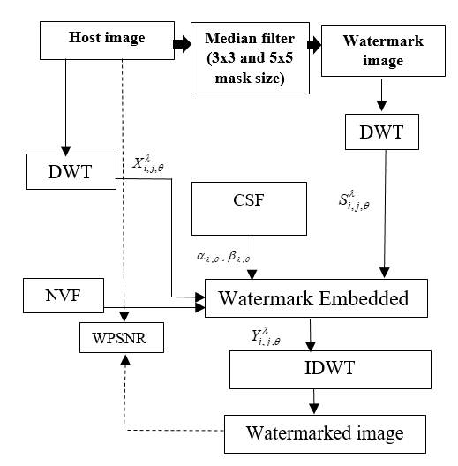
Watermarking Algorithm
Preparing image
Image segmentation
Watermark extraction
Inverse Discrete Wavelet Transform

Slide 9

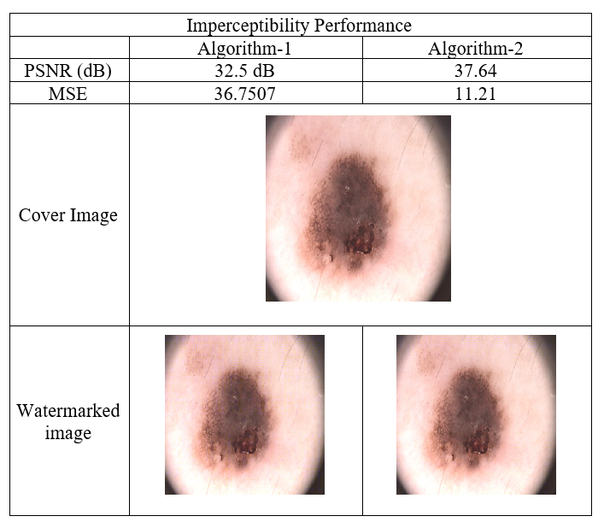
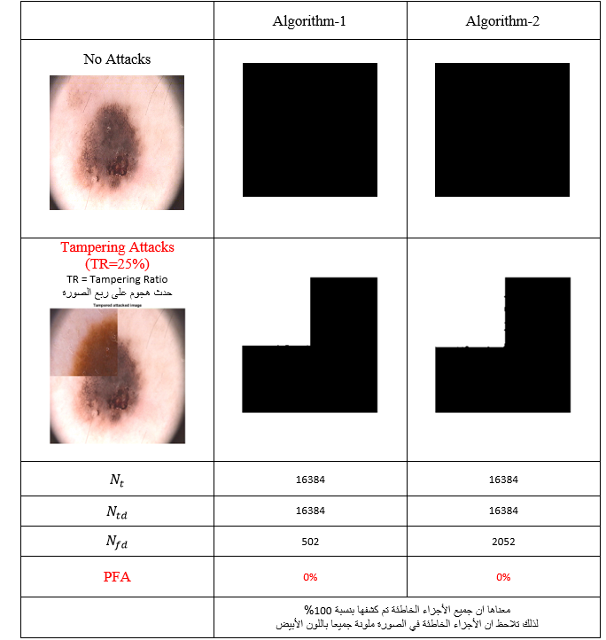
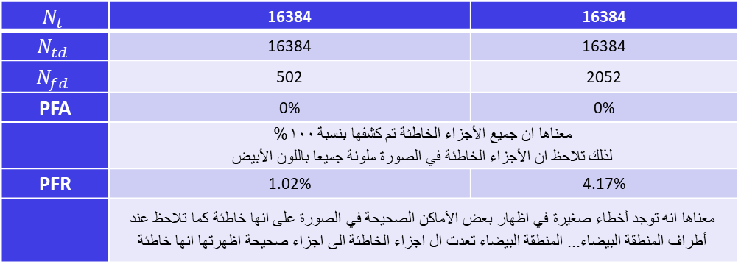
The results
$$N_{t}$$ | 16384 | 16384
$$N_{td}$$ | 16384 | 16384
$$N_{fd}$$ | 502 | 2052
PFA | 0% | 0%
 | معناها ان جميع الأجزاء الخاطئة تم كشفها بنسبة 100% لذلك تلاحظ ان الأجزاء الخاطئة في الصورة ملونة جميعا باللون الأبيض
PFR | 1.02% | 4.17%
 | معناها انه توجد أخطاء صغيرة في اظهار بعض الأماكن الصحيحة في الصورة على انها خاطئة كما تلاحظ عند أطراف المنطقة البيضاء... المنطقة البيضاء تعدت ال اجزاء الخاطئة الى اجزاء صحيحة اظهرتها انها خاطئة

Slide 10
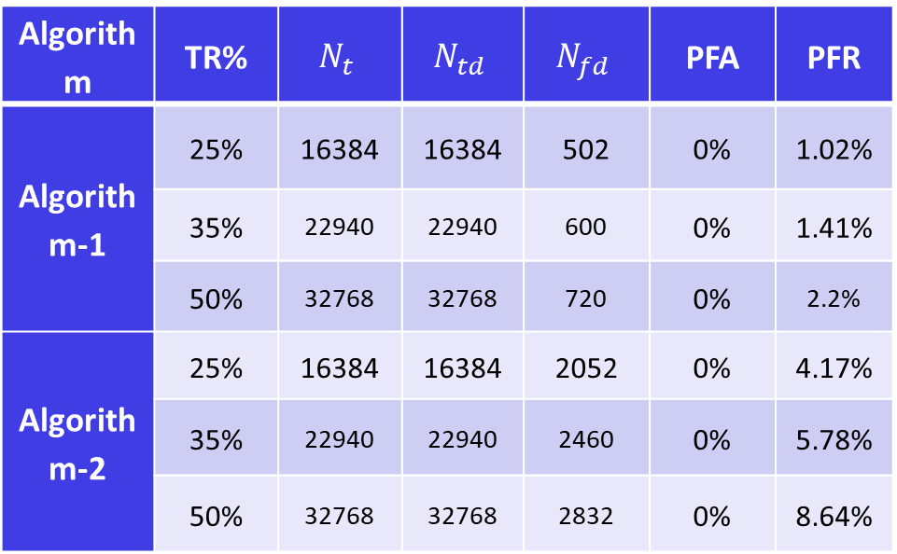
The results
Algorithm | TR% | $$N_{t}$$ | $$N_{td}$$ | $$N_{fd}$$ | PFA | PFR
Algorithm-1 | 25% | 16384 | 16384 | 502 | 0% | 1.02%
 | 35% | 22940 | 22940 | 600 | 0% | 1.41%
 | 50% | 32768 | 32768 | 720 | 0% | 2.2%
Algorithm-2 | 25% | 16384 | 16384 | 2052 | 0% | 4.17%
 | 35% | 22940 | 22940 | 2460 | 0% | 5.78%
 | 50% | 32768 | 32768 | 2832 | 0% | 8.64%

Slide 11
Conclusions and Future Works
We Draw a Conclusion Cancer is a disease that is always changing and affects a lot of individuals all around the world. Large amounts of data are involved in the 8.2 million deaths from this illness, according to the World Health Organization, where you can observe the typical cancer occurrences including lung, liver, colon, and stomach.
According to the literature reviewed, a wide range of datasets focused on the study of the illness have been developed, which is essential for the construction of tools that enable the identification of skin cancer. The Skin Cancer data collection from was used in this analysis.
We advise further development of the system to enable Internet operation.
It is suggested that the system be designed to identify more disorders.

Slide 12
Thanks For Lestening

