Slide 1














The Future is Now
Recent developments in intelligent control systems and autonomous control
Intelligent & Autonomous Control Systems
AI & ML are redefining automation across industries.
Propelling a shift to self-sufficient, adaptive technologies.
Driving unprecedented efficiency, precision, and safety.
Innovation
Transformation
Excellence

Slide 2

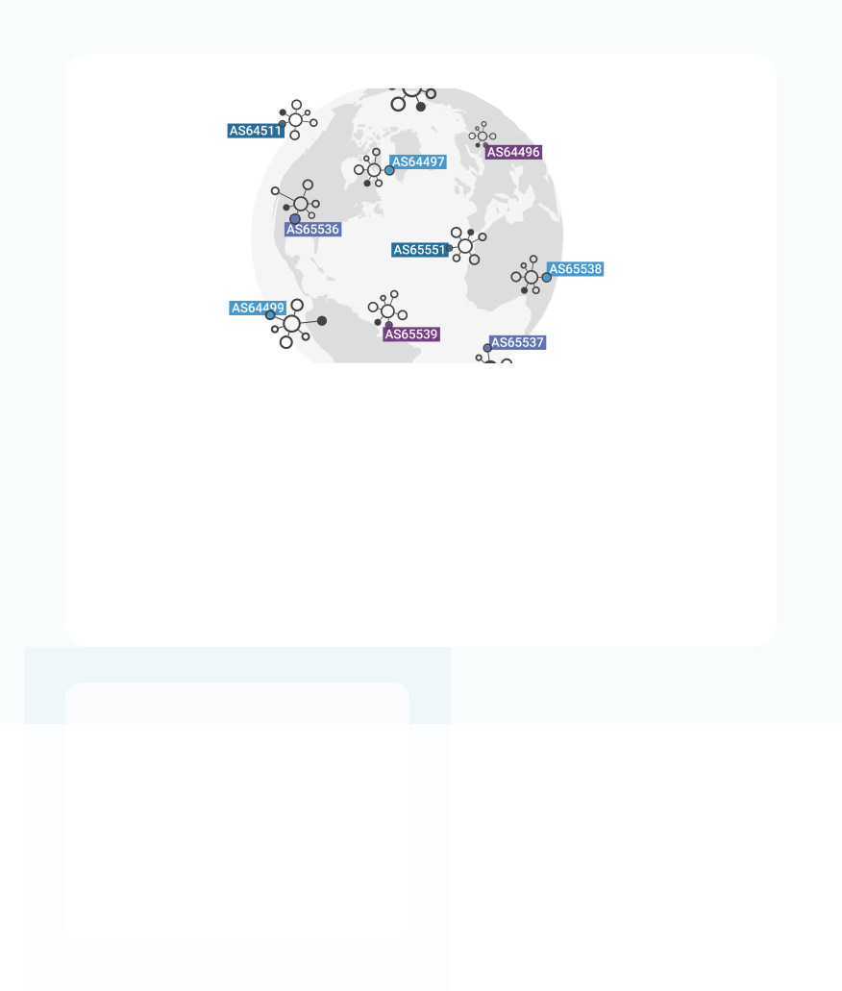










Autonomous Transformation
Recent developments in intelligent control systems and autonomous control
Introduction
Autonomous systems are transforming control engineering, encompassing advanced robotics and sophisticated automation.
Paradigm Shift
Shifting from manual controls to intelligent, self-sufficient technologies that adapt and learn.
Autonomous Systems
Modern control architectures enabling self- directed operations
Industry Revolution
Redefining efficiency and capability across diverse industries through intelligent automation.
Control Systems
Advanced engineering
Smart Tech
Intelligent solutions

Slide 3












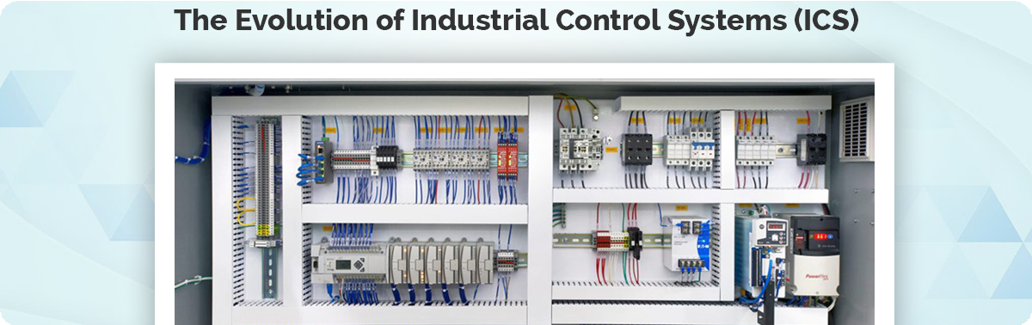




Recent developments in intelligent control systems and autonomous control
75%
75%
Evolution of Control Systems
1
Traditional Systems
Relied on predefined algorithms Required human intervention Often reactive approach
2
Digital Advancements
Complex algorithms improved Feedback loops enhanced Still required oversight
3
AI Integration
A paradigm shift, enabling systems to:
Process massive data at unprecedented speeds
Predict potential issues proactively Adjust parameters in real-time
Make autonomous decisions for optimization
The Transformation Impact
75%
90%
24/7
Efficiency Gain
Error Reduction
Autonomous Operation
Industrial Evolution
From manual controls to intelligent automation systems

Slide 4




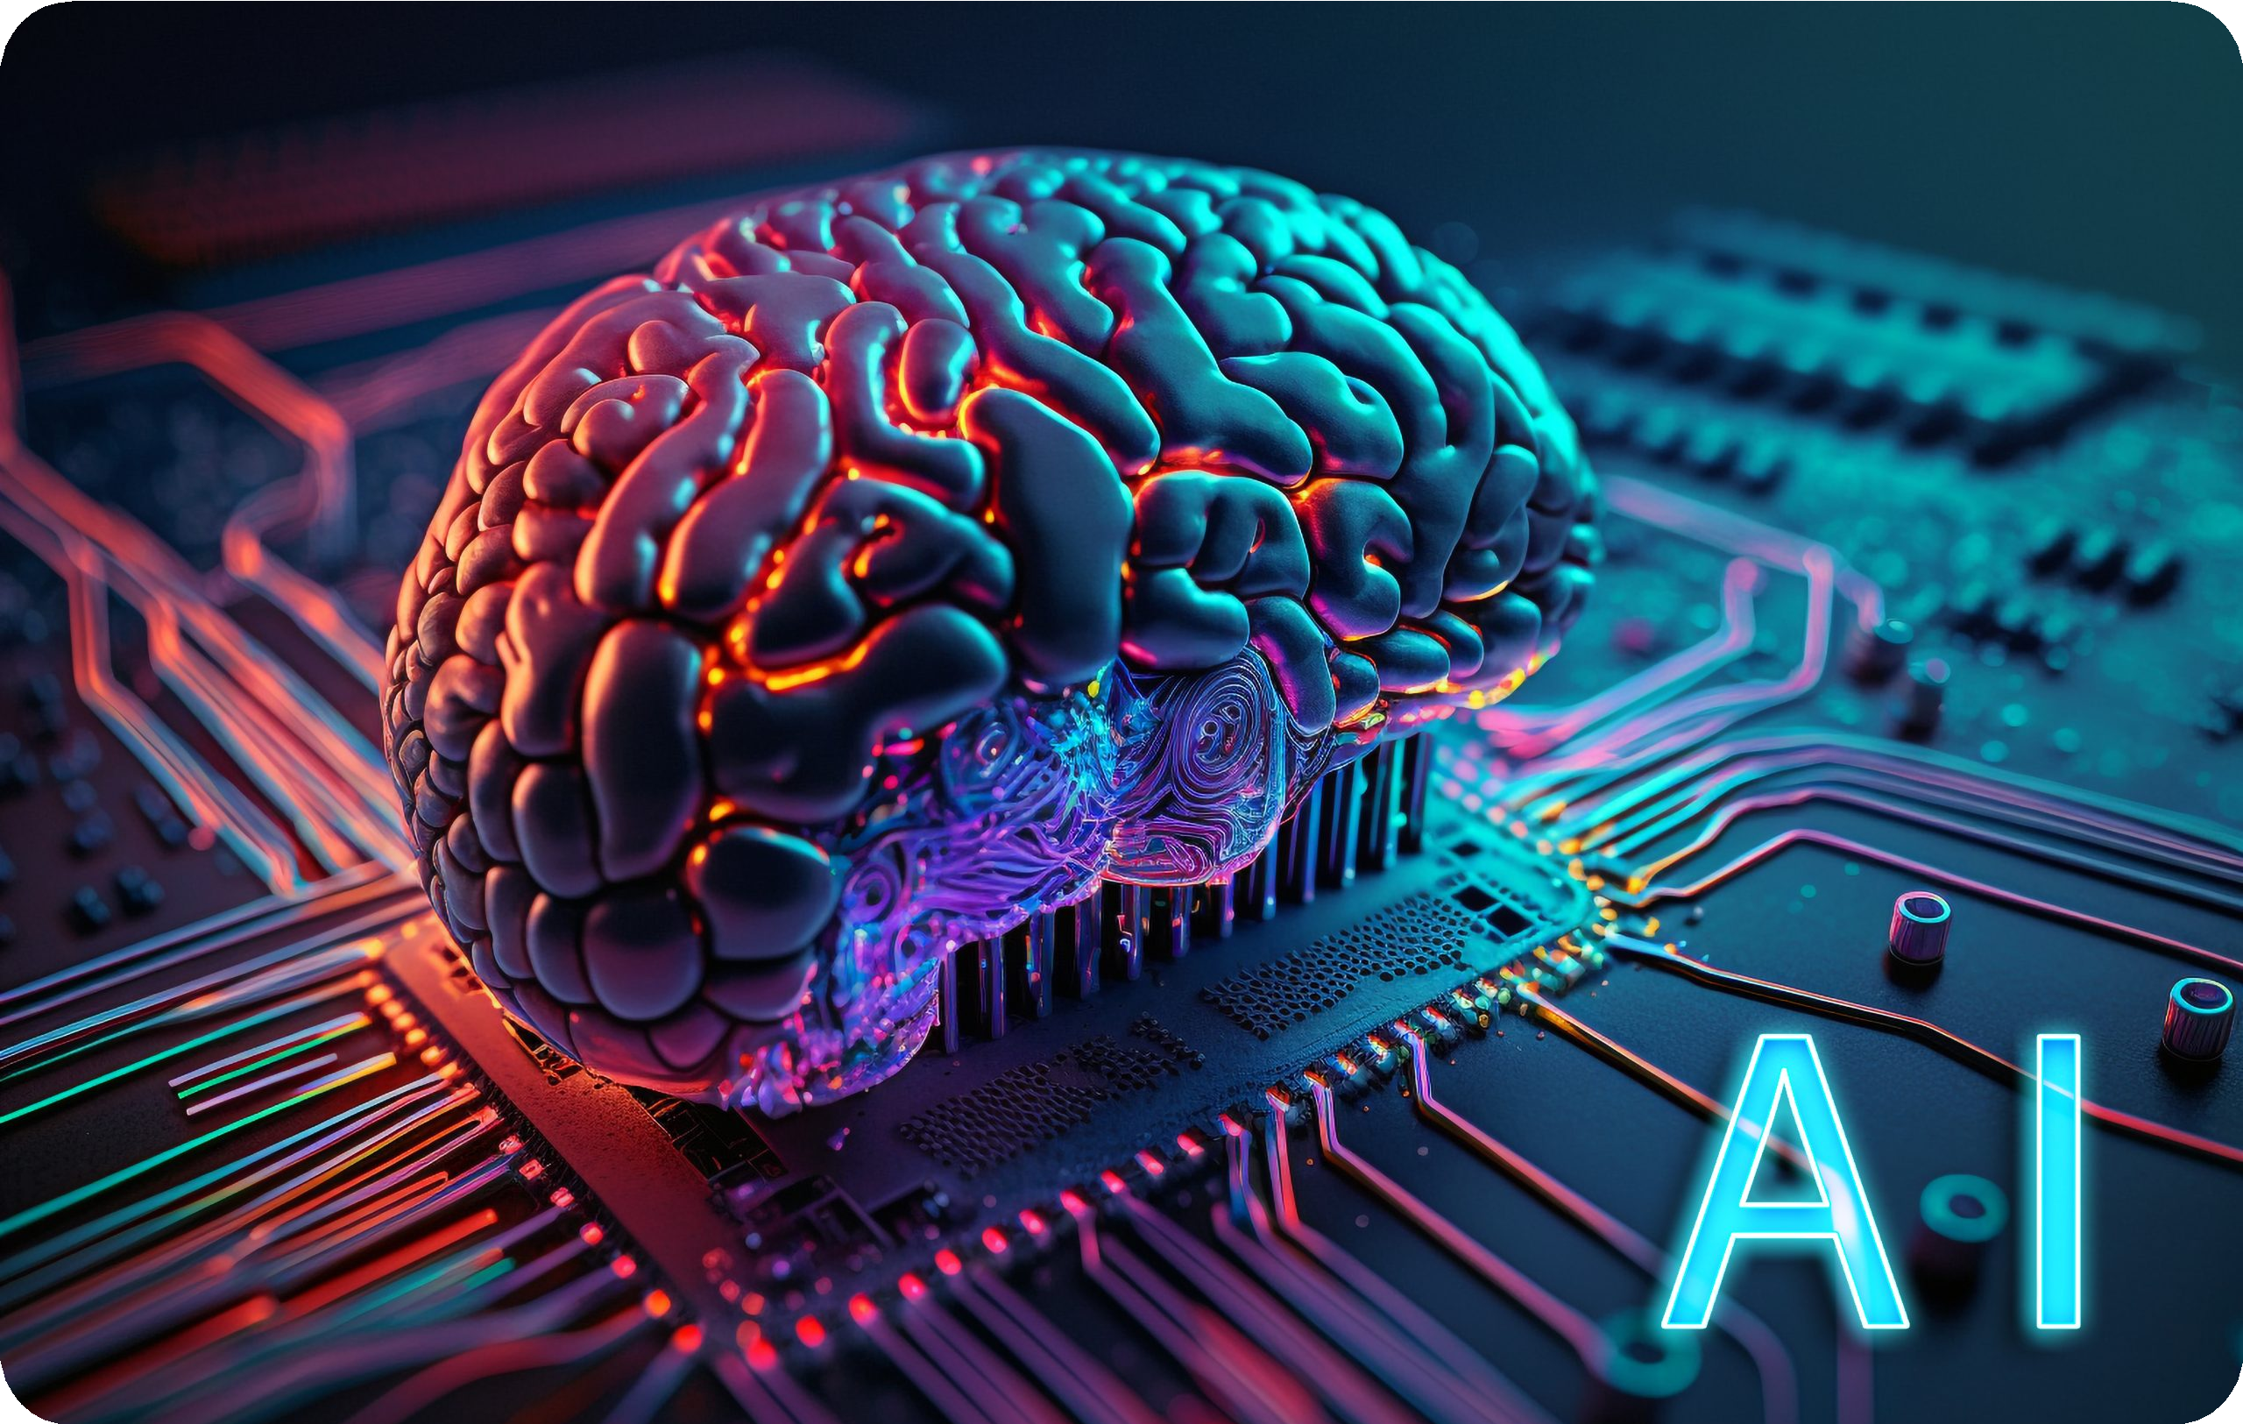












Recent developments in intelligent control systems and autonomous control
AI & Machine Learning
Intelligent Algorithms
Improve decision-making, optimize processes, reduce human intervention.
Machine Learning Control
Solves optimal control problems by leveraging ML algorithms.
Deep Reinforcement Learning
Enables controllers to learn from continuous practice, discovering nuances and exceptions.
Neural Networks
Learn to approximate unknown disturbances from data, replacing fixed models.
AI Technology
Advanced neural networks and machine learning systems
Automation Smart processes
Meta-learning
Teaches systems how to adapt to different types of disturbances, enhancing flexibility and adaptability across diverse operational scenarios.
Optimization Performance gains

Slide 5









1. Learning
Recent developments in intelligent control systems and autonomous control
Characteristics of AI-Based Controllers
2. Delayed Gratification
Learn to recognize
short-term sub- optimal behavior to
achieve long- term optimal
gains, pushing past local minima.
3. Non- Traditional Input Data
Manage and evaluate sensor
Methodically and continuously practice, discovering nuances and exceptions not easily captured by fixed-gain controllers.
information beyond traditional automated systems, including visual, sound, and vibration data.
Visual Processing Image & video analysis
Vibration Sensing Mechanical feedback
Audio Analysis Sound pattern recognition
Adaptive Intelligence
Strategic Optimization
Multi-Modal Sensing

Slide 6













Manufacturing
Recent developments in intelligent control systems and autonomous control
Applications Across Industries
Transportation
Energy Sector
Robotic arms & automated production lines
Quality control systems
Predictive maintenance
Process optimization
Autonomous vehicles with collision avoidance
Adaptive cruise control & lane-keeping
Drone delivery & monitoring systems
Navigation in uncertain environments
Smart grid management systems
Infrastructure monitoring
HVAC energy optimization
Predictive issue resolution
Healthcare
Logistics & Supply Chain
Access Control
Robotic surgical assistance
Automated patient care systems
Real-time patient monitoring
Medical equipment automation
Route optimization algorithms
Automated inventory management
Material flow optimization
Warehouse automation
Touchless entry systems
Remote security management
Unified security platforms
AI-powered automation

Slide 7



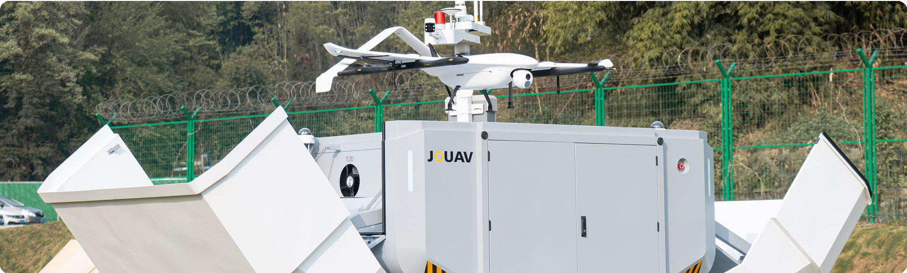





Recent developments in intelligent control systems and autonomous control
Case Study: Autonomous Drones in Uncertain Environments
MIT Research Innovation
Challenge
Autonomous drones face significant challenges from unpredictable disturbances (e.g., gusting winds) in dynamic environments.
Solution
MIT researchers developed a new machine learning-based adaptive control algorithm.
Autonomous Drone Technology
Advanced control systems enabling adaptive flight in uncertain environments
Key Innovation
Learns from small amounts of observational data (e.g., 15 mins flight time) Automatically determines optimal adaptation algorithm (mirror descent) Uses meta-learning to teach system adaptation to various disturbance types
Meta-Learning
Adaptive algorithms
Wind Resistance
Dynamic adaptation
Impact
Training Efficiency
15min
50%
Less Tracking Error
Minimal flight time required for effective learning
Achieved better performance even with unseen wind speeds in simulations.

Slide 8








Higher Operational Efficiency
Recent developments in intelligent control systems and autonomous control
Benefits of AI & ML in Control Systems
Enhanced Product Quality
AI-powered defect detection systems achieve near-zero defect rates and faster inspection.
Optimizes processes beyond human capability, leading to better resource utilization and lower costs.
Reduced Downtime
Predictive maintenance analyzes data to predict equipment failure, enabling proactive repairs and extending machine life.
Improved Safety & Collaboration
AI takes over hazardous tasks; collaborative robots (cobots) work safely alongside humans, increasing productivity.

Slide 9
















Recent developments in intelligent control systems and autonomous control
Challenges & Considerations for Implementation
High Initial Investment
Significant capital required for hardware, software, and data infrastructure setup.
Data Quality & Quantity
ML models require vast amounts of high-quality data; inconsistent data leads to poor predictions.
Cybersecurity Risks
Increased connectivity makes systems vulnerable; compromised AI can lead to catastrophic failures.
Lack of Skilled Workforce
Shortage of expertise in both automation and data science across industries.
Complexity & Interpretability
AI models can be complex, making it challenging to understand their decisions (need for Explainable AI .
Ethical Implications
Questions about accountability and decision-making as systems become more autonomous.

Slide 10





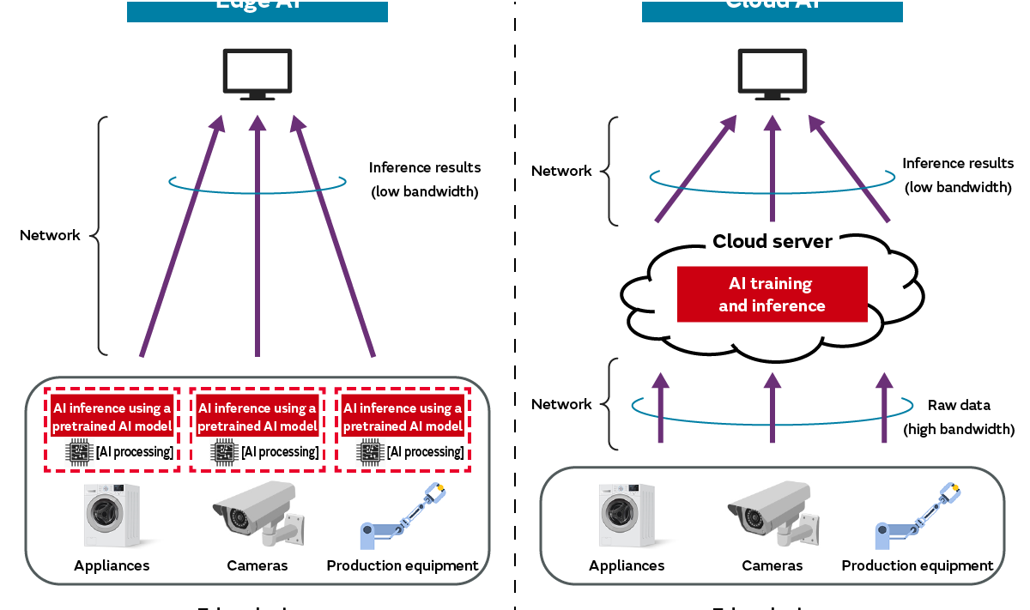






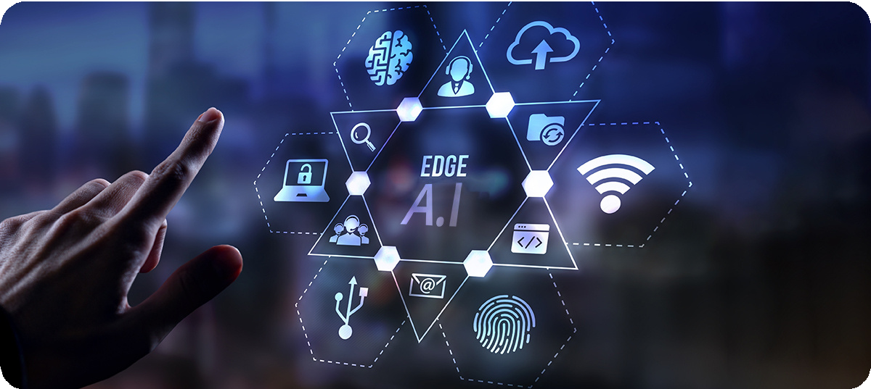



Recent developments in intelligent control systems and autonomous control
Future Outlook
Edge AI
Deployment of AI algorithms closer to data sources for real- time processing and reduced latency.
IoT & Blockchain
Enhanced connectivity, data integrity, and automation strategies.
Explainable AI XAI
Development of transparent and interpretable AI models for better understanding of decisions.
New Job Roles
AI development, deployment, and maintenance opportunities.
Edge AI Implementation
Real-time processing at the edge
AI-driven Digital Twins
Virtual replicas of physical systems enhanced by AI to learn from data and predict future behavior.
Growth Continuous innovation
Next-Gen IoT
AI-powered connectivity

Slide 11




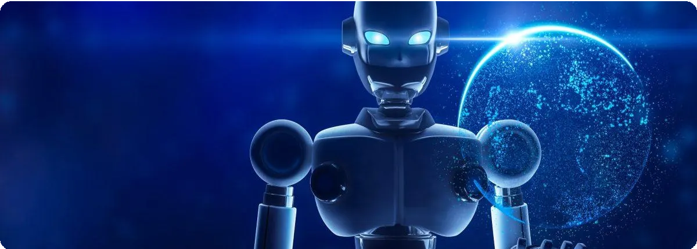




Key Takeaways
Recent developments in intelligent control systems and autonomous control
Conclusion
AI and ML represent the future of intelligent automation, driving unprecedented transformation across all industries.
AI and ML are not a passing trend but the driving force behind the next generation of control
systems.
The Smart Future
Embracing intelligent automation and AI-driven control systems to create a more efficient, adaptive, and sustainable tomorrow.
They enable unprecedented levels of efficiency, precision, and adaptability.
Transforming industries from manufacturing and transportation to energy and healthcare.
While challenges exist, continuous innovation and strategic adoption will unlock their full potential.
The future of control systems is intelligent, autonomous, and actively enhances human capabilities.
Thank You
Questions & Discussion

