Slide 1

IELTS or TOEFL:
WHICH ONE IS BETTER?
وزارة الشباب والرياضة
دائرة الرعاية العلمية
By : Nadia Jabbar

Slide 2

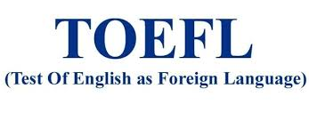


What Are International Language Tests?
English Language
Turkish language
German language

Slide 3
International English language Tests.
INTERNATIONAL ENGLISH LANGUAGE TESTING SYSTEM
(1980; 40 years ago)
TEST OF ENGLISH AS FORIGHN LANGUAGE (1964; 56 years ago)

Slide 4
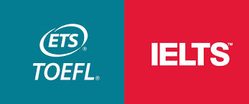
OR

Slide 5
IELTS OR TOEFL?
IELTS
TOEFL
Over 3 millions test taker
2.4 millions test taker
Developers: British Council, IDP Education, Cambridge Assessment English
Developer: ETS Company
Cost: 245$
Cost: 180$-300$
Time: 2hours and 45 minutes
Time: 4 hours
Score: 0-9
Score: 0-120
Methods (Iraq) : Paper delivered test
Methods (Iraq): internet-based test.

Slide 6
IELTS OR TOEFL?
IELTS
TOEFL
Place: -
Place:-
Validity: 2 years
Validity: 2 years
types: Academic and General
Type: Academic
Test parts:
listening
Reading
Writing
Speaking
Test parts:
listening
Reading
Writing
Speaking

Slide 7
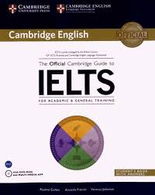
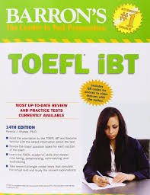
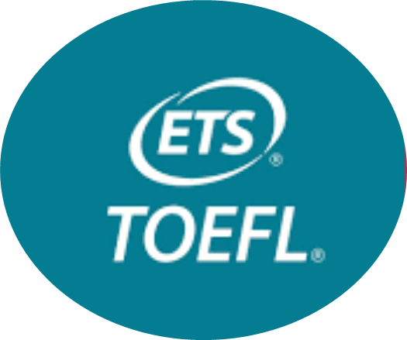
OFFICIAL GUIDES

Slide 8
Conclusions & Recommendations
Very important English Proficiency tests
Public & Private sector employees should always be keen on taking such exams (esp. physicians, engineers, lawyers, medical servants, and athletes)
All university graduates who seek advancement
All job seekers who seek employment
All youths who seek good prospects
Need such tests to keep their English alive

Slide 9



Any Questions??

