Slide 1
المحاضرون : م.د.كرار علي الساكني م.د. نصر طارق محمد
دورة طرق التعامل مع الحيوانات المختبرية
Handling Of Lab. Animals
للفترة 7 – 9 -نيسان

Slide 2
Characteristics features of :laboratory animals
Small in size and easily to control.
Short life cycle and rapidly reproduction (short gestation period and multifetuses)
Cheap in price with lower Bearing cost.
4.It is mammalian species like large animal and human

Slide 3
Purposes of use lab. Animals :
Evaluation and standardization of vaccines and drugs.
Study the pathogenesis of some diseases.
Study some immunological tests such as delayed type hypersensitivity (DTH ) – SKIN TEST .
Prepare hyperimmune serum for some immunological studies.

Slide 4
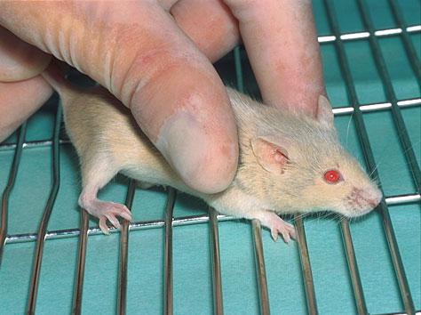
Restraints Methods In Lab. Animals:
In Mice & RatsThe animal should be grasped by the tail, and should then be placed on a rough surface such as a cage top while holding the tail firmly
.

Slide 5
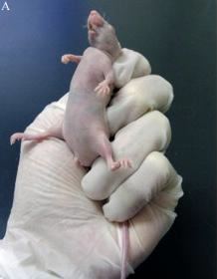
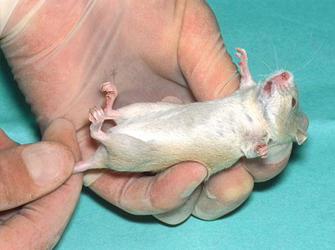
One-handed method :
Place the mouse’s tail between the last two fingers of the hand that is holding the nape.
Two-handed method:
The scruff can be grasped between the thumb and forefinger whilst maintaining a grip on the tail.
METHOD1 METHOD2

Slide 6
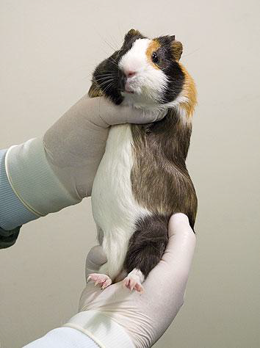
Guinea pigs & Rabbits: grasp the loose skin of shoulders and necks. The hind limbs must be supported at all times to prevent animals from injuring its back.
RABBITS are very susceptible to lumbar spinal luxation

Slide 7
Route of injection in lab. animals:
Intradermal injection(I.D.) :
Insert the needle just under the surface of the skin
A distinct bleb should form
Site of injection: The flank
In mice Syringe 1ml, hypodermic needles 15 × 0.5 mm.
In Guinea pig & rabbit Needle 2.0 × 0.5 mm are suitable for them The hair at site is removed with curved scissors or mechanical clippers.

Slide 8
2-Subcutaneous injection (S/C)
With your fingers lift the skin to make a tent like at site of injection & insert needle into the Subcutaneous tissue.
Site of injection:
Loose skin around the neck & shoulder area.
In mice 1-2 ml syringe , hypodermic needle ( 15 × 0.5 mm) .
In Guinea pigs and Rabbits,Rats Syringe of suitable size, hypodermic needle (30 × 0.5 mm).

Slide 9
3-Intramuscular injection (I.M.):
Restrian the animal(Ginea pig & Rabbit)
Site of injection:
Caudal thigh muscle
The recommended needle size is 25 gauges

Slide 10
4-Intravenous inoculation (I.V.):
Site of injection:
External marginal ear vein(Rabbit)
Tail vein(Mouse)
Disifect injection site and insert needle(27-30)gauge.

Slide 11
5-Intra-peritoneal injection(IP):
Starvation
Disinfect injection site
Site of injection:
Cranial into the abdomen at 30-45 degree caudal to umbillicus and lateral to midline.
Note:
Yellow aspirate indicates needle in bladder.
Greenish-brown aspirate indicates needle in intestine.

Slide 12
Blood Withdrawal:
1-Heart puncture
2-Tail vein
3-Ear vessels
4-Retro-orbital plexus
Note: Dilation of vessels achieved by use of a heat lamp,alcohol,massaging of ear,warm water bath or xylene

Slide 13
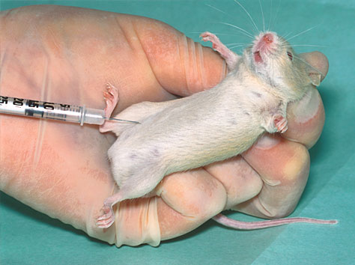
I.P.

Slide 14
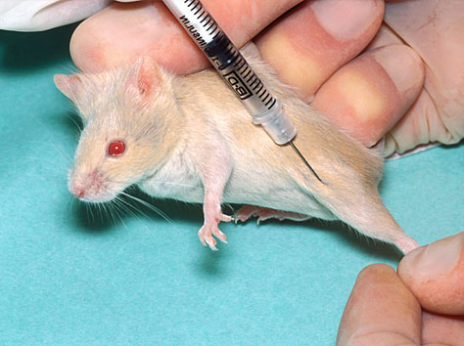
I.M.

Slide 15
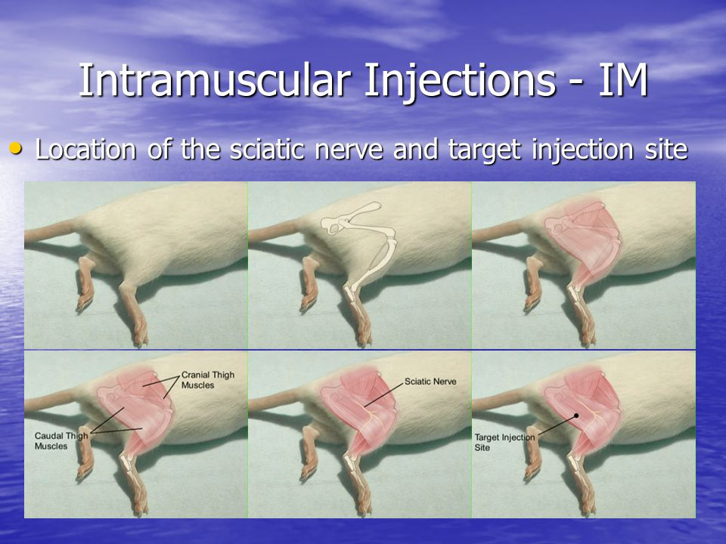

Slide 16
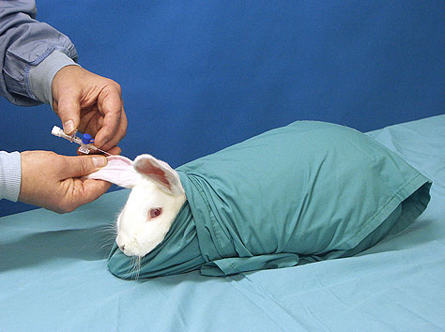
I.V.

Slide 17
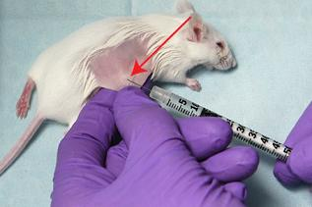
Intradermal Injection

Slide 18
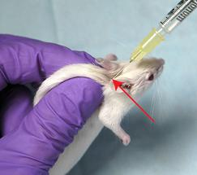
S/C

Slide 19
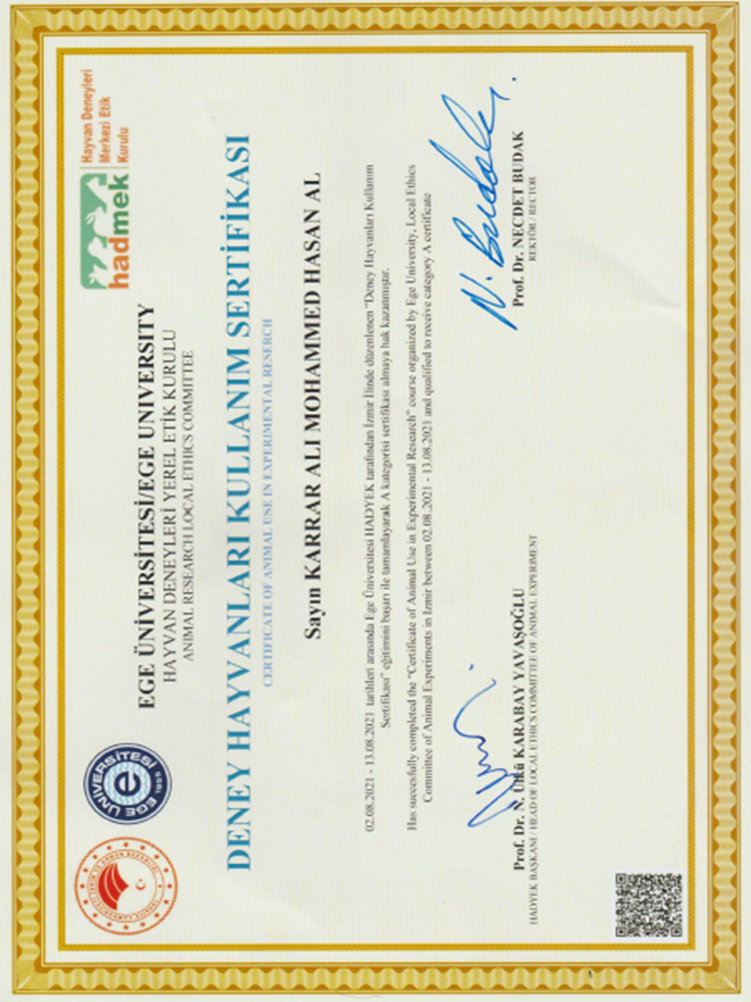

Slide 20
Thank You

