Slide 1


Presurgical Orthopaedic Treatment of Cleft Lip and Palate Patients
Professor Dr. Mushriq fawzi
College of Dentistry-University of Baghdad
BDS, MSc, PhD orthodontics (London-UK)

Slide 2

CLP: The most common congenital anomaly in the craniofacial region in human.

Slide 3
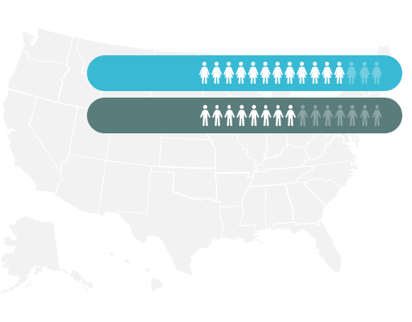
Incidence and prevalence

Slide 4
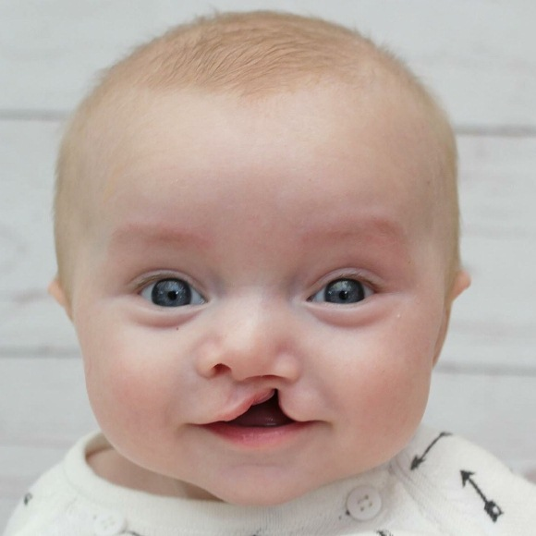
How common do you think Cleft lip and palate?
Every year, one in 750-1000 babies is born with a cleft lip and palate.
Incidence and prevalence
Source: World Health Organization (WHO) (Papadopoulos et al., 2012), CRANE Reports 2021.
Notes:
The centers for disease control and prevention

Slide 5
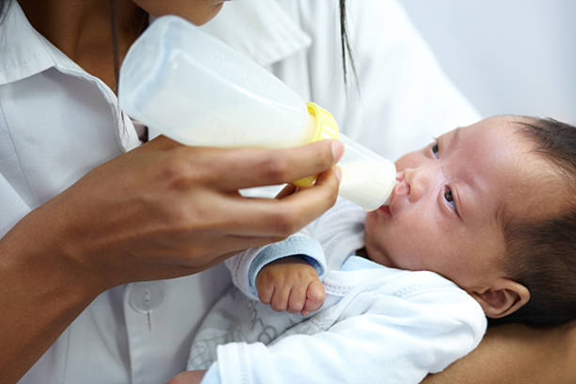

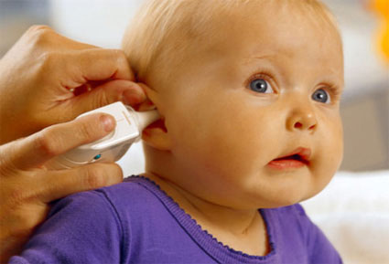
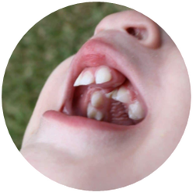
Feeding problems
Difficulty sucking
Food coming out of the nose
Weight loss
Speech problems
Speech and language delay
Speech sound coming out of the nose.
Pronunciation error.
Problems Associated
Hearing loss
Frequent ear infections
Dental & occlusal
Abnormal teeth numbers
Severe malocclusion Cl.III
Notes:
These patients also suffer from various medical problems such as difficulty with feeding, swallowing, nasal regurgitation,
Speech difficulties (because of nasal escape and articulation problems) Persistent structural abnormalities including velopharyngeal insufficiency, oronasal fistulas, and hearing impairments all play a role.
hearing problems (due to palatal muscle abnormalities), Because of the abnormal form and function of the tubal musculature, which leads to impaired ventilation through the eustachian tubes, newborns with cleft palate are more likely to develop otitis media. This middle ear mucosal abnormality induces sterile mucosal inflammation and middle ear effusion with superimposed infection.
Cleft defects thus have an adverse influence on health as well as the social integration of affected individuals. Despite early surgical intervention, residual deformity can remain through scarring and abnormal development of the face, which can result in functional and psychosocial problems8

Slide 6
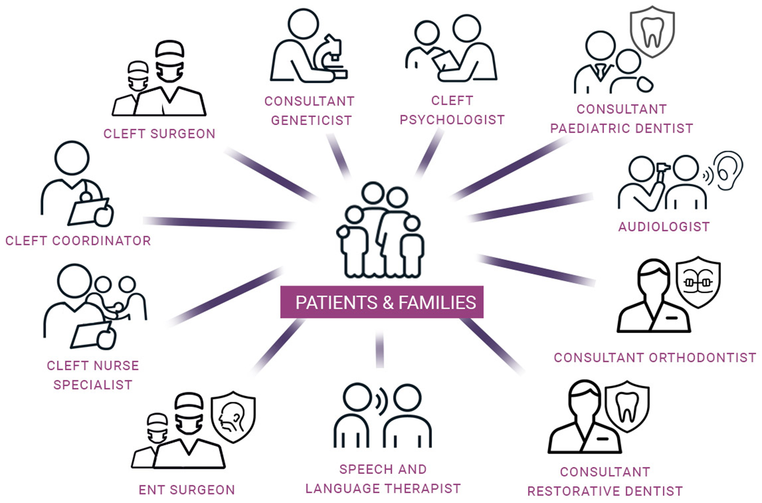
Management

Slide 7
Orthodontist
Infancy
Primary dentition
Mixed dentition
Permanent dentition
Professor Dr. Mushriq Fawzi

Slide 8
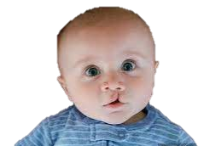
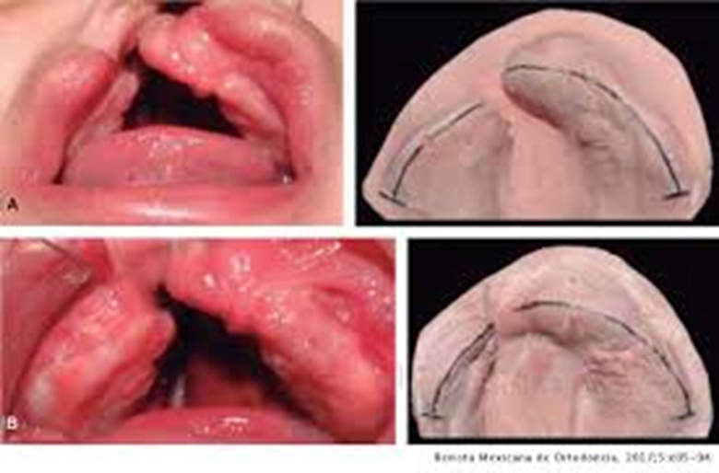
During infancy
Presurgical infants orthopedic
Appliance (PSIO) treatment that “uses forces to reposition tissues secondarily displaced due to a cleft deformity”,
Professor Dr. Mushriq Fawzi

Slide 9
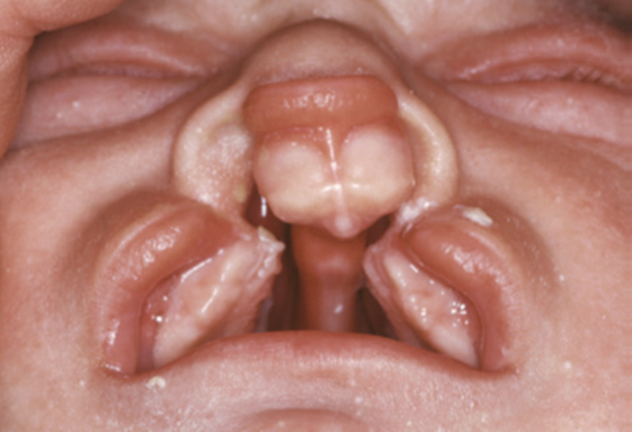
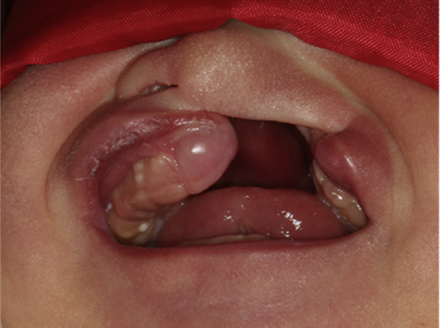
The aims of PSIO?
Reduce defect size.
Simplify surgical procedures.
Minimise scarring.
Approximate segments.
Facilitate feeding.
Professor Dr. Mushriq Fawzi

Slide 10
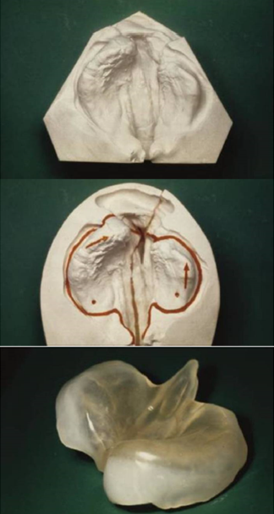
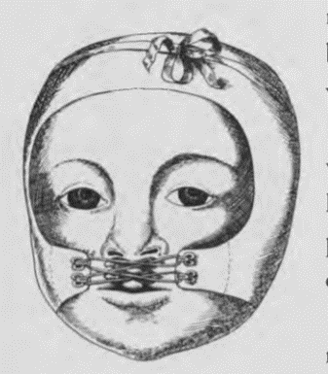
Types of PSIO
Hoffman head cap in 1686
McNeil acrylic plate in 1954
Latham appliance in 1975
Hotz appliance 1976
Grayson appliance in 1993
CAD/CAM PSIO 2002
Professor Dr. Mushriq Fawzi

Slide 11

Take home message
In summary, presurgical orthopedic appliances are a valuable tool in cleft care, facilitating better outcomes by reducing the anatomical challenges surgeons face and supporting the infant’s growth and development.

Slide 12
Thank you

