Slide 1
The use of ai in scientific research pros and cons by luma hasan

Slide 2

Contents
Definition of AI
Pros of AI
Cons of AI
Conclusion
Example

Slide 3

Artificial Intelligence (AI) has become a transformative force in scientific research, revolutionizing fields such as medicine, physics, chemistry, and environmental science. AI-driven tools enhance data analysis, automate experiments, and accelerate discoveries. However, their adoption also raises concerns about ethics, bias, and job displacement. This article examines the advantages and disadvantages of AI in scientific research, supported by references from recent studies.

Slide 4

Pros of AI
1. Accelerated Data Processing and Analysis
AI can analyze vast datasets far more quickly than humans, identifying patterns and correlations that might otherwise go unnoticed. Machine learning (ML) algorithms are particularly useful in genomics, climate modeling, and drug discovery (Topol, 2019).
2. Automation of Repetitive Tasks
AI-powered robotics and software can conduct experiments, reducing human error and increasing efficiency. For example, AI-driven lab assistants can perform high-throughput screening in drug development (Stokes et al., 2020).

Slide 5
Pros of AI
3. Enhanced Predictive Modeling
AI improves predictive accuracy in fields like epidemiology and materials science. For instance, AI models predicted COVID-19 spread and optimized vaccine development (Vaishya et al., 2020).
4. Facilitation of Interdisciplinary Research
AI bridges gaps between disciplines by integrating data from biology, chemistry, and physics, fostering innovation (Silver et al., 2018).

Slide 6
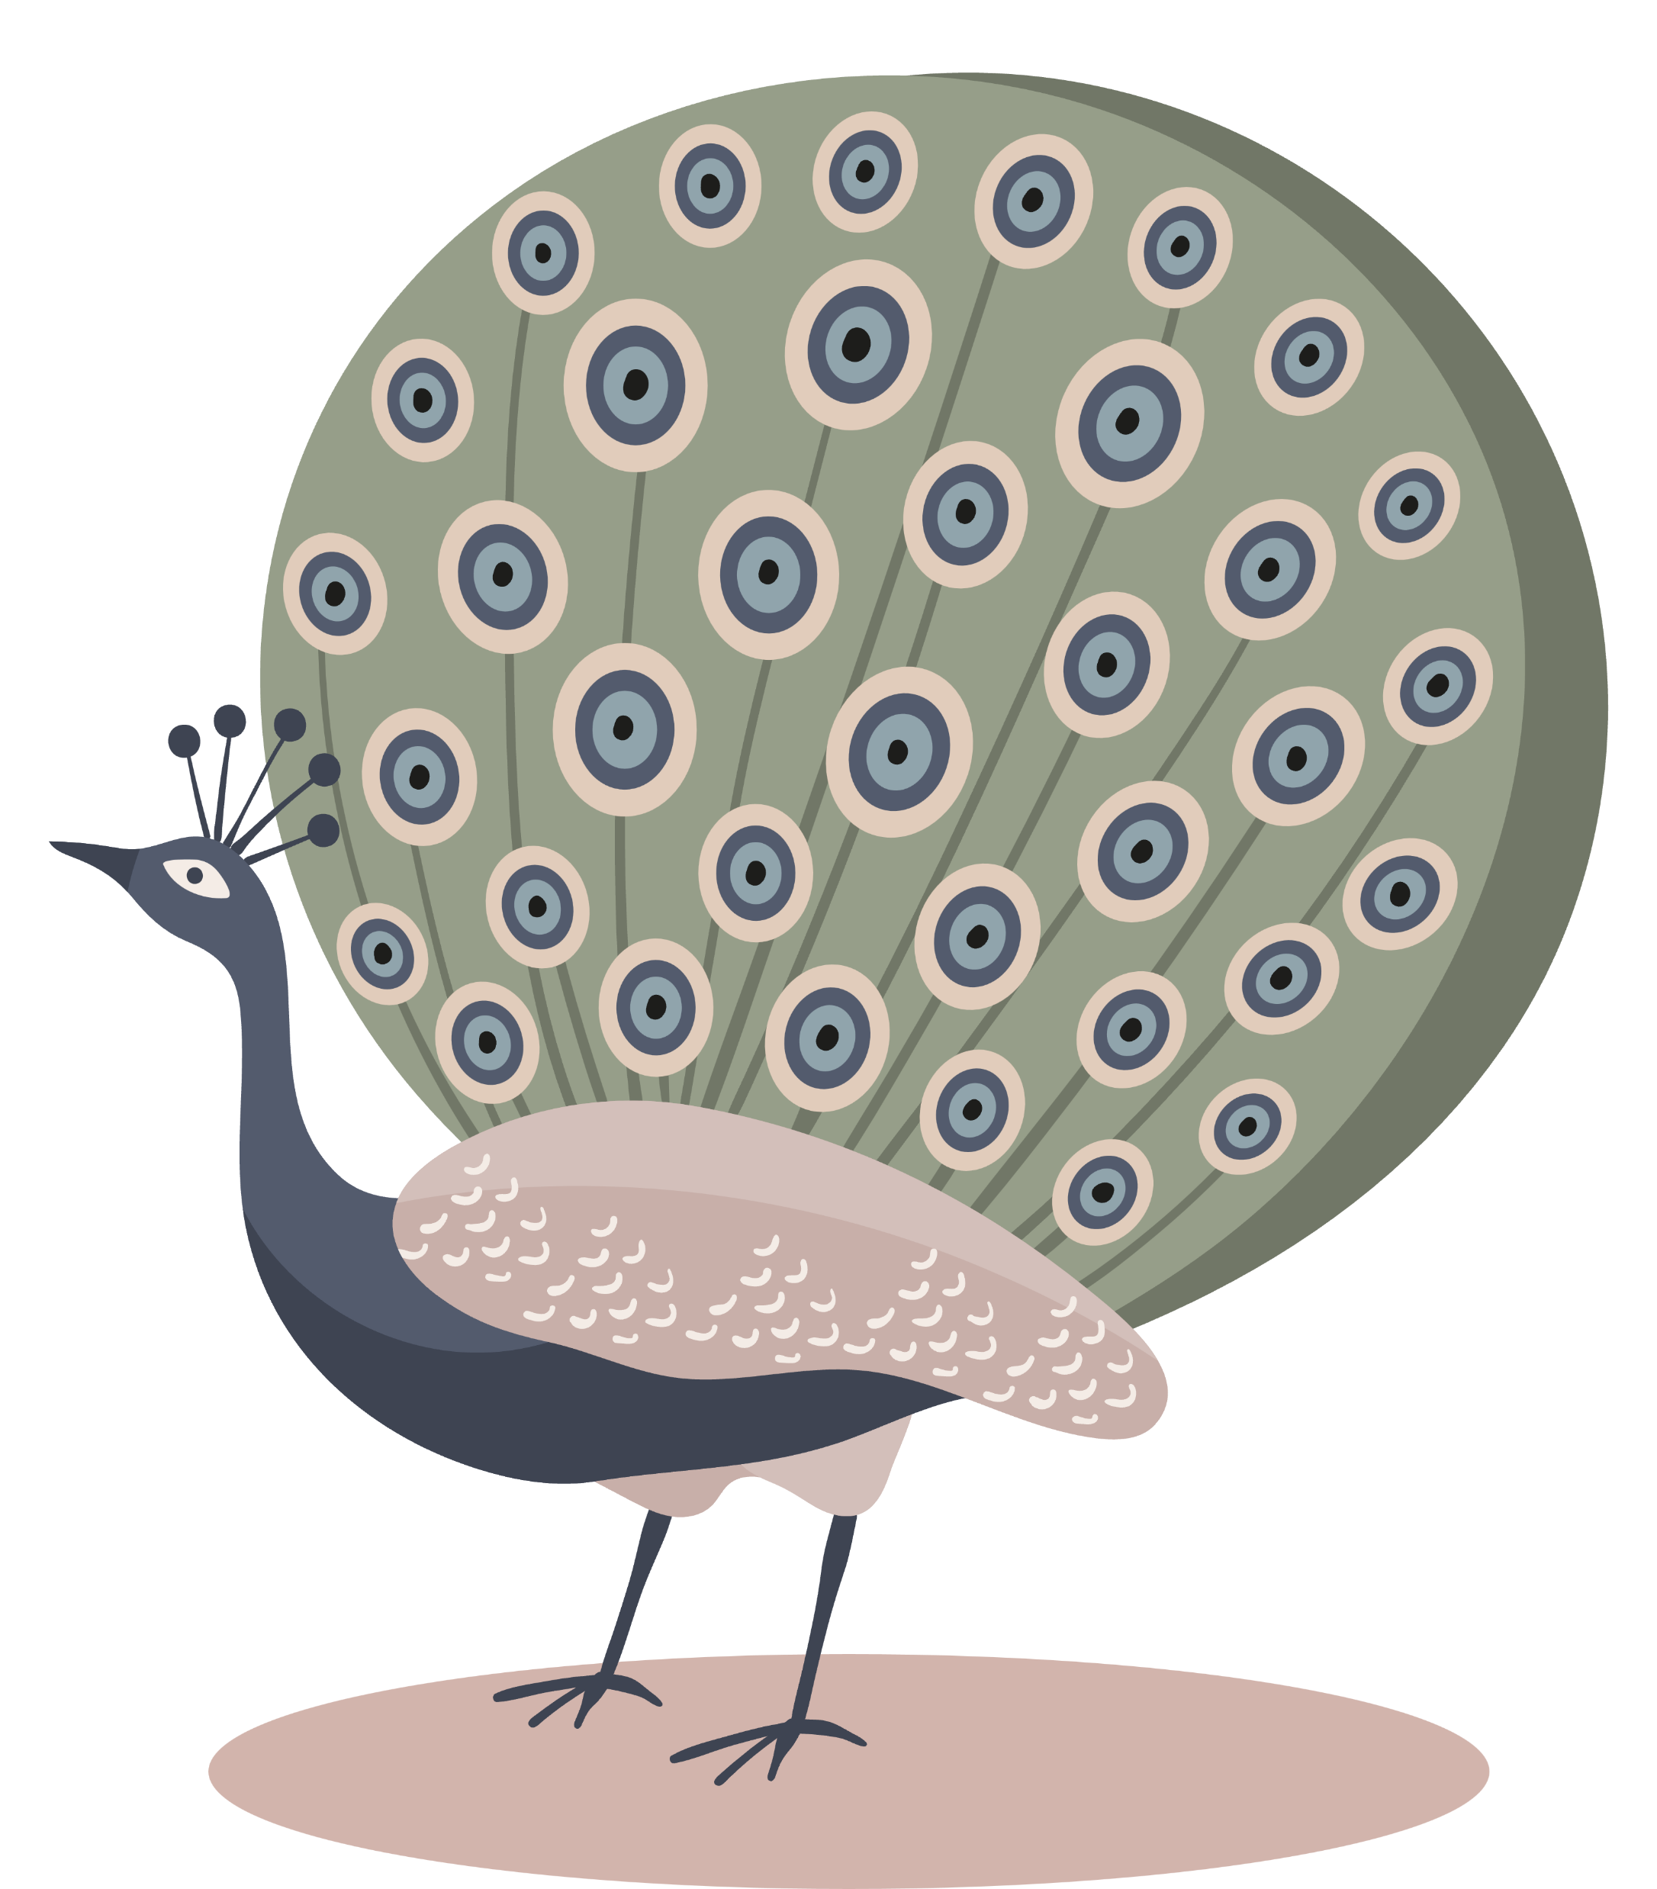
Cons of ai
1. Risk of Bias and Errors
AI models trained on biased or incomplete data can produce flawed conclusions. For example, facial recognition AI has shown racial bias (Buolamwini & Gebru, 2018).
2. Lack of Transparency (Black Box Problem)
Many AI models, especially deep learning systems, operate as "black boxes," making it difficult to interpret their decision-making processes (Castelvecchi, 2016).

Slide 7
Cons of ai
3. Ethical and Privacy Concerns
AI in medical research raises privacy issues, particularly with patient data. Misuse of AI-generated findings could lead to unethical applications (Jobin et al., 2019).
4. Job Displacement in Research
AI automation may reduce the need for lab technicians and data analysts, leading to job losses in traditional research roles (Brynjolfsson & McAfee, 2014).

Slide 8
conclusion
AI offers tremendous benefits in scientific research, including faster data processing, automation, and improved predictions. However, challenges such as bias, transparency, and ethical concerns must be addressed. A balanced approach—combining AI with human oversight—will maximize its potential while mitigating risks.

Slide 9

“Scispace”

Slide 10
References
Brynjolfsson, E., & McAfee, A. (2014). *The Second Machine Age: Work, Progress, and Prosperity in a Time of Brilliant Technologies.* W. W. Norton & Company.
Buolamwini, J., & Gebru, T. (2018). *Gender shades: Intersectional accuracy disparities in commercial gender classification.* Proceedings of the Conference on Fairness, Accountability, and Transparency, 77-91.
Castelvecchi, D. (2016). *Can we open the black box of AI?* Nature, 538(7623), 20-23.
Jobin, A., et al. (2019). *The global landscape of AI ethics guidelines.* Nature Machine Intelligence, 1(9), 389-399.
Silver, D., et al. (2018). *A general reinforcement learning algorithm that masters chess, shogi, and Go through self-play.* Science, 362(6419), 1140-1144.
Stokes, J. M., et al. (2020). *A deep learning approach to antibiotic discovery.* Cell, 180(4), 688-702.
Topol, E. J. (2019). *High-performance medicine: the convergence of human and artificial intelligence.* Nature Medicine, 25(1), 44-56.
Vaishya, R., et al. (2020). *Artificial Intelligence (AI) applications for COVID-19 pandemic.* Diabetes & Metabolic Syndrome: Clinical Research & Reviews, 14(4), 337-339.

Slide 11

THANK YOU

