Slide 1


ورشة عمل بعنوان
Microencapsulation
Asst. Prof Dr. Khalid W. Hameed
Dr. Duaa K. Mezaal
Al-Khwarizmi College of Eng.
University of Baghdad

Slide 2
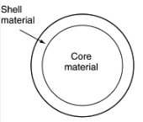
What is mean Microencapsulation
Microencapsulation may be defined as the process of surrounding or enveloping one substance within another substance on a very small scale, yielding capsules microns in size of many useful properties. In general, it is used to incorporate food ingredients, enzymes, cells or other materials on a micro-metric scale.

Slide 3
Advantages of Microparticles
(i) an effective protection of the encapsulated active agent against (e.g. enzymatic) degradation,
(ii) the possibility to accurately control the release rate of the incorporated drug over periods of hours to months,
(iii) can overcome some of the problems of conventional therapy.
(iv) enhance the therapeutic efficacy of a given drug.

Slide 4
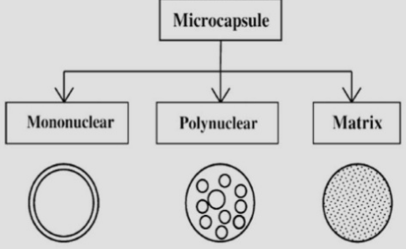
Morphology of Microcapsules:
The morphology of microcapsules depends mainly on the core material and the deposition process of the shell.
1- Mononuclear (core-shell) microcapsules contain the shell around the core.
2- Polynuclear capsules have many cores enclosed within the shell.
3- Matrix encapsulation in which the core material is distributed homogeneously into the shell material.
4- mononuclear with multiple shells

Slide 5
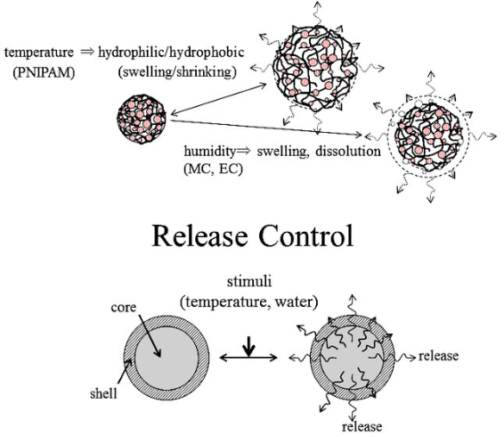
Mechanisms for the release of encapsulated core materials:
Disruption of the coating by pressure, shear, or abrasion forces.
Enzymatic degradation of the coating where permeability changes.
Diffusion or leaching of core materials.
The rate of release of core material is a function of:
the permeability of the coating to core material.
the dissolution rate of the core materials
the coating thickness
the concentration gradient existing across the coating membrane.

Slide 6
Reasons For Microencapsulation
Protect reactive substances from environment
Convert liquids to solids for easier handling
Separate incompatible substances
Control release and target delivery
Mask taste/odor and increase bioavailability
Protect gastrointestinal tract from irritants

Slide 7
Examples of Microencapsulated Core Materials
Core material can vary active ingredients, stabilizers, diluents, excipients, and accelerators or retardants of release rates make up the solid core.
Core Material | Characteristic Property | Purpose of Encapsulation | Final Product Form
Acetaminophen | Slightly water- Soluble solid | Taste-masking | Tablet
Aspirin | Slightly water- Soluble solid | Taste-masking, sustained release; reduced gastric irritation, separation of incompatibles ­ | Tablet or capsule
Progesterone | Slightly water- Soluble solid | Sustained release | Varied
Potassium chloride | Highly water- soluble solid | Reduced gastric irritation | Capsule

Slide 8
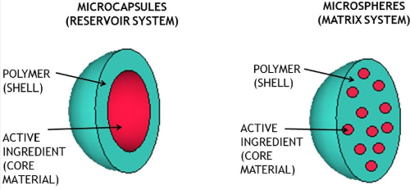
Coating Materials properties
The polymer acts as a protective film, isolating the core and avoiding the effect of its inadequate exposure. This membrane dissolves itself through a specific stimulus, releasing the core in the ideal place or at the ideal time.

Slide 9
Stabilization of core material.
Be capable of forming a film that is cohesive with the core material.
Be chemically compatible and non-reactive with the core material.
Provide the desired coating properties, such as strength, flexibility, impermeability, optical properties, and stability.
Controlled release under specific conditions.
Coating material selected from natural and synthetic film-forming polymers.
The coating can be flexible, brittle, hard, thin etc.

Slide 10
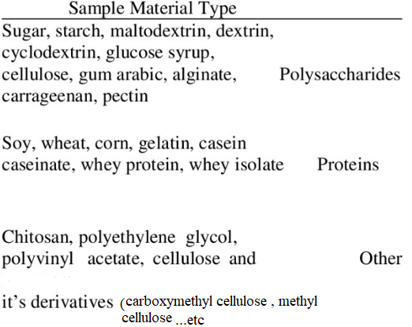
However, many traditional coating materials are satisfactory for the use in the gastrointestinal tract.

Slide 11
The selection of appropriate coating material from a long list of candidate materials needs consideration of the following general criteria by the research pharmacist:
1. What are the specific dosage forms or product requirements, such as stabilization, reduced volatility, release characteristics, and environmental conditions?
2. What coating material will satisfy the product objective and requirements?
3. What microencapsulation method is best suited to accomplish the coated product objectives?
The selection of appropriate coating material decides the physical and chemical properties of the resultant microcapsules/ microspheres.

Slide 12
Microencapsulation Methods
The selection of the microencapsulation process is governed by the physical and chemical properties of core and coating materials and the intended application of food ingredients.
Chemical: Interfacial and in situ polymerization
Physicochemical: Coacervation-phase separation, complex emulsions, meltable dispersions
Mechanical: Air suspension (Wurster), pan coating, spray drying/congealing, micro-orifice systems

Slide 13
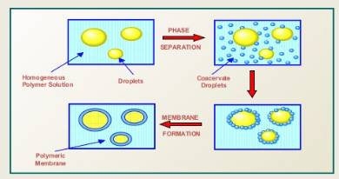
Coacervation-Phase Separation
Phase separation of hydrocolloids to form coating
High payloads (up to 99%) and controlled release
Used for oils, vitamins, enzymes, flavors
Simple and complex coacervation methods

Slide 14
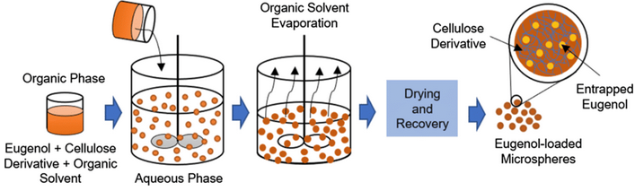
Solvent Evaporation Method
Drug dispersed in polymer solution
Emulsified in aqueous phase with stabilizer
Solvent removed to form microspheres
Suitable for hydrophilic/hydrophobic and solid/liquid drugs
Particle size 5-5000 µm

Slide 15
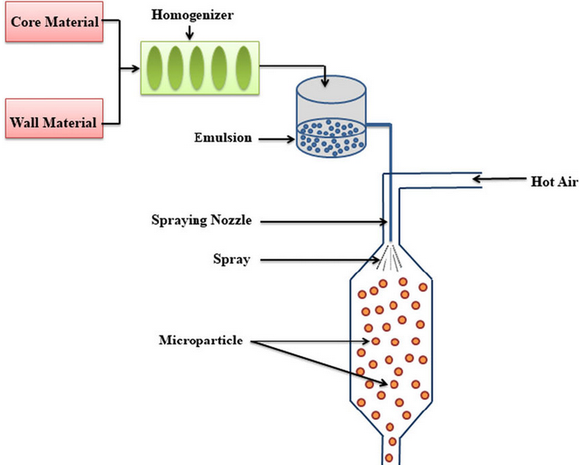
Pan Coating & Spray Drying/Congealing
* Pan Coating: For particles >600 µm, coating applied in rotating pan with warm air drying
Spray Drying: Atomizes core-coating mixture into heated air stream.
Spray Congealing: Uses molten coating materials, similar to spray drying.

Slide 16
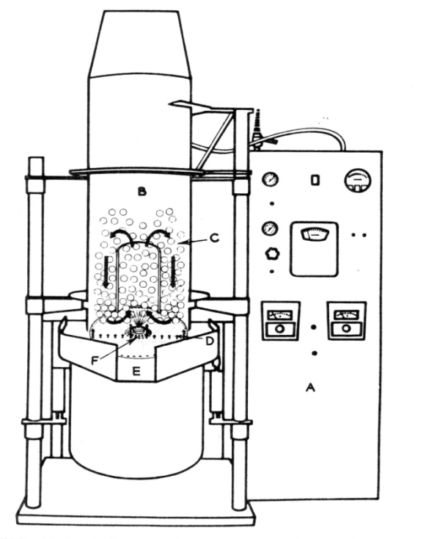
Air Suspension (Wurster Process)
Particles suspended in upward air stream
Coating sprayed onto moving particles
Cyclic coating and drying process
Suitable for solid cores, particle size 35-5000 µm

Slide 17
شكراً

