Slide 1

Management of oral halitosis
By : Mohamed Saeed

Slide 2

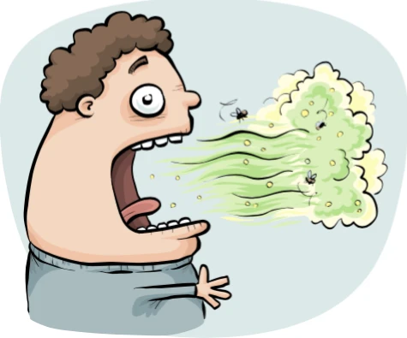
Definition
Halitosis refers to any type of unpleasant scent felt from the breath of a person during exhalation and speech (Sterer and Rosenberg, 2020b).
Originates from two Latin words (Ajith et al., 2019).
Halitus → breath
Osis → disease
It is probably the third most common cause for visiting the dentist after dental caries and periodontal diseases (Sharma et al., 2019).
Affecting more than 60% of the people worldwide (Mokeem, 2014).

Slide 3

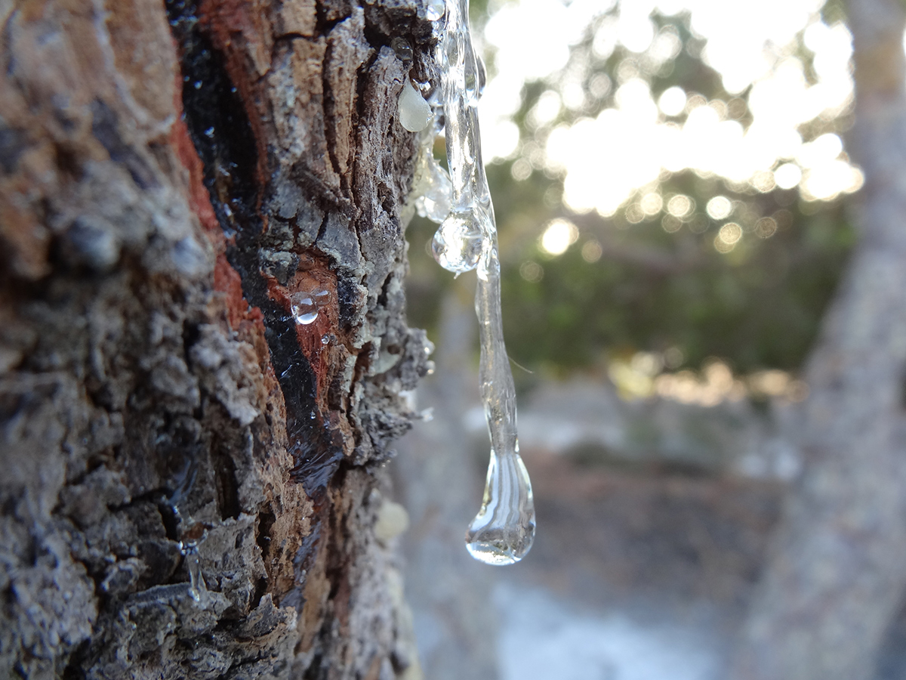
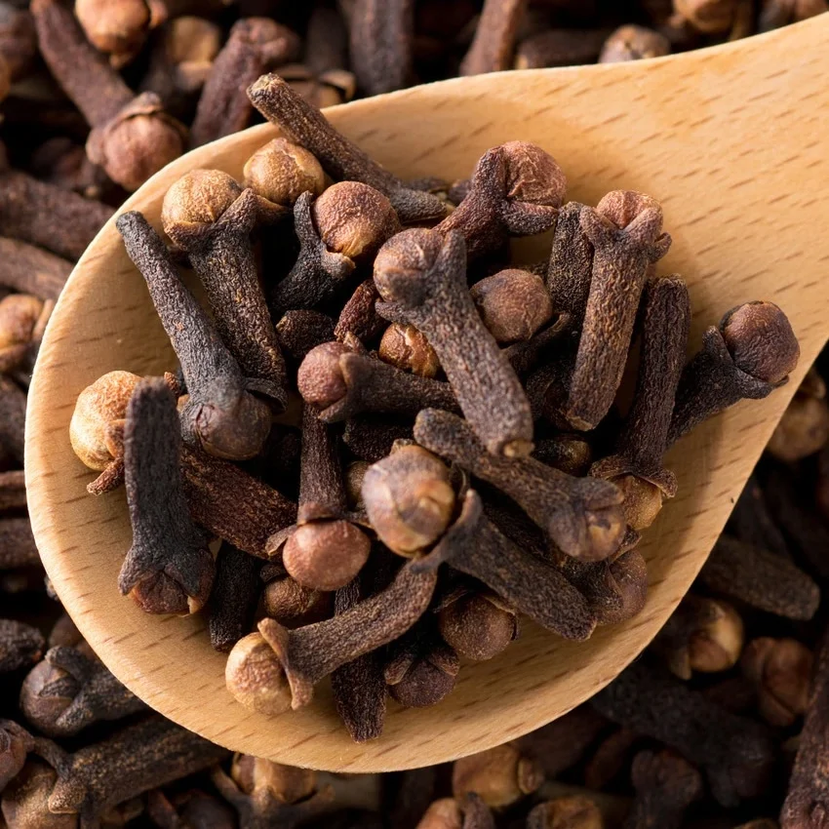
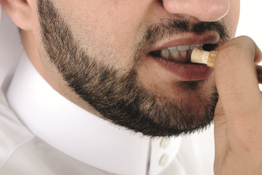
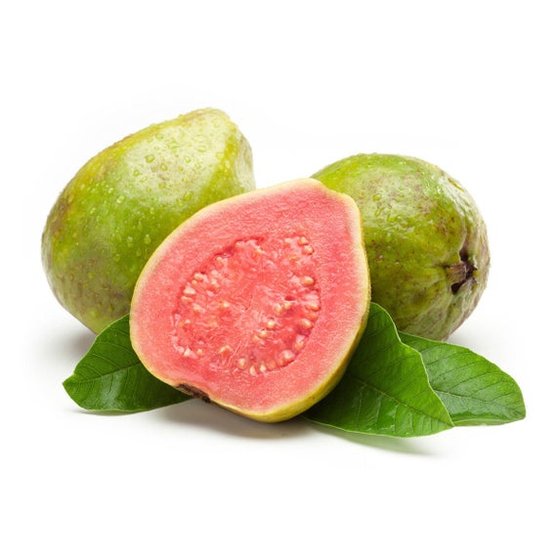
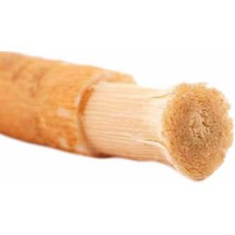
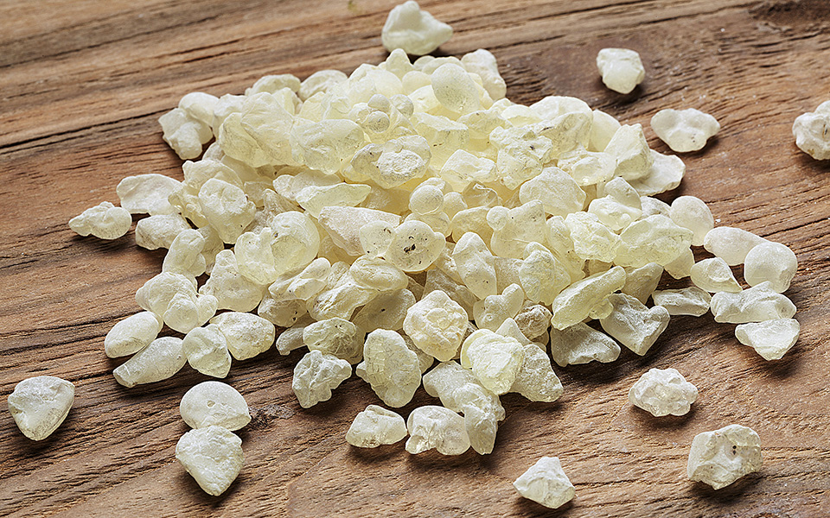
History
Halitosis was described by many documents dating back to the Greek and Roman times
Using of Siwak is considered as religious practice by Moslems
A resin from the Pistacia lentiscus tree (labdanum) was used as breath refresher for thousands of years
Other folk remedies like using of cloves (Iraq), guava peels (Thailand), parsley (Italy) and eggshells (China) were also used for bad breath management

Slide 4
Etiology of Halitosis
halitosis is considered as
multifactorial
in origin and may occur in combination with various local and systemic disorders.

Slide 5
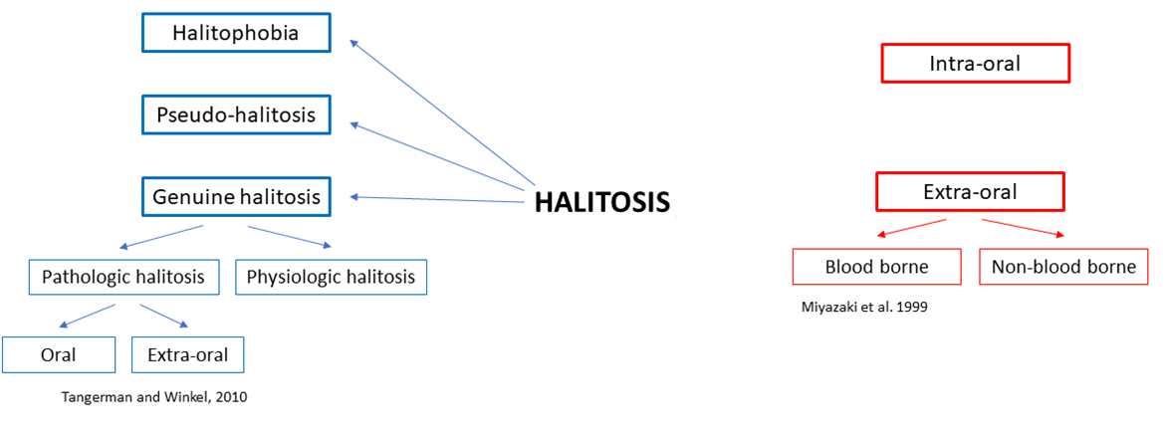
Classification

Slide 6
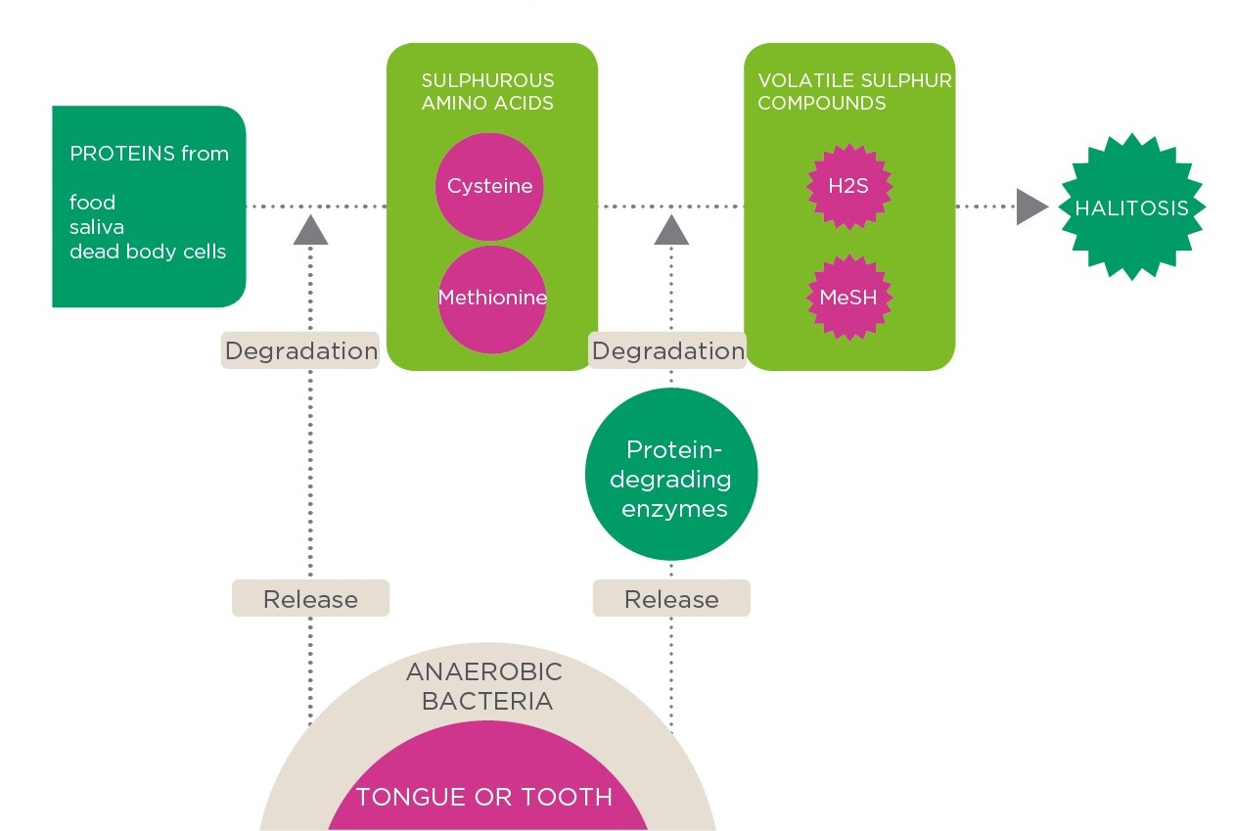
Pathogenesis

Slide 7
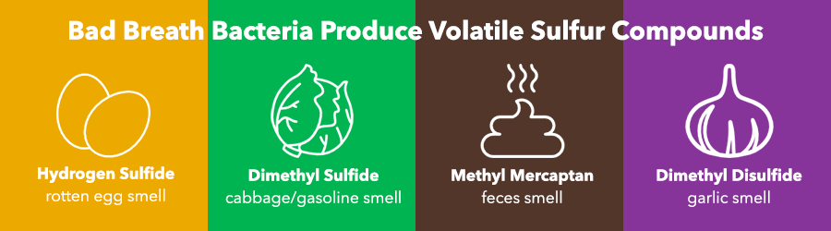
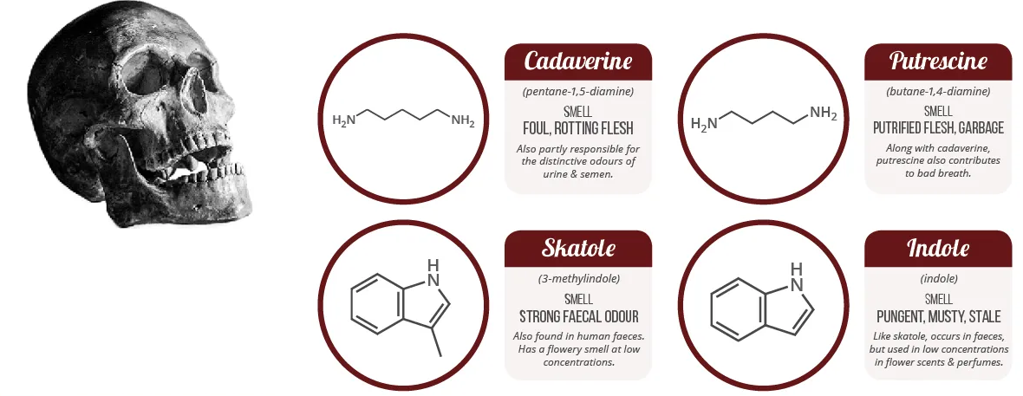
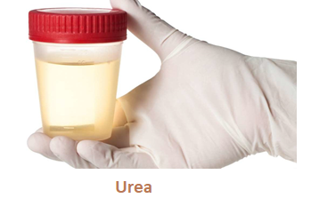
Volatile molecules contributing to oral malodor
The exhaled breath is composed of more than 150 various components (Heboyan et al., 2019b).

Slide 8
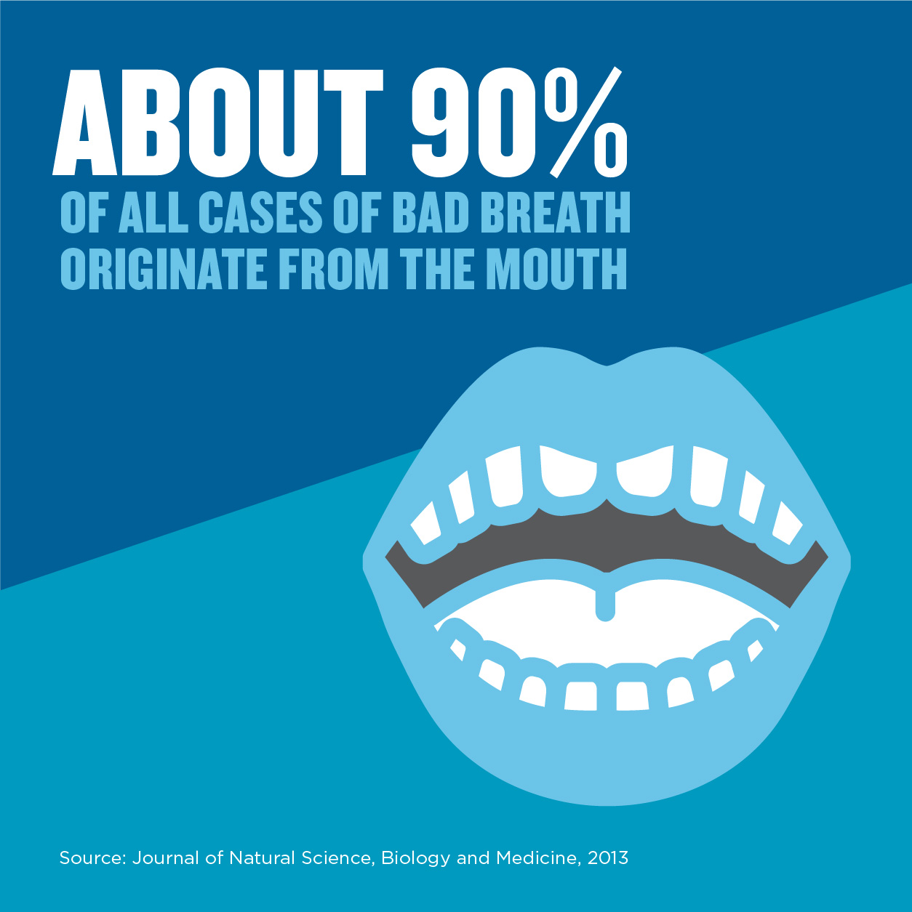
Oral halitosis
Oral halitosis
Tongue coating
Periodontal diseases
Dental caries
Oral cancer
Bad oral hygiene
Oral ulcers
Fissured and hairy tongue
Dental plaque
Failed restorations or prosthesis

Slide 9
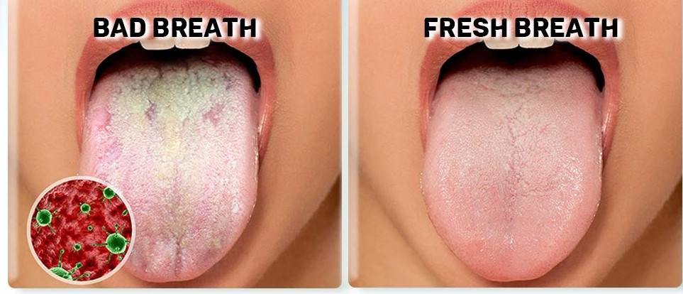
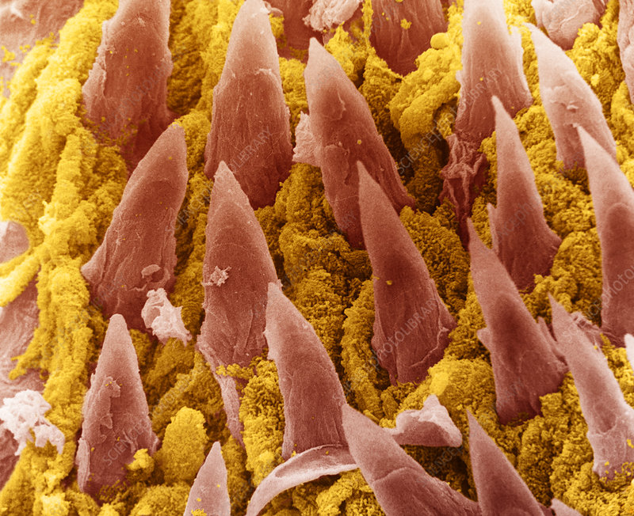
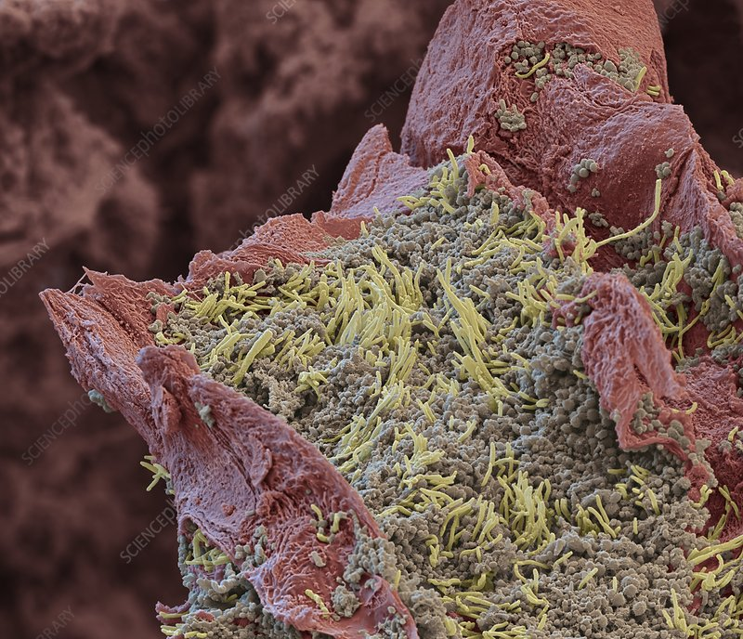
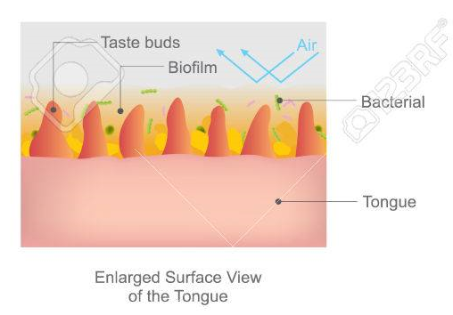
Dental plaque, periodontal pockets and tongue coating are major sources of oral malodor. However, the posterior dorsum of the tongue is regarded as the most important site emanating bad odor. This can be best explained by the tongue having the largest surface area in the mouth (25 cm²)with pits, fissures, and papillary structures (Ren et al., 2016).

Slide 10

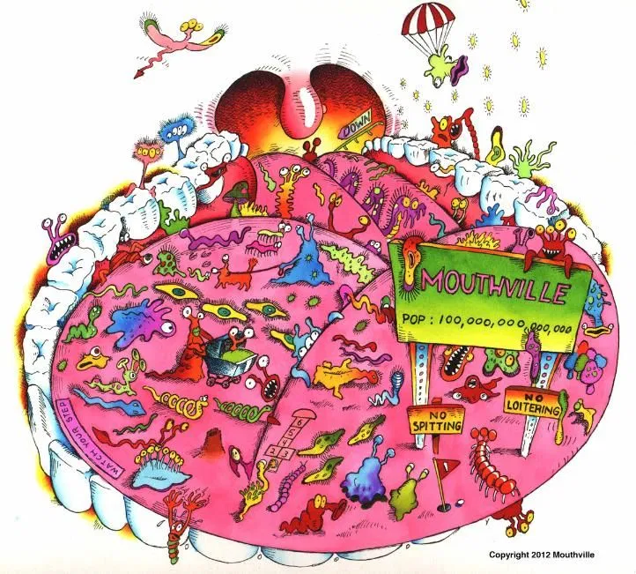
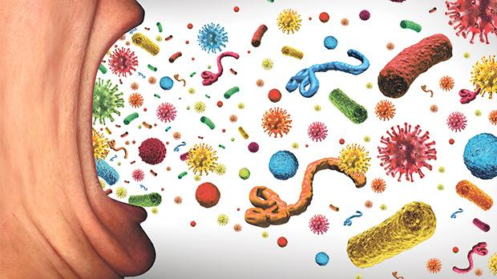

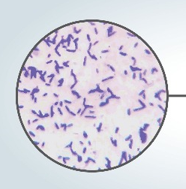
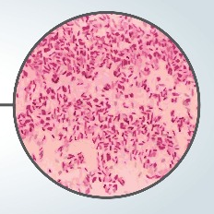
Gram positive bacteria
All Actinomyces spp.
Bifidobacterium breve
Collinsella aerofaciens
All Eubacterium spp.
All Lactobacillus spp.
Peptostreptococcus spp.
Propionibacterium avidum
Gram negative bacteria
All Campylobacter spp.
Bacteroides loescheii
Centipeda periodontii
Dialister pneumosintes
Eikenella corrodens
Enterobacteriaceae
Fusobacterium spp.
Leptotrichia buccalis
All Porphyromonas spp.
All Selenomonas spp.
Veillonella sp.
Treponema denticola
Tannerella forsythensis

Slide 11
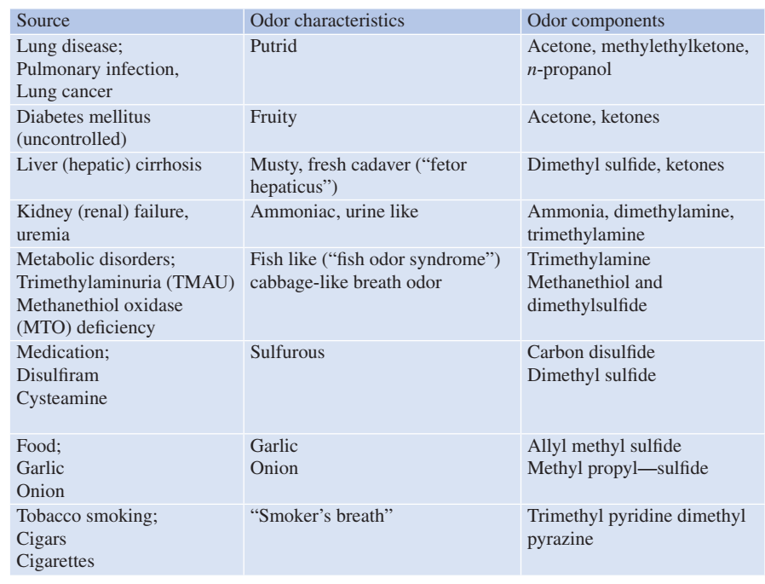
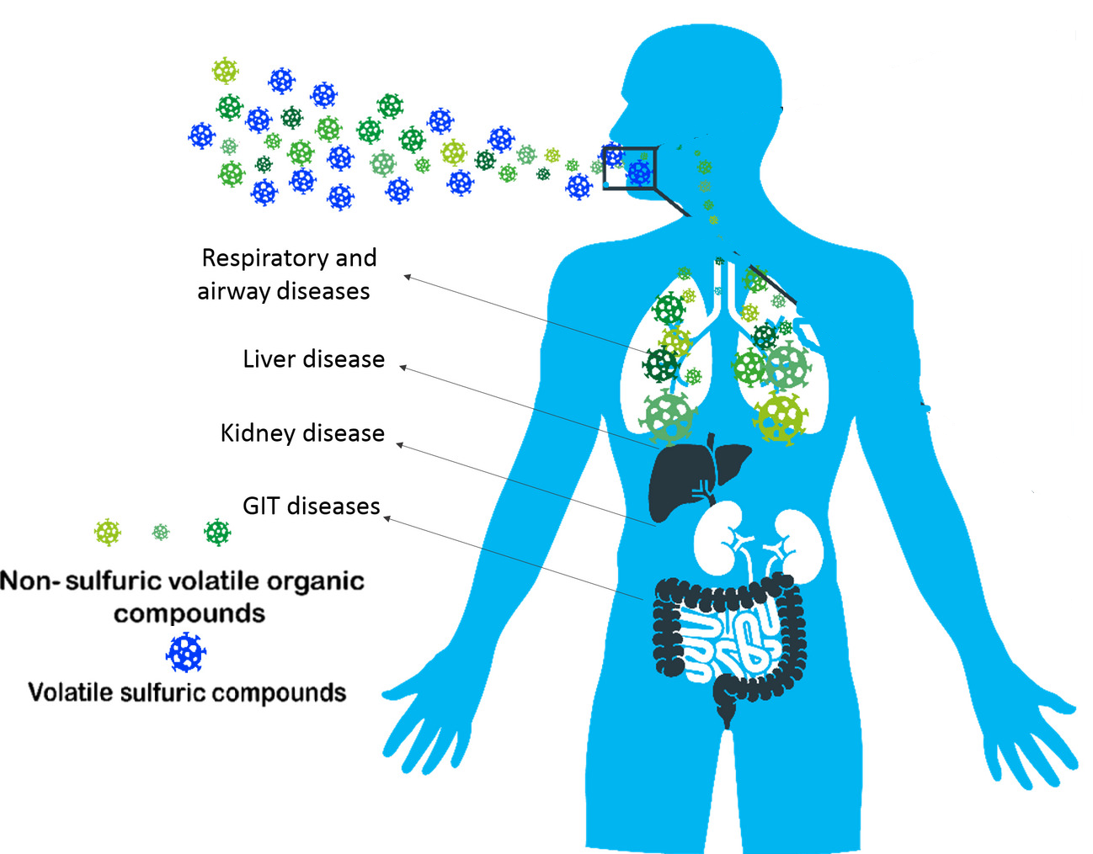

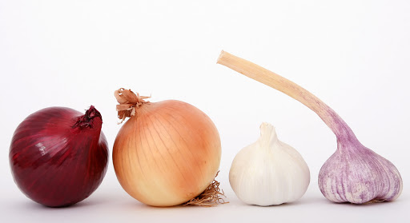
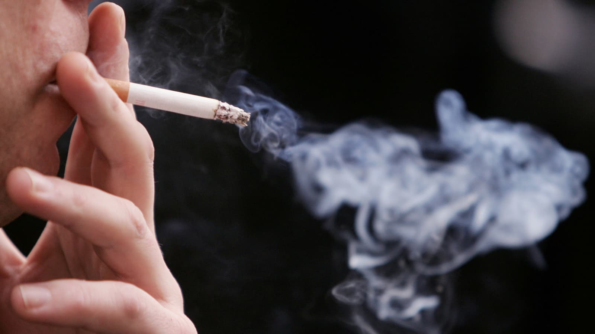
Extraoral halitosis
Account for
Of all cases of halitosis

Slide 12
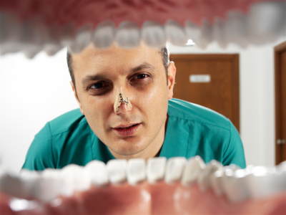

Diagnosis of halitosis
History
1. Chief complaint
2. Medical and dental history
3. Dietary information
4. Frequency
5. Duration
6. Time of appearance within a day
7. Medications
8. Habits (smoking, alcohol drinking)

Slide 13
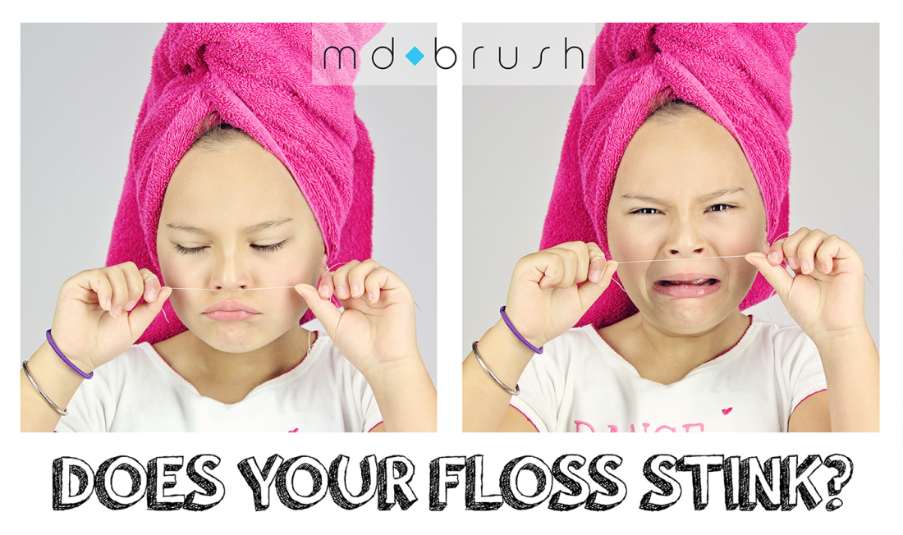
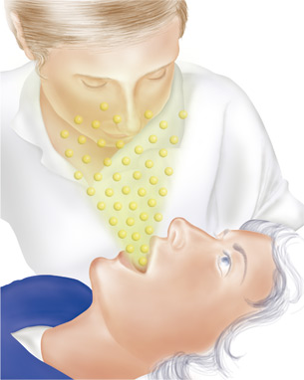
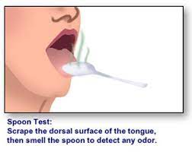
Diagnosis of halitosis
Direct measurement techniques
Organoleptic Method (Sniff Test)
The sensory organoleptic assessment by a clinician is considered as the gold standard for diagnosis of oral malodor (Sterer and Rosenberg, 2020b).
Saliva odor test
Tongue odor test
Floss odor test
Spoon odor test
Self assessment test

Slide 14
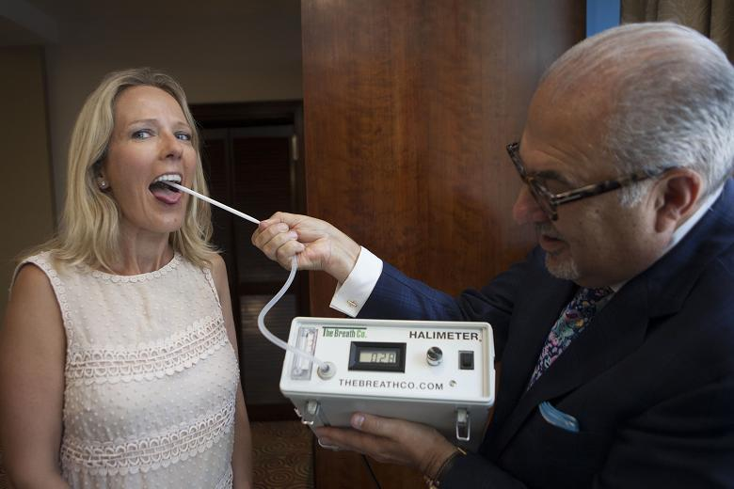
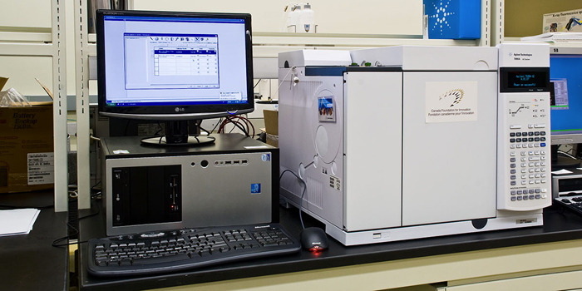
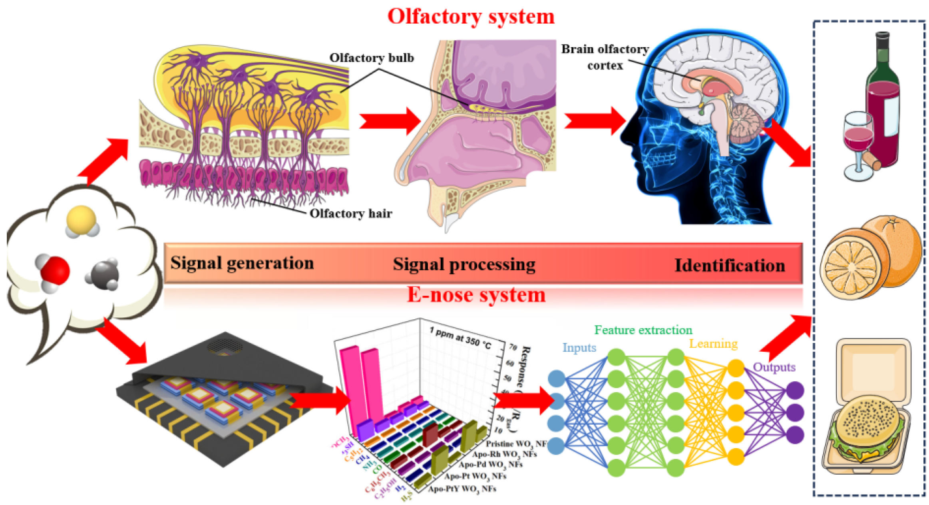
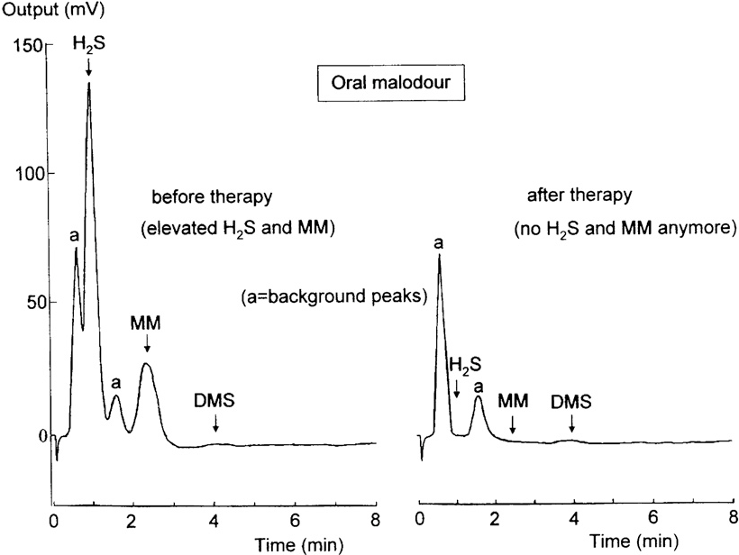
Diagnosis of halitosis
Direct measurement techniques
Gas chromatography
Halimeter
Electronic Nose

Slide 15
Diagnostic Methods for Oral Halitosis
Category | Method | Mechanism | Reliability | Clinical Utility | Key References
Organoleptic | Organoleptic Assessment | Trained clinician sniffs breath at varying distances (0–10 cm) and rates odor intensity (0–5 scale). | Gold standard; subjective but validated. | High (diagnostic reference for trials). | Rosenberg & McCulloch (1992)
Instrumental | Gas Chromatography (e.g., OralChroma™) | Quantifies volatile sulfur compounds (VSCs: H₂S, CH₃SH, (CH₃)₂S) in breath. | Objective; detects specific VSCs. | High (research/clinical use; costly). | Tangerman & Winkel (2007)
 | Sulfide Monitors (e.g., Halimeter®) | Measures total VSC levels (primarily H₂S) via electrochemical sensors. | Moderate; detects H₂S but misses other VSCs. | Moderate (common in dental clinics). | Rosenberg et al. (1991)
Microbiological | BANA Test | Detects Treponema denticola, Porphyromonas gingivalis, and Tannerella forsythia (hydrolyze benzoyl-arginine-naphthylamide). | Specific for periodontitis-related halitosis. | Moderate (supplemental use). | Loesche et al. (1990)
 | Salivary Incubation Test | Incubates saliva to measure VSC production by oral bacteria. | Correlates with oral bacterial load. | Low (research only). | Kleinberg & Codipilly (1995)
 | PCR/Culture Analysis | Identifies halitosis-associated bacteria (e.g., Solobacterium moorei). | High specificity; time-consuming. | Research-focused. | Haraszthy et al. (2007)
Self-Assessment | Patient Self-Reports | Patient rates own breath quality (questionnaires, visual analog scales). | Low reliability (under/overestimation common). | Adjunctive screening. | Eli et al. (1999)
Clinical Examination | Tongue Coating Index (TCI) | Visual scoring of tongue coating thickness (0–4 scale). | Correlates with VSC levels; moderate reliability. | High (guides tongue cleaning). | Winkel et al. (2003)
 | Periodontal Examination | Assesses plaque, gingivitis, and periodontal pockets (linked to VSCs). | Identifies oral causes (e.g., periodontitis). | Critical for treatment planning. | Rösing et al. (2009)
Emerging Technologies | Electronic Noses | AI-driven sensors mimic olfaction to detect odor patterns. | Promising but variable accuracy. | Experimental. | Dragonieri et al. (2009)
 | Portable Breath Sensors | Handheld devices (e.g., metal oxide sensors) detect VSCs. | Rapid but less precise than lab tools. | Emerging for home use. | Kim et al. (2021)

Slide 16

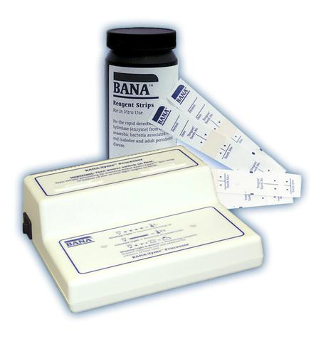
Diagnosis of halitosis
Indirect measurement techniques
BANA (Benzoyl-DL-arginine- α-Naphthylamide) test
Quantifying beta-galactosidase activity
PCR

Slide 17
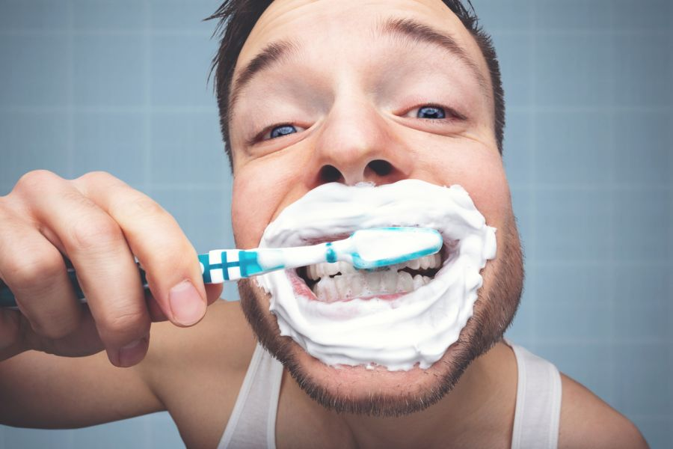
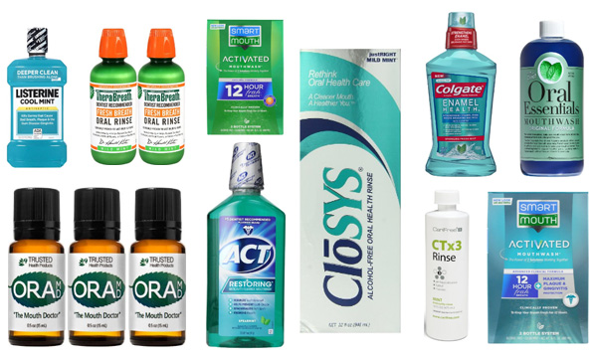
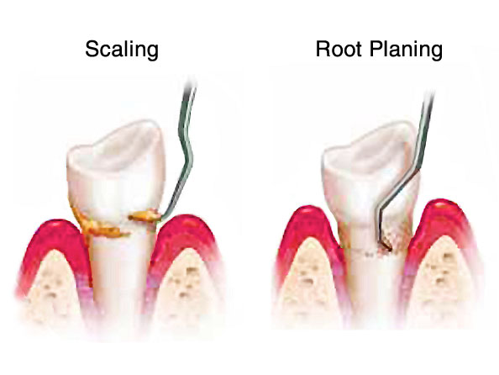
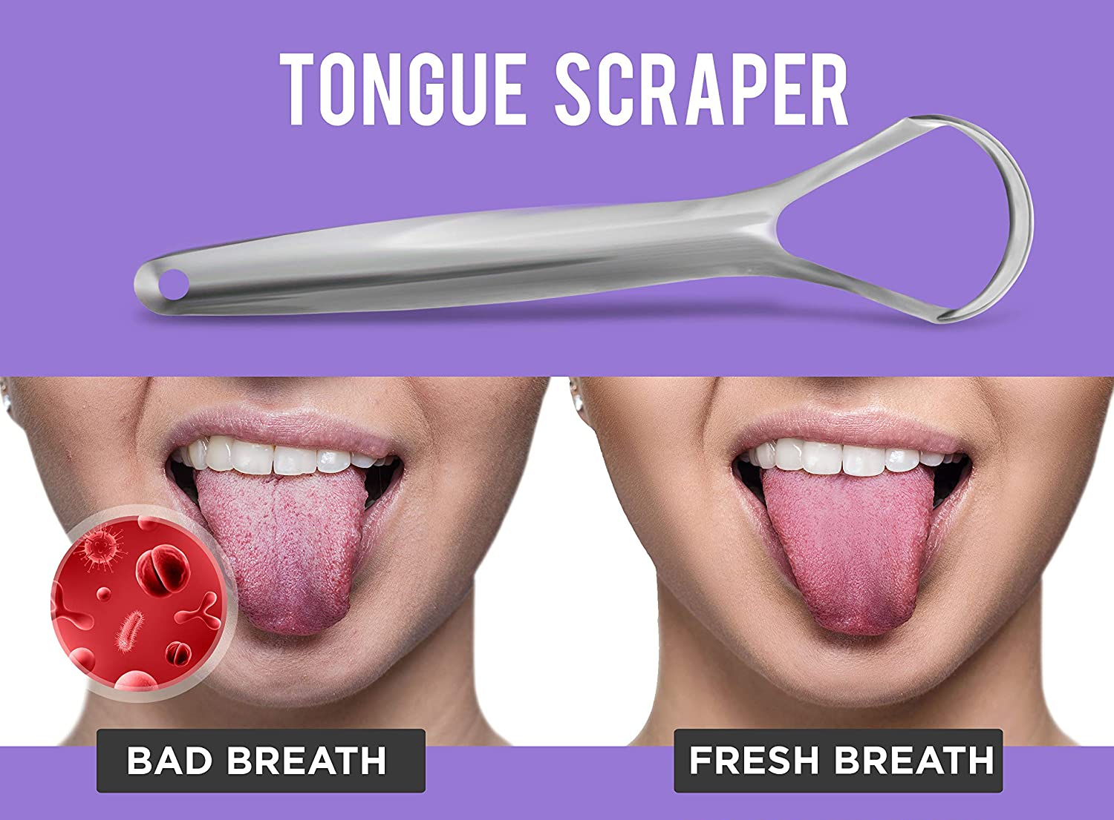
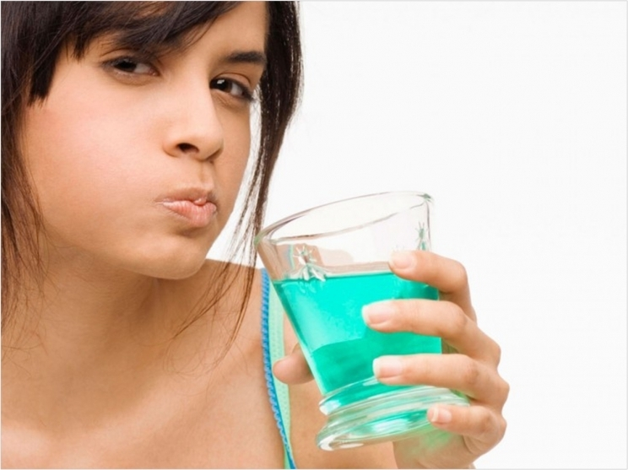
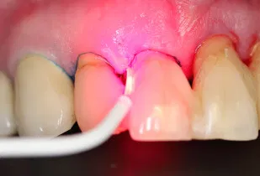
Method to reduce oral halitosis
Mechanical reduction
Tooth brushing and tongue cleaning
Chemical reduction
Masking the odor
zinc
Non-surgical periodontal therapy
Scaling and root planning
Photodynamic therapy
CHX, essential oil and cetylpyridinium chloride,…

Slide 18
Oral Halitosis Treatments
Category | Method/Ingredient | Formulation | Mechanism | Efficacy | Key References
Mechanical | Tongue Cleaning | Scrapers, brushes | Removes biofilm/debris from tongue dorsum (primary VSC source). | High efficacy when daily. | Pedrazzi et al. (2004)
 | Professional Dental Cleaning | Scaling, root planing | Removes calculus and subgingival biofilm (treats periodontal halitosis). | High efficacy for periodontitis-related cases. | Rösing et al. (2009)
 | Interdental Cleaning | Floss, interdental brushes | Reduces interdental plaque (secondary VSC source). | Moderate; adjunctive. | Van der Sluijs et al. (2016)
Chemical | Chlorhexidine (CHX) | Mouthwash, gel | Antimicrobial; disrupts biofilm and reduces VSCs. | Most potent (short-term); long-term use limited by side effects. | Van der Weijden et al. (2010)
 | Zinc Salts | Mouthwash, toothpaste | Neutralizes VSCs; inhibits bacterial growth. | High (synergistic with CHX). | Roldán et al. (2005)
 | Triple-Combo (CHX + CPC + Zinc) | Mouthwash | Multi-target: biofilm disruption, bacterial kill, VSC neutralization. | Superior to single agents. | Huynh et al. (2024)
 | Cetylpyridinium Chloride (CPC) | Mouthwash, toothpaste | Reduces bacterial load; disrupts biofilm. | Moderate to high. | Silva et al. (2016)
 | Chlorine Dioxide | Mouthwash | Oxidizes VSCs; antibacterial. | Effective for immediate VSC reduction. | Frascella et al. (2000)
 | Hydrogen Peroxide | Mouthwash | Oxygenates environment; kills anaerobes. | Short-term efficacy. | Quirynen et al. (2002)
 | Ozonated Water/Oil | Mouthwash, gel | Ozone (O₃) oxidizes VSCs and bacteria. | Rapid action; limited long-term data. | Almazrooa et al. (2023)
Natural | Essential Oils | Mouthwash (e.g., Listerine) | Antimicrobial (menthol, thymol); disrupts bacterial membranes. | Moderate short-term VSC reduction. | Fedorowicz et al. (2008)
 | Green Tea Extract | Mouthwash, toothpaste | Polyphenols (catechins) inhibit bacteria and VSCs. | Moderate evidence. | Lodhia et al. (2008)
 | Neem Extract | Mouthwash, toothpaste | Antimicrobial; reduces plaque and VSCs. | Traditional use with moderate support. | Pai et al. (2004)
 | Aloe Vera | Gel, mouthwash | Anti-inflammatory and antimicrobial. | Limited but promising. | Lee et al. (2014)
 | Oil Pulling | Coconut/sesame oil | Mechanical removal; lauric acid (antimicrobial). | Mild; adjunctive. | Asokan et al. (2011)
Advanced | Probiotics | L. reuteri, S. salivarius | Competes with pathogens; reduces VSCs. | Emerging evidence; moderate long-term. | Söderling et al. (2023)
 | Nano-Hydroxyapatite + Xylitol | Toothpaste | Remineralizes enamel; xylitol inhibits biofilm. | Reduces plaque/tongue coating. | Amaechi et al. (2022)
 | Lactoferrin | Lozenges, mouthwash | Starves bacteria of iron; anti-biofilm. | Targets Solobacterium moorei. | Tanaka et al. (2022)
 | Silver Nanoparticles | Toothpaste, mouthwash | Broad-spectrum antimicrobial. | Potent but safety concerns. | Besinis et al. (2022)
 | Photodynamic Therapy (PDT) | Laser + photosensitizers | Light-activated killing of anaerobes. | Experimental; moderate efficacy. | Köseoğlu et al. (2023)
Systemic | Treat Underlying Conditions | GERD, diabetes, sinusitis | Addresses extra-oral causes (e.g., GERD, tonsil stones). | Critical for non-oral halitosis. | Tangerman (2002)
 | Diet Modification | Low-sulfur diet, hydration | Reduces substrates for VSC production. | Mild to moderate; adjunctive. | Scully & Greenman (2012)
Adjunctive | Chewing Gum/Mints | Xylitol gum, zinc mints | Stimulates saliva; neutralizes VSCs. | Temporary relief. | Brunette et al. (2012)
 | Activated Charcoal | Toothpaste, capsules | Adsorbs VSCs and bacteria. | Limited evidence. | Brooks et al. (2017)
Emerging | Hydroxytyrosol (Olive Extract) | Mouthwash | Antioxidant; antimicrobial against Fusobacterium. | Early evidence for VSC reduction. | García-Vázquez et al. (2023)
 | CBD Mouthwash | Mouthwash | Anti-inflammatory; targets gram-negative bacteria. | Early clinical data. | Stahl et al. (2023)
 | Magnolia Bark Extract | Mouthwash | Honokiol/magnolol inhibit VSC-producing bacteria. | Moderate; natural alternative. | Chen et al. (2022)
 | Electrolyzed Water | Rinse (hypochlorous acid) | Antimicrobial; breaks down biofilm. | Safe for daily use. | Takenaka et al. (2022)

Slide 19



