Slide 1
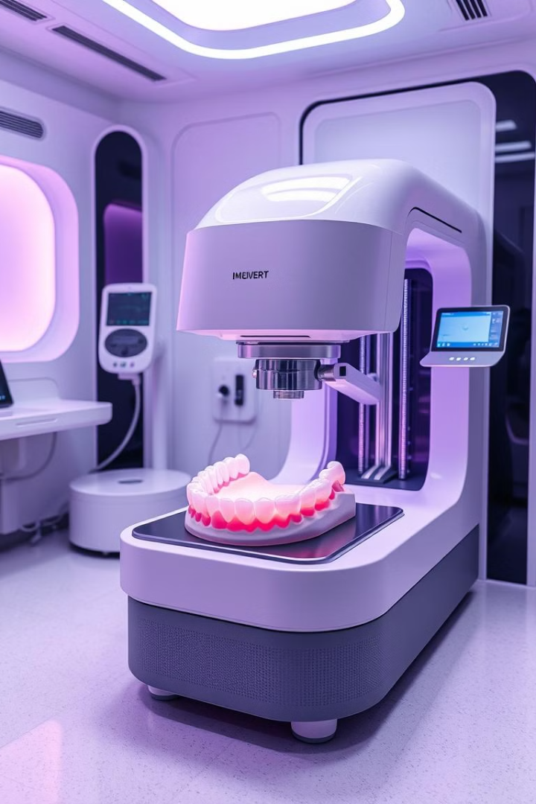
3D Bioprinting: A New Frontier for Gum Tissue Regeneration
3D bioprinting is a revolutionary approach. It promises to change regenerative medicine. We will focus on periodontal disease. New therapies are urgently needed.
Periodontitis affects nearly half of US adults over 30. Current treatments have limitations. Guided tissue regeneration has limited success. This is especially true in severe cases.

Slide 2
Understanding Gum Tissue: Structure and Function
Anatomy
Key Cells
Extracellular Matrix
The periodontium includes gingiva, periodontal ligament, cementum, and alveolar bone.
Fibroblasts, keratinocytes, and immune cells are essential.
Collagen, fibronectin, and laminin are key ECM components.
Gingiva protects, supports, and provides sensation. Gum tissue thickness ranges from 0.8mm to 1.5mm.

Slide 3
Principles of 3D Bioprinting
Definition
Key Components
Bioink Materials
Automated deposition of cells and biomaterials. Creates 3D tissue constructs.
Bioink, bioprinting system, bioprinting process.
Hydrogels like alginate, gelatin, collagen, and decellularized ECM are used.
Extrusion-based, inkjet-based, and laser-assisted are bioprinting techniques. Cell viability is typically above 85% with optimized parameters.

Slide 4
Bioprinting Gum Tissue: A Detailed Look
Bioink
Parameters
Crosslinking
Formulation: fibroblasts + keratinocytes in collagen hydrogel.
Nozzle diameter, printing speed, and layer thickness are critical.
Chemical (glutaraldehyde) or physical (UV light) methods are used.
Maintain cell viability and functionality after printing. Bioprinted constructs mimic native tissue structure.

Slide 5
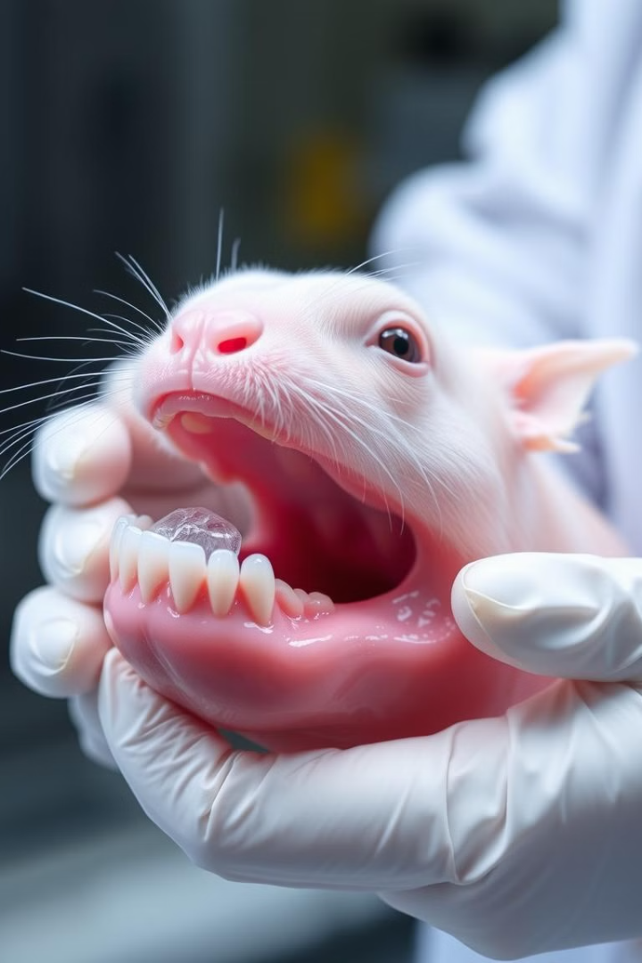
In Vitro and In Vivo Studies
1
In Vitro Results
2
Gene Expression
Bioprinted constructs show increased cell proliferation and ECM production.
Increased collagen I, fibronectin, and keratin gene expression.
3
In Vivo Results
Animal studies show successful integration of bioprinted gum tissue.
Reduced inflammation and accelerated wound healing occur in vivo. Complete defect closure is seen in animal models within 4-8 weeks.

Slide 6
Challenges and Opportunities
Complexity
Vascularization
Matching complex tissue architectures and gradients.
1
2
Incorporating blood vessels into constructs.
Regulatory
Immune Response
4
3
FDA approval hurdles for medical devices.
Minimizing rejection of bioprinted tissues.
Personalized bioprinting provides a unique opportunity. It allows patient-specific gum regeneration.

Slide 7
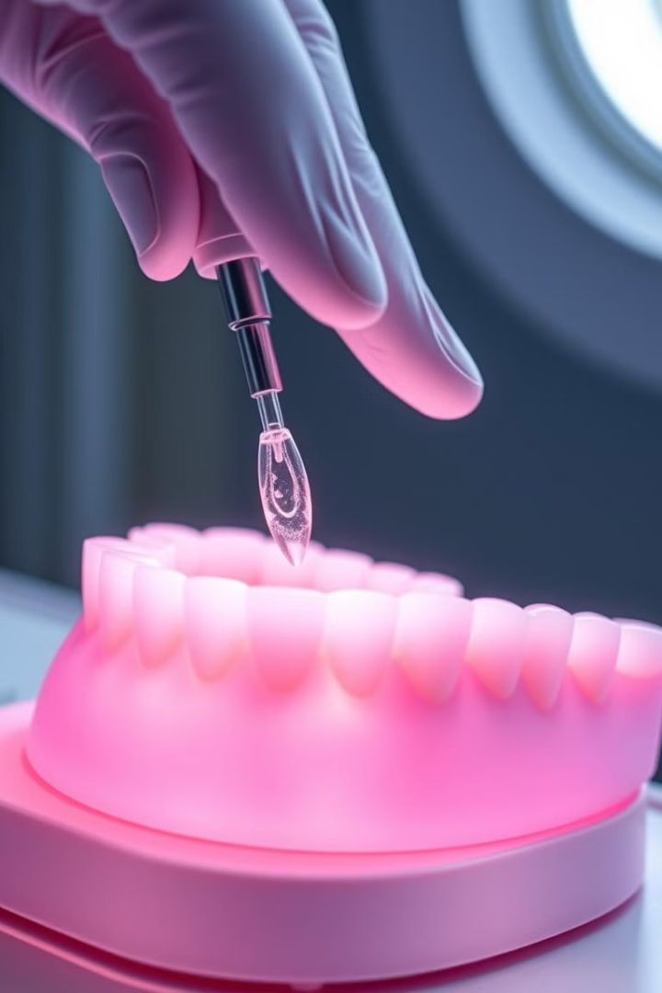
Future Directions and Clinical Translation
1
Advances
New bioink materials and bioprinting tech.
2
Vascularization
Develop fully vascularized gum tissue.
3
Clinical Trials
Assess safety and efficacy in humans.
Integrate with regenerative therapies. Human trials could happen within 5-7 years.

Slide 8
Conclusion: The Future is Bright
3D bioprinting has great potential. It could revolutionize gum tissue regeneration.
Overcoming challenges will enable clinical use. Personalized treatments for periodontal disease are coming.
Further research and collaboration are needed. This will accelerate clinical translation.

