Slide 1
What Epidemiology Reveals About Treatment Quality Risk Factors Influencing The Detection of Apical Periodontitis in Root-Filled Teeth
By
Ahmed Hamid Ali and Noor Hayder Fadhil

Slide 2
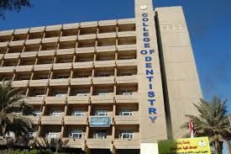
Learning Objectives
• To introduce the aim of root canal treatment and discuss the incidence of apical periodontitis in root-filled teeth.
• To explore outcomes of root canal treatment across global populations.
• To present findings from my studies on apical periodontitis prevalence in Iraq.
• To examine the factors influencing the radiographic detection of apical periodontitis.
• To emphasize the role of CBCT in dental research and highlight global academic collaborations.
www.codental.uobaghdad.edu.iq

Slide 3
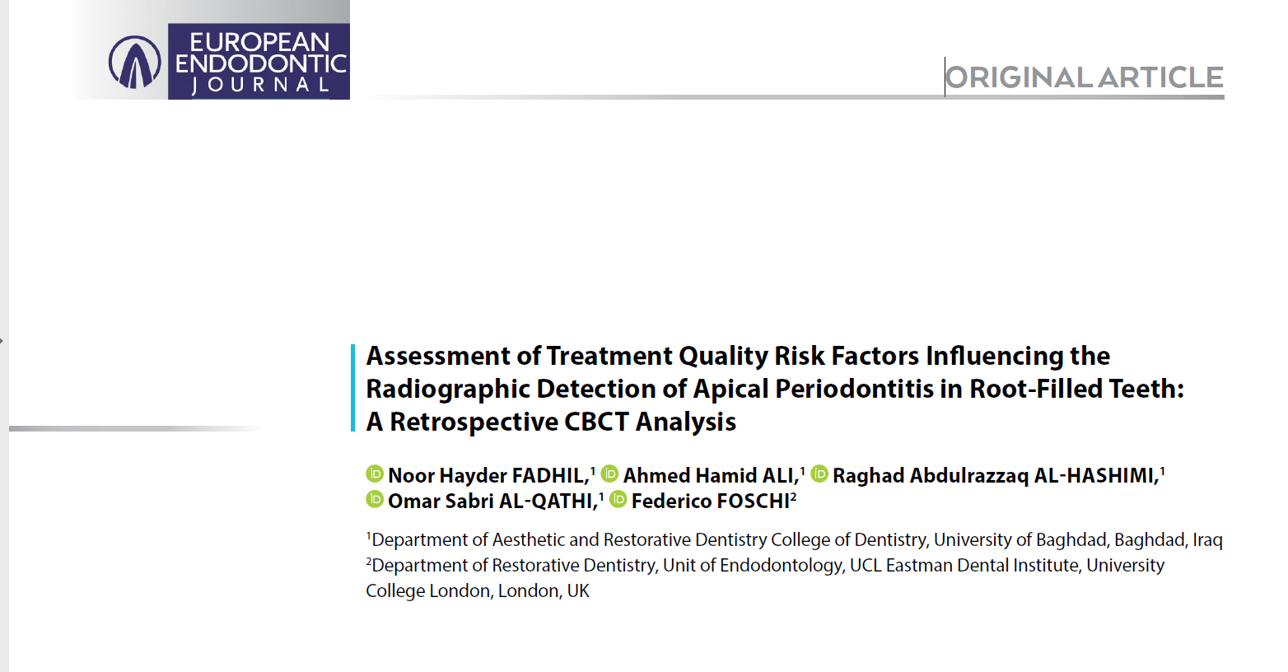
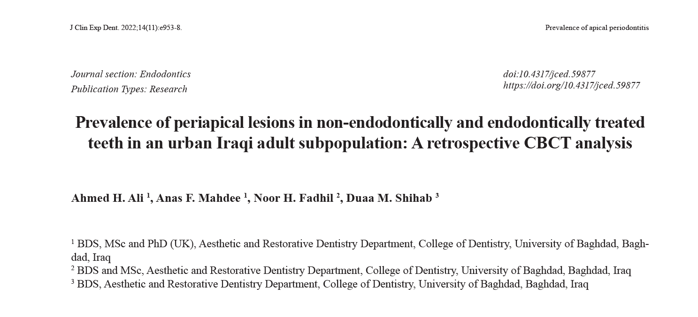
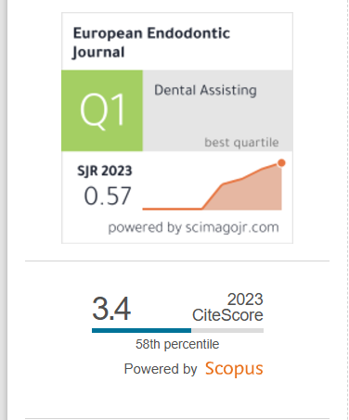

Slide 4
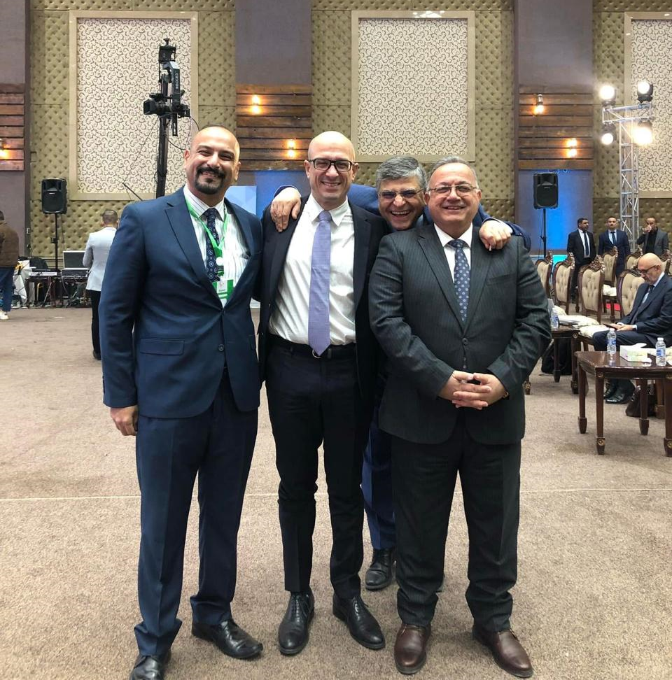
Asst. Prof
Ahmed H. Ali
Prof
Federico Foschi
Prof
Raghad Al-Hashimi

Slide 5
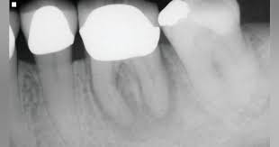
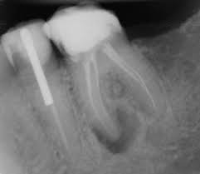
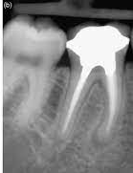
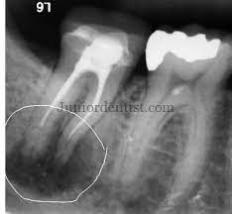
Objectives and outcome of root canal treatment
A root canal filling must completely seal a root canal system otherwise we will have a proliferation and growth of bacteria inside the root canal system and infection of the periapical area (apical periodontitis) (European Society of Endodontology, 2006).

Slide 6
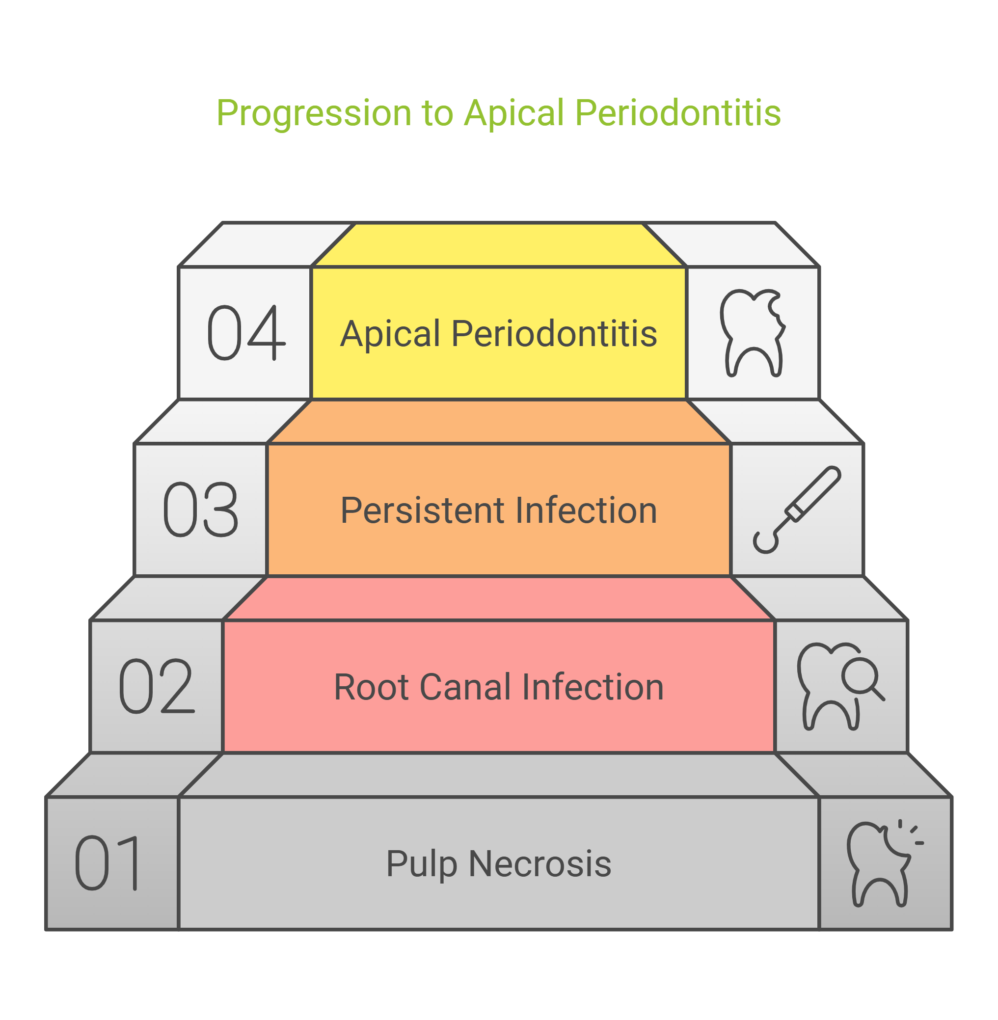
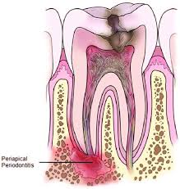
Apical Periodontitis (AP) is an infection-caused condition leading to periradicular bone resorption.
AP results from one of two causes:
Root canal infection after pulp necrosis.
Persistent infection after root canal treatment.

Slide 7
Objectives and outcome of root canal treatment
The favorable outcome of root canal treatment has been reported to be high, however, in reality, only 35%-60% of root canal-treated teeth demonstrate normal apical periodontal condition in radiographic cross-sectional studies.

Slide 8
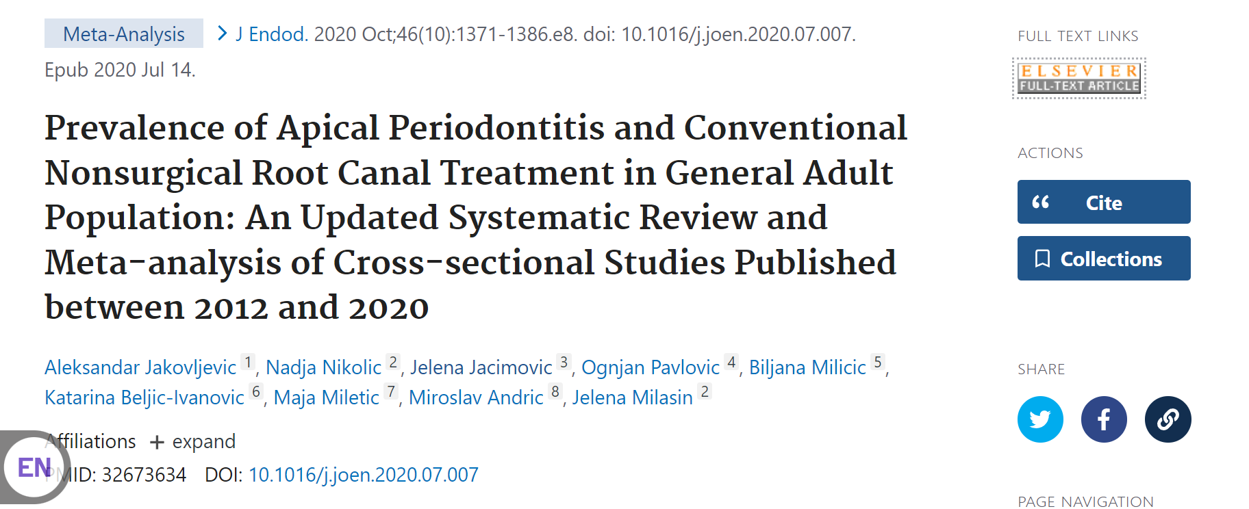
Prevalence of AP over a decade!!

Slide 10
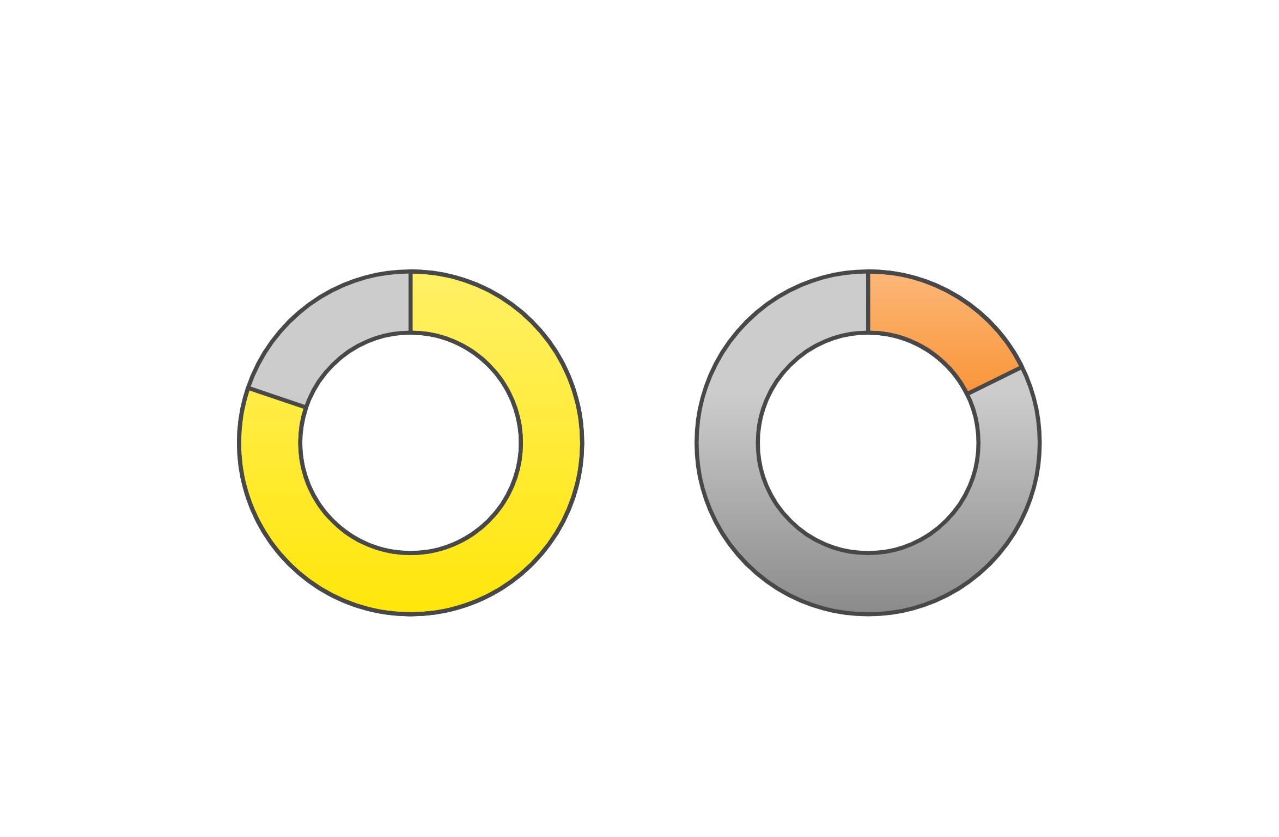

Slide 11
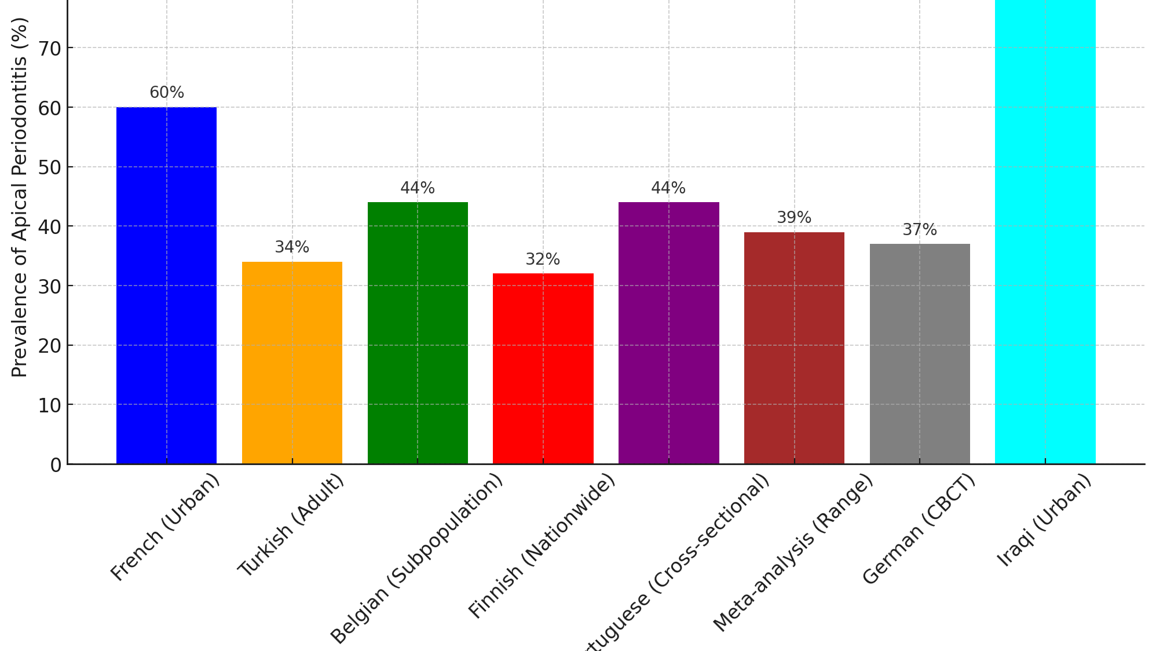
80%
In Endodontically treated teeth

Slide 12
Why it is important to assess the prevalence of apical periodontitis?

Slide 13
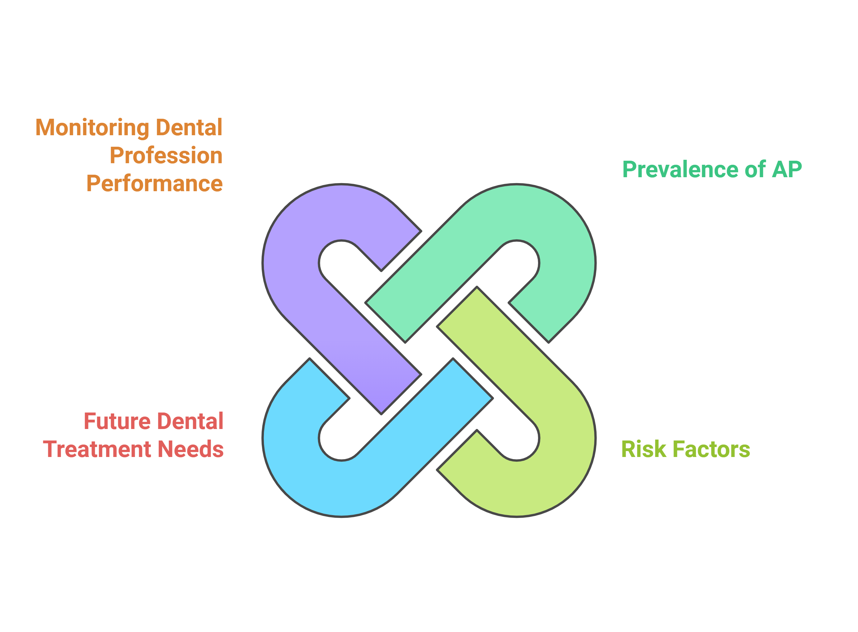
www.codental.uobaghdad.edu.iq

Slide 14
There were links between the presence of AP and systemic low-grade inflammation and health impairment.

Slide 15
After exploring the prevalence of Apical periodontitis among different populations
What are the factors in treatment quality that may influence the detection of apical periodontitis in root-filled teeth?
www.codental.uobaghdad.edu.iq

Slide 16
Study Objectives
Investigate the prevalence of Apical Periodontitis (AP) in root-filled teeth.
Examine treatment quality factors in root-filled teeth
Determine the risk factors influencing AP detection in root-filled teeth.

Slide 17
Methodology
• Retrospective cross-sectional analysis using CBCT scans.
• Scans from patients aged 18-60 ( from 2016-2022).

Slide 18
Exclusion criteria
1. Root-filled teeth undergone orthodontic treatments
2. Root-filled teeth had more than 3 mm bone loss
3. C-shaped canals
4. The presence of CBCT artifacts
5. Root resorption
6. Previous retrograde fillings

Slide 19
Study sample
Two hundred eighty-five CBCT scans were selected from a pool of archived data from the dental radiographic department of a private health clinic in Baghdad using the SCANORA-3Dx CBCT device (SCANORA 3Dx, Tuusula, Finland). Technical settings were as follows: the exposure time was 4.9 sec., 90 Kvp, tube current 10 mA, 0.125–0.200 mm3 voxel size, slice thickness (0.15 to 1 mm), 8×10 cm field of
view.

Slide 20
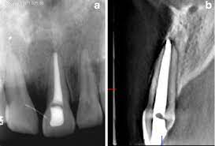
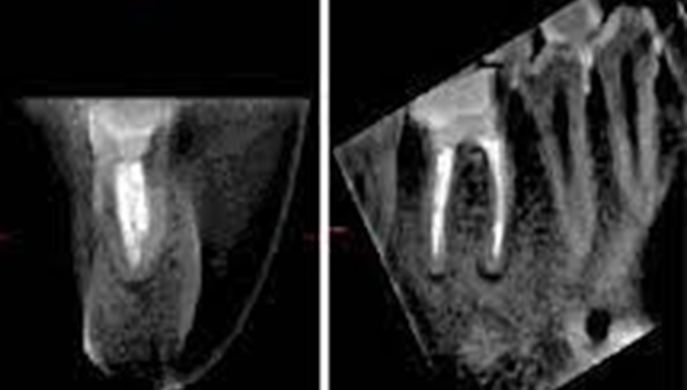
Apical Periodontitis:
Any radiolucency (that exceeds double the width of the adjacent normal periodontal ligament) associated with the apical part of the root.
Any root-filled tooth was included in the analysis. A tooth with a radiopaque material in the root canals was considered root-filled.

Slide 21
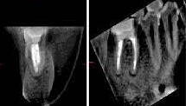
Evaluation criteria of RCF
Gender and age were recorded.
The presence/absence of AP
Unfilled canal
Perforation
Ledge
Homogenous/nonhomogeneous root canal filling (RCF)
Adequate/inadequate coronal restoration
Under/overfilled RCF and those within 0-2 mm from the radiographic apex were recorded for RFTs.

Slide 22
Results

Slide 23
Key Variables
• Demographics: Patients mean age 35.1 years.
• 610 root-filled teeth (male: 260, female: 350).

Slide 24
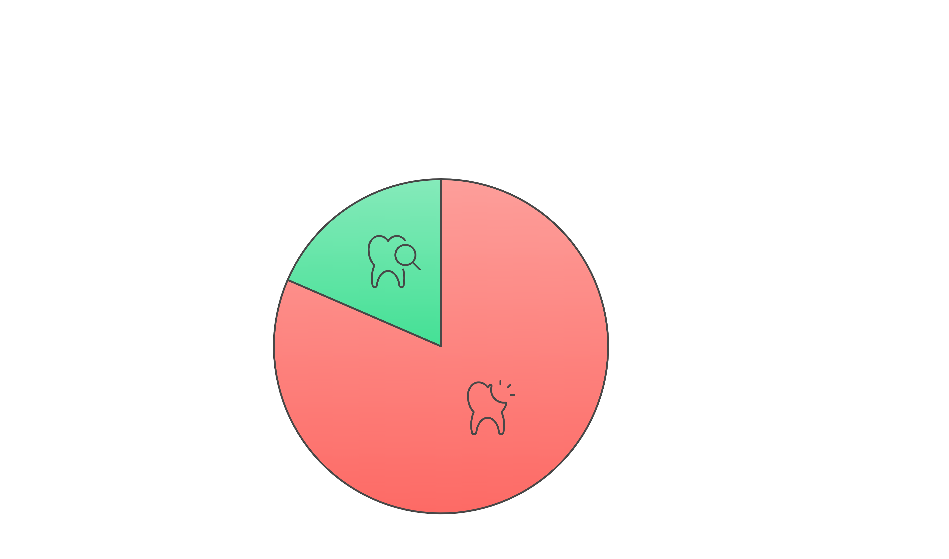

Slide 25
Results – AP Prevalence
No significant differences in AP prevalence based on gender, tooth position, or quality of coronal restoration.
Significant factors: unfilled canals, non-homogenous RCF, perforations and root filling length.

Slide 26
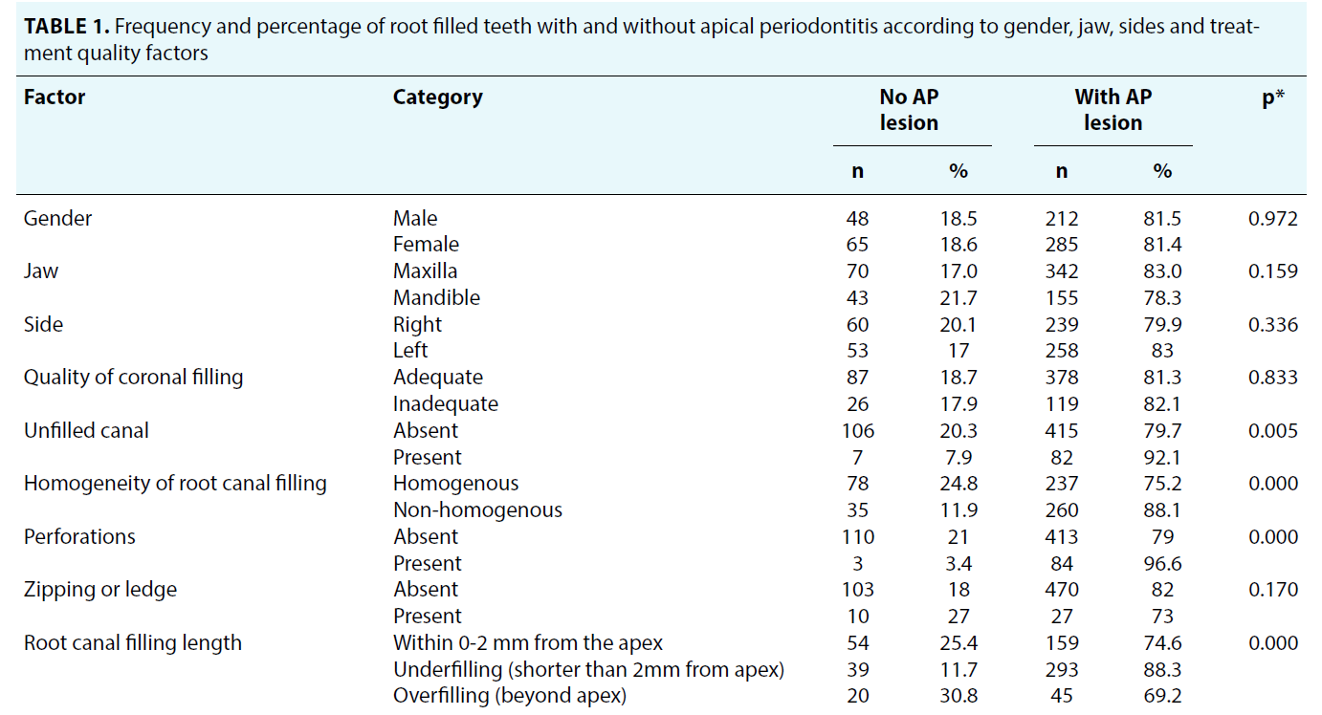

Slide 29
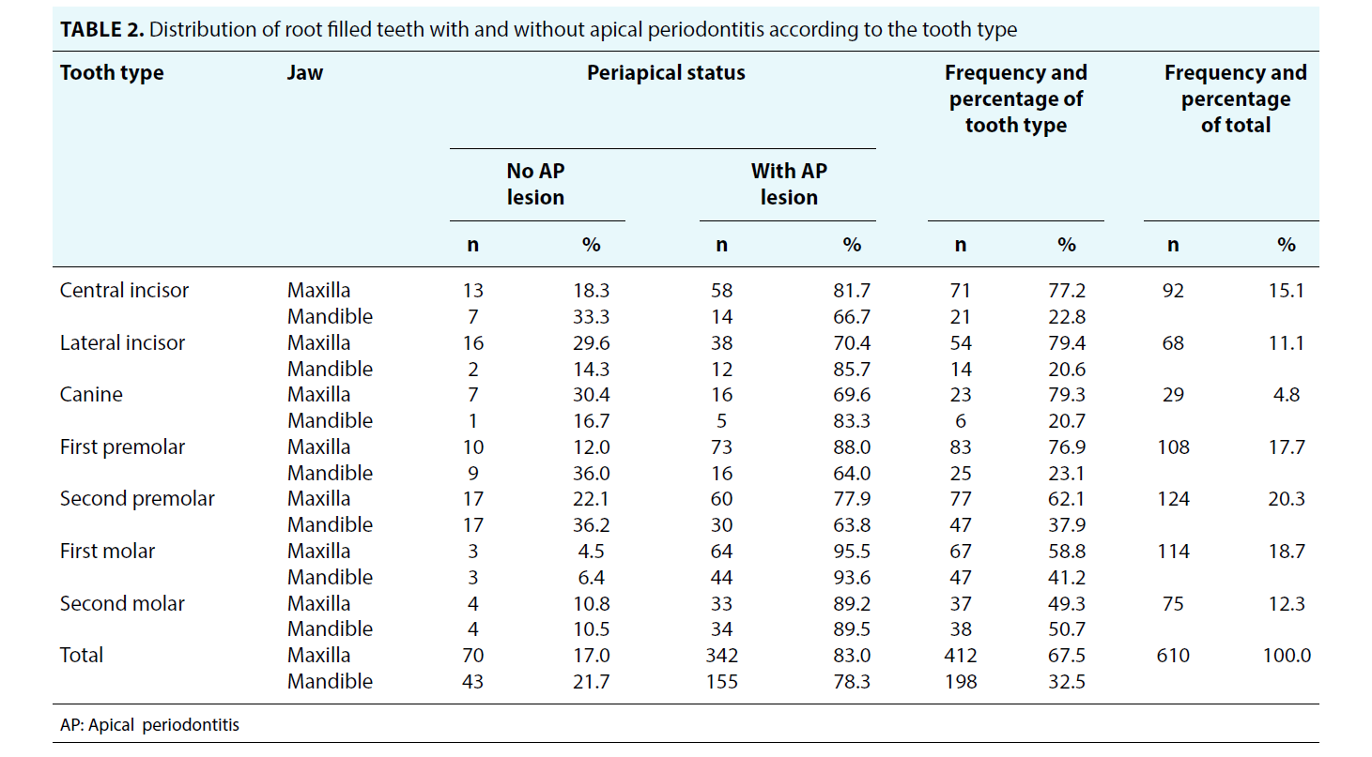

Slide 30
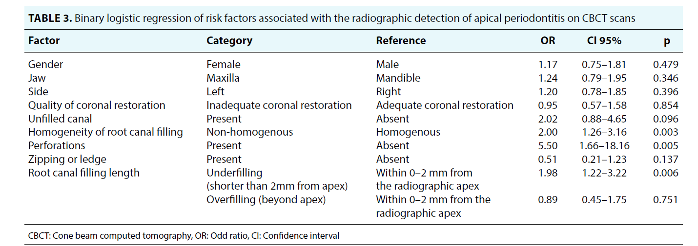

Slide 31
Clinical Findings
Homogeneous RCF is essential to reduce AP prevalence.
Perforations significantly increase the risk of AP.
Underfilled canals (> 2mm short from apex) have a high risk of AP.
First molars show the highest AP prevalence due to complex anatomy.

Slide 32
Limitations
Causative factors of the outcome of RCT
Healing or expanding of AP lesion
CBCT archived data
www.codental.uobaghdad.edu.iq
Notes:
Limitations were not capturing all the causative factors for the outcome of RCT such as the time of the treatment, skill of the operator, treatment methods, and materials. Although it is impossible to determine whether the detected AP is healing or expanding in epidemiological studies it has been found that after 10 years, the number of newly developed lesions was equal to the healing lesions (26). Another limitation is that the CBCT scans of the study population were acquired from archived data and not from a random population sample, therefore results should be applied to the general population with caution, as including CBCTs of patients with an endodontic problem could have increased the prevalence of AP in this study population. However, it is unethical to perform a randomized trial and expose the population to the radiation of CBCT to acquire the data.
The prevalence of persistent infection and the outcome of root canal treatment (RCT) can be improved by using chairside vital fluorescence staining with paper point sampling to confirm successful infection eradication. However, there are still limited surrogate endpoints for clinical use, which contributes to the suboptimal quality of endodontic treatment and the presence of iatrogenic complications.

Slide 33
Conclusions
AP was detected in most root-filled teeth (81.5%).
Risk factors for AP detection: non-homogenous RCF, underfilled canals, and perforations.
Improving root canal treatment quality is crucial to reduce AP prevalence.

Slide 34
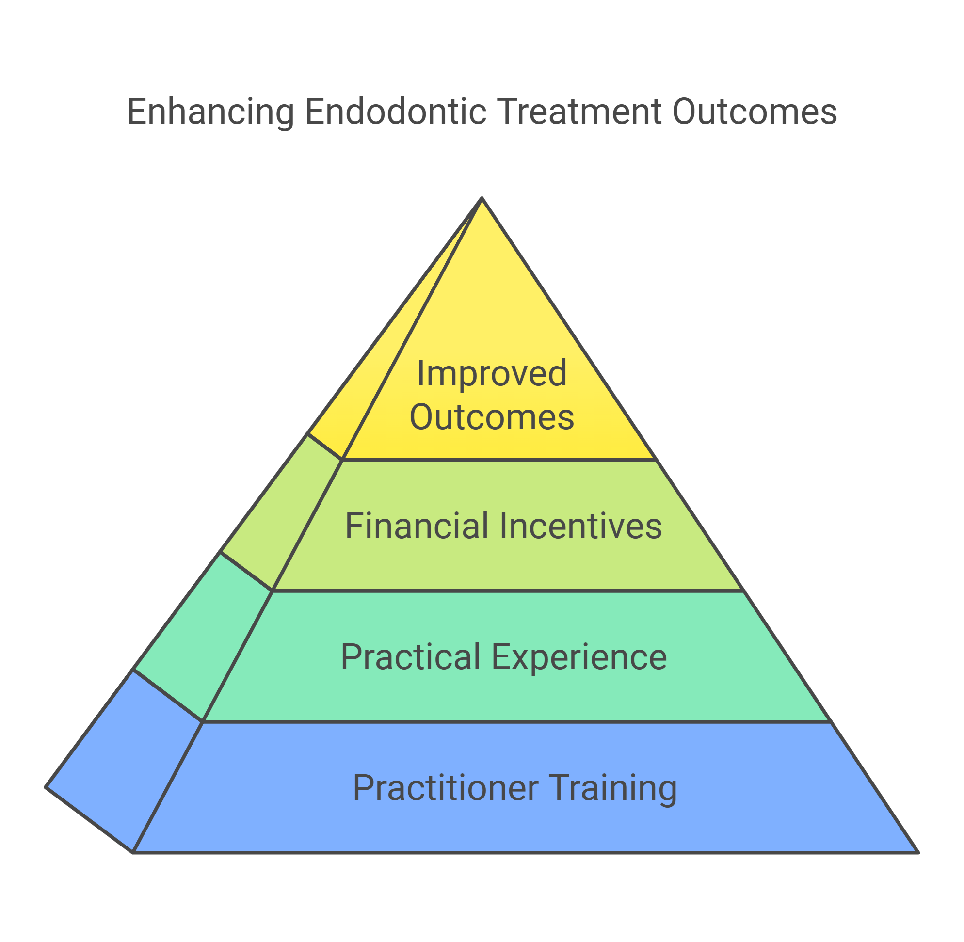
Recommendations
Notes:
It seems that the treatments provided with the current standards do not treat or prevent endodontic disease.
Improving the quality of the treatment provided for patients is a must.
Urgent investment in developing general dental practitioners' abilities to treat teeth requiring root canal treatment is needed to improve the treatment outcome.
By enhancing general dental practitioners’ contact with postgraduate mentoring and training; expanding their practical experience
Raising their pay so that they have enough time and resources to meet clinical standards.

Slide 35
Home messages
Use CBCT for better detection of missed canals and apical periodontitis in persistent infections cases
Ensure uniformity in root canal filling materials for thorough obturation
Control root canal filling length and avoid underfilling.
Avoid iatrogenic errors like perforations to prevent treatment failure

Slide 36
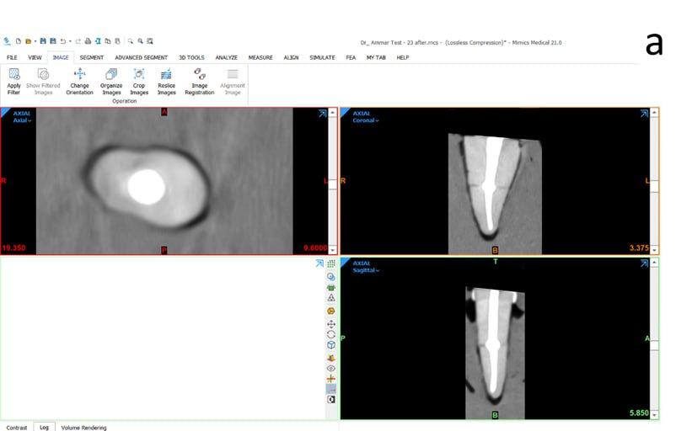
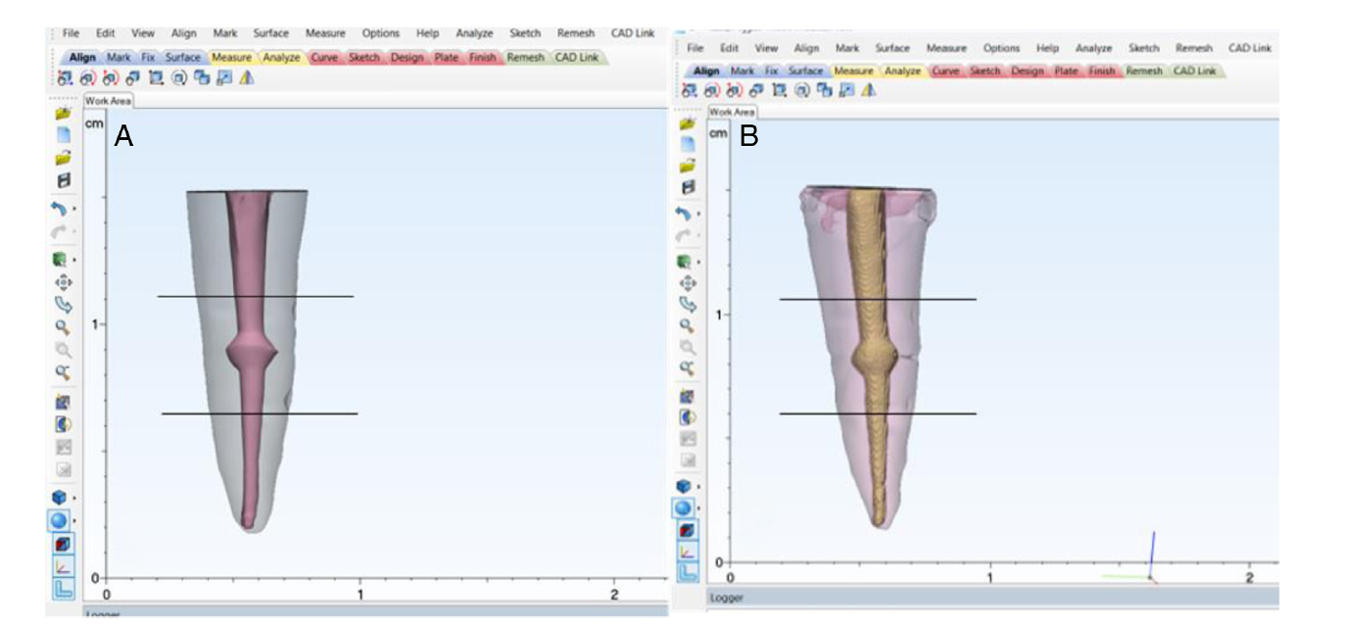

Slide 37
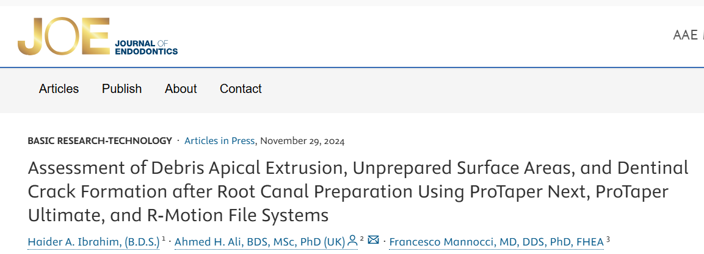

Slide 38
www.codental.uobaghdad.edu.iq

