Slide 1
Clinical Management of Subgingival Posterior Restorations
Done by
Assistant lecturer
Marwah Ismael

Slide 2
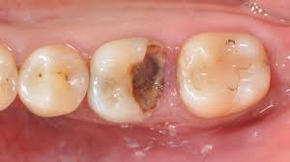
Introductin
Despite the clear advances regarding the restoration of posterior teeth, there are still several topics where the available scientific evidence does not provide clear answers in terms of clinical decisions in managing subgingival areas (Cardoso et al 2024).

Slide 3
Objectives
Identify the common causes of subgingival margins.
Explain the biological parameters influencing subgingival restorations.
Emphasize the importance of ferrule effect on the biomechanical stability of endodontically treated teeth.
Dmonstrate post vs. non-post approaches in restoring endodontically treated teeth.
Outline different treatment modalities for managing supraosseous and infraosseous subgingival margins, including surgical and non surgical approachs.

Slide 4
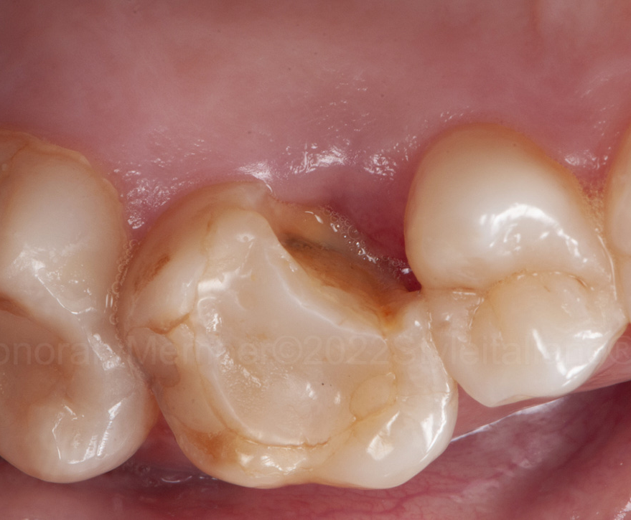
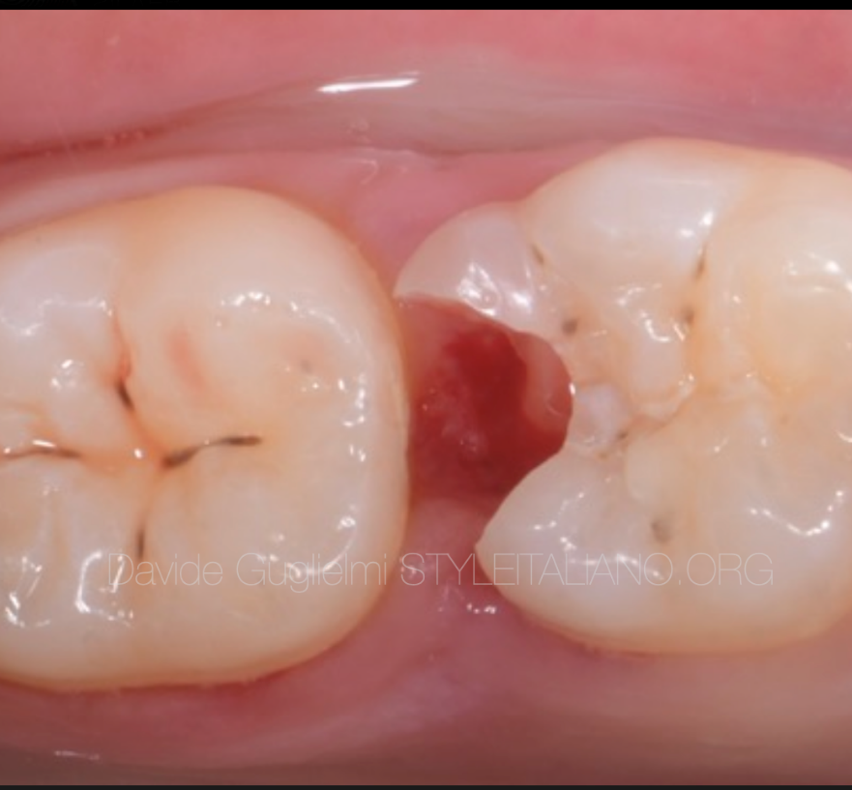
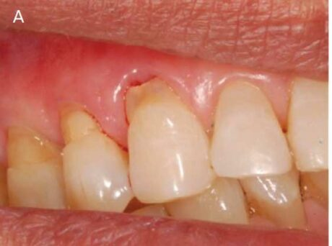
Causes of subgingival margins
Caries
Fractures
Noncarious cervical lesions

Slide 5
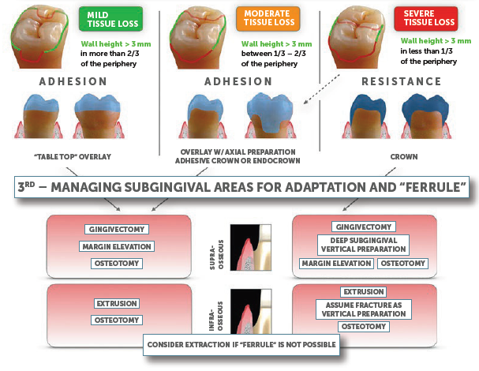
Analysis of the remaining tooth structure

Slide 6
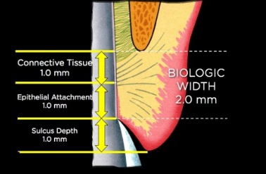
Biological parameters
“biological width” that refers to the apicocoronal dimension of gingival attachment alongside the root surface
(junctional epithelium + supracrestal connective tissue) has been redefined to “supracrestal tissue attachment” (STA) (Jepsen et al. 2017).
Margin placement should ideally be Supragingival
Patients who perform good oral hygiene can have intrasulcular margins without any detrimental effects.
https://www.speareducation.com/spear-review/2014/12/biologic-width-part

Slide 7
Biological parameters
Clinical studies show that margins placed deeper than the sulcus, into the supracrestal tissue attachment, can either cause a) Tissue recession b) Chronic inflammation.
The impingement of the deeper connective tissue will trigger inflammation and/or bone and soft tissue loss .
Soft Tissue Response
Periodontal biotype
Type of material
Restorative margin design and fitting accuracy

Slide 8
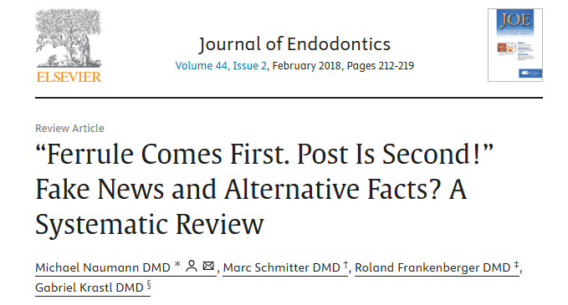
“ferrule” design
The ferrule effect is critical for restoration and root survival
Effective Ferrule Dimensions:
a) Height: ≥2 mm
b) Thickness: ≥1 mm
c) Taper: <10°
d) Presence of tissue buccally and lingually (crown seating properly mesially and distally).

Slide 9
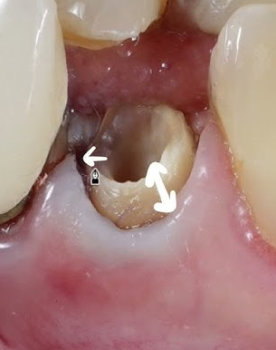
“ ferrule” design
When ferrule height/thickness is insufficient, strategies may include: (Naumann, Schmitter et al. 2018)
Posts
Crown lengthening
Orthodontic extrusion
Surgical extrusion
Splinting to adjacent teeth
Extraction Consideration:
If ferrule cannot be achieved without compromising periodontal health, extraction is recommended.

Slide 10
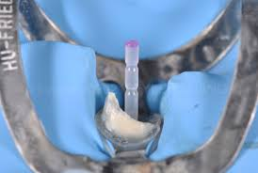
posts
Posts and the Ferrule Effect:
The ferrule effect plays a greater role than posts for restoration survival (Naumann, Schmitter et al. 2018)
Posts complement the ferrule by preventing separation of the tooth/core/post complex from the root.
Fiber posts generally show better long-term prognosis than metal posts.
Fiber posts :less catastrophic root fractures but may fail due to retention loss.
Metal posts: more likely associated with severe root fractures. (Wang, Shu et al. 2019)

Slide 11
posts
Posts are more beneficial for incisors, canines, and premolars due to horizontal occlusal loads. (Naumann, Schmitter et al. 2018)
Key Considerations for Post Selection (Carvalho, Lazari et al. 2018)
Preserve tooth structure to support the ferrule effect.
Avoid excessive canal preparation that weakens the tooth.
Use posts that fit the original canal width.

Slide 12
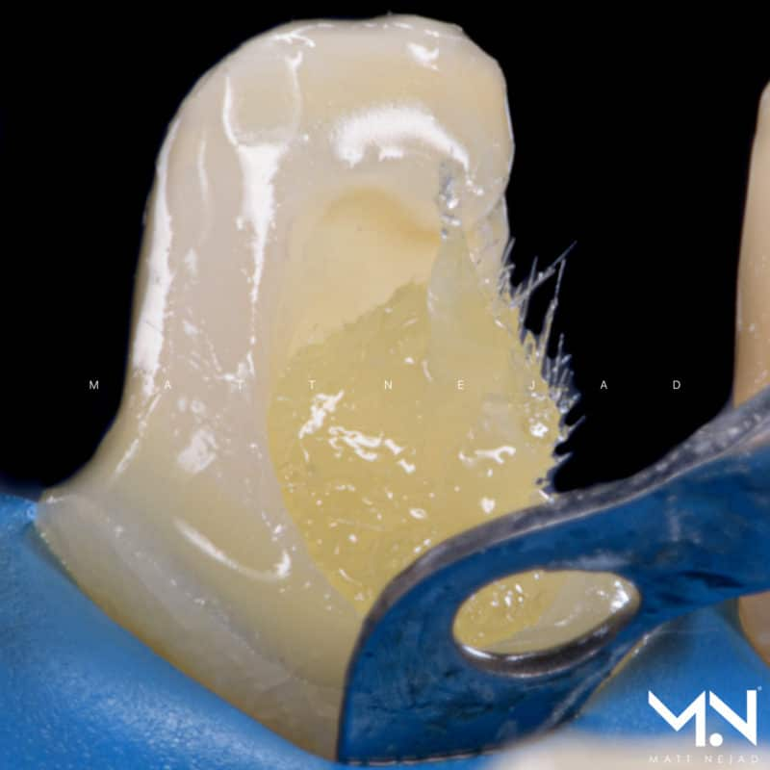
Fiber-Reinforced Composites
Suggested as an alternative to posts and reduce cusp coverage needs.
using fiber-reinforced composites instead of conventional hybrid composites improves the fracture resistance of endodontically treated teeth (Magne, Goldberg et al. 2016).
Other studies demonstrate that these fiber-reinforced direct composites cannot reduce the need for posts and may not provide more benefits than conventional composites (Casanova and Özcan 2021)

Slide 13
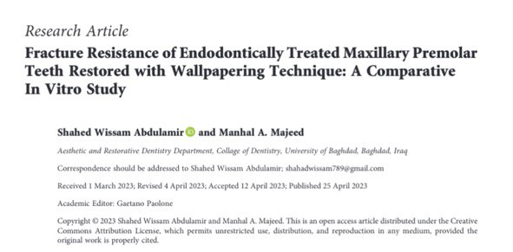
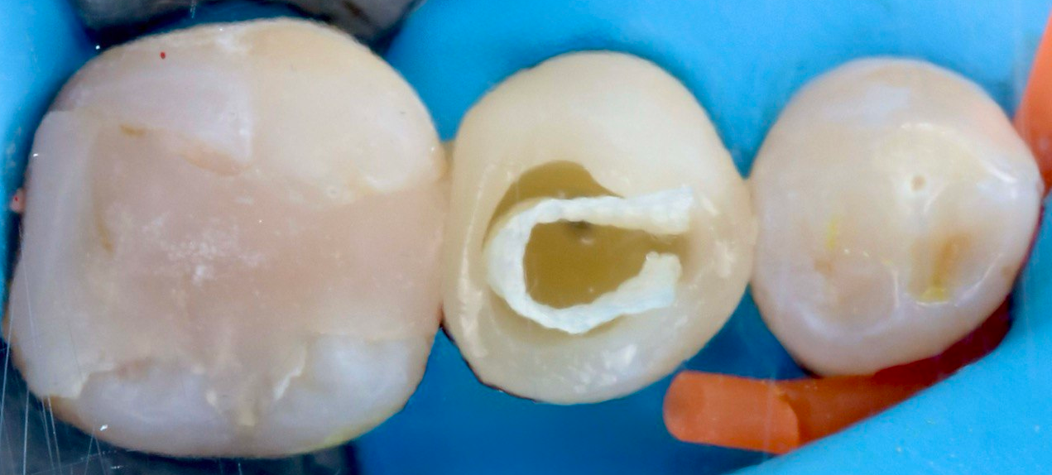
Fiber-Reinforced Composites
Restoration of endodontically treated teeth using the wallpapering technique recorded the highest mean of fracture resistance with a repairable mode of fracture

Slide 14
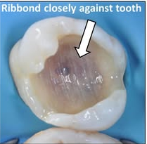
Fiber-Reinforced Composites
long polyethylene fibers appear to enhance overall fracture resistance and promote favorable fracture modes (Ferrando Cascales, Andreu Murillo et al. 2025).
A recent systematic review and meta-analysis showed that both short glass-fiber or bidirectional polyethylene fiber improve fracture resistance and the fracture mode of structurally compromised teeth is equally efficient (Bijelic-Donova, Bath et al. 2025)

Slide 15
Case.1. Supraosseous subgingival margins moderate tissue loss
For supraosseous and shallow subgingival defects, a simple gingivectomy is sufficient to provide proper access.
Deep Margin elevation DME procedures are effective for subgingival but supraosseous defects
Gingivectomy exposes the supraosseous structure for proper isolation (e.g., rubber dam or clamp placement).
Tools such as Teflon tape, curved matrices, and wedges are essential for displacing soft tissue and stabilizing the restoration (Cardoso et al 2024).

Slide 16
DME
Alhassan and Bajunaid , (2020) suggested that DME can be performed when the lesion reaches the gingival sulcus till the junctional epithelium.
When caries invades the connective tissue, SCL needs to be performed.
Clinical studies show stability in the long term without significant adverse periodontal effects, although increased bleeding on probing is sometimes observed.

Slide 17
Case.1. Supraosseous subgingival margins moderate tissue loss DME
(Cardoso et al 2024)

Slide 18
(Cardoso et al 2024)

Slide 19
(Cardoso et al 2024).

Slide 20
CASE 2.Supraosseous subgingival margins
Severe tissue loss
Edgeless vertical preparation
When there is insufficient residual tooth structure to provide an effective ferrule, alternative strategies must be considered.
Subgingival tooth structure can be utilized for restoration engagement to create a valid ferrule effect.
Placing the margin within the sulcus is the safest option to avoid complications.

Slide 21
Edgeless vertical preparation
If deeper margins are needed, they should remain within the junctional epithelium, at least 1 mm away from the bone
Proper assessment of periodontal health and tissue tolerance is essential.
Gingivectomy can aid in achieving proper rubber dam isolation for prior buildups.
Electrocautery ensures blood clot stabilization, protects exposed bone, and reduces patient discomfort.
(Cardoso et al 2024)

Slide 22
Edgeless vertical preparation
Aluminum chloride paste is effective for controlling bleeding during the procedure.
Same-Day Impression or scan
Lab Instructions not to extend closer than 1 mm from the bone level.
Ferrule Goal: aim for 2 mm of vertical tooth structure.
(Cardoso et al 2024).

Slide 23
Supraosseous subgingival margins
Severe tissue loss
Edgeless vertical preparation
(Cardoso et al 2024)

Slide 24
3 years followup
(Cardoso et al 2024)

Slide 25
CASE 3. Infraosseous subgingival margins
Osseous Reduction: SCL
Effective for exposing remaining tooth structure in cases of caries or fractures below the bone level.
Concerns
Interproximal Bone Reduction
Reduces papilla volume leading to food impaction in the interproximal space, even with well-designed contact points.

Slide 26
furcation anatomy restricts the extent of bone reduction.
Bone reductions of 2–3 mm in posterior teeth may complicate future implant placement.
Anatomical constraints, such as the maxillary sinus or mandibular alveolar nerve.
Limitations of SCL

Slide 27
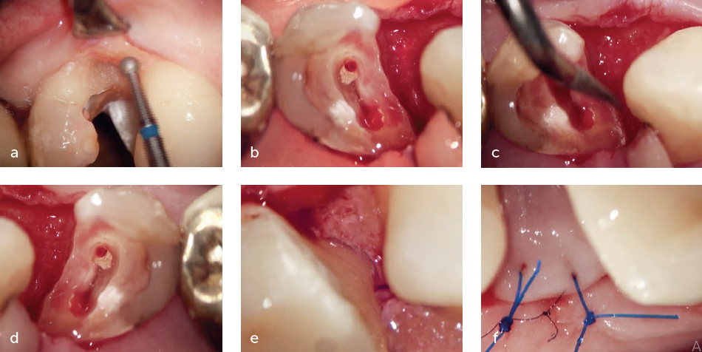
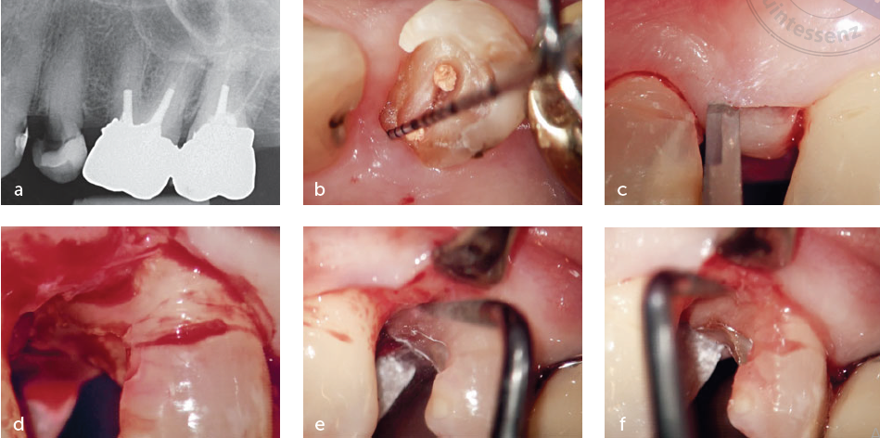
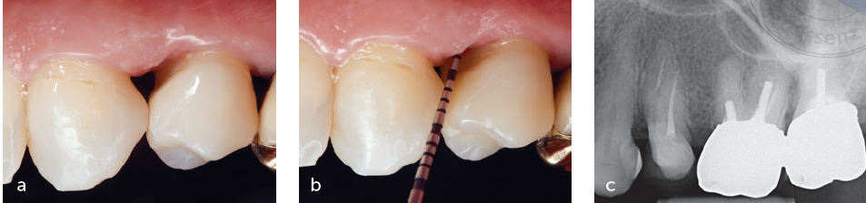
Osseous Reduction: SCL
3 years followup
(Ghezzi et al., 2019)

Slide 28
CASE 4.
Infraosseous subgingival margins oblique fracture vertical preparation
Oblique fractures have been traditionally treated with difficult tissue retraction and rubber dam isolation techniques or bone reduction.
Subgingival Feather-Edge Preparation: Encourages supracrestal attachment formation, increasing tissue thickness and stability.
This can only be considered in localized fractures that do not risk the biomechanical stability of the tooth, assuring the necessary wall dimensions for a “ferrule” design.

Slide 29
CASE 4.
Infraosseous subgingival margins oblique fracture vertical preparation
(Cardoso et al 2024)

Slide 30
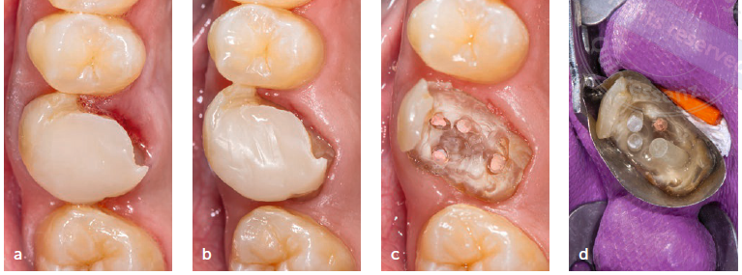
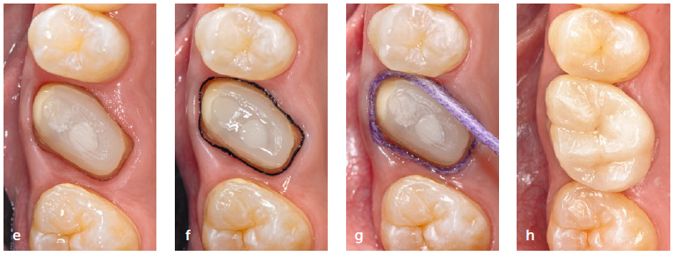
Infraosseous subgingival margins oblique fracture vertical preparation

Slide 31
Five years follow up
(Cardoso et al 2024)

Slide 32
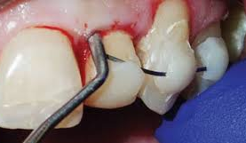
CASE 5.
Infraosseous subgingival margins
Tooth Extrusion
Extrusion Concept:
A technique to expose more tooth structure by moving the root out of the bone socket, either surgically or orthodontically.
Objective:
Achieve ≥4 mm of tissue above the alveolar bone to allow a 2-mm ferrule without supracrestal tissue impingement.
Crown-to-Root Ratio:
A 1:1 ratio is acceptable.

Slide 33
Orthodontic
Extrusion
(Forced Eruption)
Moves the tooth occlusally without dragging soft tissue or bone.
Uses continuous forces (>50 g) with anchorage on adjacent teeth or implants.
Supracrestal fiberotomy & root planing help prevent soft tissue reattachment and relapse.
Takes 1–3 weeks per millimeter depending on bone density and root surface area.
Fewer complications than surgical extrusion.

Slide 34
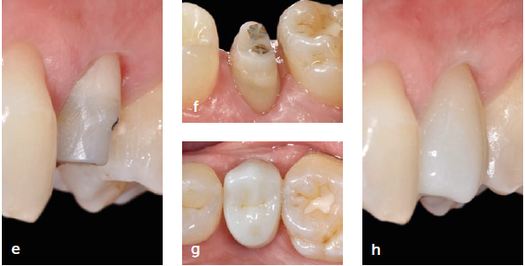
Orthodontic Extrusion (Forced Eruption)
(Cardoso et al 2024)

Slide 35
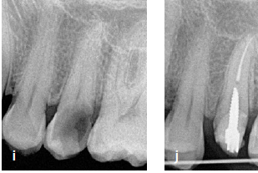
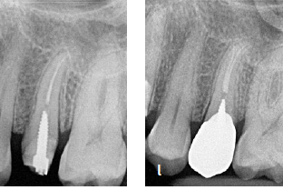
Preoperative Postoperative
(Cardoso et al 2024)

Slide 36
Surgical Extrusion
A one-step procedure where the tooth is partially removed from the socket with minimal trauma.
Splinting for ≤3 weeks to reduce ankylosis risk.
Endodontic treatment begins at ~4 weeks, and restorative work at 6–8 weeks when bone apposition is evident.
Faster, lower cost, and a viable alternative to extraction or implants.
Complication rate <10%, making it a reasonable long-term solution.

Slide 37
Surgical Extrusion

Slide 38
Surgical Extrusion
(Cardoso et al 2024)

Slide 39
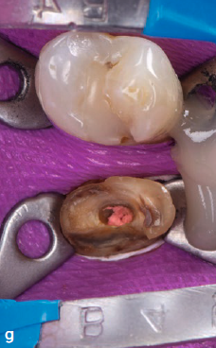
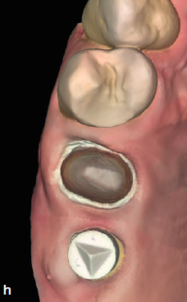
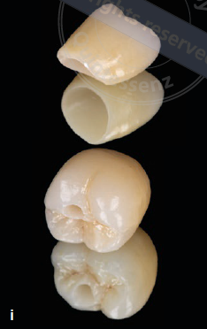
Surgical Extrusion

Slide 40
Surgical Extrusion
3 years followup
(Cardoso et al 2024)

Slide 41
Conclusions
Subgingival but supraosseous margins
Shallow margins, gingivectomies and/or efficient soft tissue retraction with Teflon tape and rubber dam with a clamp for proper access.
Deep subgingival vertical preparations to gain “ferrule” if the planned restoration is a resistive crown.
Subgingival and infraosseous margins
Osteotomies: Can be performed but have limitations, especially in posterior teeth.
Vertical Margin Approach: If a remaining ferrule is present, the tooth may still be restorable.
Extrusion Procedures: Orthodontic and surgical extrusion can help achieve a ferrule design, each with its own advantages and risks.

Slide 42


