Slide 1
Viral infections of the maxillofacial tissues
Assist.Prof.Dr. Ban F. Al-Drobie
B.D.S., M.S.c.,Ph.D. (Oral Pathology)

Slide 2
A wide spectrum of viral infections can affect the mouth and allied structures. In most instances, these give rise to short-term local illness (e.g., herpes simplex infections in immunocompetent hosts); however, infections such as Human Immunodeficiency viruses (HIV), Epstein Barr virus (EBV), and the oncogenic types of Human Papillomavirus (HPV) can cause significant orofacial disease that will increase patient morbidity and possibly lead to early death. The epidemiology of viral infections is ever changing; hence, health care providers are encouraged to maintain knowledge of virally driven infections that may impact upon the health and clinical care of their relevant specialty.

Slide 3
Viral infectoions of the maxillofacial region
Herpes simplex virus
Varicella -zoster virus
Herpangina
Hand-foot-mouth disease
Measles (Rubeola) and German measles (Rubella)
Infectious mononucleosis
Cytomegalovirus
Mumps
human immunodeficiency virusand acquired immunodeficiency syndrome

Slide 4
Herpes simplex virus
Herpes simplex virus two forms:
primary (systemic) and secondary (localized)
• Both forms are self-limited, but recurrences of the secondary form
are common
• Physical contact with an infected individual or with body fluids is the typical route of HSV inoculation and transmission.
• During the primary infection, only a small percentage of individuals show clinical signs and symptoms of infectious systemic disease, whereas a vast majority experience only subclinical disease. After resolution of primary herpetic gingivostomatitis, the virus is believed to migrate, through some
unknown mechanism, to the trigeminal ganglion.
• Reactivation of virus may follow exposure to sunlight (“fever blisters”), exposure to cold (“cold sores”), trauma, stress, or immunosuppression causing a secondary or recur rent infection.

Slide 5
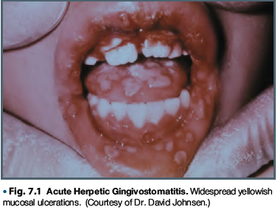
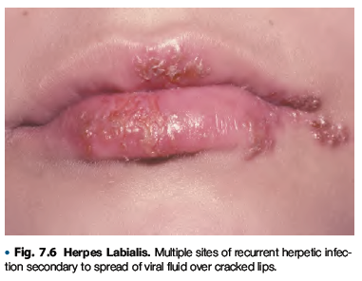

Slide 6
Clinical features
Primary Herpetic Gingivostomatitis.: usually seen in children,
although adults who have not been previously exposed to HSV may be
affected.
• The vesicular eruption may appear on the skin, vermilion, and oral mucous
membranes.
• Intraorally, lesions may appear on any mucosal surface. This is in
contradistinc tion to the recurrent form of the disease, in which lesions are
confined to the lips, hard palate, and gingiva.
• The primary lesions are accompanied by fever, arthralgia, malaise, anorexia,
headache, and cervical lymphadenopathy.
• lesions heal without scar formation after about 7-10 days By this time, the
virus may have migrated to the trigeminal ganglion to reside in a latent form

Slide 7
represents the reactivation of latent virus. Antibodies to HSV are present in a
large majority of the population.
• Patients usually have prodromal symptoms of tingling, burning, or pain in the
site at which lesions will appear.
• Within a matter of hours, multiple fragile and short-lived vesicles appear.
• These become unroofed and unite to form maplike superficial ulcers.
• The lesions heal without scarring in 1 to 2 weeks and rarely become secondarily
infected.
• Regionally, most secondary lesions appear on the vermilion and surrounding
skin. This type of disease is usually referred to as herpes labialis. Intraoral
recurrences are almost always restricted to the hard palate or gingiva.

Slide 8
Varicella-zoster virus infection
• Primary varicella-zoster virus (VZV) infection is known as varicella or chickenpox;
• secondary or reactivated disease is known as herpes zoster or shingles
• Varicella is transmitted predominantly through the inhalation of contaminated droplets.
• The condition is very contagious.

Slide 9
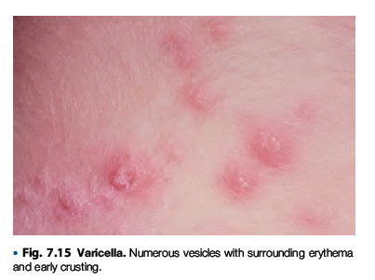
Varicella
• Fever, chills, malaise, and headache may accompany a rash that involves primarily the trunk and head and neck. The rash quickly develops into a vesicular eruption that becomes
pustular and eventually ulcerates.
• The infection is self-limiting and lasts several weeks.
• Oral mucous membranes may be involved in primary disease and demonstrate multiple shallow ulcers that are preceded by vesicles.

Slide 10
Herpes zoster
• condition of the older adult population and compromised immune responses.
• The sensory nerves of the trunk and head and neck are commonly affected.
• Involvement of various branches of the trigeminal nerve may result in unilateral oral, facial, or ocular lesions.
• Involvement of facial and auditory nerves produces the Ramsay Hunt syndrome, in which facial paralysis is accompanied by vesicles of the ipsilateral external ear, tinnitus, deafness, and
vertigo.

Slide 11
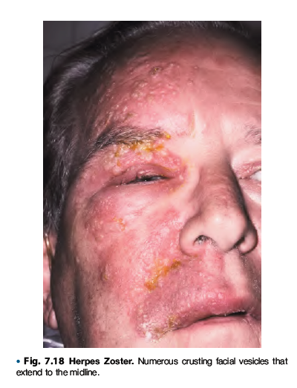

Slide 12
After several days of prodromal symptoms of pain and/or paresthesia a well-delineated unilateral maculopapular rash appears accompanied by systemic symptoms.
• The rash quickly becomes vesicular, pustular, and then ulcerative.
• Remission usually occurs in several weeks
Treatment:
For varicella in normal individuals, supportive therapy is generally indicated. for immunocom¬promised patients,
systemically administered acyclovir, vidarabine, and human leukocyte interferon.
• Corticosteroids generally are contraindicated

Slide 13
Herpangina
• Herpangina is an acute viral infection caused by Coxsackie type A virus.
• It is transmitted by contaminated saliva and occasionally through contaminated feces.
Clinical Features
• Herpangina is usually endemic
• It is more common in children than in adults.
• complain of malaise, fever, dysphagia, and sore throat
• after a short incubation period. Intraorally, a vesicular eruption appears on the soft palate, faucial pillars, and tonsils and persists for 4 to 6 days.
• A diffuse erythematous pharyngitis is also present. No
associated skin lesions are typically seen.

Slide 14
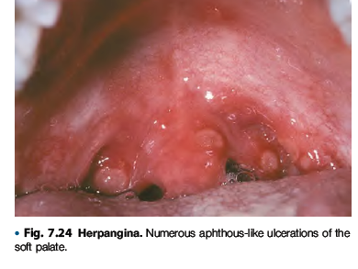
Because herpangina is self-limiting, is mild and of short duration, and causes few complications, treatment usually is not required.

Slide 15
Hand-Foot-and-Mouth Disease
• HFM disease is a highly contagious viral infection caused by Coxsackie type A16 or enterovirus 71.
• transferred through airborne spread or fecal-oral contamination.
Clinical Features:
• typically occurs in epidemic or endemic
• (about 90%) affects children younger than 5 years of age.
• After a short incubation period, the condition resolves
spontaneously in 1 to 2 weeks.

Slide 16
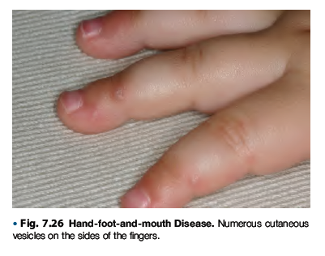
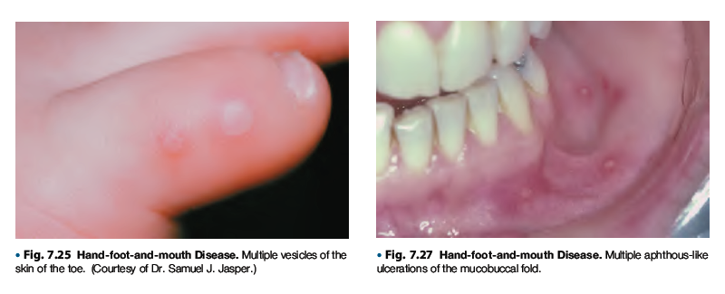

Slide 17
Signs and symptoms
mild to moderate , low-grade fever, malaise, lymphadenopathy, and sore mouth.
• Pain from oral lesions is often the patient’s chief complaint.
• Oral lesions begin as vesicles quickly rupture to become ulcers.
• Lesions can occur anywhere in the mouth.
• Multiple maculopapular lesions, typically on the feet, toes, hands, and fingers, appear concomitantly with or shortly after the onset of oral lesions. These cutaneous lesions progress to a vesicular state; they eventually become ulcerated.
Because of the relatively short duration, generally self-limiting nature, and general lack of virus-specific therapy, treatment for HFM disease is usually symptomatic

Slide 18
Measles (Rubeola) and German measles (Rubella)
• Measles is a highly contagious viral infection ,caused by a
member of the paramyxovirus family of viruses.
• oral eruptions consist of early pinpoint elevations over the
soft palate
• German measles, or rubella, is a contagious disease ,caused
by an unrelated virus of the togavirus family.
• It shares some clinical features with measles, such as fever,
respiratory symptoms, and rash. However, these features
are very mild and short lived in German measles.

Slide 19
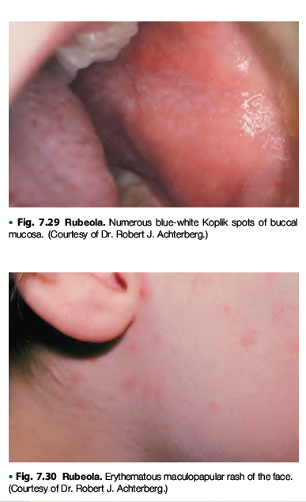

Slide 20
Clinical Features.
• After an incubation period of 7 to 10 days, prodromal
symptoms of fever, malaise, coryza, conjunctivitis, photophobia, and cough develop.
• In 1 to 2 days, pathognomonic small erythematous macules with white necrotic centers appear in the buccal mucosa, these lesion as Koplik’s spots. precede the skin rash by 1 to 2 days.
• The rash initially affects the head and neck, followed
by the trunk, and then the extremities

Slide 21
Treatment.
• No specific treatment for measles is known. Supportive therapy of bed rest, fluids, adequate diet, and analgesics generally suffices

Slide 22
THANK YOU

