Slide 1
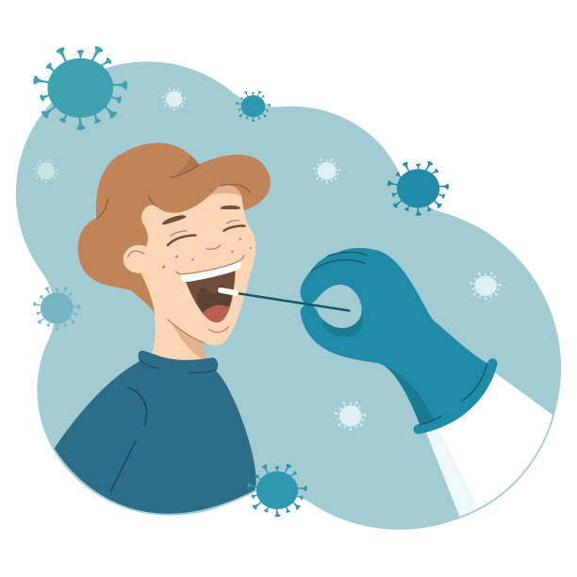
م.م هبة خزعل
Collection and separation of saliva

Slide 2
• Saliva is composed of more than 99% water and less than 1% solids, mostly electrolytes and proteins, the latter giving saliva its characteristic viscosity
• The term saliva refers to the mixed fluid in the mouth in contact with the teeth and oral mucosa, which is often called ‘whole saliva’
• Normally the daily production of whole saliva ranges from 0.5 to 1.0 litres

Slide 3
The greatest volume of saliva is produced before, during and after meals, reaching its maximum peak at around 12 am., and falls considerably at night and during sleep.
• Some research indicated that saliva secretion was increased with an increase in temperature, hence, the seasons of year is consider as effective factor in saliva collection

Slide 4
Factors affecting stimulated saliva include gland size, food intake, smoking, gag reflex and type of stimulation given. Stimulated saliva represents the secretion during food intake (physiological stimulation), and is present in the mouth for up to 2 hours. Various stimulants like paraffin wax, unflavoured chewing gum base, cotton puff and rubber bands bring about masticatory stimulation.

Slide 5
Saliva has many important roles in oral health like lubrication, physical protection, cleansing, buffering, tooth integrity, maintenance of pH and antibacterial action.
• When compared to other body fluids, saliva is readily available, can be non-invasively collected, with no risk of cross infection. Moreover, salivary analysis can detect changes that are reflective of both oral and systemic conditions.
• Despite its advantages as a diagnostic fluid, lack of enough information regarding the methods of collection and storage of samples

Slide 6
Saliva has been used to detect caries risk, periodontitis, oral cancer, breast cancer, salivary gland diseases, and systemic disorders such as hepatitis.
• Of course, successful measurement of salivary analytic requires optimal collection, processing, and storage procedures and conditions
• Oral samples include saliva, gingival crevicular fluid (GCF), oral swabs and dental plaque. Recent years has seen an increasing interest in the use of oral fluids as diagnostic tools, especially whole or total saliva.

Slide 7
Collection of whole saliva
There are 4 methods for collection of whole saliva:
1. Spitting method
2. Draining method
3. Suction method
4. Swabbing method

Slide 8
Spitting method
• Ask the patient to spit in the spittoon before starting collection.
• Clean the mouth with a sterile piece of gauze This considered the zero time.
• Take a sterile beaker and weight it.
• Due to the saliva is allowed to accumulate in the floor of the mouth, ask the patient to spit inside the beaker, e.g.: each 30 sec. interval for about 5 min.
• Then the spitting is stopped and the beaker is weighted after that, subtract the weight of beaker when its empty and after completion of spitting , the result is multiplied by the specific gravity of saliva to get the volume of saliva within 5 min.

Slide 9
Draining method
• Repeat the first 3 points in the previous method.
• Ask the patient to sit with the head bent down and the mouth open to allow the saliva to drip passively from the lower lip into the graduate sterile beaker below his mouth for about 3-5 min.
• After that ask the patient to spit what is found in his mouth in the spittoon, and get the volume by the same previous method.

Slide 10
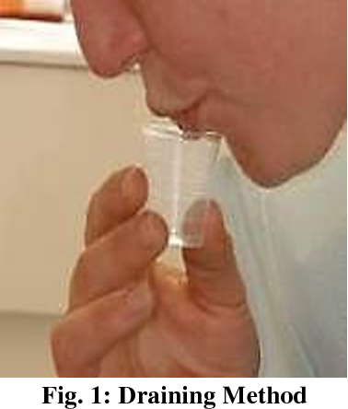

Slide 11
Suction method
• Saliva is allowed to accumulate in the floor of mouth and aspirated continuously by using syring, micropipettes or saliva ejector or an aspirator
• Repeat the first 3 steps in the 1 st. method.
• Bring the beaker and put in it a rubber stopper which is penetrated from one side by saliva ejector and from the other side by a connector to the vacuum apparatus , when the pressure created inside the beaker by the vacuum lead to more saliva sucked from the oral cavity , e.g. for about 4-5 min, then the volume of saliva collected is getting as previously mentioned.

Slide 12
Swabbing Method
• Repeat the first 2 steps in the first method.
• It is performed by introducing a synthetic gauze sponge, preweighed swab or cotton pad into the mouth, at the orifices of major salivary glands.
• Asked the patient to chew such that the sponge gets soaked within the saliva. Saliva soaked sponge is removed and placed in a sterile test tubes.
• Though this method is less reliable, it helps in the assessment of the level of oral dryness. It is mainly used in the monitoring of drugs, hormones or steroids.

Slide 13
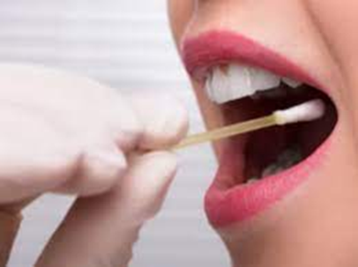

Slide 14
Guidelines for collection of saliva:
• The subject should be made to sit comfortably in a calm and isolated room.
• He / she should rinse the mouth thoroughly using distilled water or deionized water to remove any food debris.
• The patients are then asked to spit out the saliva that has been collected in the initial 30 seconds.
• They are also trained to collect the saliva in the floor of the mouth for whole saliva collection.
• High quality tubes or vials should be used for collection.

Slide 15
Collection should be made at a standard time, preferably between 8 to 11 am. The subject should preferably be in the fasting state or two hrs after breakfast.
• The participants should not brush their teeth for a duration of 45 min prior to the sample collection.
• The participants should not drink alcohol or drink anything on the day of saliva collection.
• The participants should not consume dairy products, acidic or surgry food within 30 min before saliva collection.
• Denture wearers should remove their dentures prior to saliva collection.

Slide 16
Dental work or oral examination should not be performed within 24 hrs prior to the sample collection.
• Participants should be screened for any oral health problems or injuries. Visibly contaminated samples with blood should be discarded. • The subjects should avoid smoking for at least two hours prior to saliva collection.

Slide 17
Conclusions The saliva flow rate and pH are very important for maintenance of oral tissues. The protective role and benefits including buffering, remineralization in the healthy oral mucosa, immune defense, digestion, lubrication, diagnostic purpose, and proteome analysis are fulfilled by saliva.

