Slide 1
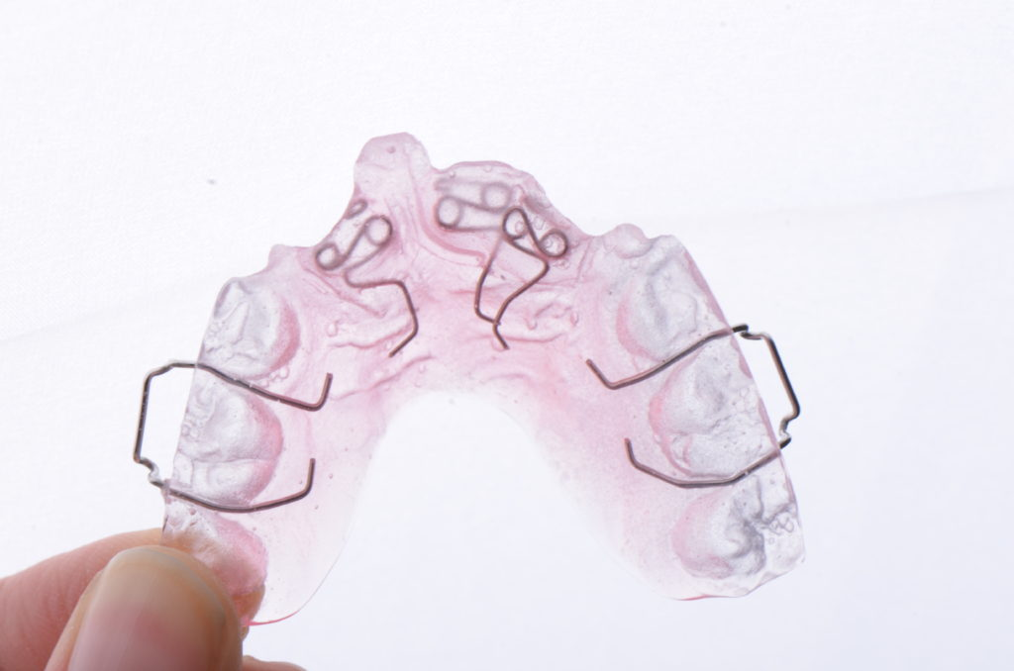
The extensions of the acrylic base plate of removable orthodontic appliane
اعداد
أ.م.د.اسراء سلمان جاسم
أ.م.سارة محمد جاسم
م.زينب موسى كاظم

Slide 2
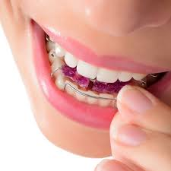
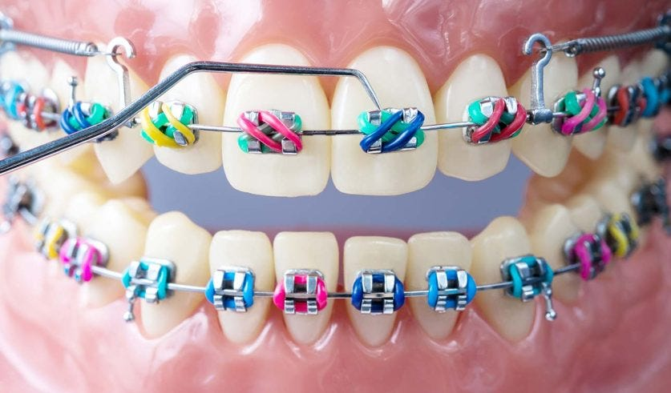
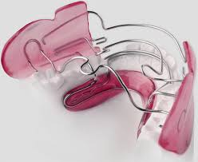
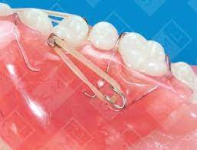
Types of orthodontic appliances

Slide 3
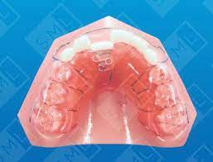
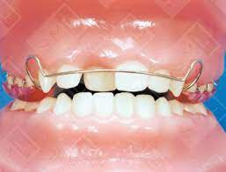
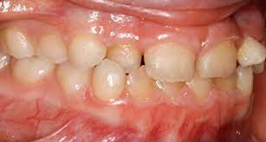
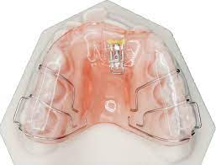
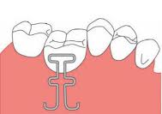
Indications of orthodontic appliances
Single tooth crossbite
1- Active component:……………………
2- Retentive components:………………
3- Posterior biteplate
4- Acrylic base plate
5- Hawley arch

Slide 4
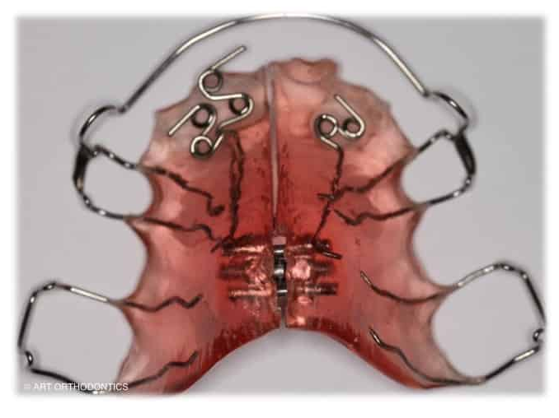
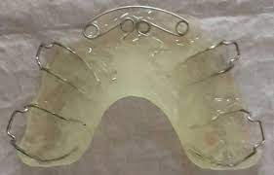
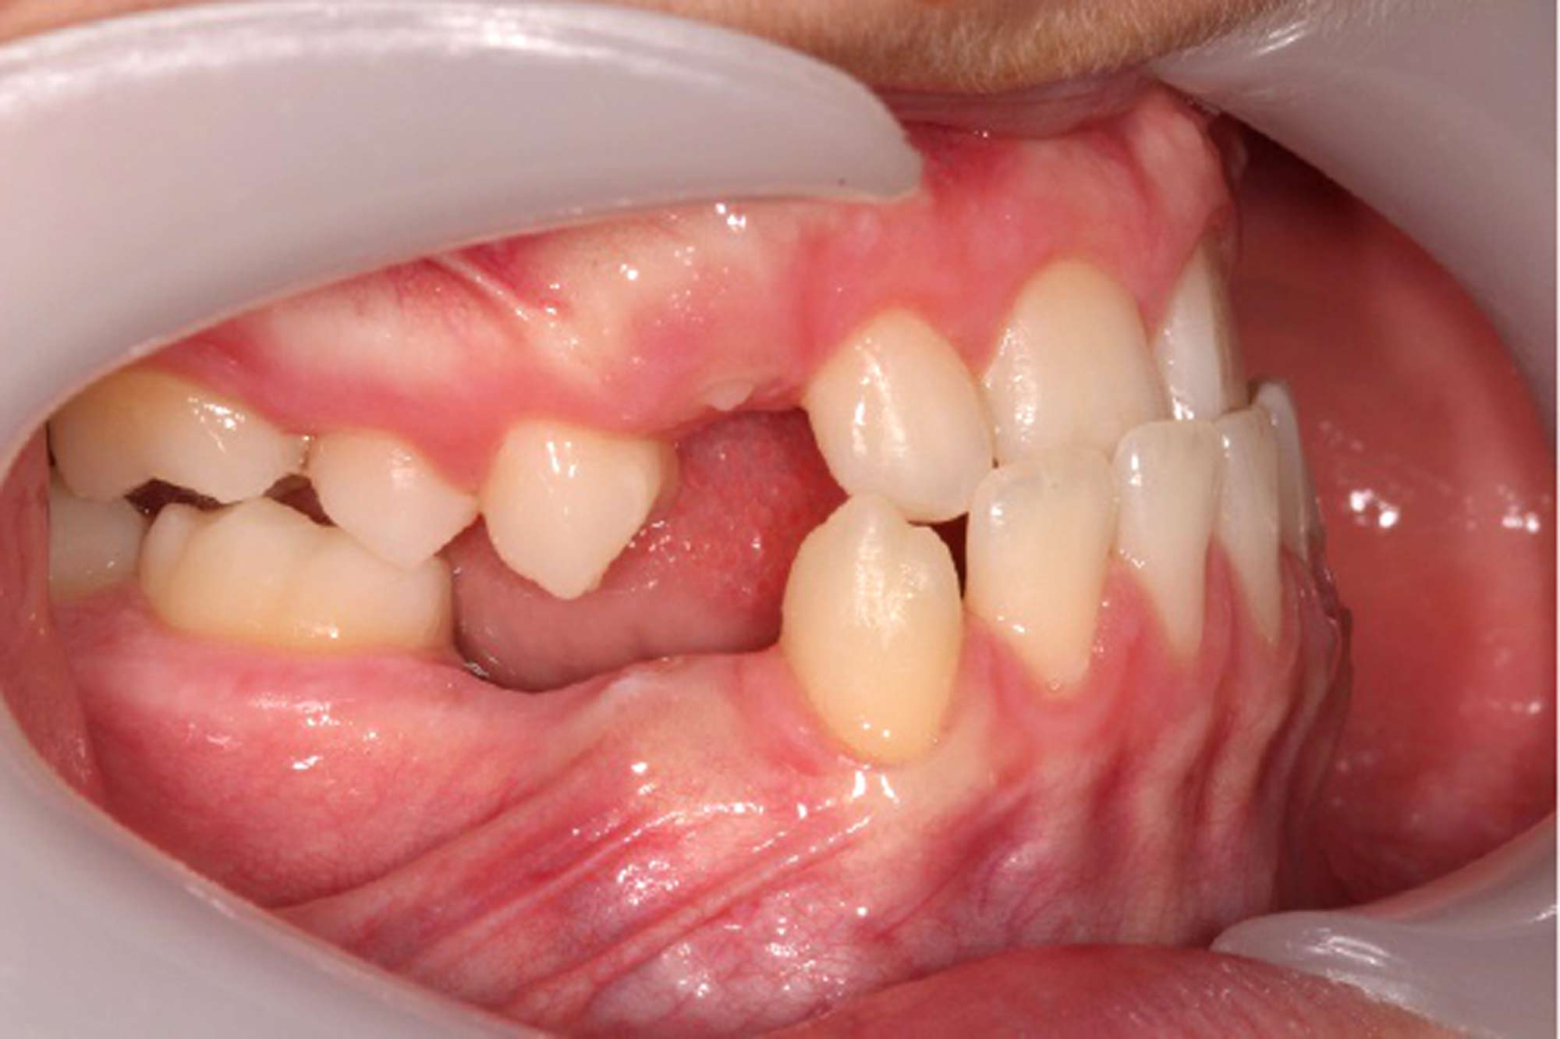
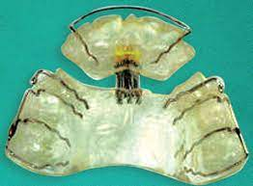
Anterior teeth crossbite
1- Active component:……………………
2- Retentive components:………………
3- Posterior biteplate
4- Acrylic base plate
5- Hawley arch

Slide 5
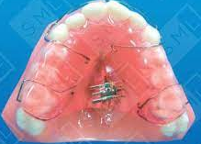
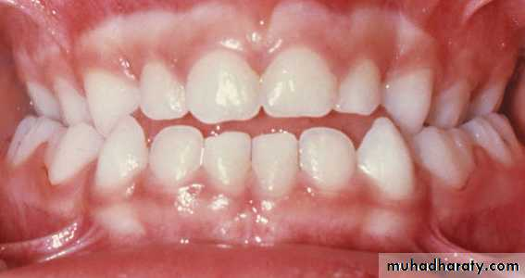
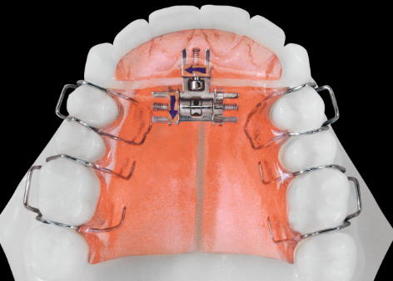
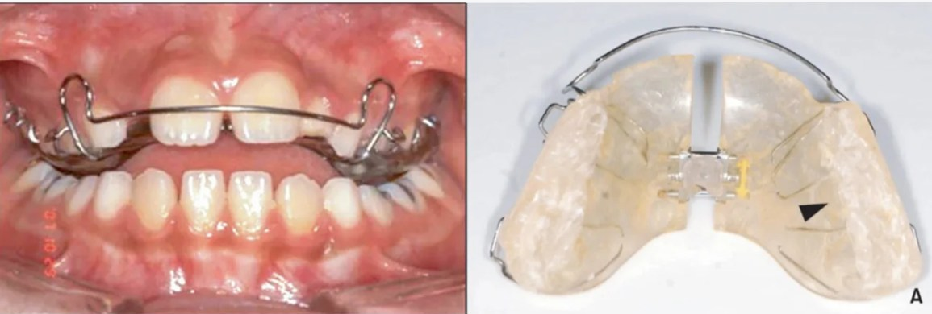
Posterior teeth crossbite
1- Active component:……………………
2- Retentive components:………………
3- Posterior biteplate
4- Acrylic base plate
5- Hawley arch

Slide 6
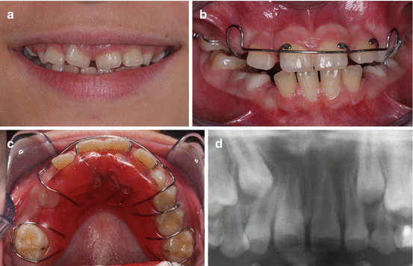
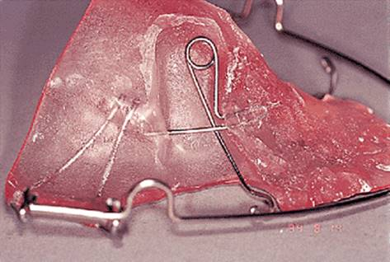
Median diastema
1- Active component:……………………
2- Retentive components:………………
3- Acrylic base plate
4- Hawley arch

Slide 7
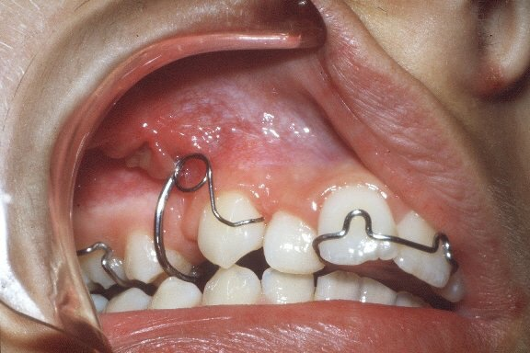
Mesial inclined canine
1- Active component:……………………
2- Retentive components:………………
3- Acrylic base plate

Slide 8
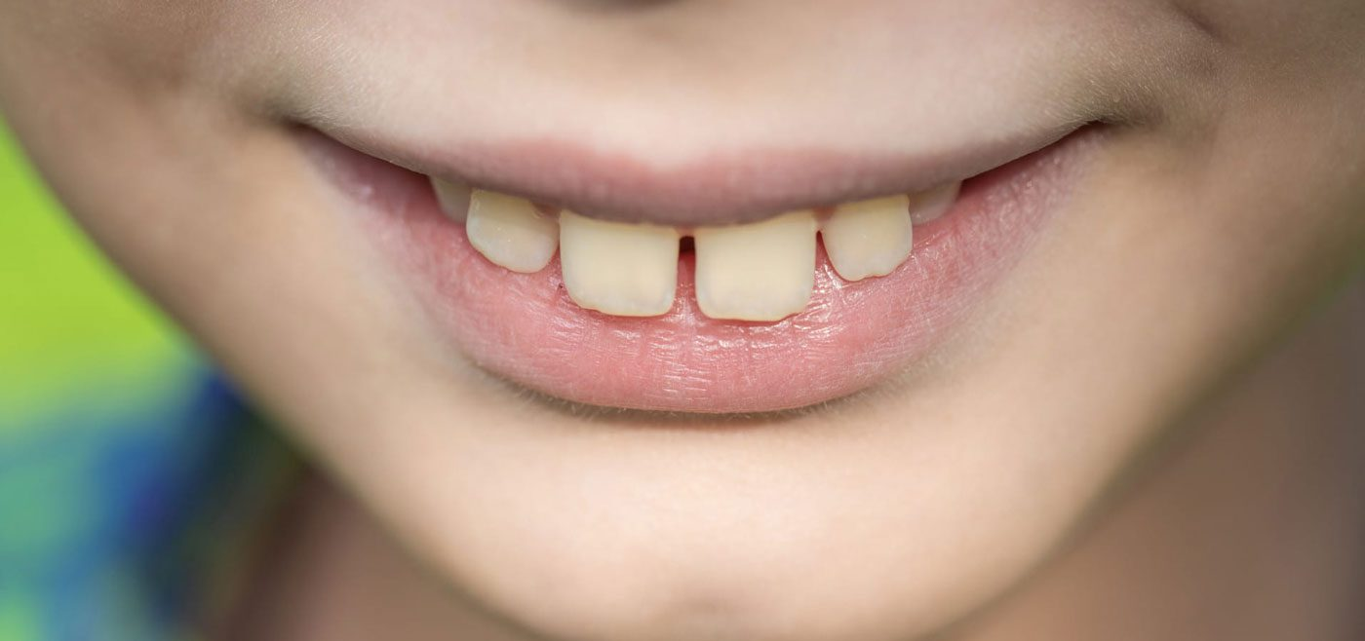
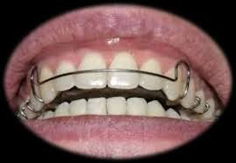
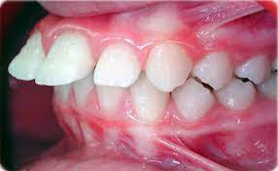
Retraction of spaced and/or proclined anterior teeth
1- Active component:……………………
2- Retentive components:………………
3- Acrylic base plate
4- Hawley arch

Slide 9
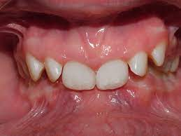
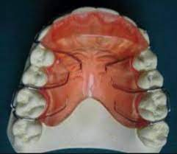
Deep bite
1- Active component:……………………
2- Retentive components:………………
3- Acrylic base plate
4- Hawley arch

Slide 10
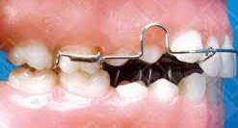
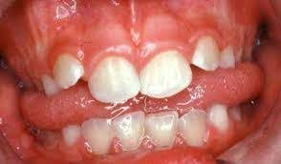
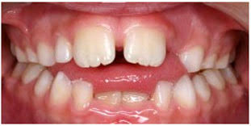
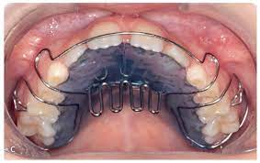
Open bite (bad oral habit)
1- Active component:……………………
2- Retentive components:………………
3- Acrylic base plate
4- Hawley arch

Slide 11
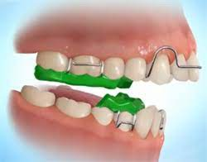
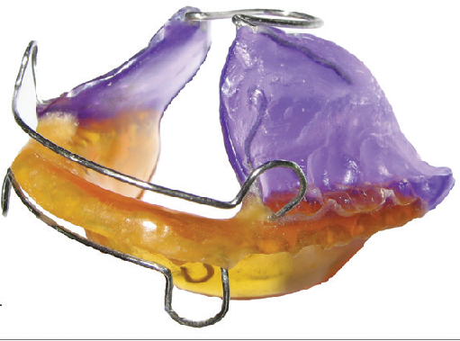
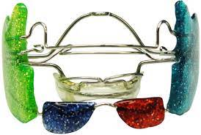
Myofunctional appliance

Slide 12
Acrylic base plate
Cold cure or heat cure acrylic.
It acts as a support for pressure sources and distributes the reaction of these forces to the anchorage areas.
In the maxillary arch it should extend to the distal of the first molar .
in the lower arch does not extend too deep to avoid trauma to the sulcus.
Properties of base plate
1. act as major connector.
2. It helps in anchorage and retention of the appliance in the mouth .
3. It protects the palatal springs against distortion in the mouth.
4. Bite planes can be incorporated into the base plate .

Slide 13
Modifications of acrylic base plate
Flat anterior bite plane (FABP):
Action: the anterior bite plane is added to the maxillary plate to prevent the posterior teeth from occluding by contacting with lower incisors opening the bite posteriorly.
Properties:
should be wide enough that the patient cannot bite behind it.
should be flat, not inclined posteriorly, to avoid mandibular retrusion effect.
Indication:
deep bite by separating the molars allowing them to over-erupt & so decreasing the overbite. After opening the bite, the bite plane is cut lingually but not occlusally to allow for upper incisor retraction.

Slide 14
2. Inclined anterior bite plane:
Corrects deep bite, added to the maxillary plate, but it corrects increased overjet as well by proclining lower incisors and acting as a myofunctional appliance enhancing mandibular growth & retarding maxillary growth.

Slide 15
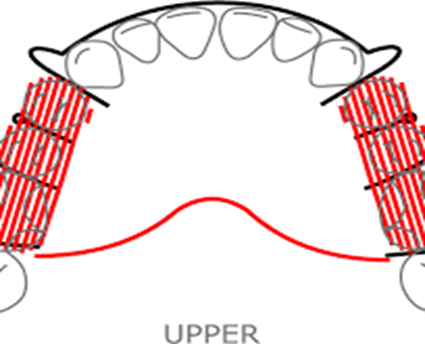
Posterior bite plane:
Action: the posterior bite plane can be added to the maxillary or mandibular plate. It usually covers the occlusal surfaces of all the posterior teeth, so that when the teeth are brought together the mandibular canines, premolars & molars occlude on the bite plane, thus leaving the incisors out of contact & free to be moved without occlusal interferences.
Indications:
It opens the bite anteriorly to allow, correction of anterior crossbite.
Treatment of posterior crossbite by expansion screw. The bite plane is flat on both sides to allow for mandibular repositioning after crossbite correction.

Slide 16
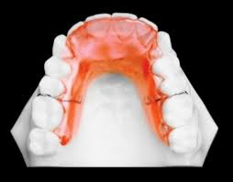
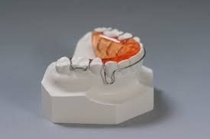
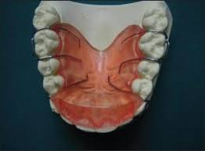

Slide 17


