Slide 1



الذكاء الاصطناعي في سوق العمل AI in the Labor Market
م.م. احمد سمير
Asst. Lec. Ahmed Sameer

Slide 2
What is AI, Really?
AI, in its fundamental core, is applied statistics. But it’s also much more than that.
Statistics is about understanding and modeling data to make inferences about the world, it’s a foundational pillar of modern AI, especially in machine learning.
AI is the fusion of statistics, computer science, and other disciplines to create systems that act intelligently which can learn, reason, and act in ways that mimic or surpass human capabilities.

Slide 3



AI in the Labor Market
Transforming Work
AI is fundamentally reshaping how we work, what jobs exist, and the skills needed to thrive in the modern economy. This transformation is happening at unprecedented speed, creating both significant opportunities and challenges.
Current State of Adoption
Of businesses are currently using or actively considering implementing AI technologies into their operations.
77%
Impact on Marketing
Of marketing and advertising firms have already incorporated generative AI tools into their creative workflows.
Impact on Job Displacement Already, 14% of workers in the US report being displaced by automation in their industries.
While routine and predictable tasks face the highest risk of automation, even knowledge-based professions are experiencing disruption as AI systems demonstrate capabilities in areas previously thought to be exclusively human domains.
37%

Slide 4

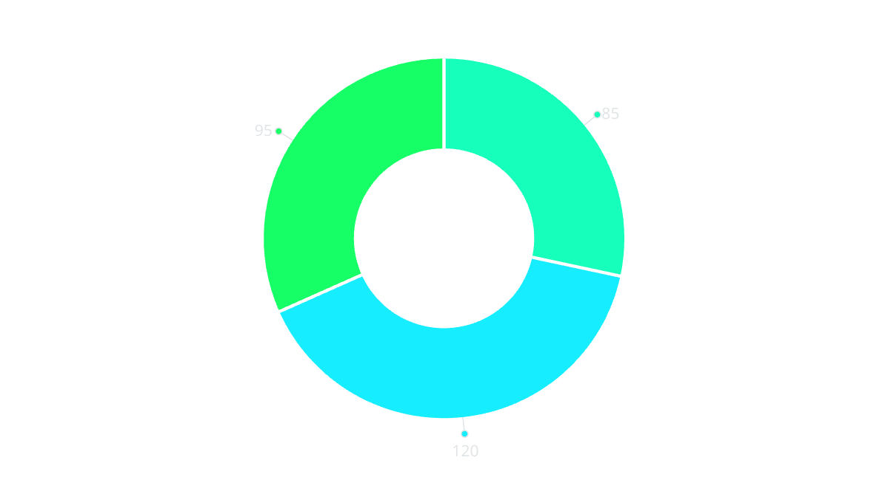
INDUSTRY OUTLOOK
Fully Automated Jobs
Partially Automated Jobs
Minimally Impacted Jobs

Slide 5
Sectors Most Affected by AI
Administrative & Clerical
Financial Services
Routine tasks like data entry, scheduling, and document processing are being automated through natural language processing and robotic process automation, reducing demand for administrative staff by up to 40% in some organizations.
AI algorithms now handle fraud detection, risk assessment, and even investment recommendations. Nearly 30% of tasks performed by financial analysts and banking professionals could be automated within five years.
Software Development
Media & Entertainment
AI-assisted coding tools are revolutionizing software development, with systems capable of generating functional code from natural language descriptions, potentially automating up to 20% of current developer workflows.
Generative AI is transforming content creation, enabling the production of articles, images, videos, and music with minimal human intervention, disrupting traditional creative industries.

Slide 6





AI's Role in Augmenting Work
Enhanced Productivity
1
Focus Shift
AI tools automate routine tasks
2
Workers allocate time to complex problems
Implementation
4
Creative Expansion
3
Solutions deployed with AI optimization
New ideas developed with AI assistance
Human-AI collaboration has shown productivity increases of 25-40% in knowledge work environments. For example, radiologists working with AI diagnostic tools can review more images with greater accuracy, while marketing professionals use AI to generate and test campaign concepts at unprecedented scale.

Slide 7
Real-World Example

Slide 8
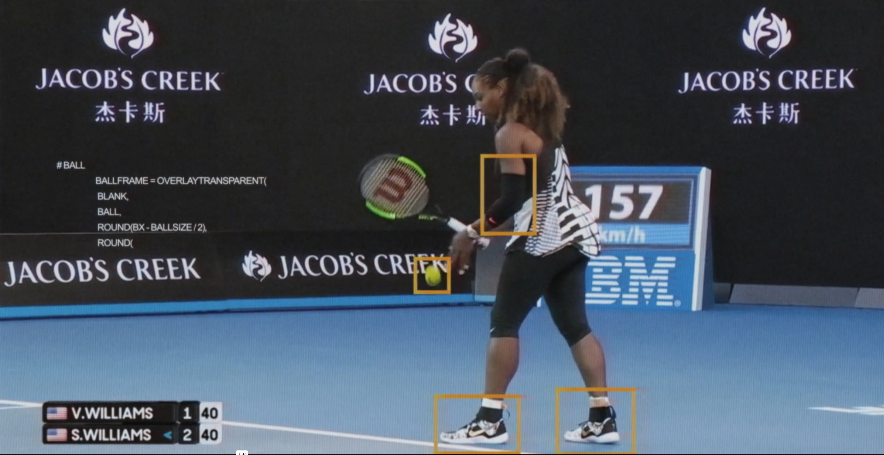
Real-World Example

Slide 9
Ethical and Social Implications
Workforce Displacement
Economic Inequality
Algorithmic Bias
As AI automates more tasks, workers in affected industries face displacement. This transition period creates significant social and economic challenges, particularly for mid-career workers whose skills may no longer match market demands.
AI may exacerbate income inequality by disproportionately benefiting highly skilled workers and capital owners while displacing routine jobs. This "winner-takes-most" dynamic requires proactive policy interventions to ensure the benefits of AI are broadly shared.
AI systems can perpetuate and even amplify existing biases in hiring, lending, and other critical decisions. Ensuring AI systems are fair, transparent, and accountable represents a significant ethical challenge requiring both technical
and regulatory solutions.

Slide 10
THANK YOU!
“AI won’t replace managers, but managers who use AI will replace those who don’t.“
– Unknown

