Slide 1
A Case of Lysosomal Storage Disease in the Oral Cavity
Noor Sami Allawi
BDS MSc (Oral and Maxillofacial Pathology)

Slide 2
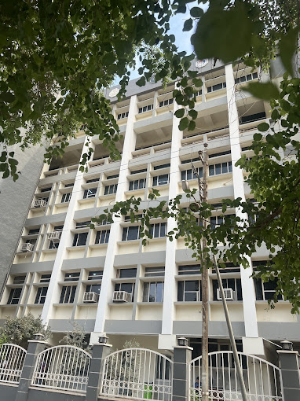
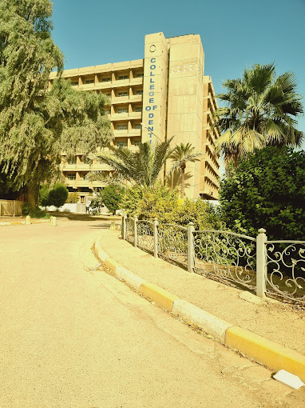

Slide 3
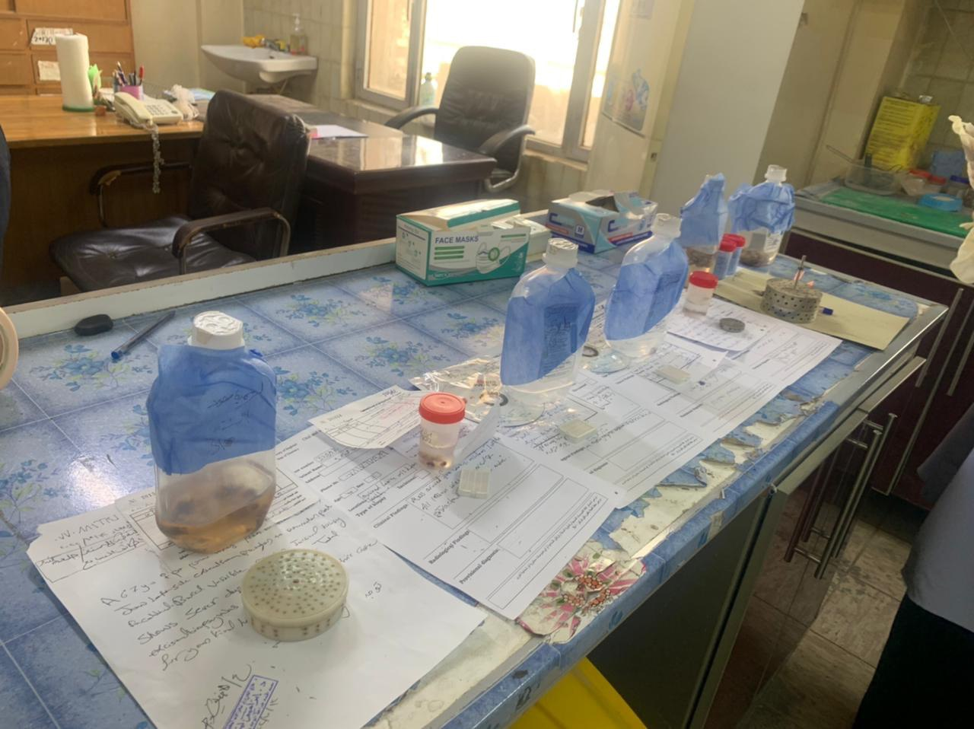

Slide 4

Before we start

Slide 5

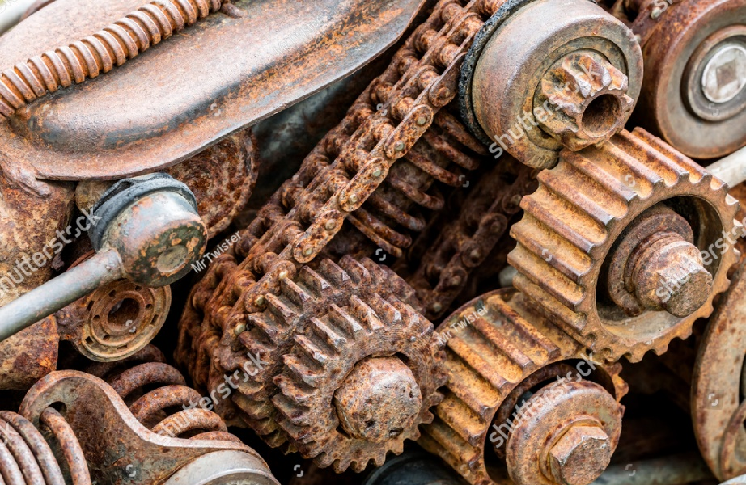

Sections of the lecture
How things work
How things break
How problems are identified

Slide 6
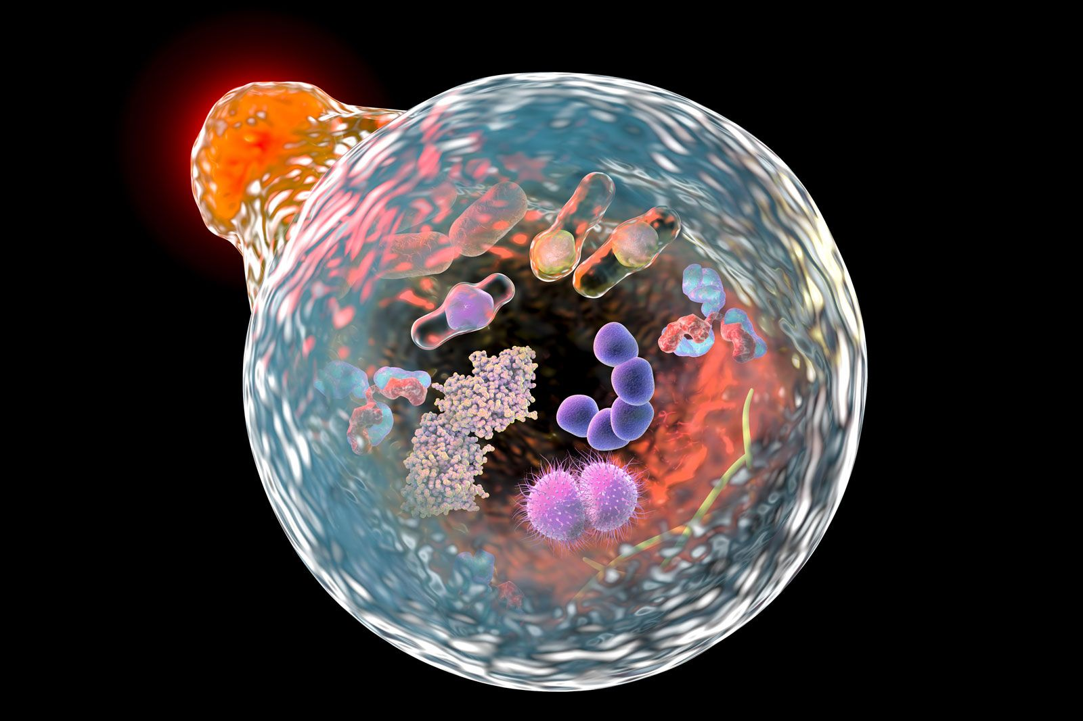
How things work

Slide 7
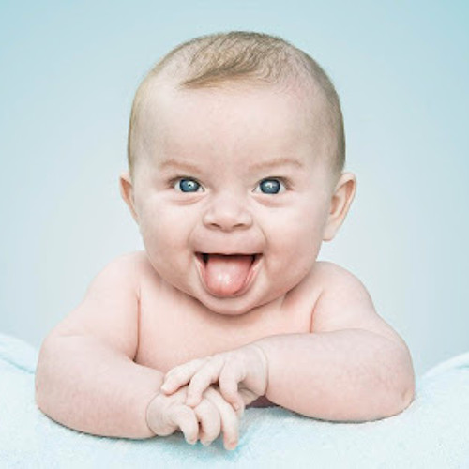
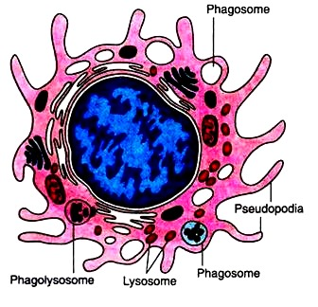
How things work

Slide 8

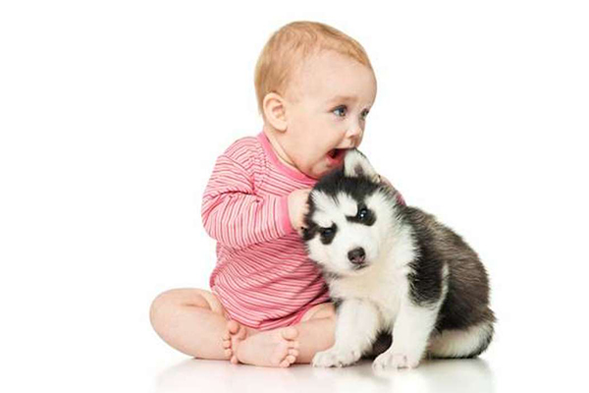

Macrophages can “eat”
Microorganisms
Foreign material
Body tissues

Slide 9
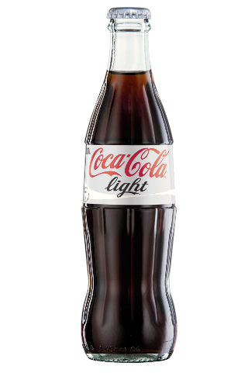

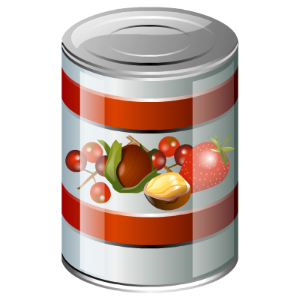

Mucopolysaccharides
• Heparan sulfate
• Dermatan sulfate
• Keratan sulfate
• Chondroitin sulfate
Lysosomes

Slide 10
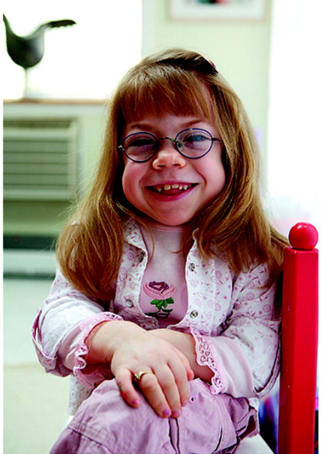
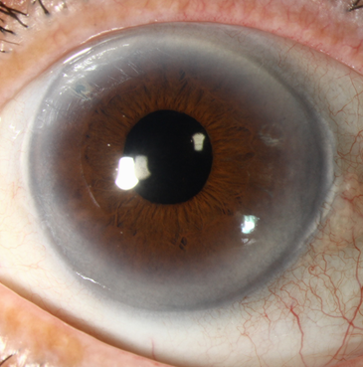
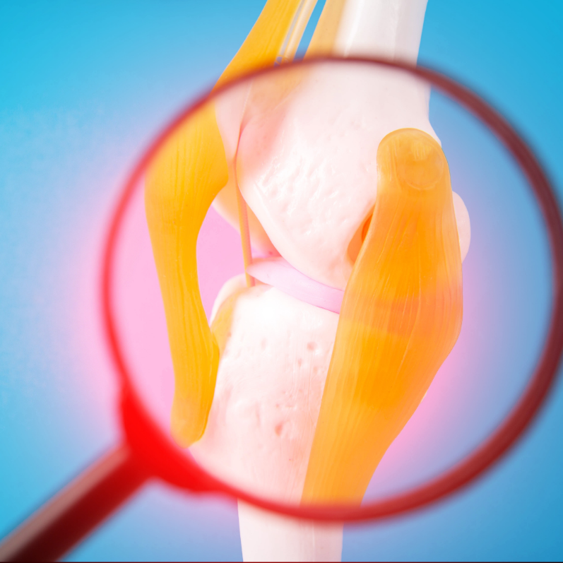
Clinical features
Coarse facial features
Cloudy corneas
Stiff joints

Slide 11
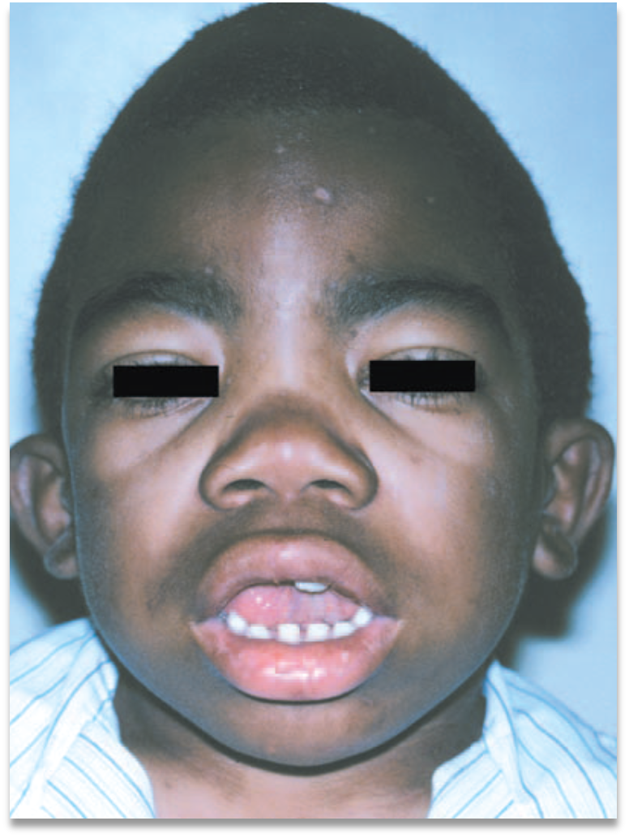
Clinical features
Heavy Brow ridges

Slide 12
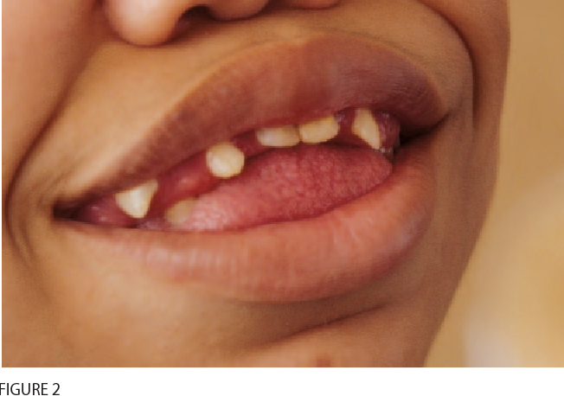
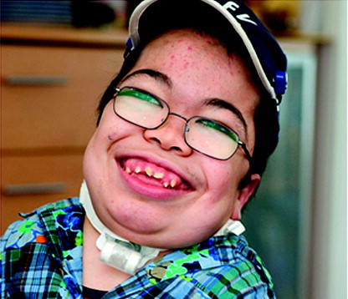
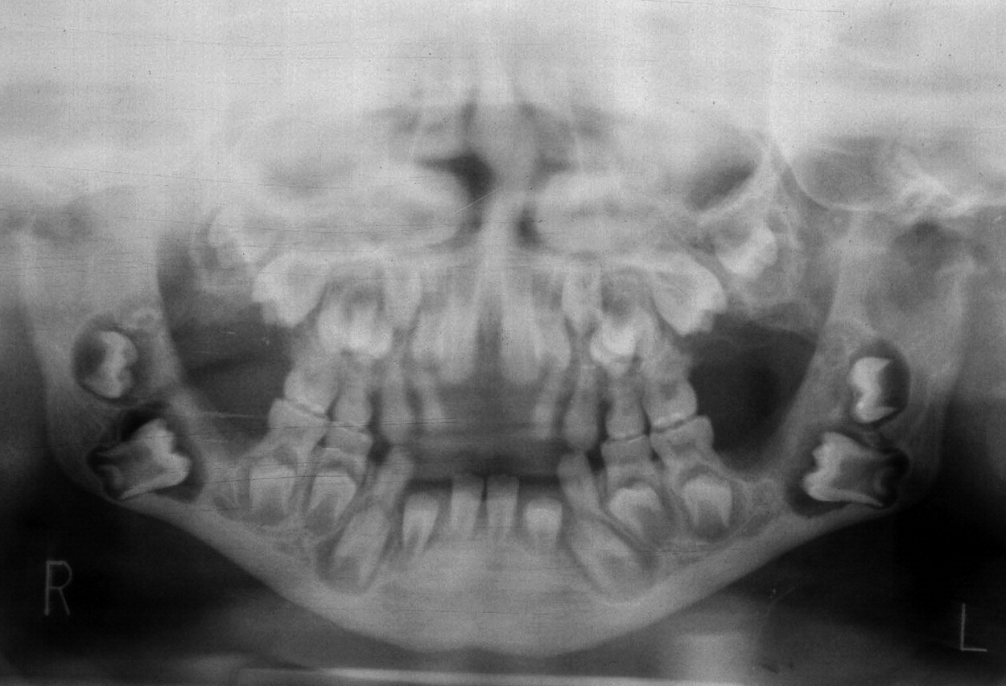
Oral manifestations
Macroglossia
Gingival hyperplasia
Multiple impactions

Slide 13
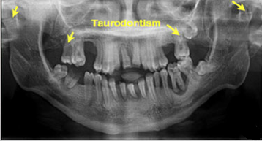
Oral manifestations
Taurodontism and condylar deformities

Slide 14
Diagnosis
Glycosaminoglycans
Lysosomes

Slide 15
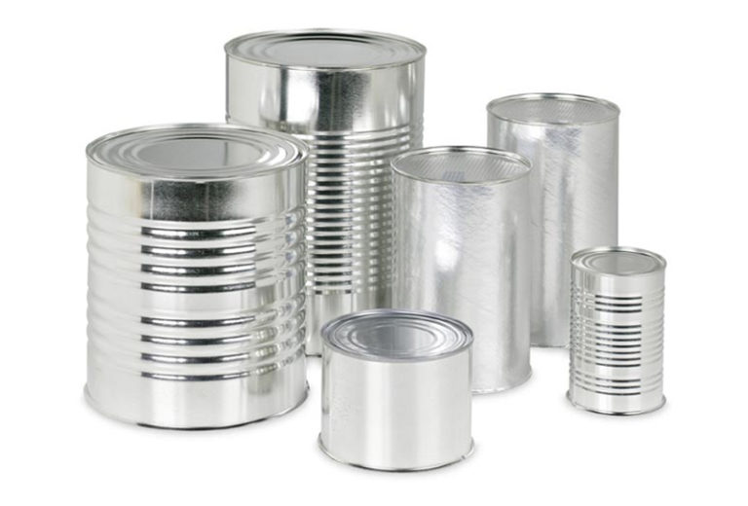
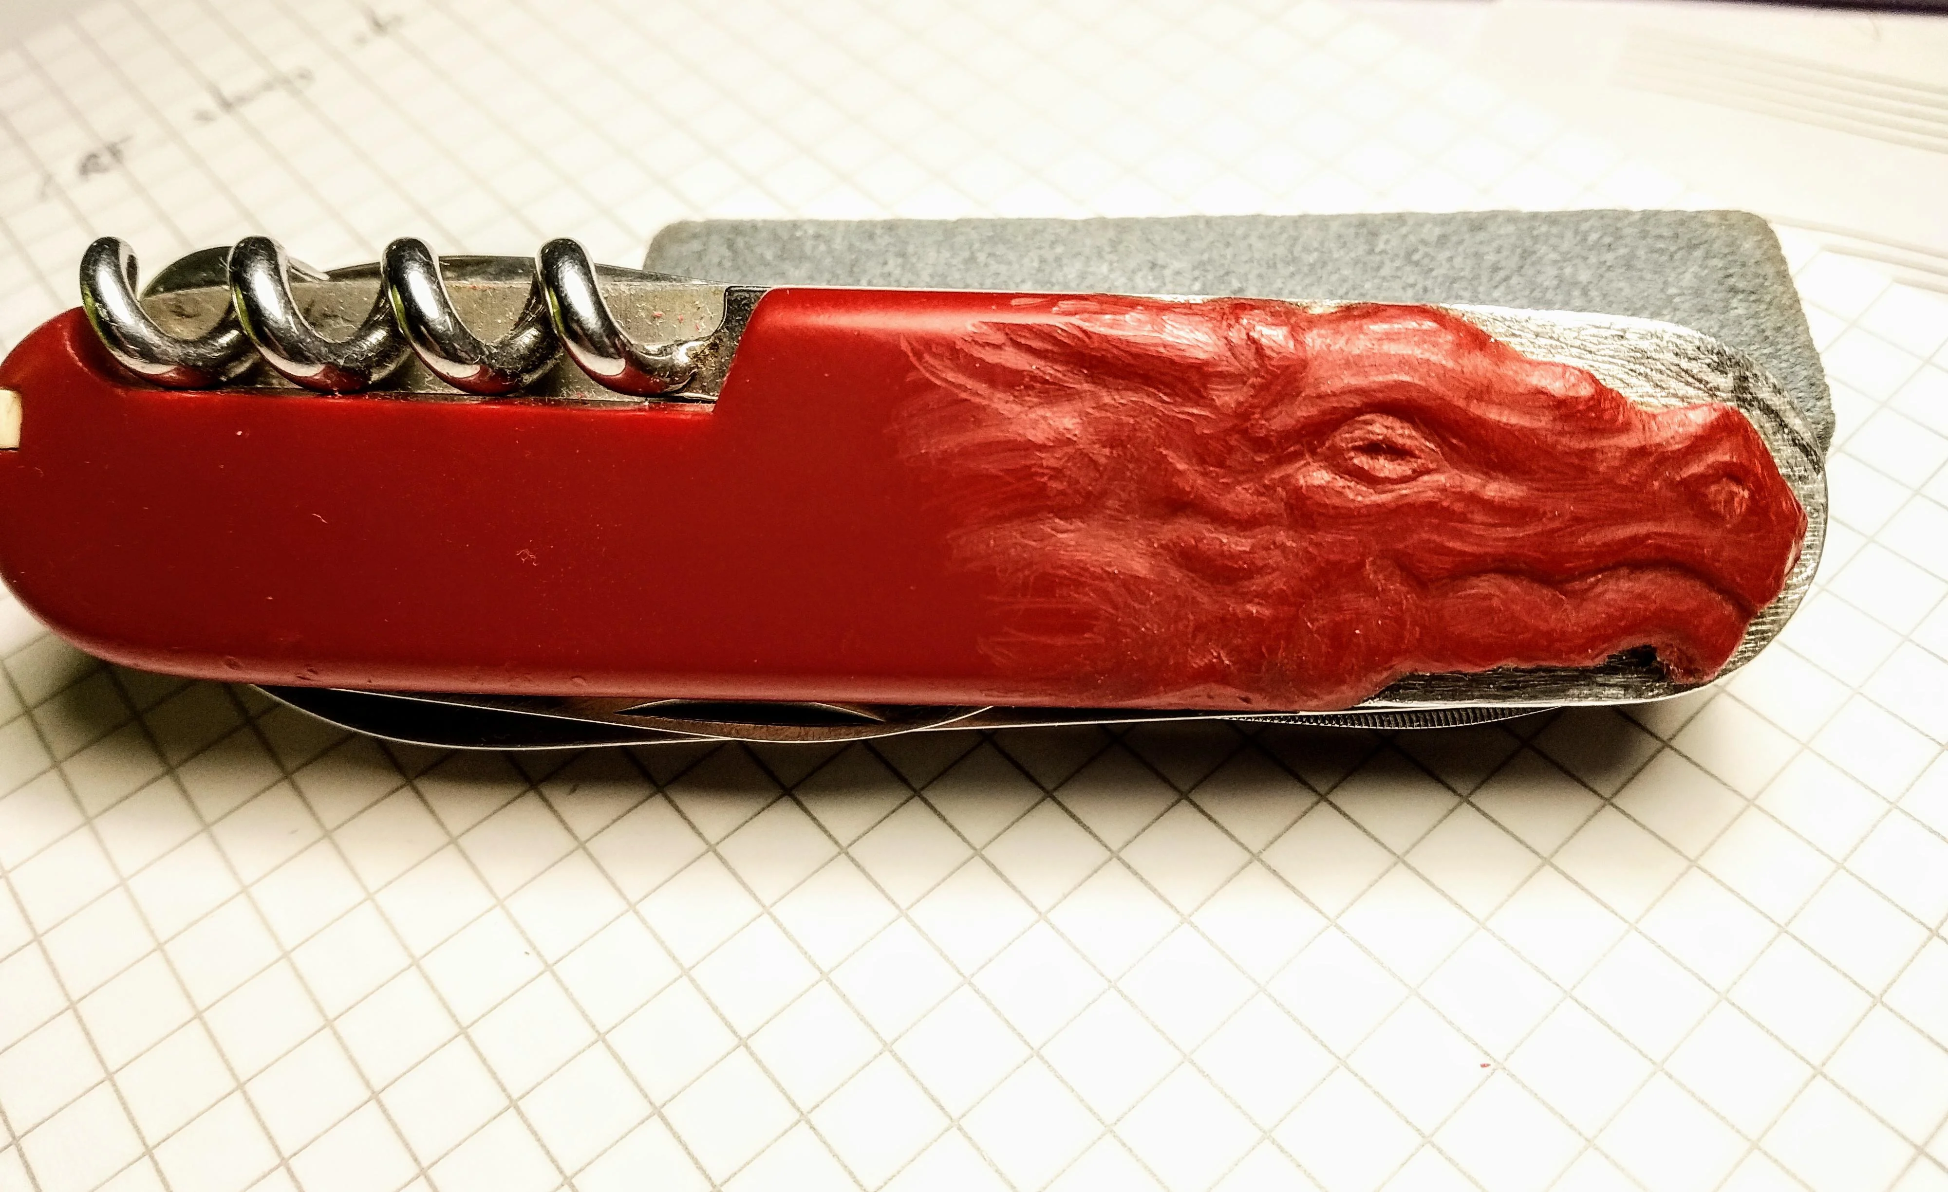
Diagnosis
Too much glycosaminoglycans
Enzyme deficiency

Slide 16
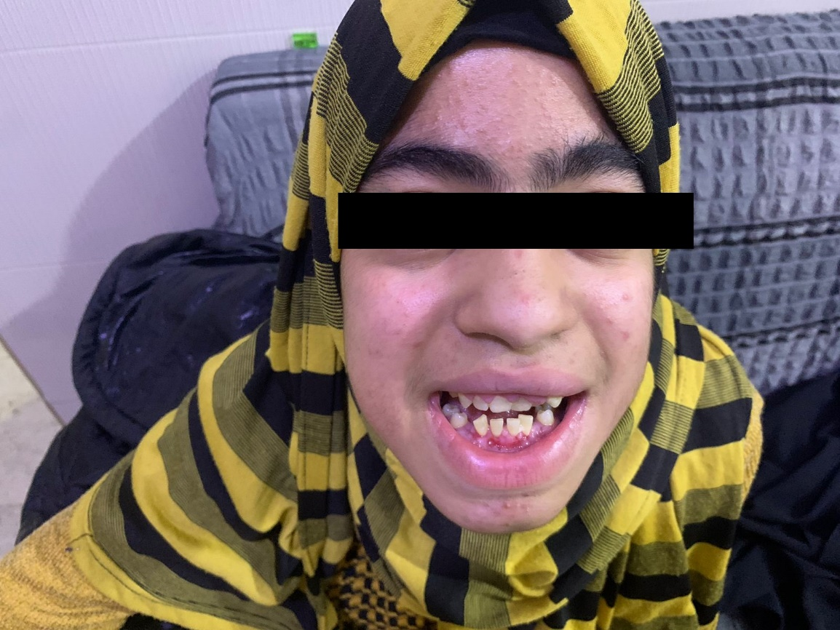
17 year old female presented with:
Painless gingival overgrowth.
Deafness
Intellectual disability
Multiple tooth impactions
Retention of deciduous teeth.
No medications

Slide 17
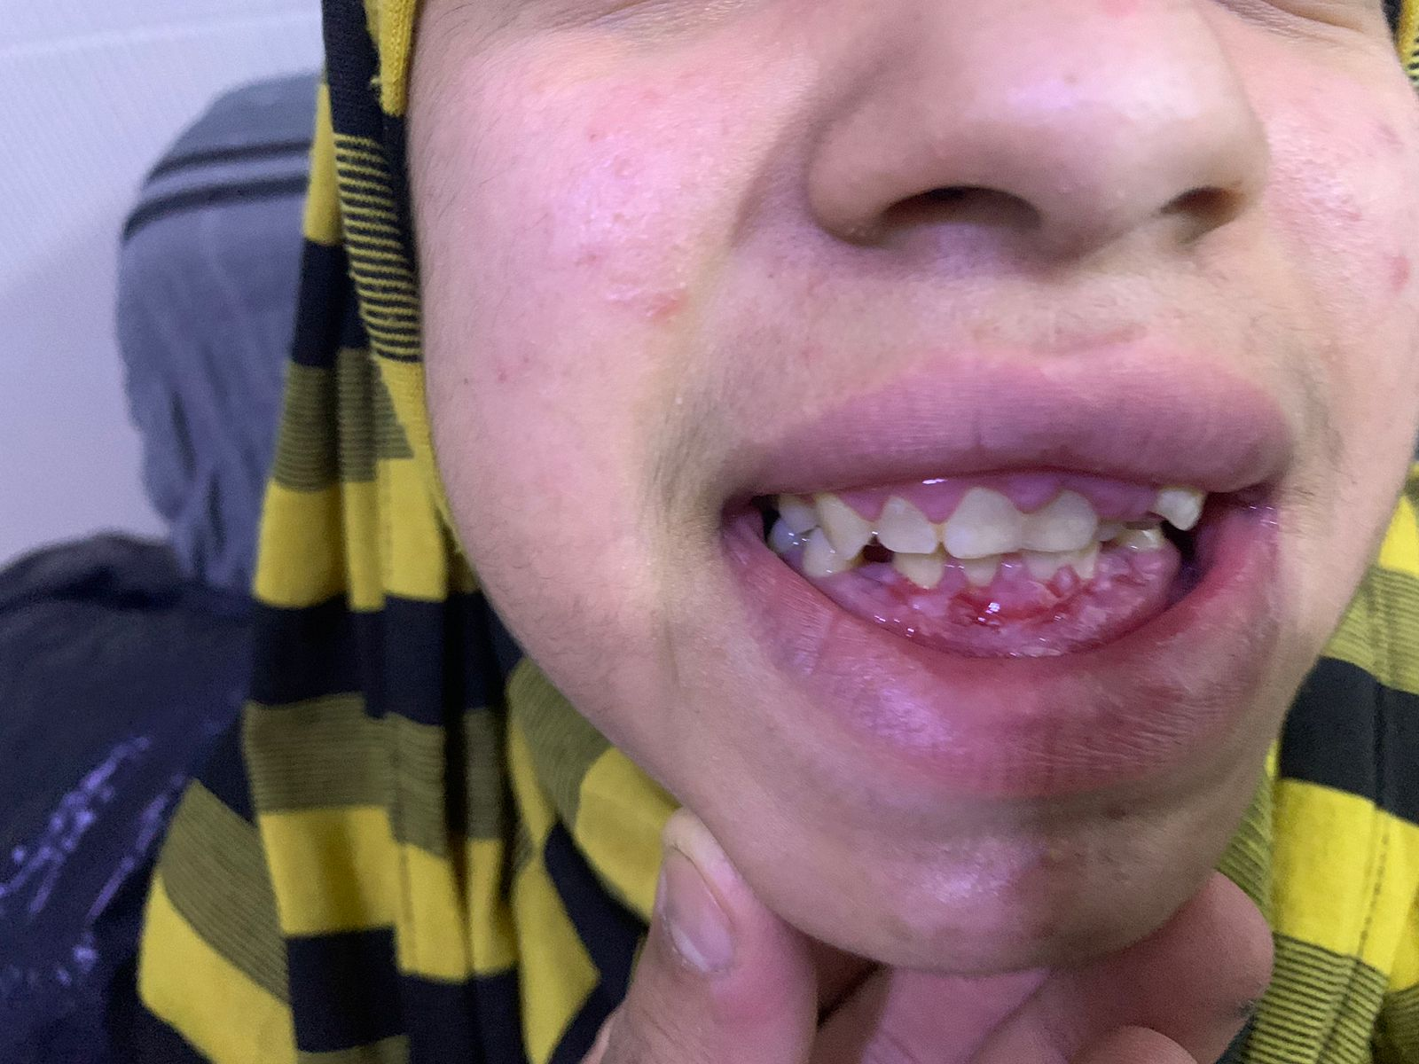
Family History
Three stillborn siblings.
A sibling who died 7 days after birth.
Two nieces with an undiagnosed congenital disease.
Three deaf cousins.

Slide 18
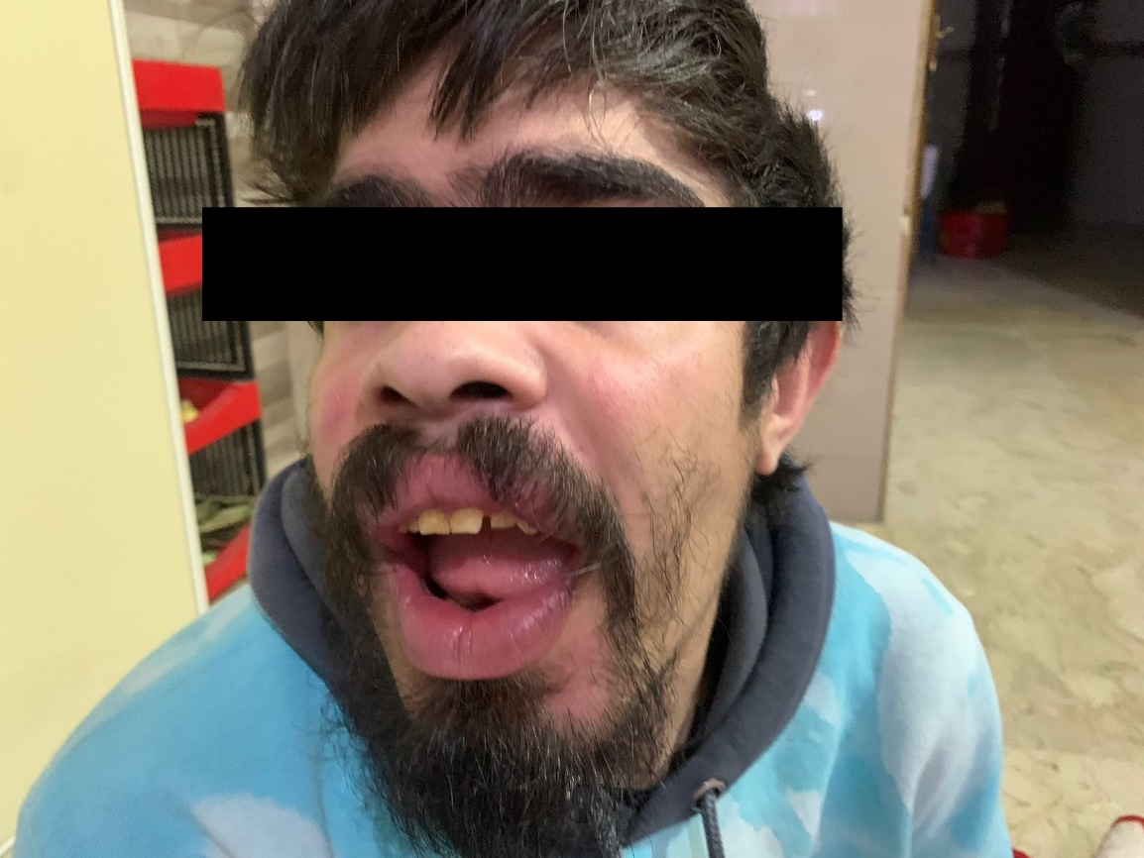
Family History
Three stillborn siblings.
A sibling who died 7 days after birth.
Two nieces with an undiagnosed congenital disease.
Three deaf cousins.

Slide 19
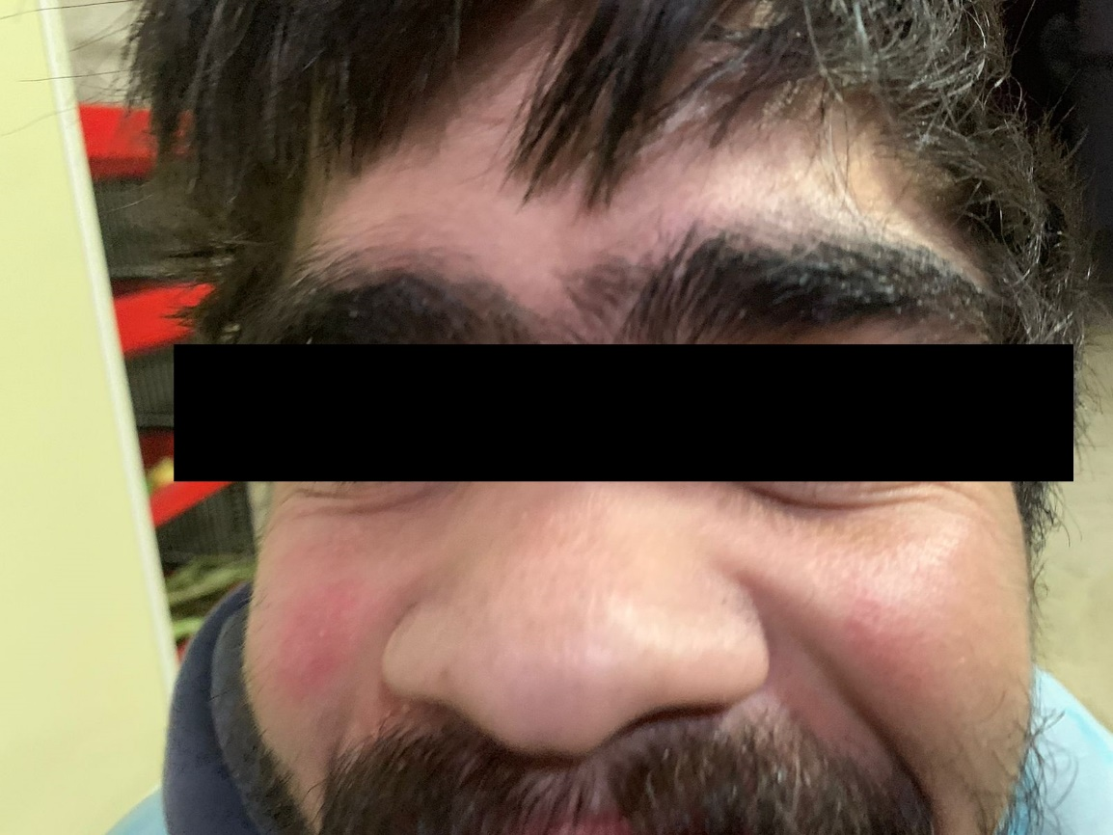
Family History
Three stillborn siblings.
A sibling who died 7 days after birth.
Two nieces with an undiagnosed congenital disease.
Three deaf cousins.

Slide 20
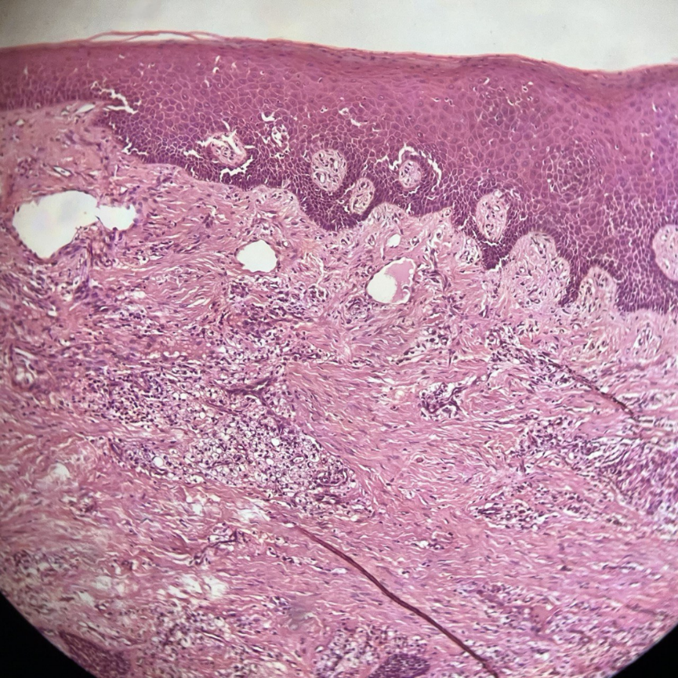
Histopathology
Hyperplastic oral epithelium.
Fibrous connective tissue stroma.
Histiocytic aggregates.

Slide 21
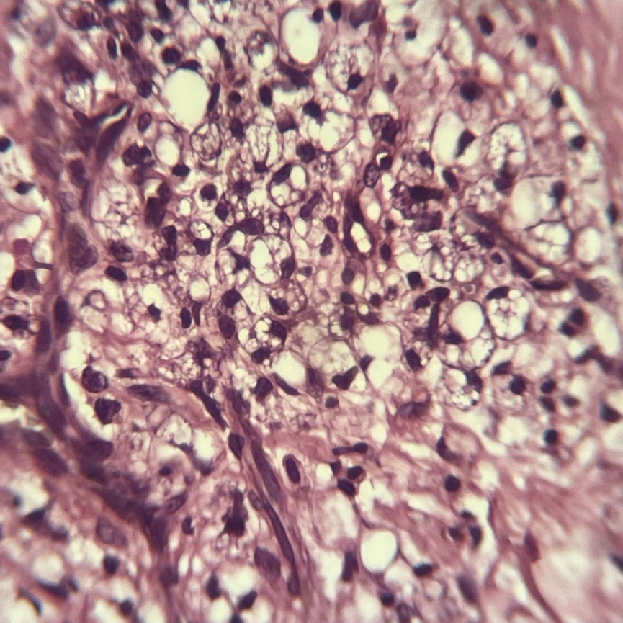
Histopathology
Hyperplastic oral epithelium.
Fibrous connective tissue stroma.
Histiocytic aggregates.
Cytoplasmic inclusions.

Slide 22
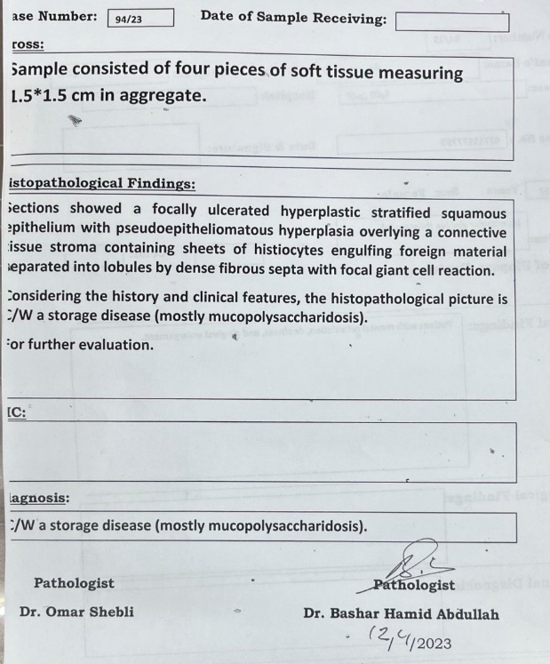
Histopathology

Slide 23
Treatment
No satisfactory treatment exists
Allogenic bone marrow transplant
Iaronidase enzyme replacement

