Slide 1


Quantum Optics Applications in Communications
by
Asst. Lect. Salwa Marwan Salih

Slide 2
Outlines
Quantum Optics in Communications
Basic Property of Quantum Mechanics
Definition of quantum optics
Integrated Phonics Platform

Slide 3
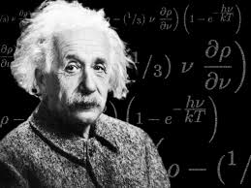
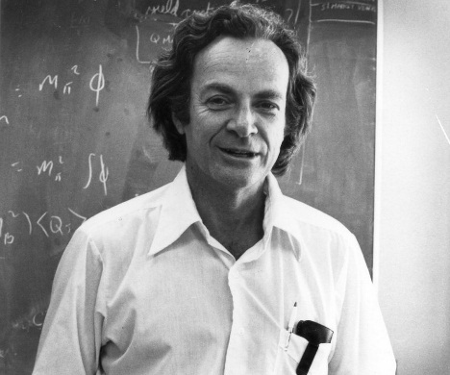
“ All these fifty years of conscious brooding have
brought me no nearer to the answer to the question,
'What are light quanta?'
Nowadays every Tom, Dick and Harry
thinks he knows it, but he is mistaken.”
Albert Einstein
“..it is safe to say no one really
understands quantum mechanics”
Richard Feynman

Slide 4
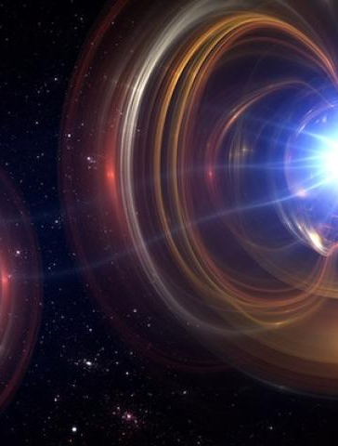
Quantum Optics
Quantum optics is a branch of physics that studies the quantum mechanical properties of light (photons) and its interactions with matter. It focuses on understanding light as quantized particles, rather than just electromagnetic waves, and explores phenomena such as photon entanglement, quantum superposition, and coherence.

Slide 5
Fundamentals of Quantum Optics
Quantum states
Describe the properties of photons including the polarization
Superposition
Allow photons to exist in multiple states , enabling complex information processing
Photons
The fundamental of light particles that carried quantum information

Slide 6

Basic Property of Quantum Mechanics
Randomness
Quantum mechanics is inherently random.
The outcome of certain experiments cannot be predicted
Example: A single photon incident on a beam splitter
50/50
François Hénault, Quantum physics and the beam splitter mystery, Proc. SPIE 9570, The Nature of Light: What are Photons, 2015.

Slide 7
Quantum Optics in Communications
Quantum Cryptography
Quantum Computer
E91 Entangled photons
BB84 Single – Photon QC system
Quantum Teleportation

Slide 8
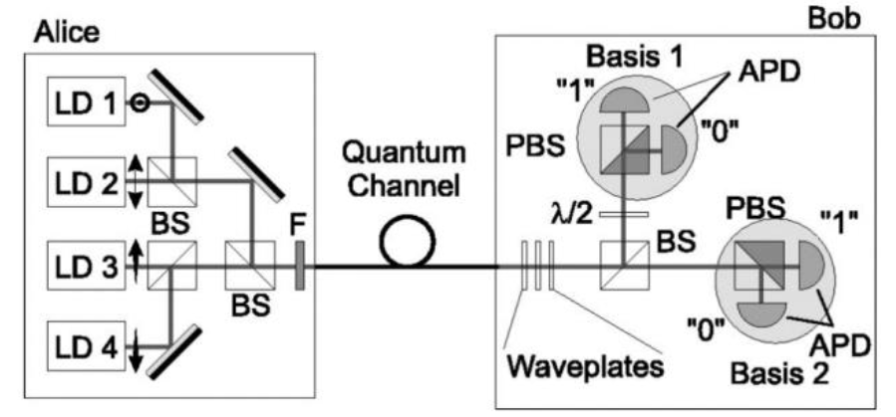
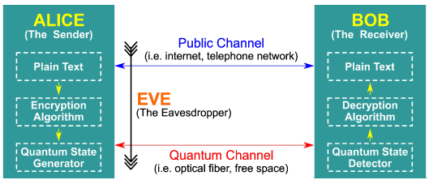
BB84 Protocol
Ali Ibnun Nurhadi and Nana Rachmana Syambas, Quantum Key Distribution (QKD) Protocols: A Survey. IEEE,2018

Slide 9
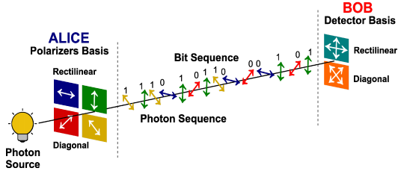
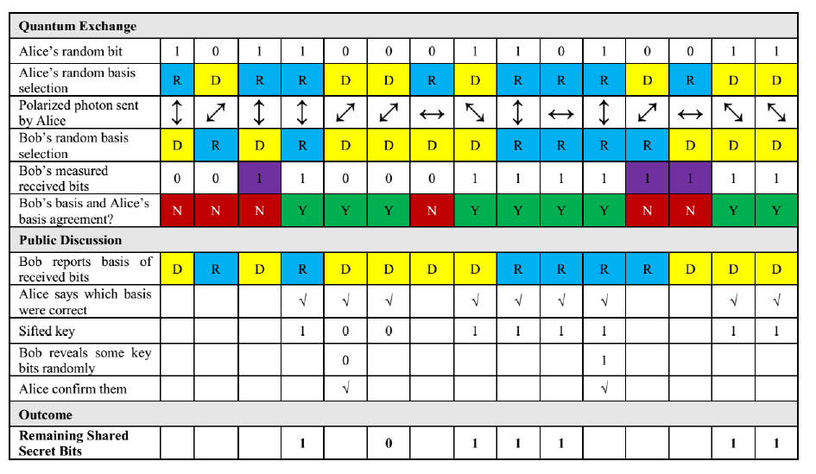

Slide 10
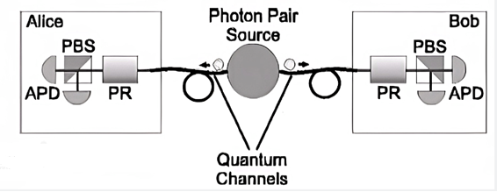
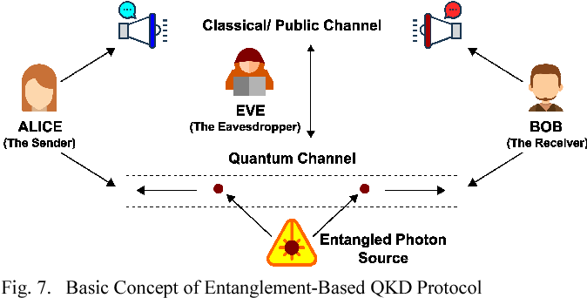
E91 Protocol
Ajay Kumar and Sunita Garhwal, State-of-the-Art Survey of Quantum Cryptography, Archives of Computational Methods in Engineering, 2021

Slide 11
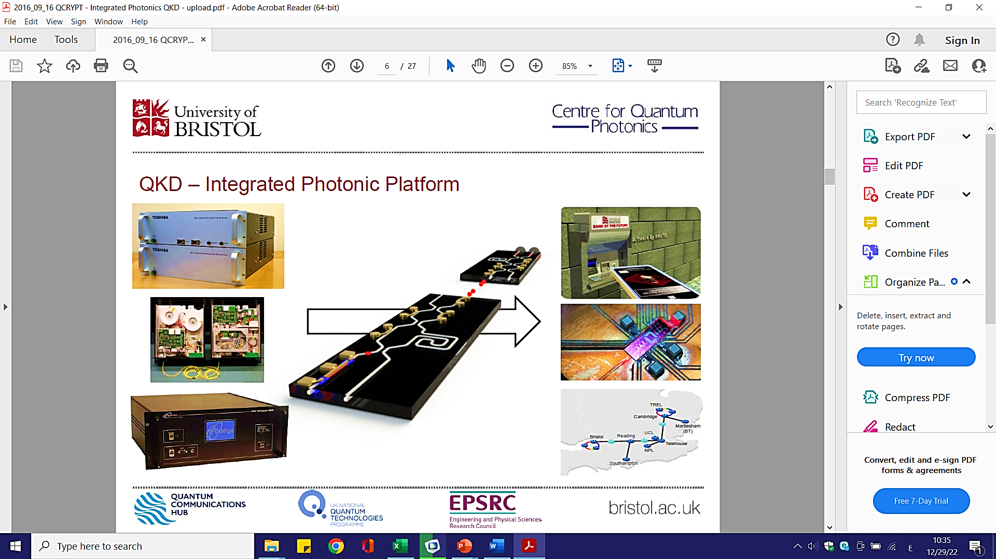
Integrated Phonics Platform
Silicon Photonics
• Mature semiconductor fabrication processing
• Cheap
• Reliable
• Mass-manufacturable
• Electronics integration

Slide 12
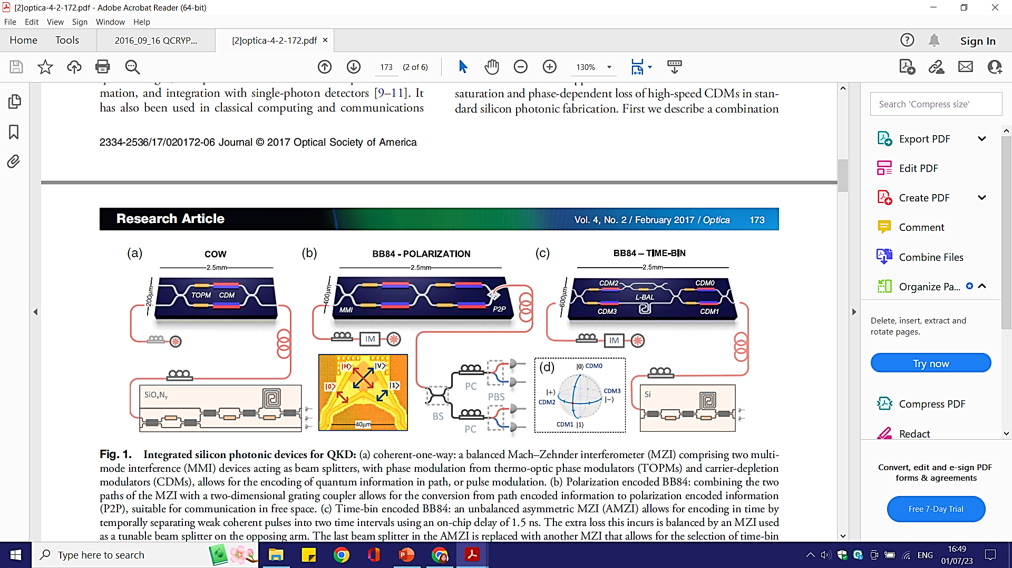
Silicon QKD –Experiments
Philip Sibson et al. , Integrated silicon photonics for high-speed quantum key distribution, Optica, 2017

Slide 13
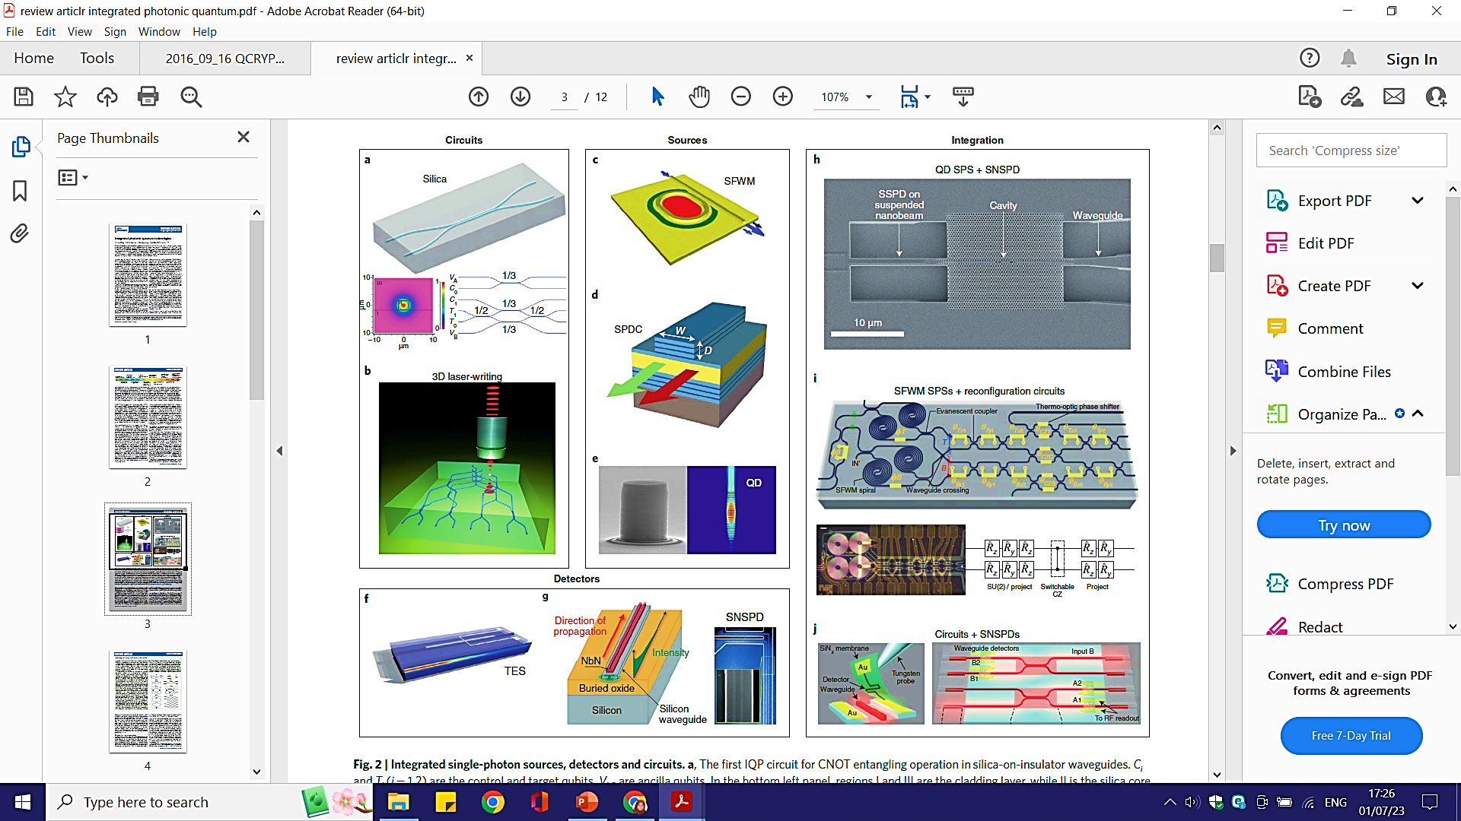
Jianwei Wang, et al., Integrated photonic quantum technologies. Nature Photonics, 2019

Slide 14
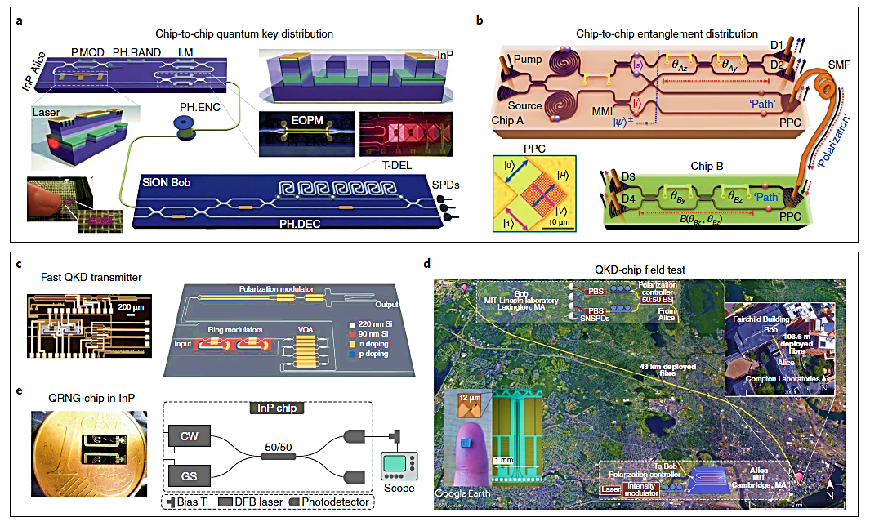

Slide 15

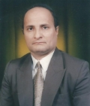
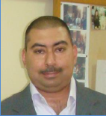
Group members
Founder
Prof. Khalil I. Hajim
Head
Asst. Prof. Shelan Kh. Tawfeeq
Consultant
Prof. Raad S. Fayath
Coordinator group member, Dr. Ahmed I. Khaleel
Dr. Alhuda A. Al-mafrji
Dr. Mayhem S. Jaber
Dr. Adel F. Mushatet
Dr. Farooq A. Khaleel

Slide 16
Thank you

