Slide 1
Physiological Role of Fat Soluble Vitamins In Human Body
Prepared by
Asst. Prof. Dr. Suha Talal Abd

Slide 2
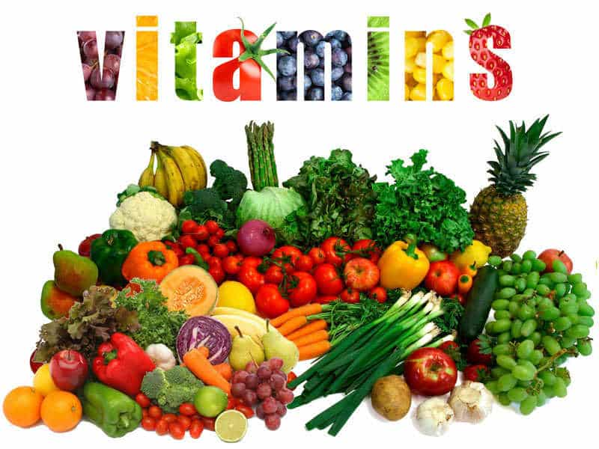

Slide 3
Micronutrients are vital components that humans and other organisms require in variable amounts throughout their lives to coordinate a variety of physiological activities and maintain good health. Essential nutrients can’t be generated in humans or can’t be synthesised in significant levels, thus they have to be received from diet.

Slide 4
These vitamins can be found in a variety of foods, including plant and animal sources. For good health and development, they must consume a balanced diet on a regular basis. Vitamin shortages are linked to major health issues, as well as delays in normal development and growth.

Slide 5
Vitamin deficits pose major health risks because they are essential for human health, growth, development, reproduction, and maintenance. Thirteen vitamins are real vitamins that can be divided into two categories: water soluble and fat soluble. Vitamins A, E, K, and D are fat soluble, and vitamins B1, B2, B3, B5, B6, B7, B9, B12, and C are water soluble.

Slide 6
Vitamins are a diverse set of chemical molecules that are unable to be manufactured by the human body but are required for the body's basic processes to function properly. Essential nutrients, like several beneficial phytochemicals, cannot be generated or synthesised in the human body (organism), either entirely or in inadequate amounts, and must therefore be received through diet.

Slide 7
Under normal circumstances, we can receive the various vitamins via food and proper nutrition, but minimum nutritional requirements are frequently not satisfied, necessitating supplementation. Vitamins are necessary for metabolism, as well as for body growth and proper function. The body produces only vitamin D; all other vitamins must be received through food.

Slide 8
Vitamin A (Retinoic acid)
Vitamin A is required for reproduction, eyesight, bone growth, cell division, and epithelial tissue differentiation, as well as immune system control. Ingesting provitamin A carotenoids from plants, as well as retynil esters, retinol, or retinal, can all be converted into the active form’s retinol, retinal, and retinoic acid, ensuring these functionalities. Vitamin A insufficiency is caused by a lack of vitamin A stored in the liver.

Slide 9
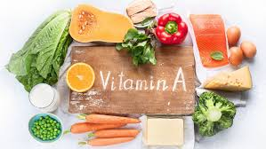
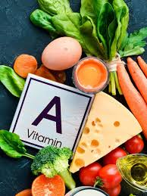
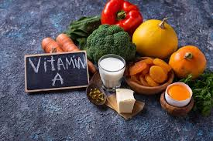

Slide 10
When a healthy adult quits eating vitamin A-rich foods, deficiency symptoms may not occur until the deposits have been depleted, which can take up to two years. During the growing phase, however, this period is relatively limited in children.

Slide 11
Vitamin insufficiency is one of the most serious concerns in developing countries. More than 100 million children worldwide show signs of deficiency, making them more susceptible to infections, night or complete blindness (xerophthalmia), and keratinization, all of which can lead to mortality

Slide 12
Vitamin D (Calciferol)
Because its biologically active form, 1,25-(OH)2colecalciferol or vitamin D3, is a hormone that may be produced in the body from cholesterol, vitamin D is not a required nutrient if enough UV radiation is received. Vitamin D is necessary for maintaining calcium and phosphorus balance as well as cell differentiation.

Slide 13
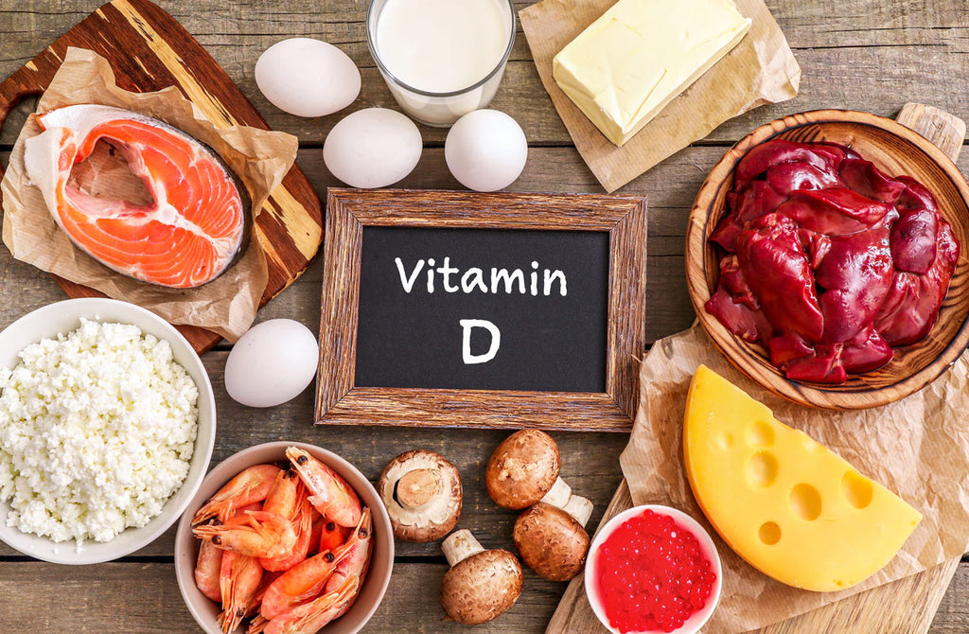

Slide 14
The active form of vitamin D is found in the small intestine, which increases calcium ion active transport. It enhances calcium and phosphate ion reabsorption in the kidney tubules. Vitamin D has physiological functions in non-skeletal tissues as well.

Slide 15
Adults can develop osteocalcin, a bone deformity similar to rickets. It is more common in women who do not get enough calcium, do not get enough sunlight, and have had multiple pregnancies with breastfeeding. It involves the loss of bone density, which may typically be avoided by eating enough vitamin D, calcium, and phosphorus.

Slide 16
The symptoms of vitamin D shortage (50 nmol/L) are similar to those of calcium deficiency because vitamin D deficiency prevents calcium from being absorbed, even if there is enough calcium in the diet. Rickets is a disease of vitamin D insufficiency in children. It's marked by structural anomalies in the bones, which become overly flexible and mushy. As a result, they are unable to endure stress, resulting in bone abnormalities such as bent legs.

Slide 17
Vitamin E (Tocopherol)
Vitamin E is the body’s primary fat-soluble antioxidant. It is found in biological membranes, where it shields membrane phospholipids’ polyunsaturated fatty acids (PUFA) from oxidative destruction by free radicals. It works in tandem with other cell-defence mechanisms (such as the enzymes glutathione reductase, glutathione peroxidase, and superoxide dismutase) and is influenced by the nutritional status of other minerals like selenium.

Slide 18
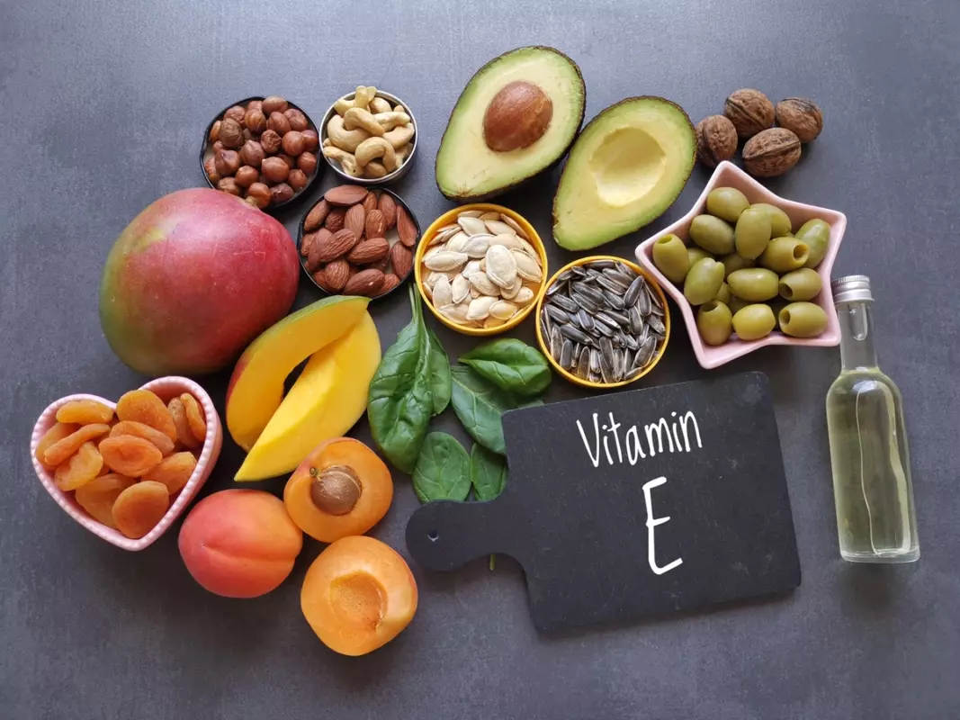

Slide 19
Vitamin E’s antioxidant action helps with ageing, arthritis, cancer, cardiovascular disease, cataracts, diabetes, and infections by reducing oxidative stress in cells. The most major protective effect is that of vitamin E. Vitamin E “contributes to the protection of cells from oxidative stress,” according to the EFSA.

Slide 20
Vitamin E deficiency is uncommon, however it is linked to diseases of fat malabsorption, such as cystic fibrosis. Long-term vitamin E deficiency can lead to neuromuscular dysfunction, which damages the spinal cord and retina. A sustained deficiency might produce erythrocyte haemolysis due to PUFA oxidation, which can be seen in preterm new-borns.

Slide 21
Vitamin K (Menaquinone)
Vitamin K is required for the activation of numerous proteins involved in the blood clotting process. This vitamin is also important in the manufacture of bone proteins, which allow minerals to link together to create bones. The deficit is uncommon and is caused primarily by poor absorption.

Slide 22


Slide 23
Bleeding is the most common symptom of vitamin K deficiency, which can lead to fatal anaemia. Some drugs (coumarinsacenocumarol, Sintroms, anticoagulants, blood thinners, salicylates, and antibiotics) counteract vitamin K's effect by reducing the gut bacteria required to manufacture the bioactive form.

Slide 24
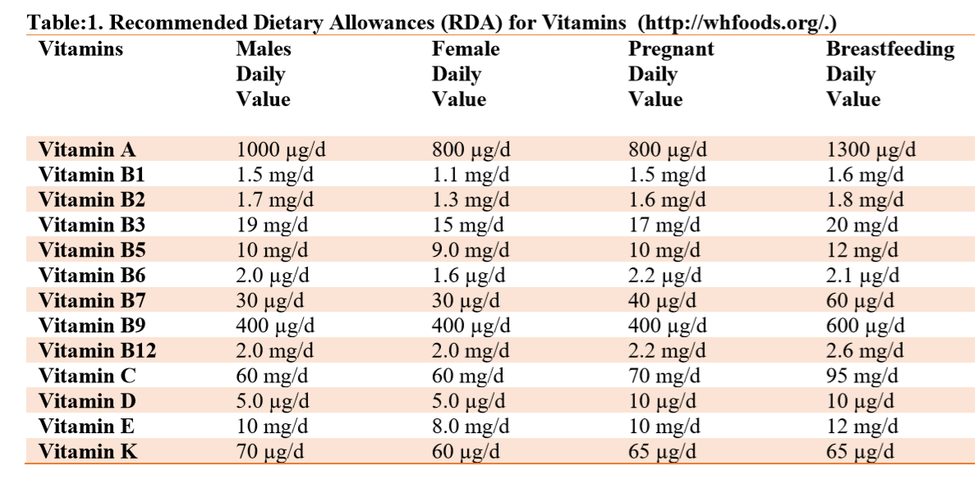

Slide 25
CONCLUSION
To conclude, there are two types of vitamins that are vital to the human body: water-soluble vitamins and fatsoluble vitamins; both play an important role in the human body. Nobody can deny the importance of these vitamins to the body at all ages, and a lack of them can cause significant damage to specific regions of the body depending on the vitamin, age, and health state of each individual. Vitamins can do a more work in a small quantity. As a result, their overall daily requirement is generally also very low.

Slide 26
Thank you

