Slide 1
Impact of E-Cigarettes on candida growth and Oral Health
أعداد م.م لينا سامي

Slide 2
The e-cigarette combines a plastic tube, an electronic heating component, and a reservoir for an e-liquid solution that contains propylene glycol and glycerol, with or without nicotine . Following airflow detection by the internal sensor in the e-cigarette device, the heating component in contact with the e-liquid produces a vaping solution of a smoke-like aerosol that is subsequently inhaled into the upper airways .

Slide 3
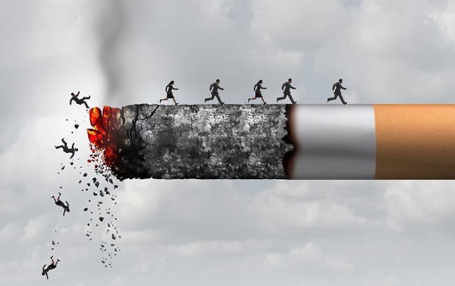
agenda
Smoking triggers environmental changes in the oral cavity and increases the risk of mucosal infections caused by Candida albicans such as oral candidiasis Smoking is a well-established risk factor for oral diseases such as oral cancer, caries, candidiasis, and periodontal diseases . Indeed, cigarette smoke has a strong impact on the oral mycobiome communities and especially C. albicans, which is the major cause of oral candidiasis . Cigarette smoke contains numerous toxic chemicals with nicotine as the main component

Slide 4
Electronic cigarettes (e-cigarettes) have been marketed as a “safer alternative” to combustible cigarettes and have become popular, especially among young adults e-cigarettes were reported to induce inflammation and produce destructive free radicals that affect the innate immune system and increase oral infections

Slide 5
Chemical Composition of e-cigarettes contribute to oral health issues

Slide 6
These chemicals collectively impact oral health by promoting bacterial growth, damaging tissues, reducing saliva's protective properties, and increasing the risk of various oral diseases
Nicotine: This primary ingredient affects blood flow to the gums, leading to increased risks of periodontal disease and dry mouth, which can exacerbate dental problems.
Glycerin and Propylene Glycol: These common e-liquid components can increase microbial adhesion to teeth, promoting plaque formation and contributing to dental caries. They can also break down into acidic compounds that erode tooth enamel
Heavy Metals: E-cigarette aerosols often contain metals such as nickel, lead, cadmium, and chromium. These metals can cause cytotoxic effects on oral tissues and are linked to periodontal disease and inflammation
Aldehydes: Chemicals like formaldehyde and acetaldehyde are produced during vaping and can damage oral epithelial cells, leading to irritation and potential long-term health issues like oral cancer

Slide 7
5. Flavoring Agents: Certain flavorings, such as diacetyl, can be harmful when inhaled. They may lead to respiratory issues and have been associated with cellular damage in oral tissue.
6. Acids: E-cigarette emissions may contain acids like acetic acid that can directly affect tooth enamel, increasing the risk of decay.
7. Sugars: Some e-liquids contain sugars that can promote bacterial growth in the mouth, further contributing to dental caries

Slide 8
SALIVA
Saliva Enzymes (such as lipase and amylase), white blood cells, electrolytes (sodium, potassium, calcium, bicarbonate), lysozymes, antimicrobial agents (secretory IgA), and enzymes (such as amylase and lipase) make up the other components of saliva, which is a hypotonic fluid . Some of the most significant biomarkers found in saliva are immunoglobulins (Ig), which are both specific indicators and defense factors; enzymes found in saliva; ions found in saliva

Slide 9
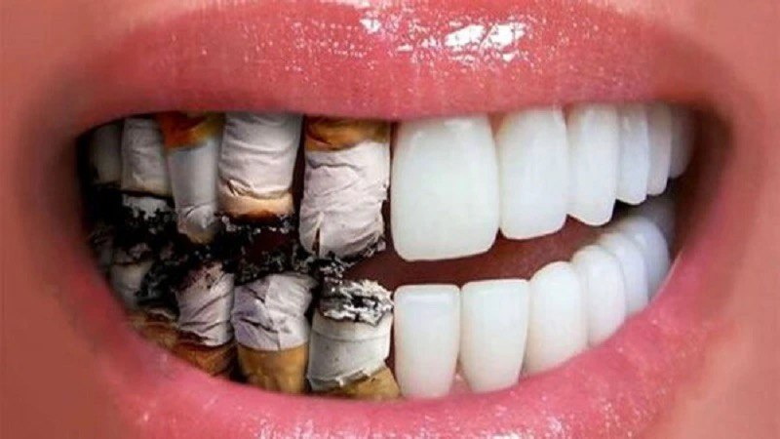
E-cigarettes significantly impact saliva composition and its properties in several ways:
e-cigarettes alter saliva's composition by changing its pH, increasing protein levels, affecting electrolyte balance, reducing antibacterial properties, disrupting the microbiome, and promoting inflammation, all of which can lead to various oral health problems.

Slide 10
Altered pH Levels
Increased Protein Concentration
Changes in Electrolyte Composition
Reduced Antibacterial Properties
Impact on Oral Microbiome
Oxidative Stress and Inflammation:

Slide 11
nicotine play Role in the oral health impacts of e-cigarettes
Gum Disease: Nicotine contributes to the development of periodontal disease by constricting blood vessels, which reduces blood flow to the gums. This diminished circulation can impair healing and increase susceptibility to infections, leading to conditions such as gingivitis and periodontitis Dry Mouth: E-cigarettes often lead to xerostomia (dry mouth), a condition exacerbated by nicotine's effects. Reduced saliva production increases the risk of cavities and gum disease, as saliva is crucial for neutralizing acids, washing away food particles, and demineralizing tooth enamel Altered Oral Microbiome: Nicotine may negatively affect the oral microbiome by suppressing beneficial bacteria while promoting pathogenic strains. This imbalance can lead to an increased risk of dental caries and other oral disorders Tissue Damage: The presence of nicotine in e-cigarette aerosols can cause irritation and inflammation of the oral mucosa, potentially leading to lesions and conditions like nicotine stomatitis Bone Loss: Long-term nicotine exposure has been linked to bone loss around teeth, increasing the risk of tooth loss and complicating dental procedures like implants Potential for Cancer: Nicotine may also play a role in the development of oral cancers, particularly through its impact on cellular health and inflammation within the oral cavity

Slide 12
specific metals in e-cigarette aerosols are most harmful to oral health
1
2
3
4
5
Nickel
Lead
Cadmium
Chromium
Arsenic

Slide 13
the viscosity of e-cigarette aerosols impacts dental health
Increased Bacterial Adhesion: The high viscosity of e-cigarette aerosols, primarily due to ingredients like propylene glycol and vegetable glycerin, promotes the adhesion of bacteria, particularly Streptococcus mutans, to the enamel surface. This increased adhesion facilitates biofilm formation, which is a precursor to dental caries
Retention on Oral Surfaces: Viscous aerosols are more likely to linger on teeth and oral tissues, leading to prolonged exposure to harmful substances. This retention can contribute to tooth discoloration and increase the risk of developing cavities and gum disease
Altered Saliva Properties: The sticky nature of the aerosol can interfere with saliva's natural cleansing action. Reduced saliva flow, often exacerbated by nicotine's vasoconstrictive effects, leads to dry mouth (xerostomia), which diminishes the mouth's ability to neutralize acids and wash away food particles and bacteria
Oral Mucosa Irritation: The increased viscosity can cause irritation and inflammation in the oral mucosa, potentially leading to lesions or other oral health issues
In summary, the viscosity of e-cigarette aerosols plays a crucial role in promoting bacterial colonization, enhancing the risk of dental caries and gum disease, and contributing to overall oral health deterioration.

Slide 14
E-cigarette use significantly impacts the pH levels of saliva, generally leading to a more acidic environment
Lower Salivary pH: Studies indicate that e-cigarette users tend to have lower salivary pH compared to non-smokers. For instance, one study found that the pH of saliva among e-cigarette users was lower than that of non-smokers, indicating a shift towards acidity in the oral environment
Comparison with Traditional Smokers: E-cigarette users often exhibit similar or slightly less acidic salivary pH levels compared to traditional cigarette smokers. However, both groups have been shown to have more acidic saliva than non-smokers, which can contribute to various oral health issues, such as increased risk for dental caries and periodontal disease
Physicochemical Changes: The use of e-cigarettes alters the physicochemical properties of saliva, including its pH and protein concentration. E-cigarette users showed statistically significant differences in these properties compared to non-smokers, further supporting the notion that vaping affects oral health negatively
Implications for Oral Health: A lower pH in saliva can lead to enamel demineralization and increased susceptibility to cavities. The acidic environment can also promote the growth of harmful bacteria while inhibiting beneficial ones, exacerbating oral health problems over time

Slide 15
Candida species are anaerobic and aerobic fungi that lack the capacity for anaerobic conditions, they are part of the normal flora that inhabits the mucosal membranes of the oral cavity, digestive system and vagina . Over 80% of the Candida species isolated from the oral cavity are (C. albicans, C. glabrata, C. tropicalis, C. pseudotropicalis ) are more rarely encountered . Common names for Candida albicans infection, which affects 95% of cases include oral candidiasis, oropharyngeal candidiasis, and oral thrush

Slide 16
Effect of E-Cigarette Smoke Condensates on Candida albicans Biofilm Formation and Gene Expression
that nicotine from different sources affected the pathogenic characteristics of C. albicans including hyphal growth, biofilm formation and morphology, and expression of virulence-related genes, which were found differentially expressed

Slide 17
Candida albicans morphological changes, growth, attachment, and biofilm formation are controlled by several genes such as HWP1, EAP1, SAP2, and ALS3. The HWP1 gene encodes the hyphal wall protein1, which is the major protein of C. albicans involved in hyphal development, cell wall assembly, and intracellular signaling pathways Notably, overexpression of HWP1 increased the attachment of C.albicans cells to the tooth surface and buccal epithelial cells as the primary stage of colonization and biofilm formation nicotine from all sources led to an increase in the expression level of HWP1 in C. albicans cells with N having the significantly highest effect

Slide 18
SAP2 is a proteolytic enzyme of C. albicans that contributes to adherence, tissue invasion, as well as mucosal and systemic infection. The participation of HWP1 in C. albicans adherence is supported by the EAP1 gene which mediates attachment of C. albicans to the surfaces .
This protein family mediates attachment and invasion of C. albicans to the oral epithelial cells, as well endothelial cells and plays a key role in the biofilm formation of C. albicans on prosthetic surfaces

Slide 19
Chitin Content was High in e-Cigarette Vapor-Exposed C. albicans
Chitin Content Cell wall proteins, including chitin, are know C. albicans growth following exposure to e-cigarette vapor was accompanied by increased chitin In to be involved in sensing stressful agents, such as changes in carbon source When exposed to e‐vapor, C. albicans may consider this contact to be an abnormal situation, thereby promoting chitin production as a protective pathway against the possible deleterious effects of the e‐vapor.

Slide 20
Influence of Electronic Cigarettes on Antioxidant Capacity
An infection in the oral tissues may lead to oxidative stress, which in turn increases free radical generation and speeds up the breakdown of cell walls and oral tissues
The balance between reactive oxygen species production and the activity of antioxidant systems present in saliva is an important element in maintaining oral environment homeostasis. E-cigarettes adversely affect the oral cavity and their cytotoxic effect is related to oxidative stress

Slide 21
oxidative stress may lead to alterations in cell wall components of candida spp. and an increase in the production of virulence factors, such as proteases and phospholipases.
E-cigarette use can increase oxidative stress and impact on Candida albicans, a fungus that can cause oral candidiasis E-liquids induce inflammatory and oxidative stress responses and Nicotine-rich e-cigarettes led to increase C. albicans growth.

Slide 22
thank you
BRITA TAMM
502-555-0152
brita@firstupconsultants.com
www.firstupconsultants.com
THANK YOU

