Slide 1
SMD resistor
BY
Mohammad Yahya Almuhanna

Slide 2
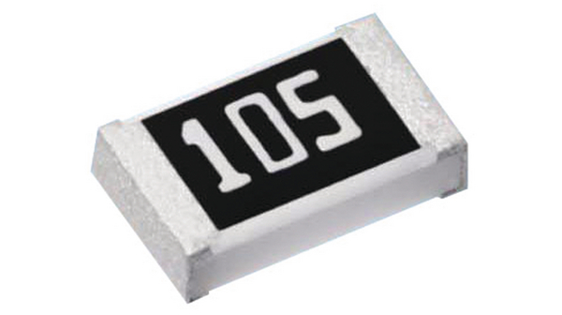
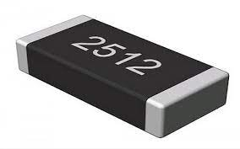
Surface Mount Resistor

Slide 3
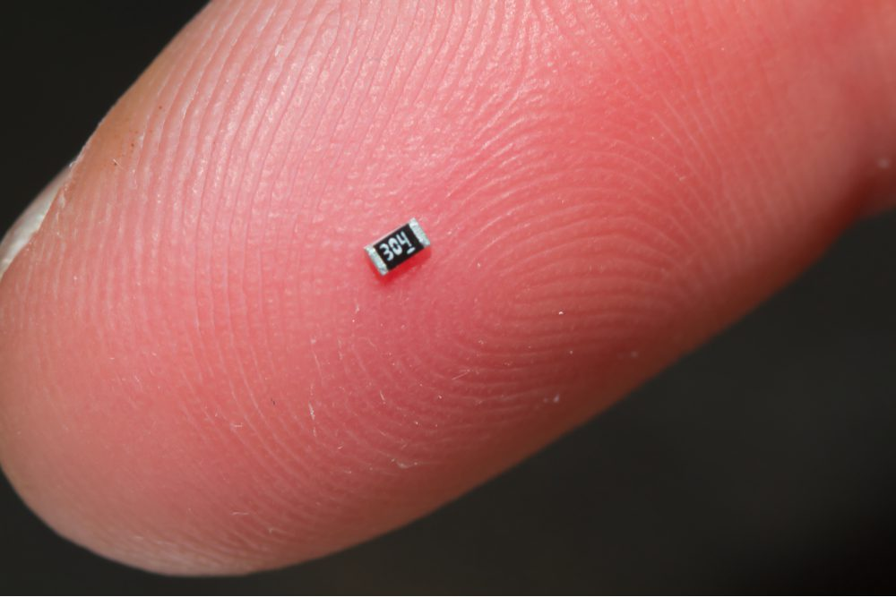

Slide 4
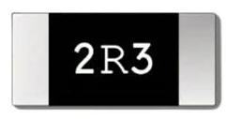
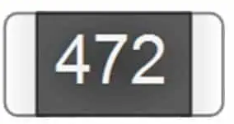

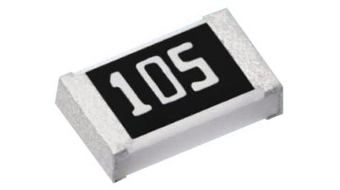

Types of SMD
1) 3-digit SMD Resistor codes
the first 2 digits are the numerical value, and the third digit is the multiplier, that is, the number of zeros we need to add to the value.
R = 2 . 3
R = 47 00
R = 0 . 42
R = 10 00000
R = 1
R = 1

Slide 5
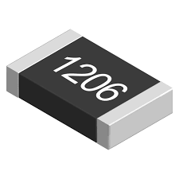
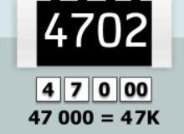

2) 4-digit SMD Resistor codes
the first three digits are the numerical value, the fourth digit is the multiplier, that is, the number of zeros we need to add to the value.
R = 12 0 000000
R = 0 . 382

Slide 6
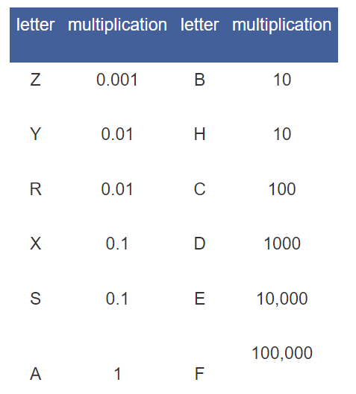
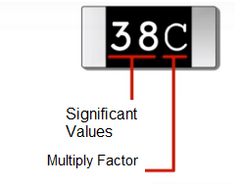
3) EIA-96 coded SMD resistors
Manufacturers have developed a new code system called EIA-96. The first two digits of the number read in EIA-96 are values, the last letter is a multiplier.

Slide 7
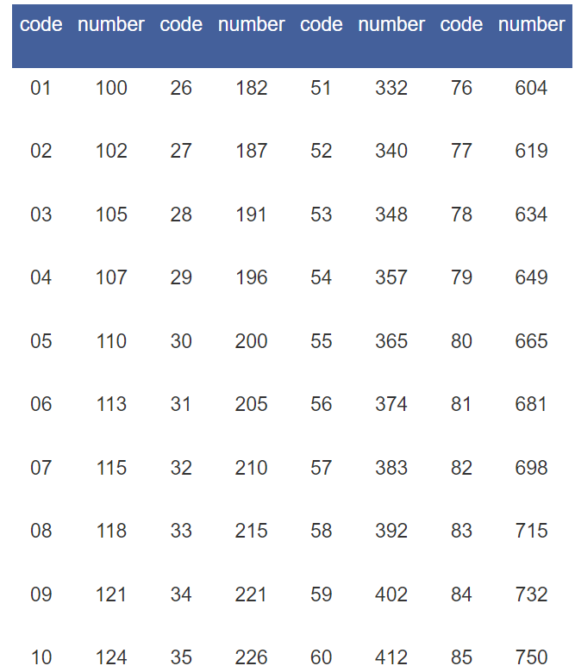
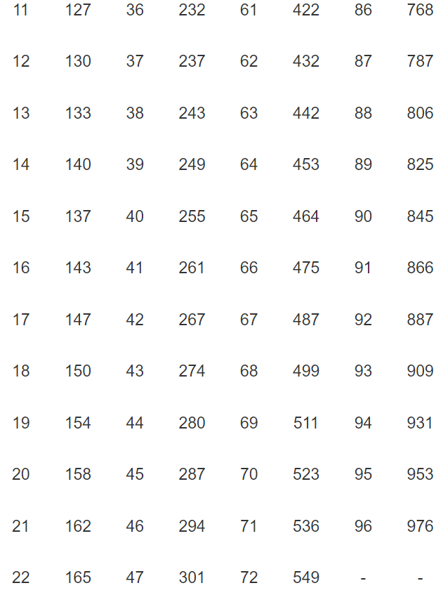

Slide 8
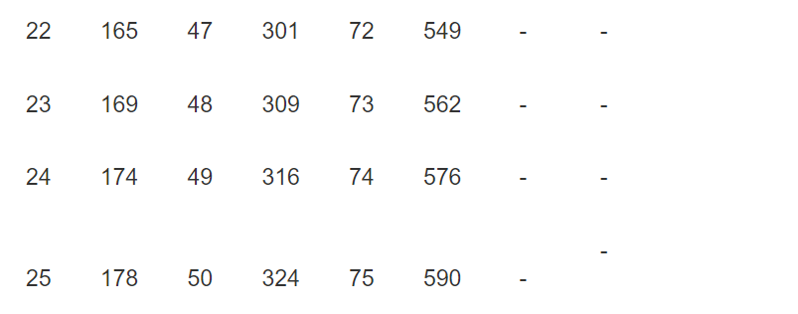
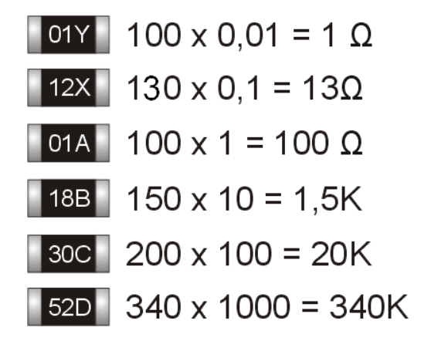

Slide 9
