Slide 1
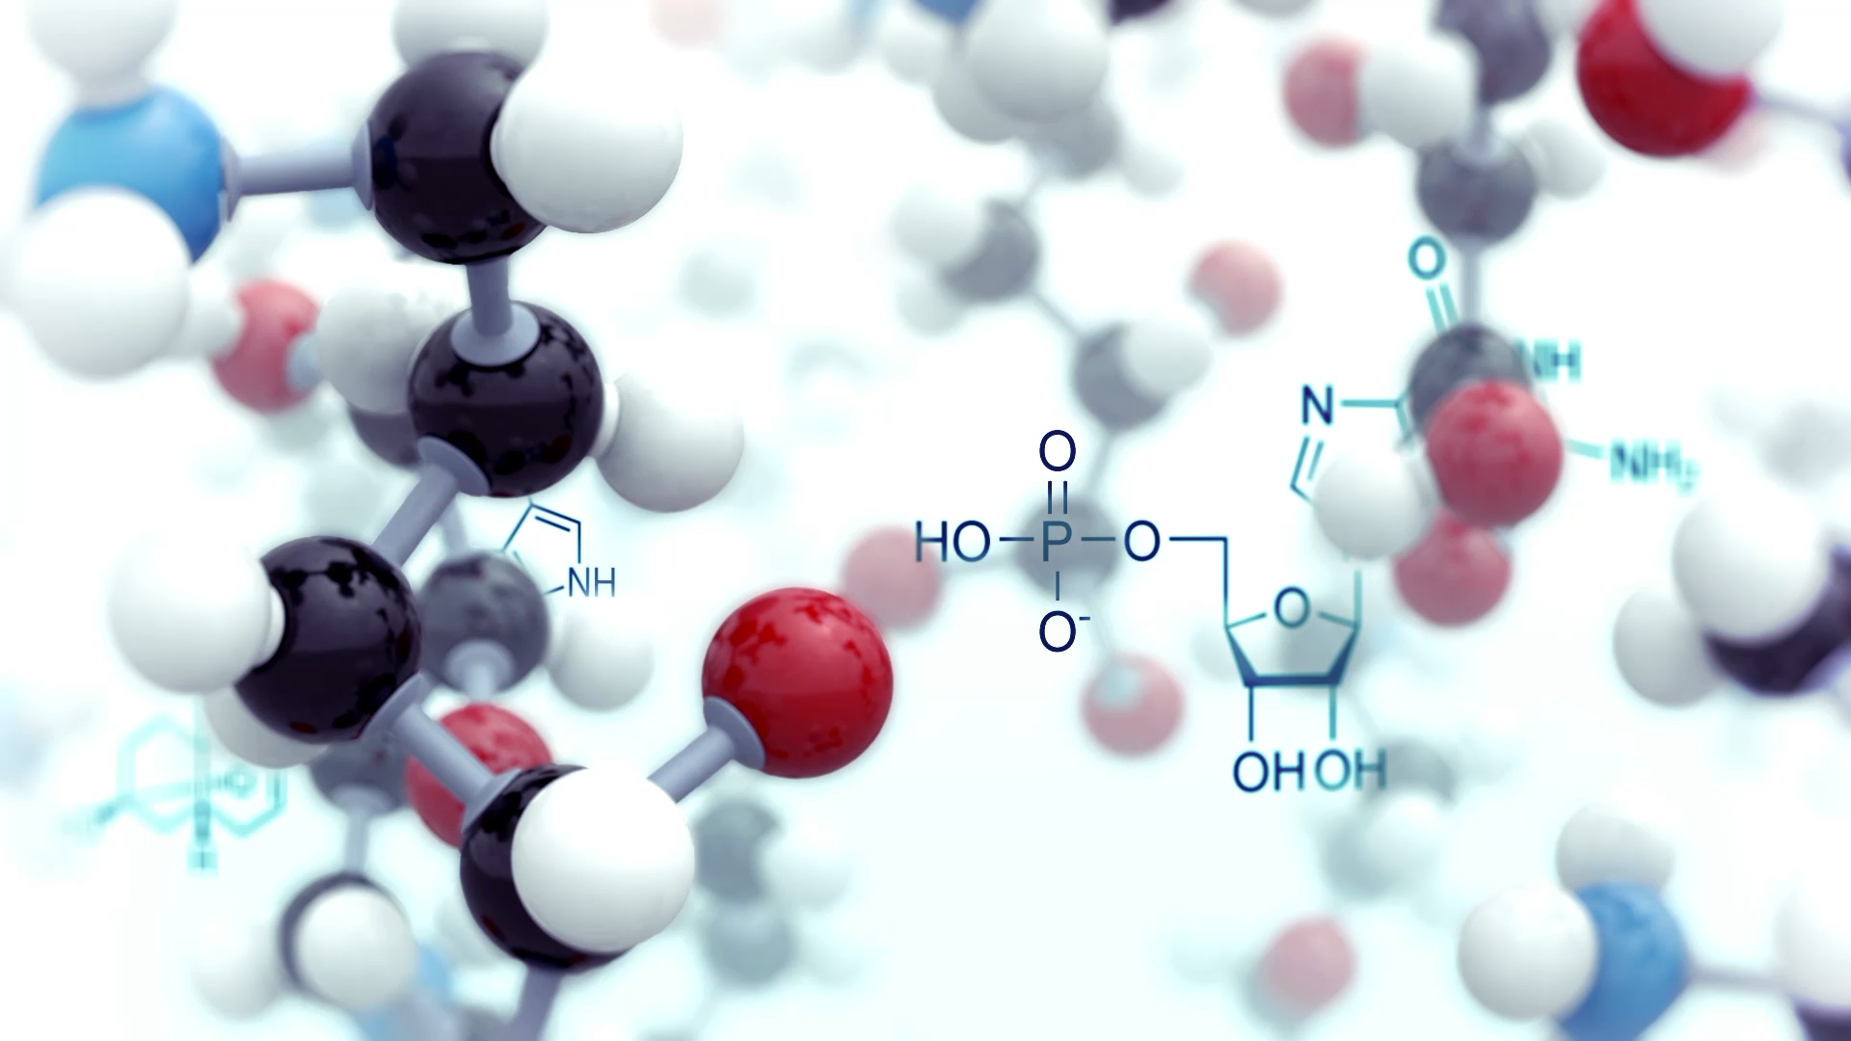
Enzyme Immobilization
Dr. Khalid Waleed
Dr. Doaa Khalid

Slide 2
Enzyme Immobilization
Immobilization is a method of entrapping/attaching cells or enzymes in a suitable matrix for stability and reuse.
This technique enhances the efficiency and cost-effectiveness of enzymes/cells for industrial use.
Immobilized enzymes retain their structural conformation for catalysis.

Slide 3

Cell Immobilization vs. Enzyme Immobilization
Cell immobilization is favored for its low cost and improved stability.
Enzyme immobilization has high isolation and purification costs.
Immobilized whole cells are increasingly used in biotechnology and industrial production.

Slide 4
Technological Properties of Immobilized Enzyme Systems
Economical: Easy removal for recycling and repetitive use.
Stability: Greater thermal and operational stability; no enzyme contamination.
Convenience: Rapid start/stop, long half-life, and elimination of reagent preparation.

Slide 5
Disadvantages of Enzyme Immobilization
Limited industrial applications
Loss of catalytic properties
Some enzymes become unstable
Enzymes inactivated by heat
High costs for isolation, purification, and recovery

Slide 6
Applications of Enzyme Immobilization
Industrial production: Antibiotics, beverages, amino acids
Biomedical applications: Treatment, diagnosis, drug delivery
Food industry: Production of jams, jellies, syrups
Research: HRP in blotting, proteases for cell lysis
Biodiesel production
Waste water management
Textile industry: Scouring, bio-polishing, desizing
Detergent industry: Lipase for dirt removal

Slide 7
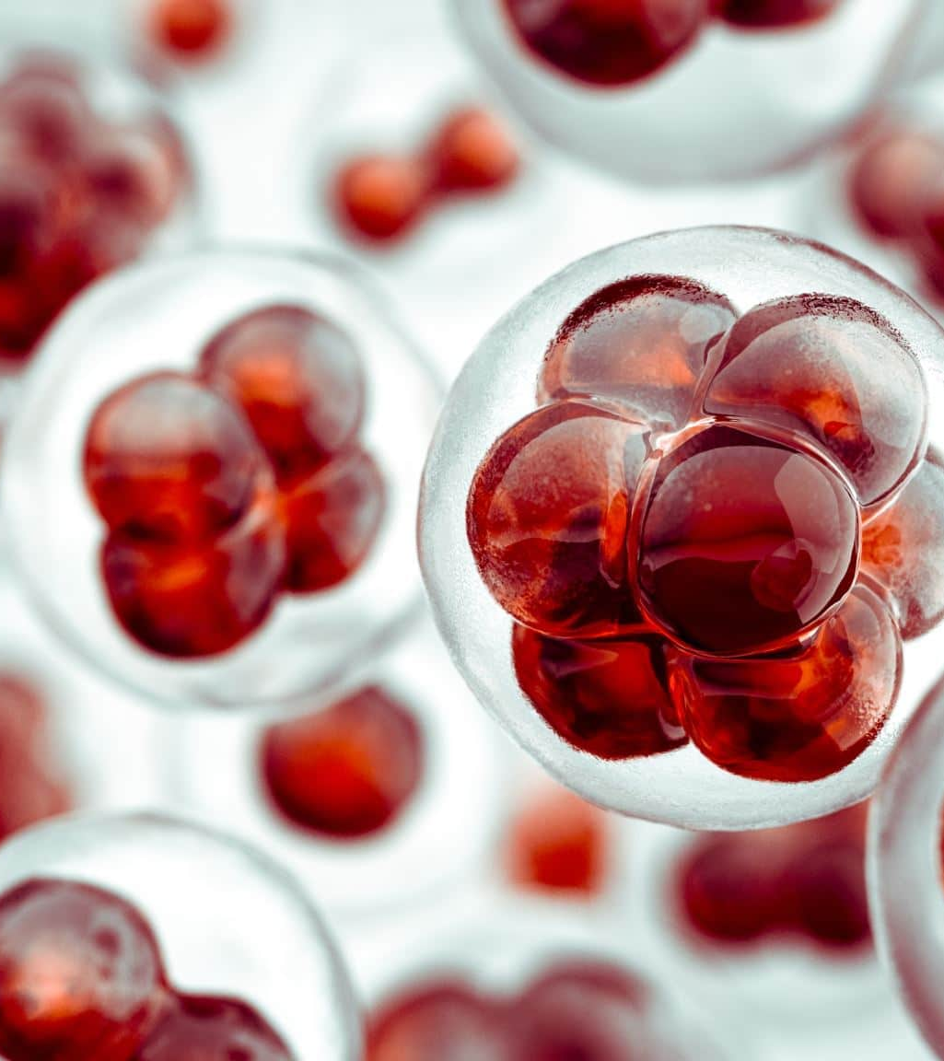
Methods of Immobilization Gel Entrapment
Cells/enzymes physically entrapped inside a polymer or gel matrix.
Bonds may be covalent or non-covalent.
Matrix: water-soluble polymer (e.g., polyacrylamide gel, collagen, gelatin, starch, cellulose, silicone, rubber).
The enzymes or cells are not directly attached to the support surface, but trapped inside the polymer matrix.
Polymeric solution with cells extruded into hardening solution to form beads.
One of the easiest, simplest, and safest methods.

Slide 8
Methods of Immobilization Adsorption
Physical binding of enzymes (or cells) on the surface of an inert support.
Support materials: inorganic (alumina, silica gel, calcium phosphate gel, glass) or organic (starch, carboxymethyl cellulose, DEAE-cellulose, DEAE-sephadex).
Adsorption involves van der Waals, electrostatic, hydrogen bond, and hydrophobic forces.
Adsorbed enzymes can be easily removed by changes in pH, ionic strength, or temperature (a disadvantage for industrial use).
Adsorption is well-suited for viable cells compared to entrapment.
It is one of the easiest techniques.
Most microbial cells naturally adhere to the support surface.
Affinity depends on the chemical nature and age of the cells.

Slide 9

Methods of Immobilization Covalent Binding
Enzyme immobilization by creating covalent bonds between chemical groups of cells/enzymes and the support.
This technique is widely used.
However, it is often associated with loss of some enzyme activity.
The inert support usually requires pretreatment to form a pre-activated support before binding to the enzyme.

Slide 10
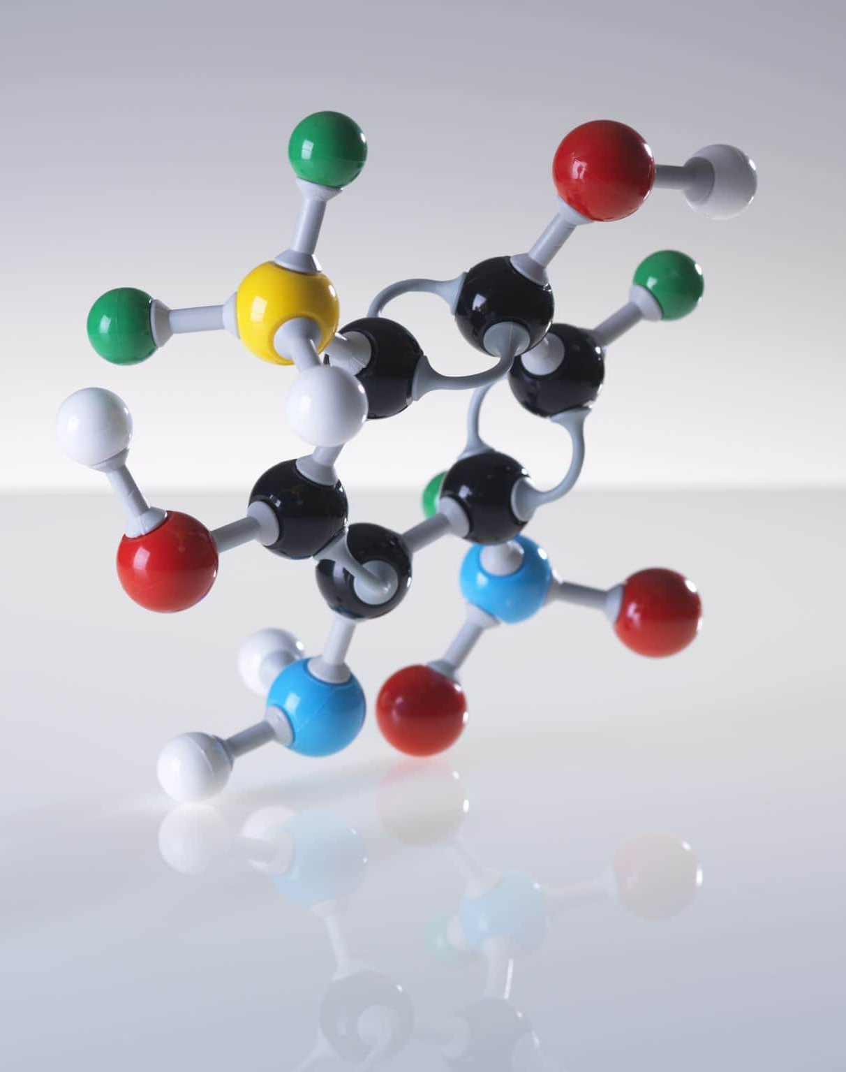
Methods of Immobilization Cross-Linking
The absence of a solid support is a characteristic feature.
Enzyme molecules are immobilized by creating cross-links between them using poly-functional reagents.
These reagents react with enzyme molecules and create bridges to hold them.
Glutaraldehyde is the most extensively used cross-linking reagent.

Slide 11


