Slide 1
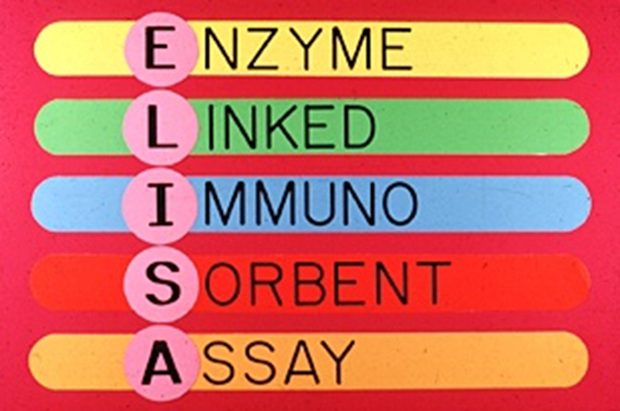
ENZYME LINKED
IMMUNOSORBENT ASSAY
(ELISA)
Enzyme immunoassay EIA

Slide 2
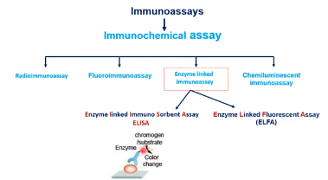

Slide 3
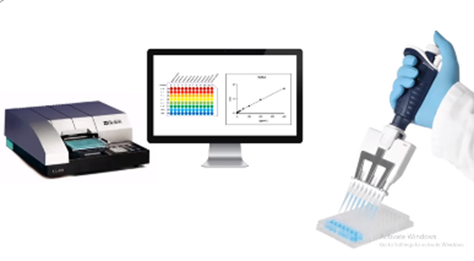
ELISA assays rely on an enzymatic reaction between an enzyme-conjugated label and a substrate to produce a colorimetric, chemiluminescent, or fluorescent product.
These products are then detected and quantified via a spectrophotometer or fluorometer, providing information about the concentration of target protein in the sample.

Slide 4
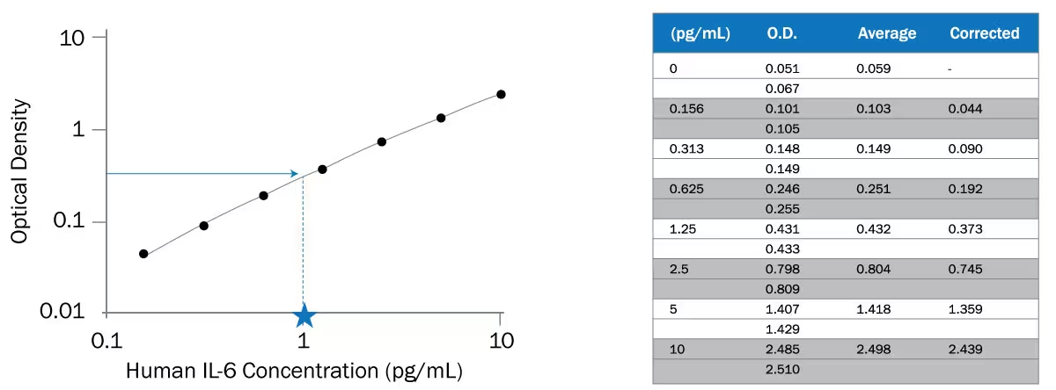
ELISA give Qualitative and Quantitative information about the presence of an antigen or antibody.
يمكن استخدام كل نوع من انواع ELISA نوعيا Qualitative للكشف عن وجود AB or Ag
كذلك , يمكن تحضير منحنى قياسيstander curve بناء على تراكيز معروفه لABاو الAg واستخدامه لتحديد تركيز conce. العينة.

Slide 5
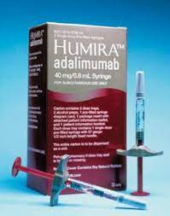
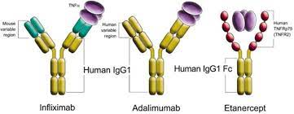
What is ELISA?
an assay technique used to detect small amounts of antibodies, antigens, peptides, proteins, glycoproteins, Hormones and viruses in biological samples
Commonly used in medicine, scientific research and detection of viruses in plants. Very sensitive .

Slide 6
Is so named because the technique involves the use of immunosorbent ,an absorbing material specific for one of the components of the reaction,the antigen or antibody.
ELISA is usually done using 96-well microtitre plate suitable for automation

Slide 7
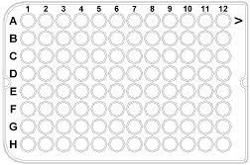
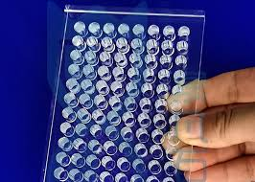
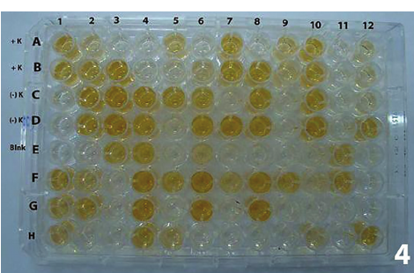
Polystyrene microtiter plate
capacities: 350 μl. 360 μl. 400 μl.

Slide 8
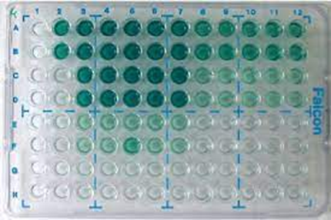
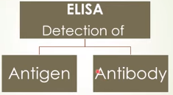
ELISA
One of the most sensitive immunoassays available. The typical detection range for an ELISA is 0.1 to 1 fmole or 0.01 ng to 0.1 ng.

Slide 9
Antigens[Ag]:
-Asubstance that when introduced into the body stimulates the production of an antibody
Antibody[Ab]:
-They are large Y-shaped glycoproteins. They are produced(from?) by the immune system to identify and neutralize foreign objects (antigens)

Slide 10
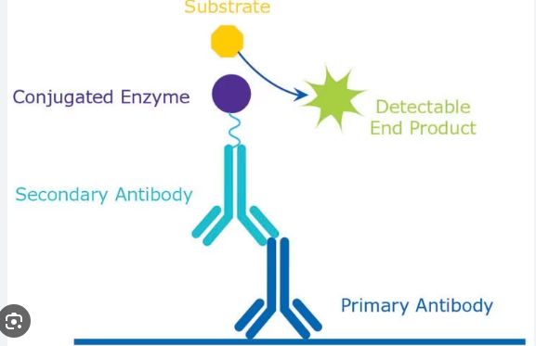

Slide 11
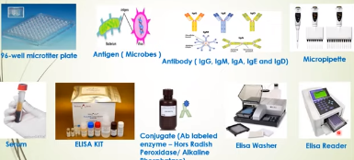

Slide 12
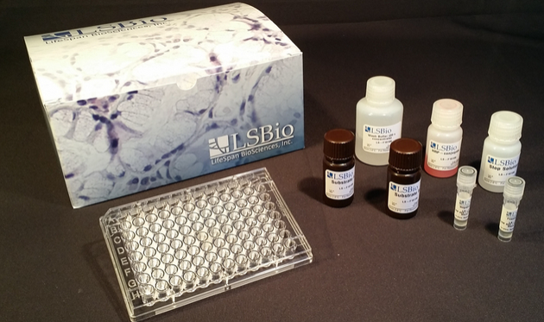

Slide 13
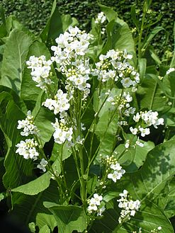
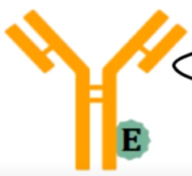
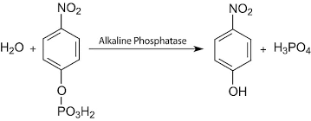
Enzymes : Horseradishفجل الخيل ريفي peroxidase ,B-galactosidase ,Alkaline phosphatase(Chormogenic substrate ) .
TMB substrate of HRP convert to blue color (intensity).

Slide 14
Washing buffer
ELISA wash buffers help eliminate any excess material found from the wells of a microtiter plate. This is done without disrupting the intended antigen – antibody binding reaction.
With the proper buffering environment, unbound assay components can be washed away without suppressing antibody binding interactions.
Remember after each step there is incubation and Washing.

Slide 15
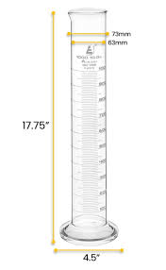
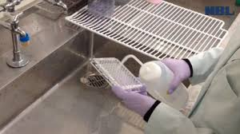
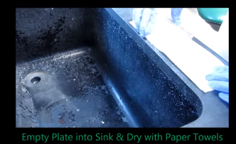
Phosphate buffer saline PBS 0.01 M pH 7.2
Dissolve contents of one packet in one liter deionized water to yield a 0.05 M Tris, 0.138 M NaCl, 0.0027 M KCl, pH 8.0 at 25 oC.

Slide 16
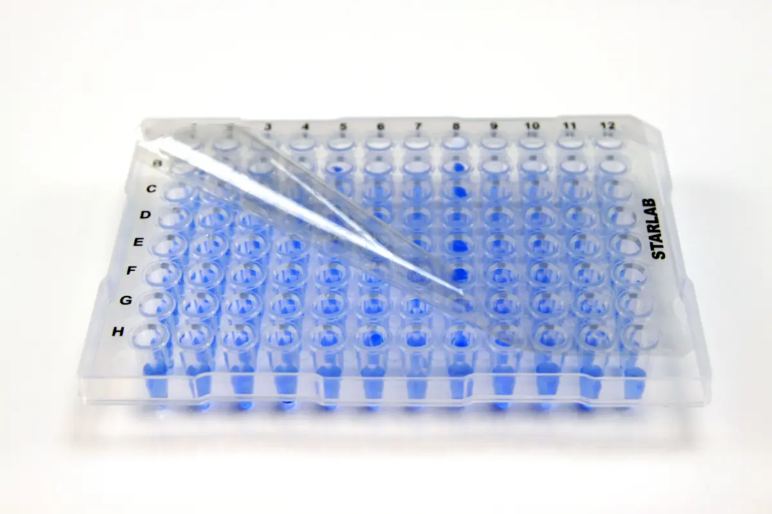
the antibodies are adsorbed to the plate, and bind to the target antigen in the sample fluid. This requires an incubation step to allow the binding kinetics to reach equilibrium.
Cover the plate with an adhesive plastic and incubate for 2 h at room temperature.

Slide 17
The technique is divided into:
1-Competitive ELISA
2-Sandwich ELISA
3-Indirect ELISA
4-Direct ELISA
Direct ELISA (antigen-coated plate; screening antibody) Indirect ELISA (antigen-coated plate; screening antigen/antibody) Sandwich ELISA (antibody-coated plate; screening antigen)

Slide 18
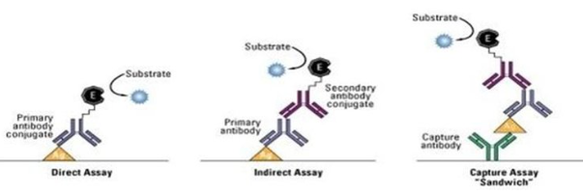

Slide 19
Sandwich ELISA
In case detect Ag in sample the 96-Well will be coated with AB ,and this AB specific that Ag that wanted to be detected.
HIV/AIDS, Hepatitis, Cancer biomarkers.

Slide 20
1-AB coated and specific for Ag.
2-In case Ag present in sample
3-Addind 2nd AB,Also specifc for Ag.
Notes:
هنا الحالة هي وجود الAg Positive

Slide 21
4-Adding substrate
5-Adding stop solution Will give stable color

Slide 22
In case Negative sample
1- AB coated well
2-In case Ag not present in sample
3-Adding 2nd AB ,Not bind,
Notes:
هنا الحالة هي وجود الAg Negative

Slide 23
4-After washing the 2nd AB removed
5-After adding substrate the well remain colorless

Slide 24
Indirect ELISA
Can detect AB for HIV and Hepatitis viruses.
Add serum that wanted to revile Presence AB(primary ) in the Serum to the well that coated with Ag allow them to react with Ag bound to the well.
After wash any AB not bound ,The AB bound to Ag will be detected by adding 2nd AB (link with enzyme) bound to primary AB.

Slide 25
After incubation then wash to remove 2nd AB not bound
Adding substrate for enzyme .
Will measure product color of reaction (after stop reaction by stop solution )by using plate reader.

Slide 26
1-Ag bound to well
2-Adding sample serum(If contain AB will bind to Ag)
3-Adding 2nd Ab ,specific to primary AB

Slide 27
4-Adding substrate ,the enzyme will produce color,change from colorless to color
5-After incubation period adding stop solution,to stop the reaction.
6-Plate reader

Slide 28
1-Ag bound to well
2-Adding sample serum(If Not contain AB,After wash there is no binding to Ag)
3-Adding 2nd Ab ,Will not bind Because there is no primary AB

Slide 29
4-After wash will get ride any 2nd
^{AB}
5-Adding substrate ,the is no enzyme that act on this substrate will remain colorless

Slide 30
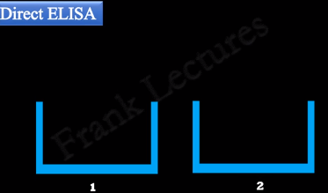
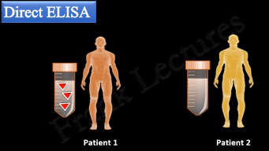
Direct ELISA
Used to detect antigens in a test sample.
Test result can be Postive or Negative depending on the presence of the antigen in the test sample.
We take two microtiter Wells

Slide 31
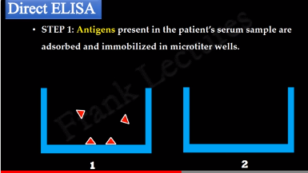
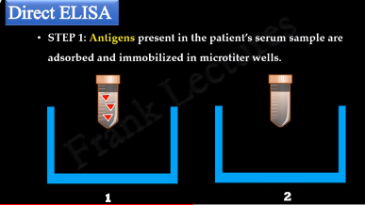

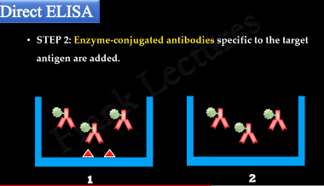
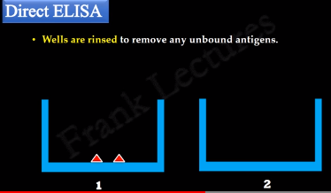
STEP 1:Antigens present in the patients serum sample are adsorbed and immobilized in microtiter wells.
Wells are rinsed to remove any unbound antigens.

Slide 32
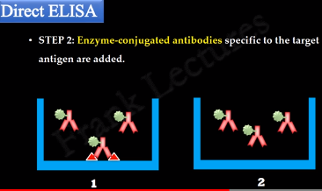
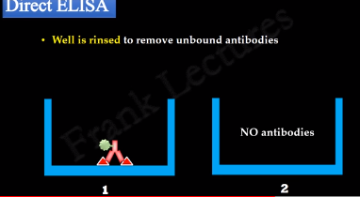

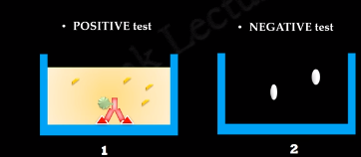
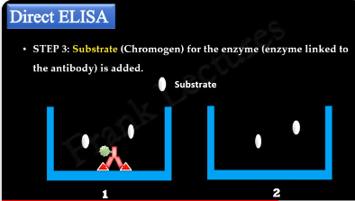

STEP 2:Enzyme-conjugate antibodies specific to the target antigen are added.There is Ag-AB interaction in Well1 and No in well 2.
Enzyme in 1 act on Substrate formation colored end-product ,While in 2 No enzyme

Slide 33
This test commonly used for immunohistochemical staining of tissue and cells.
Examples of bacterial infections include Lyme disease, and brucellosis
. Examples of viral infections include HIV and hepatitis A, B and C.

Slide 34
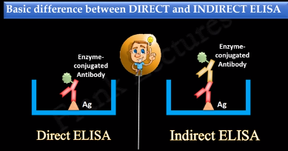
Enzyme linked to AB Direct bind to Ag ----Direct ELISA,
Enzyme linked to AB Indirect bind to Ag ------Indirect ELISA.

Slide 35
Thank you for Listening and Watching

