Slide 1
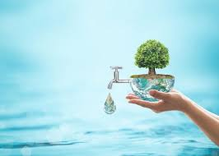
Magnetized water
and its effect
Dr. Nusaibah Amer

Slide 2
It is the water that is obtained after treating the water magnetically, by placing a magnet inside the water or by passing a magnetic field in the water, which in turn affects the chemical and physical properties of the water, and this process is done using specialized devices, where calcium and magnesium in the water are replaced with sodium; This is to purify hard water from high levels of minerals.

Slide 3
Magnetized water does not retain magnetism, as the water molecules are periodically changed by the magnetic field to form a new structure for the water molecules, this property is maintained for a certain period and returned to its original state, and accordingly, this water is called magnetized water

Slide 4
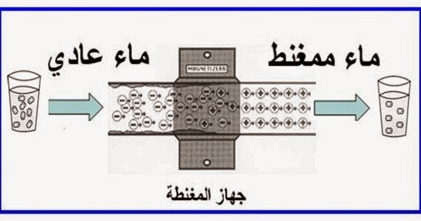

Slide 5
Magnetic water energy in nature
Whenever water is natural and no chemicals or pollutants interfere with it; Therefore, spring water and mountain water are the best that a person can drink, as they are naturally self-purified in the Earth's magnetic field, which does not stop at purity and enhancing the alkalinity and freshness of the water; but rather extends to loading this water with a magical positive energy, an energy that affects the human being and his psychological path before the organic.A Shapes of water crystals affected by soundIncluding Zamzam water from the book Messages from Waterby Dr. Masaru Emoto

Slide 6
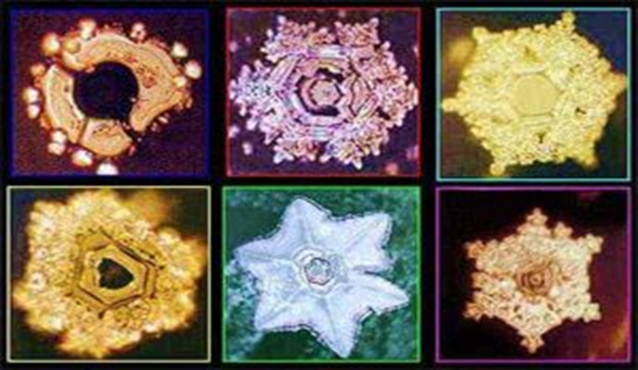
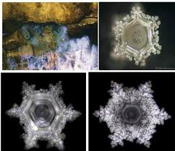
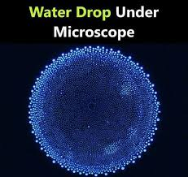
Magnetic water Zamzam water

Slide 7
Water magnetism and its properties
The water magnetization process was carried out to restore the water to its natural state and its lost elements as a result of treatment processes, or as a result of other external factors such as pollutants. Therefore, the water that has been magnetized retains new properties, the most important of which are the following:
Easy and purity, due to the disintegration of water molecules and the fragmentation and breaking of salts.
Positive energy, as magnetization of water works to restore life to the main elements in it, which leads to an increase in its vitality.
Easy to absorb, due to the disintegration of its molecules, the fragmentation of dissolved salts, and the improvement of the dissolution of elements.

Slide 8
Some properties that water acquires through the process of magnetization
Improve electrical conductivity due to magnetic
improves the ability to dissolve
Improves the speed of chemical reactions
Improves the evaporation property of water
Improves and increases the permeability
increases the percentage of dissolved oxygen in it
Increases the surface tension of water

Slide 9
Types of magnetized water
Northern magnetized water is mainly used to treat internal infections, such as urinary tract infections or ulcers, as well as external infections such as eczema. The northern magnetization has the properties of giving the body calm and the ability to fight pain, infection and inflammation.
Southern magnetized water is mainly used to treat diseases resulting from bacteria such as abscesses, boils, as well as to treat viral infections. If the patient suffers from abscesses and skin infections, it is recommended to use the water internally by drinking it, and externally by washing the affected area with it, in anticipation of more effective results.
Bipolar water magnetization: is used to treat many problems such as indigestion, urinary tract problems and to activate the body in general. This type of water is more suitable for those looking to activate their magnetic potential.

Slide 10
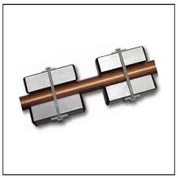
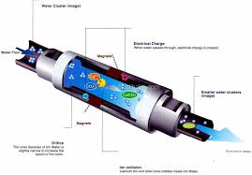

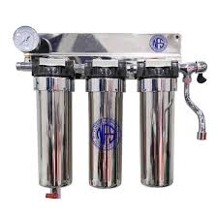

Slide 11
Practical part

Slide 12
the effect of magnetizing water on the natural properties of cow's milk and goats:
Digestion and absorption
Cell growth and functions, as it has a good effect on blood circulation
Increased secretion of the hormone prolactin, thus increasing milk production in animals.
Increases in the number of red blood cells and hemoglobin, and the reason for this increase is attributed to the fact that the magnetic field works to attract iron, which leads to an increase in the number of red blood cells and the concentration of hemoglobin, thus carrying oxygen.

Slide 13
The effect of using magnetized water on agriculture and soil:
According to an academic study by the Iraqi researcher Solaf Adnan published in 2016 in the Journal of the College of Basic Education, Al-Mustansiriya University; magnetizing water works to
Break salt crystals
increase germination rates
Improve saline soil conditions and early emergence and increase soil water retention and reduce surface tension
There are more than 14 properties that change in water after magnetization, such as electrical conductivity and increased dissolved oxygen levels.
magnetization increases the ability of water to dissolve salts, which contributes to increasing the speed of chemical reactions used in it, in addition to increasing the speed of evaporation and increasing permeability.The ability of water after magnetization to wash salts in the soil and increase the availability of nutrients in itThe positive effect of magnetized water on the vegetative characteristics of tomato crops and the qualitative and quantitative characteristics of many fruits, such as increasing plant lengths and root weights for yellow corn plants, for example.

Slide 14
The effect of magnetized water on public health
Strengthening the human immune system
strengthening it in a way that allows it to resist diseases more effectively.
Helps in getting rid of fatigue and work exhaustion. Regulating the physiological and biochemical processes that take place inside the body Stimulating the vital points on the skin that are closely linked to the internal organs and tissues of our bodies, so magnetism and magnetic fields can be used to treat all health problems.

Slide 15
In an academic study by researcher Nusaibah and others published in 2016 in the Al-Nahrain Journal of Science;
The study included the effect of magnetized water on the tissue structure of the heart and lung.
For this purpose, the animals were divided into equal groups, and the groups were given magnetized water at a density of 250, 750, 1000, and 1500 Gauss every day for 30 days.

Slide 16
The tissue changes in the heart and lung were studied. The best result was at a density of 250 Gauss. The pathological tissues of the heart and lung did not show any clear pathological lesion in the mice treated with magnetized water. While the lung section belonging to the group of mice given magnetized water at a density of 750, 1000, and 1500 Gauss showed enlargement of the lymphatic tissue in the bronchioles wall and enlargement of the alveoli wall.

Slide 17


