Slide 1
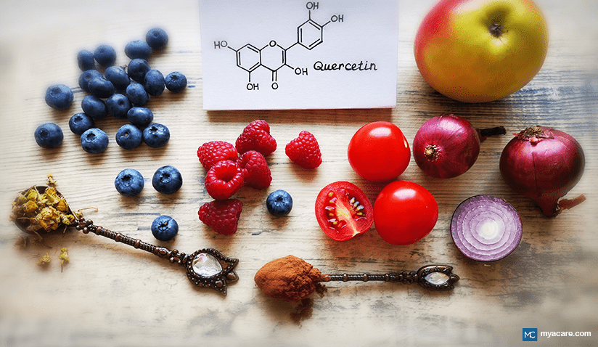
Efficacy of quercetin as an anti-inflammatory and immunomodulatory Presented by
Prof. Ikram Abbas Aboud
Microbiology department\ Immunology

Slide 2
Content
Introduction
Source
Anti-Inflammation and Promotion of Immunity
Antimicrobial Activity

Slide 3
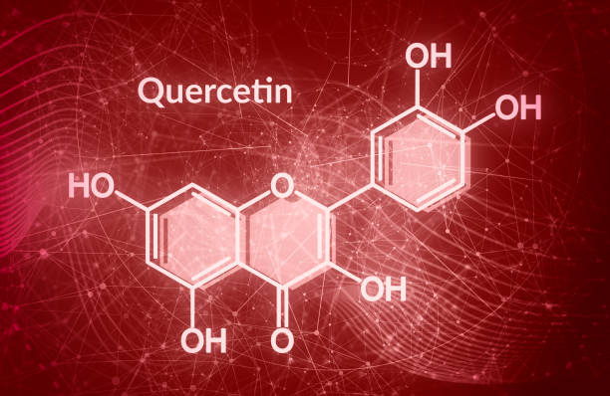
Introduction :
Quercetin is a flavonoid (yellow in color) found in nature, classified within the polyphenol family, and with properties that may enhance mental and physical performance and lower infection risk. Its potential health benefits include anti-carcinogenic, anti-inflammatory, antiviral, and antioxidant, This seminar reviews quercetin's impact on inflammation, immunity, and overall health.

Slide 4
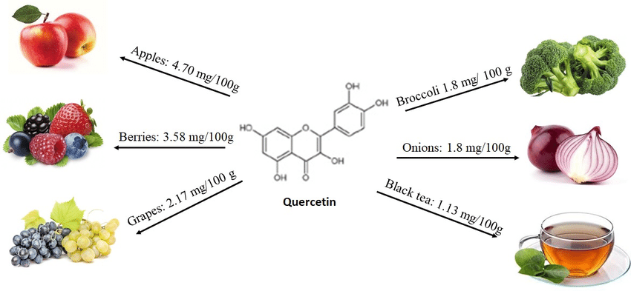
source

Slide 5

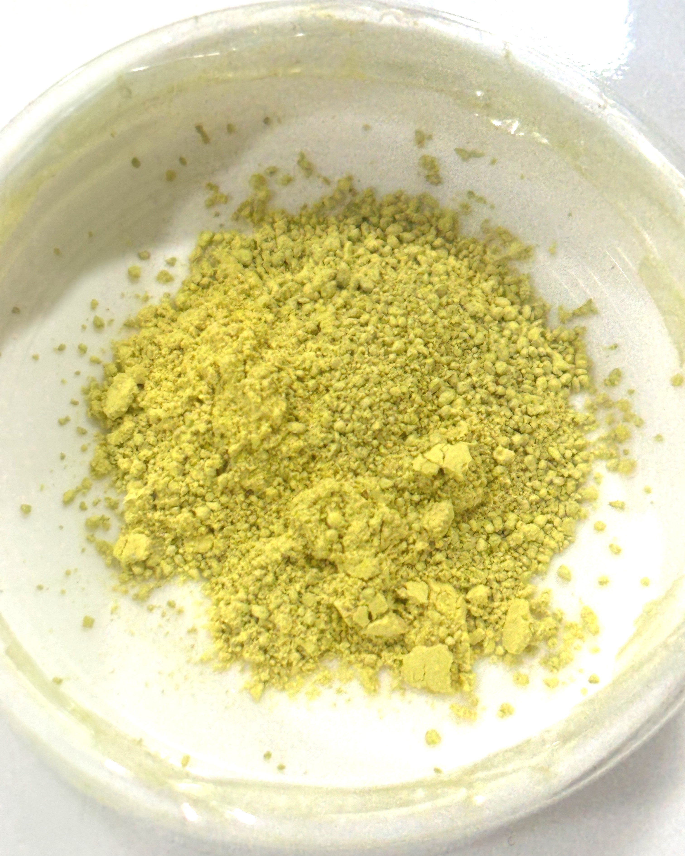

Slide 6
Anti-Inflammation and Promotion of Immunity
Quercetin was reported as a long-lasting anti-inflammatory substance that possesses strong anti-inflammatory capacities ,it possesses anti-inflammatory potential that can be expressed on different cell types, both in animal and human models.
It is known to possess both mast cell stabilizing and gastrointestinal cytoprotective activity. It can also play a modulating, biphasic, and regulatory action on inflammation and immunity .
Additionally, quercetin has an immunosuppressive effect on dendritic cells function

Slide 7
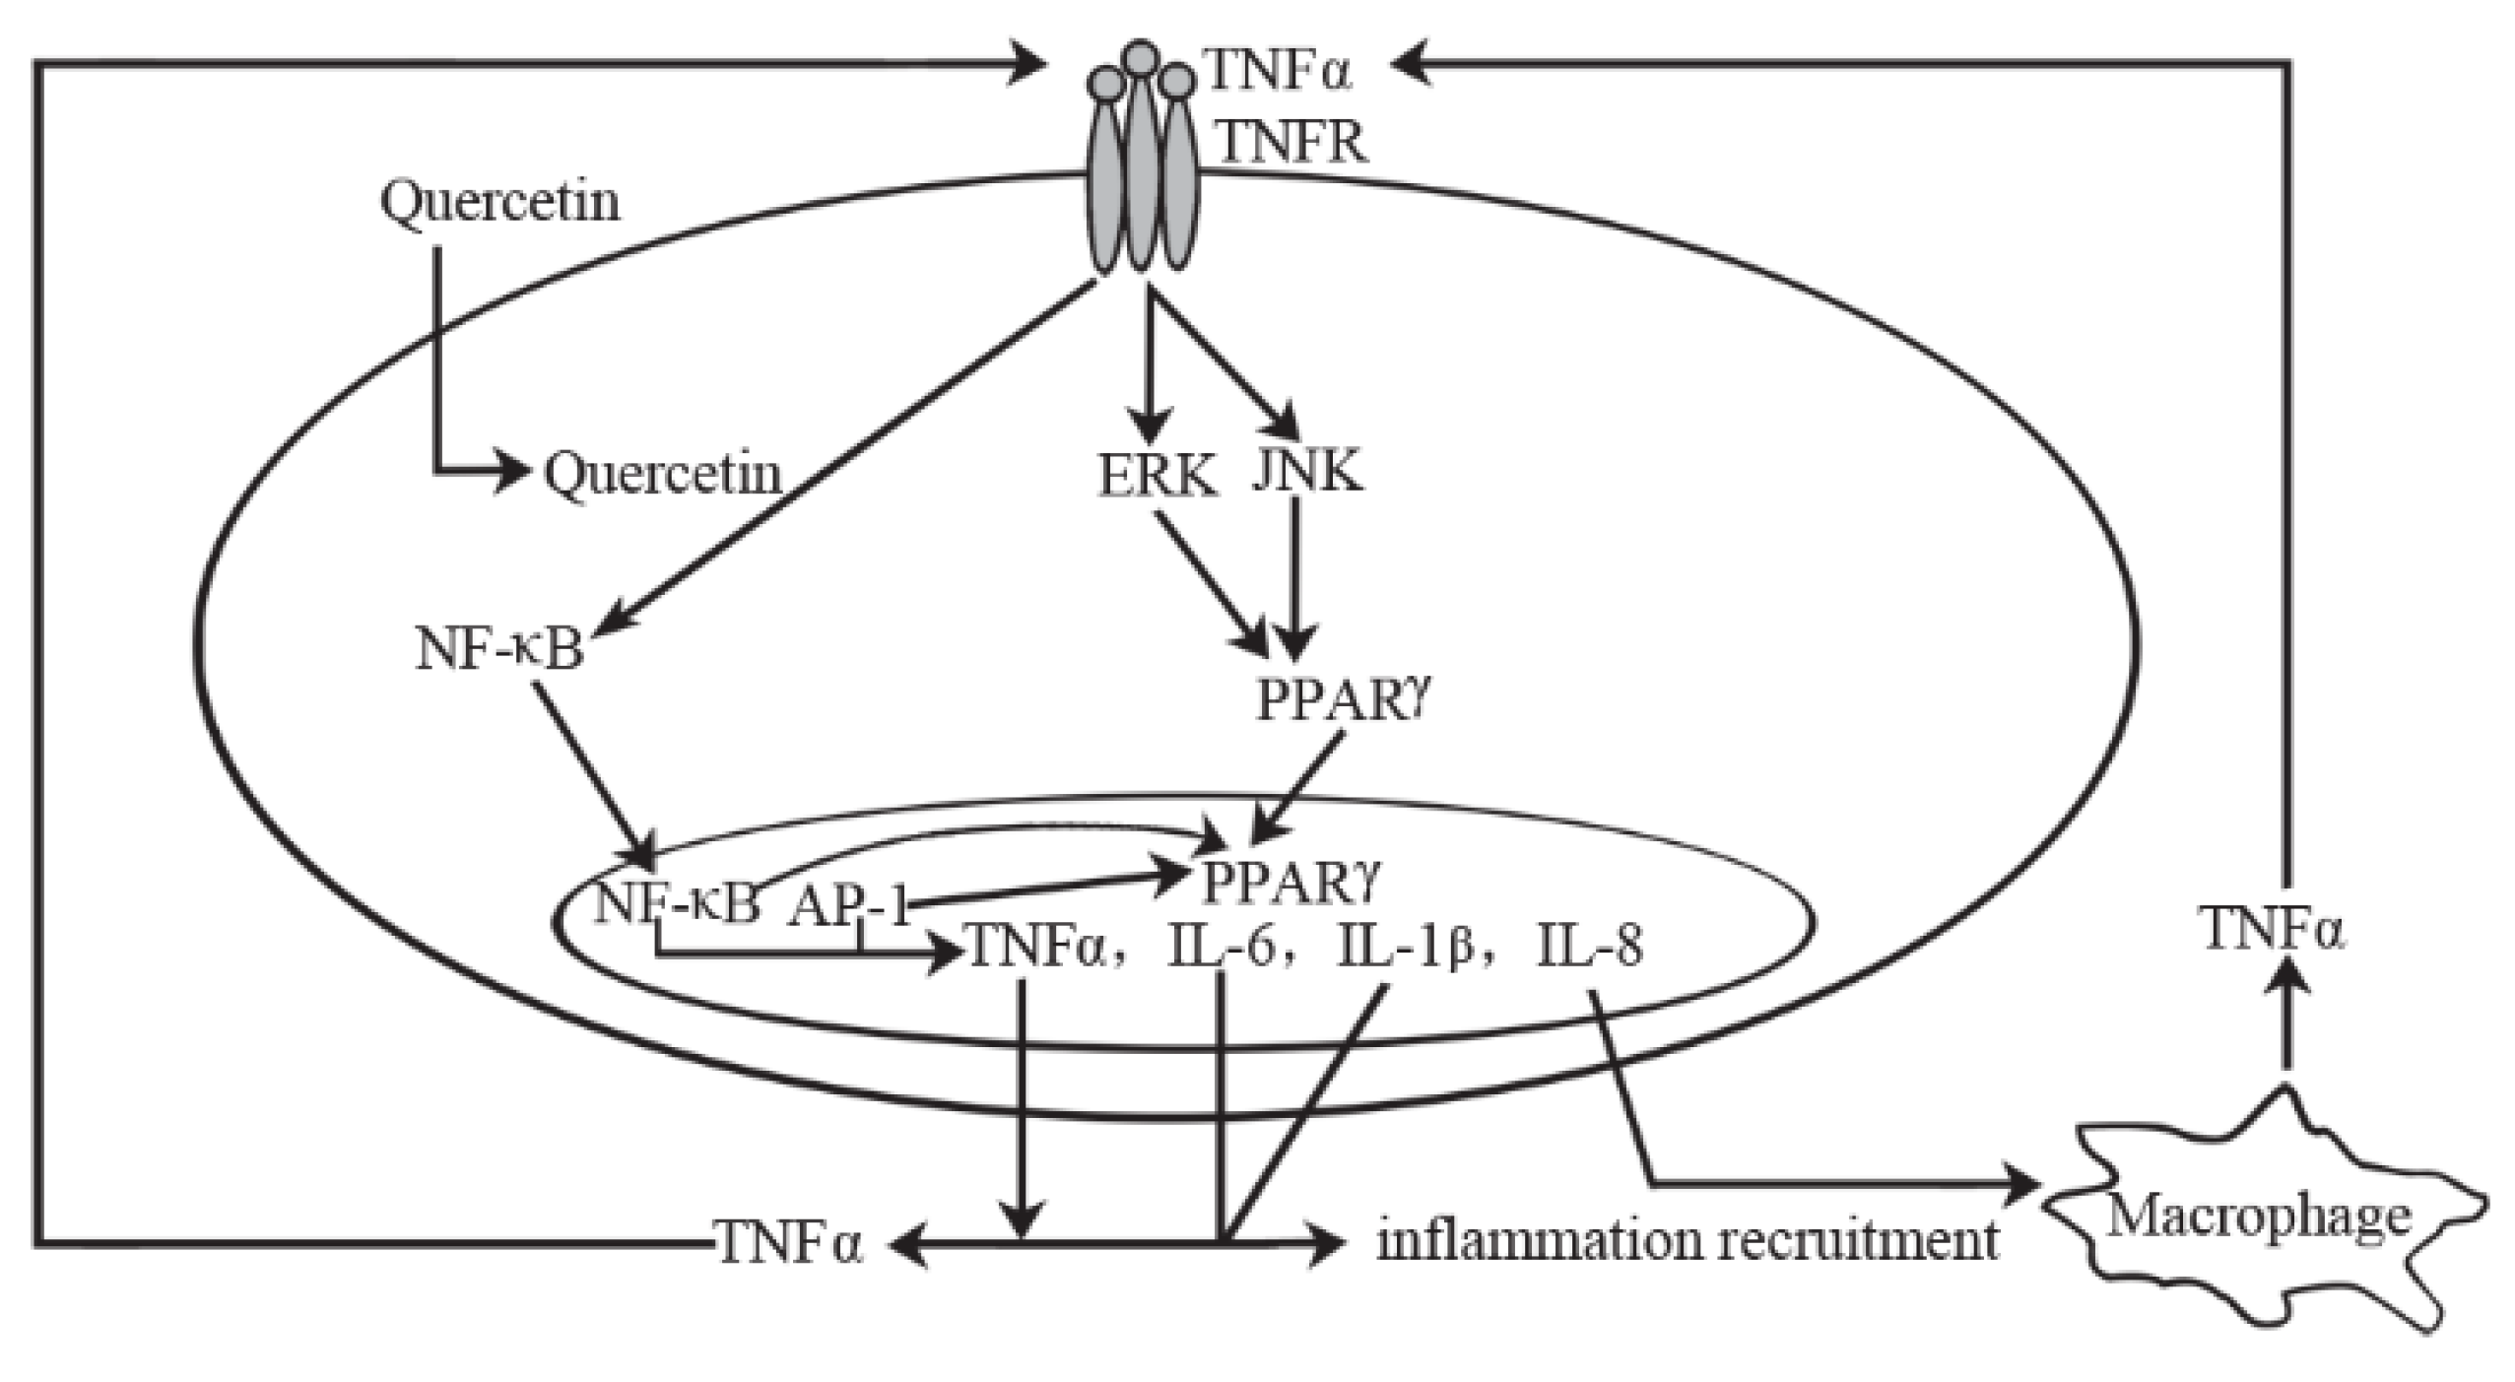
Anti-inflammatory mechanism of quercetin

Slide 8
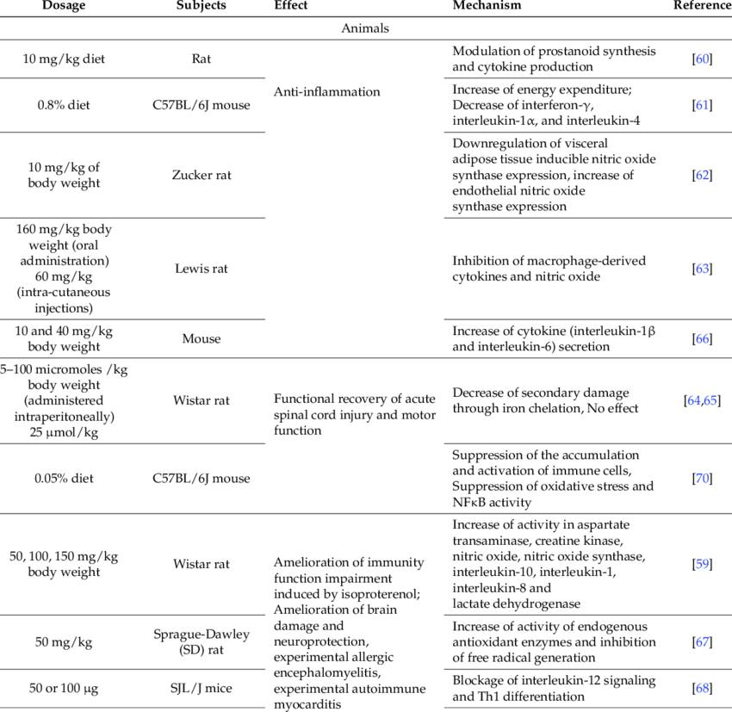

Slide 9
Antimicrobial Activity
Quercetin is antibacterial against a wide range of bacterial strains, particularly those affecting the gastrointestinal, respiratory, urinary, and integumentary systems.
Quercetin’s antibacterial ability has been linked to its solubility and its interplay with the bacterial cell membrane, which is largely determined by the presence of quercetin’s hydroxyl groups.

Slide 10
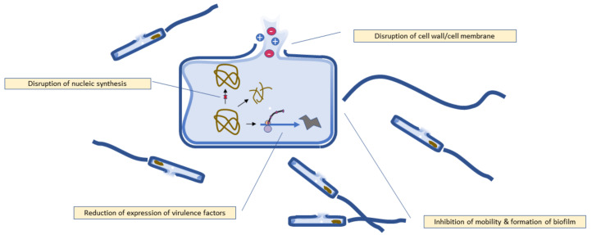
Antibacterial mechanism of quercetin

Slide 11
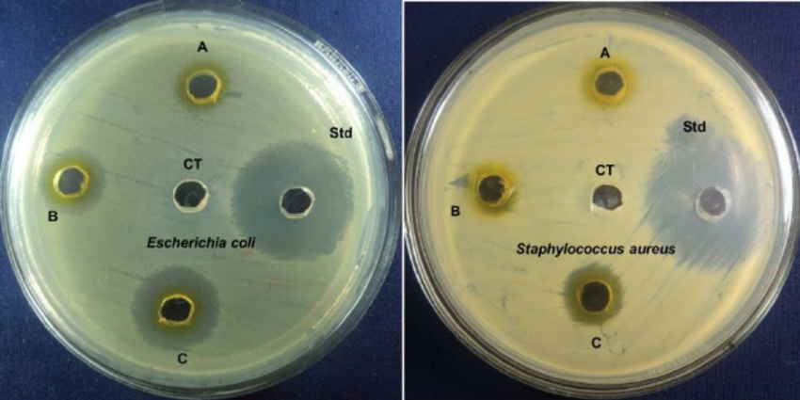

Slide 12
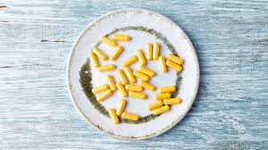
Conclusion
The quercetin has anti-inflammatory and immunomodulatory potential in treating infections.

Slide 13
Thank you

